Slide 1
Introducing LetsGrow
[ATGS 7140] Plant Factory – Theory and Practice
[ANISCI7047] Smart Production of Livestock
A psychrometric software
https://gpe.letsgrow.com/psychro
Wei FANG
NTU_BME and Global ATGS
National Taiwan University
2022/03/16

Slide 2
Psychrometrics
Simulation models
Radiation monitor

Slide 3
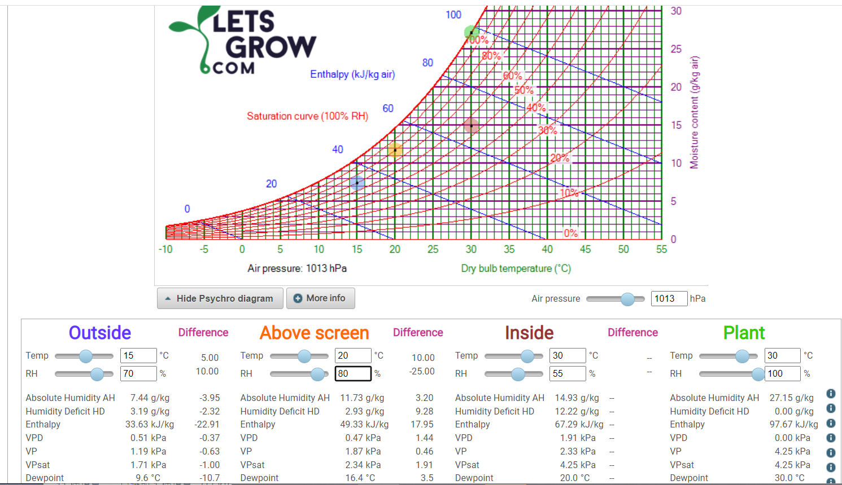
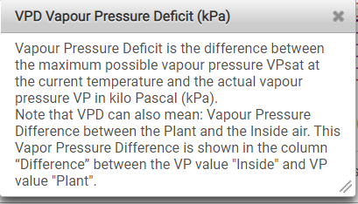
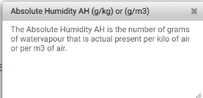
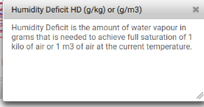
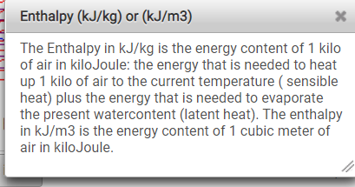
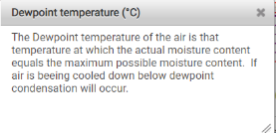

Slide 4
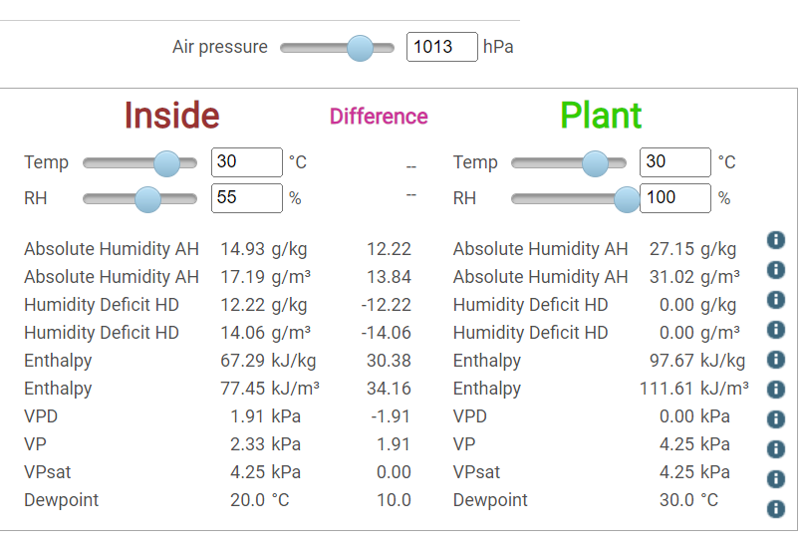
1 ATM = sea level, altitude = 0 m
This is AH_{dif}
RH inside stomata is 100%
AH_{dif}>0 to ensure water vapor inside stomata can be escaped to outside
This is AHD
or HD
= VPsat - VP
This is VP_{dif}

Slide 5
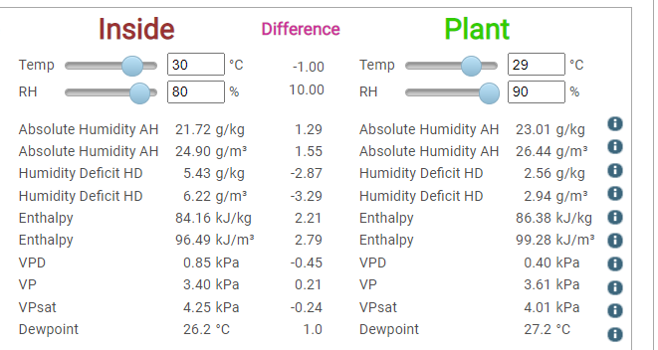
Micro-climate
This is AH_{dif}
AH_{dif}>0 to ensure water vapor move away from crop canopy
= VPsat - VP
This is VP_{dif}
AHD is not equal to AH_{dif} , AHD is the AH@Tsat – AH@Tdb
VPD is not equal to VP_{dif}, VPD is the VP@Tsat – VP@Tdb

Slide 6
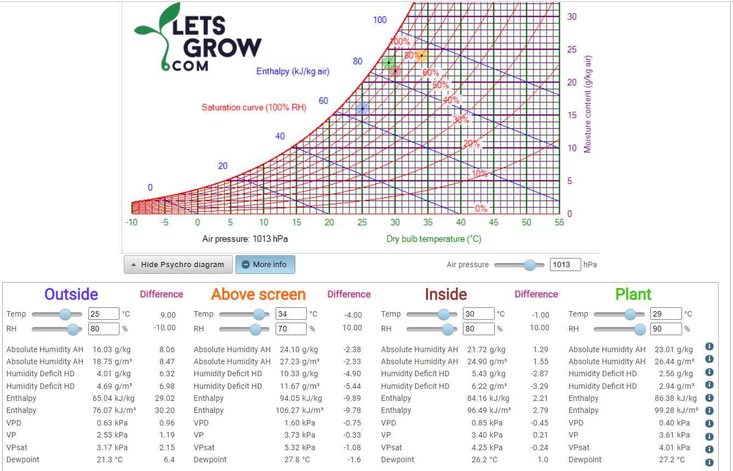
Detail
version

Slide 7
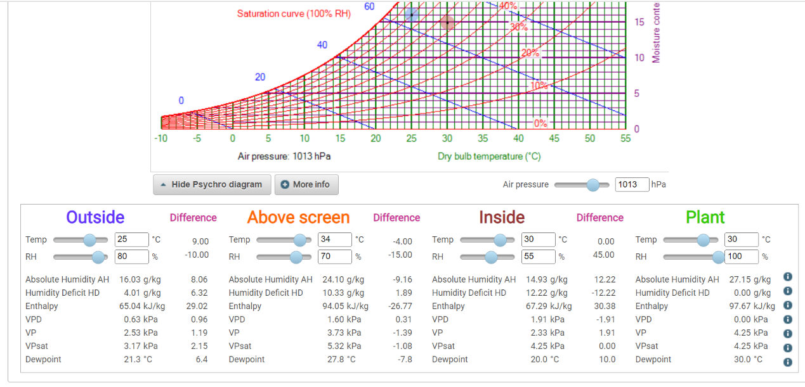
Simplify
version

Slide 8
Geo location
Bring in the outdoor T and RH info from worldwide weather station into the psychrometric software

Slide 9
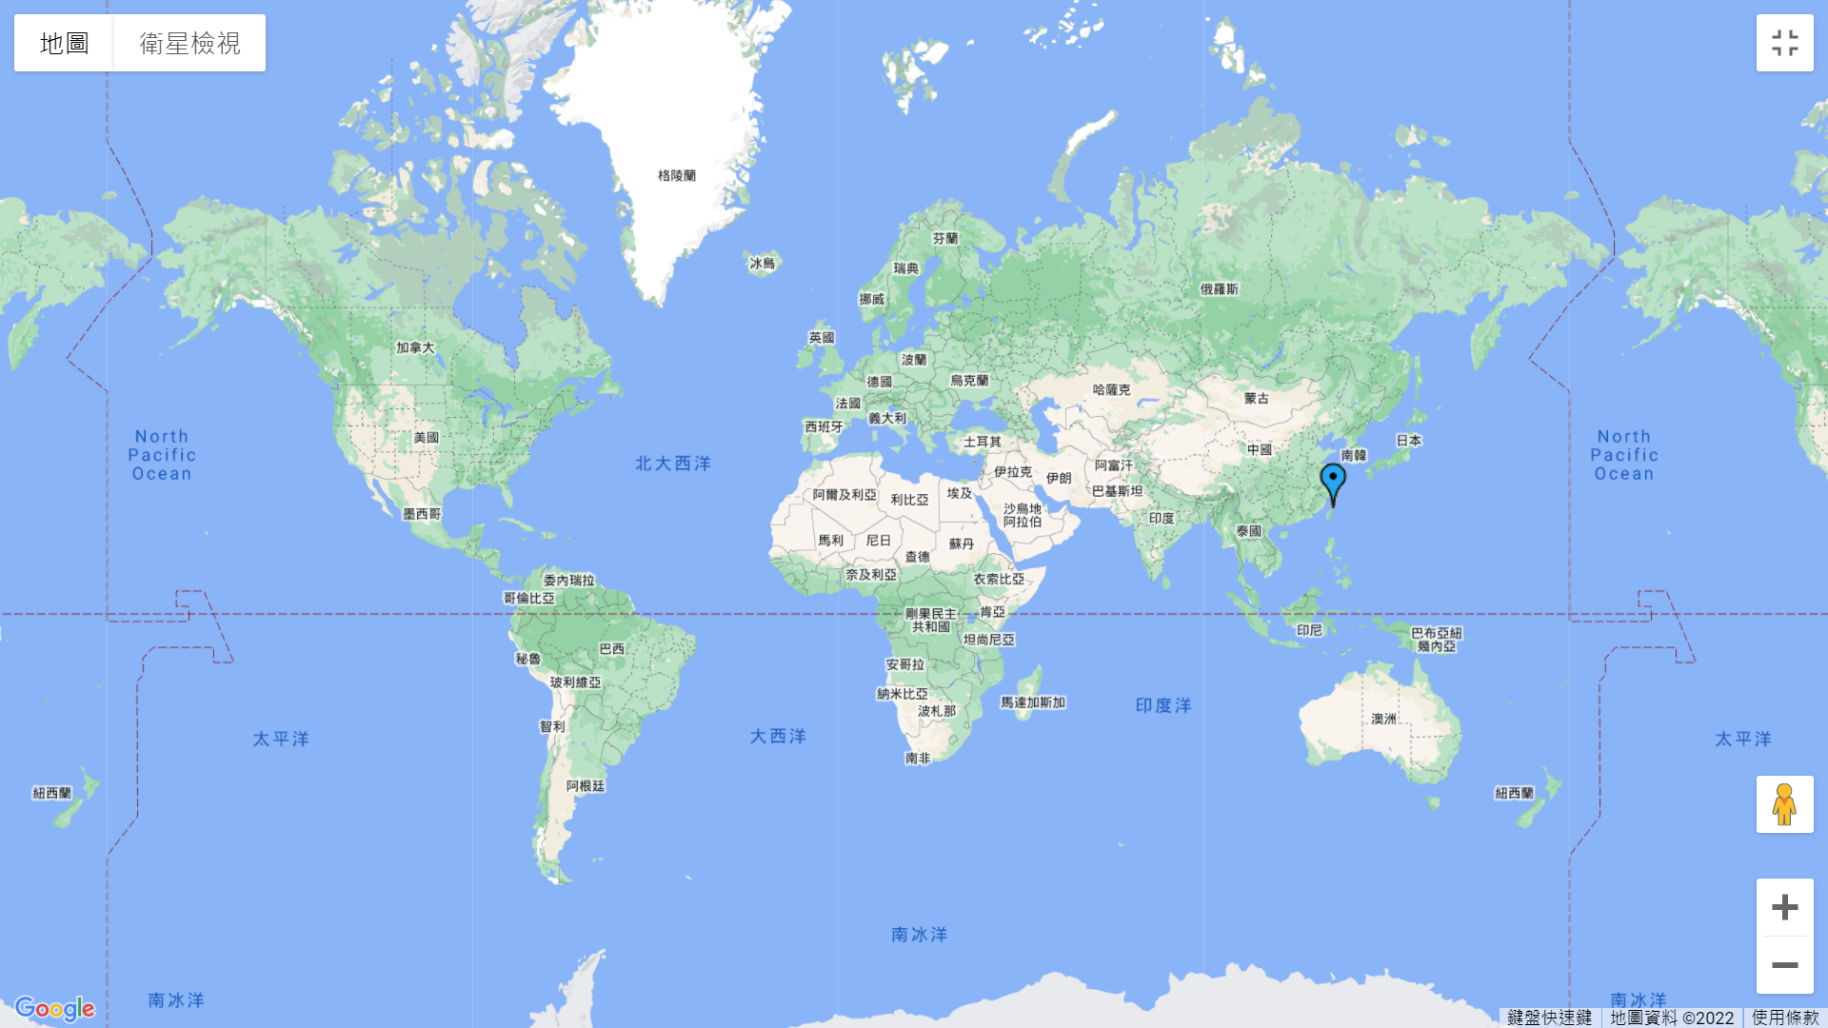

Slide 10
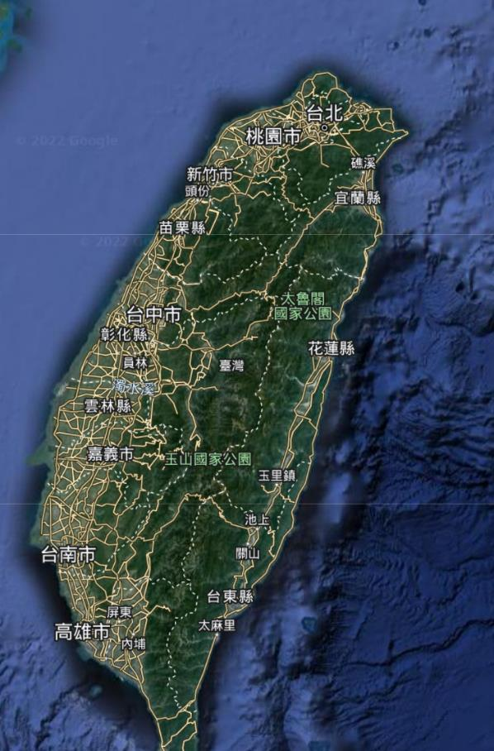
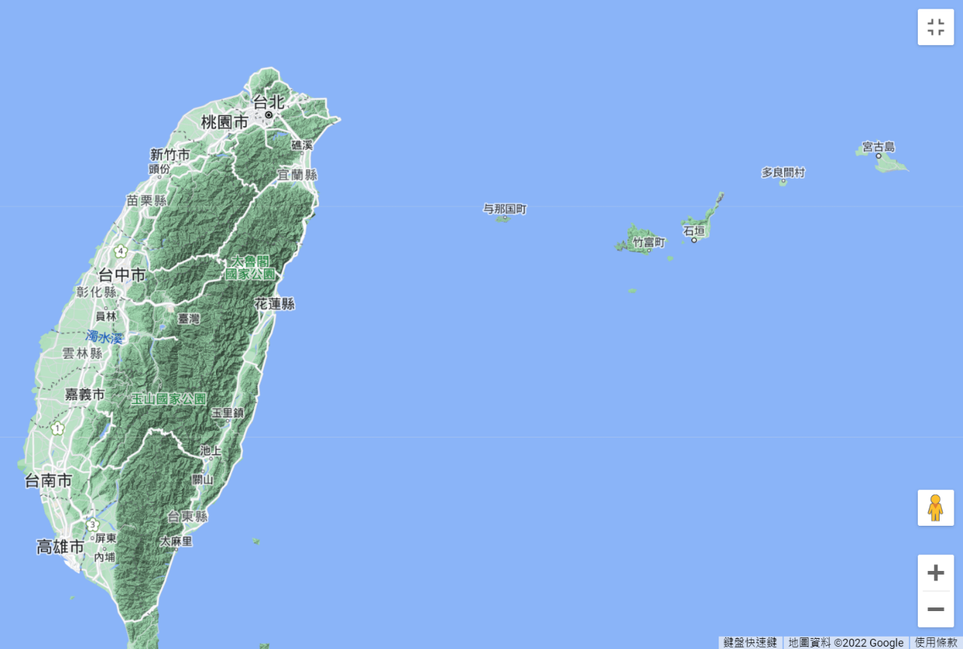
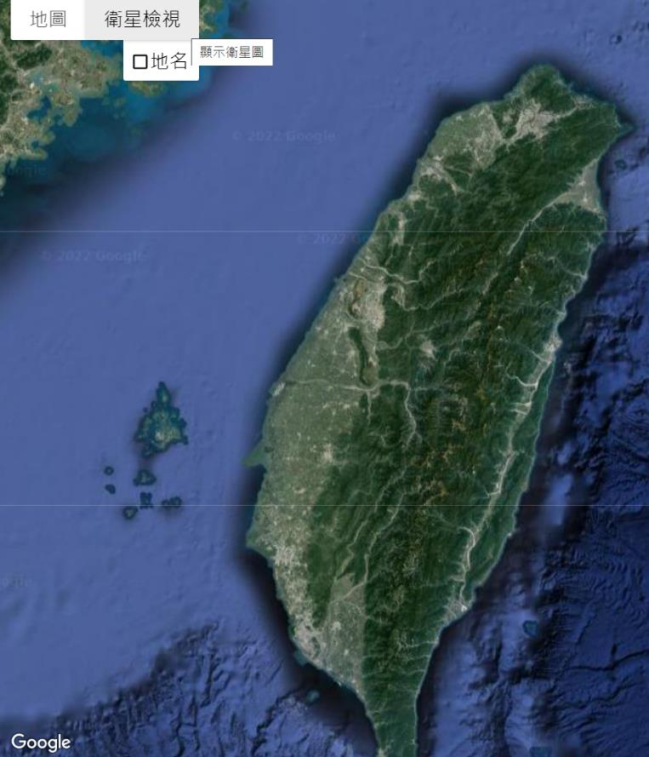
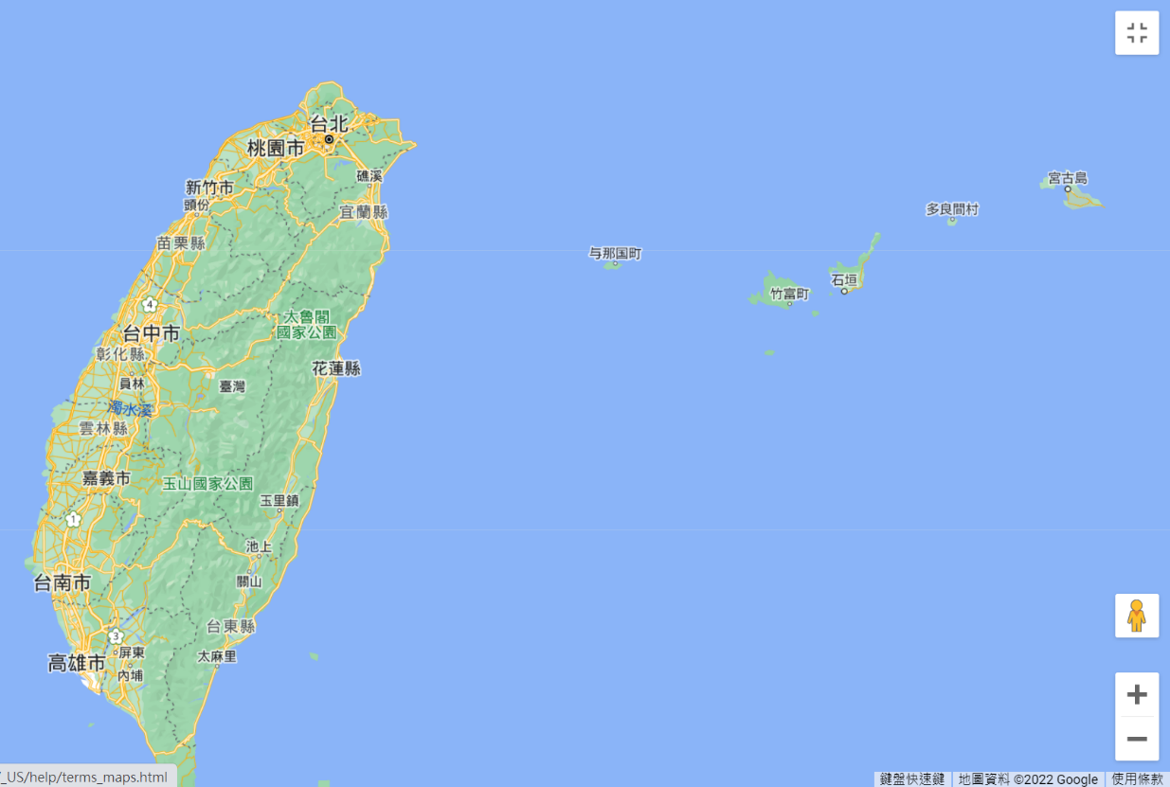

Slide 11
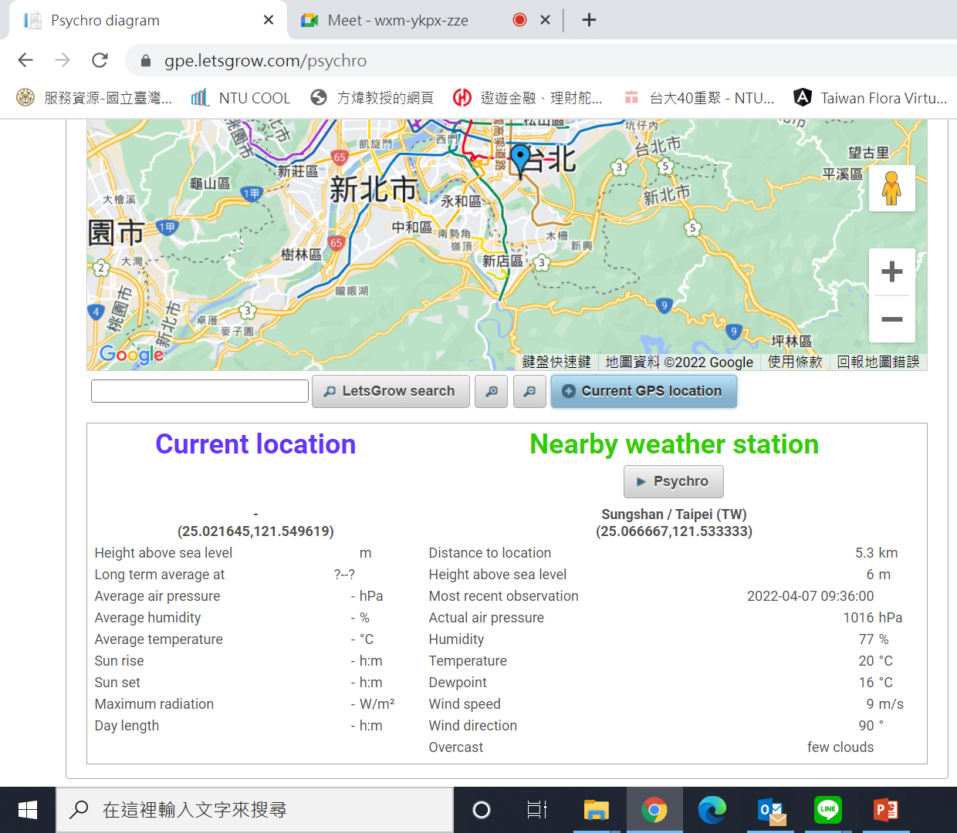
Click on this icon can bring the weather condition to the Psychro software

Slide 12
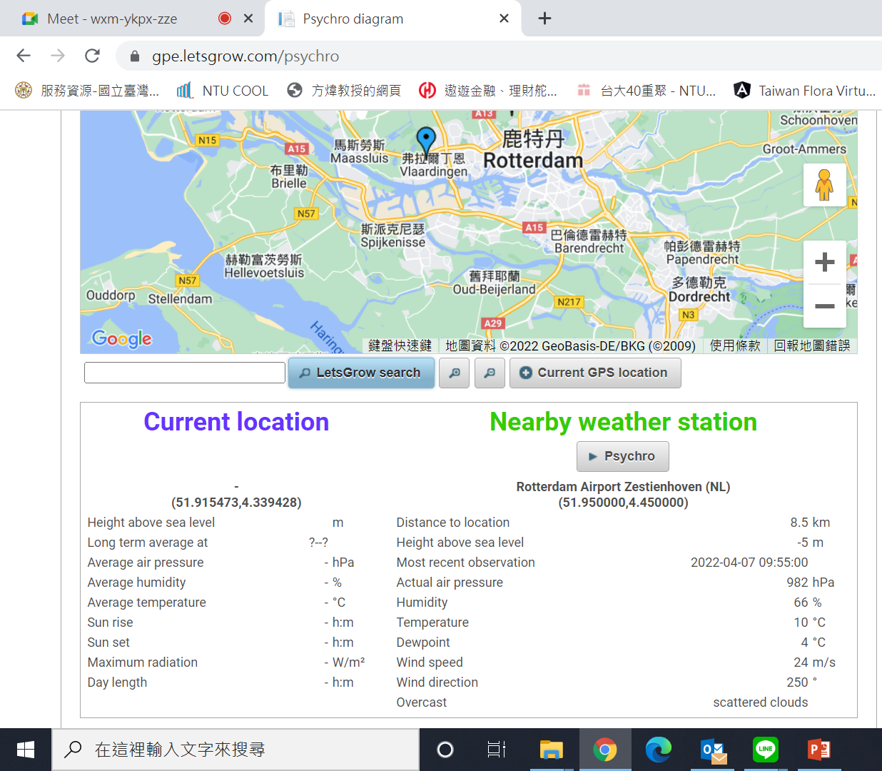
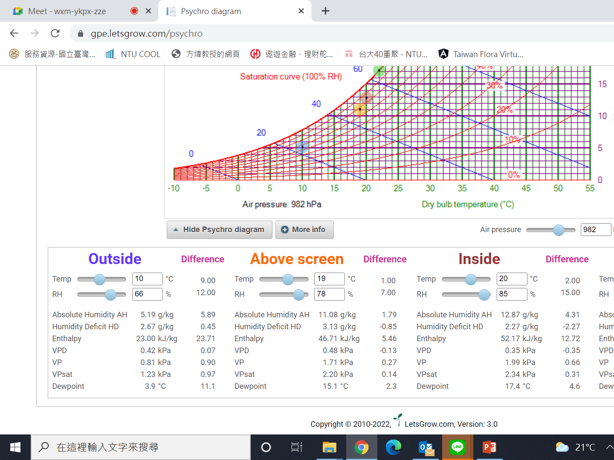

Slide 13
Three Extra Analysis

Slide 14
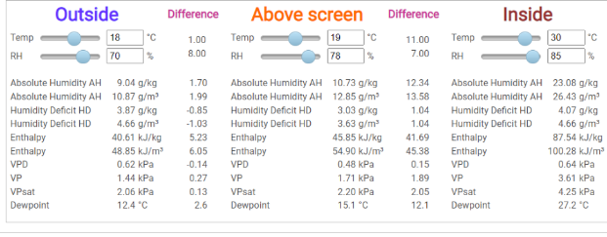
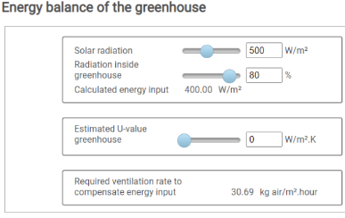
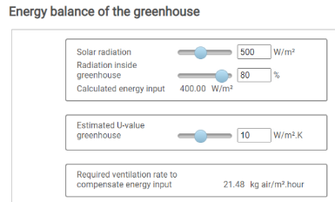
Energy Balance
Based on outside and inside conditions defined previously
ExtraHeat = (Radiation*Transmittance) – (U*dT)
=[500*0.8 - 0*(30-18)]*3600/1000 kJ/m².h
∆Enthalpy=87.54-40.61=46.93 kJ/kg
Ventilation=ExtraHeat/∆Enthalpy
=400*3.6/46.93=30.69 kg/m².h
ExtraHeat=[500*0.8 - 10*(30-18)]*3600/1000 kJ/m².h
Ventilation=ExtraHeat/∆Enthalpy=(400-120)/46.93=21.48

Slide 15
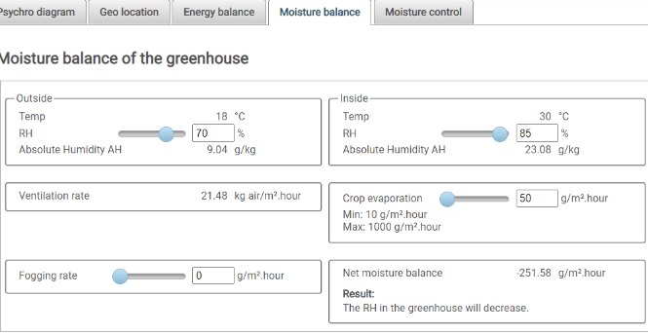
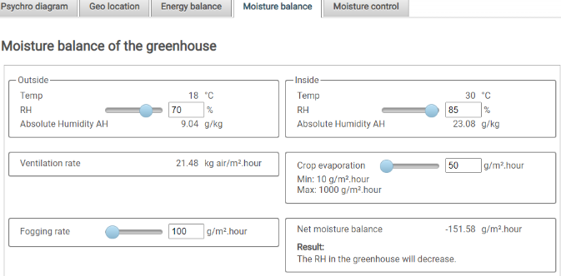
Moisture Balance based on ventilation rate derived from energy balance
AH_{dif} = 23.08 - 9.04 = 14.04 g/kg air
Moisture removed @given ventilation rate = 21.48 * 14.04 = 301.58 g/m².h
Value from Energy balance
Net moisture balance = Moisture removed – Crop evaporation – fogging rate
= 301.58 – 50 - 0 = 251.58 g/ m².h
Net moisture balance = Moisture removed – Crop evaporation – fogging rate
= 301.58 – 50 - 100 = 151.58 g/ m².h

Slide 16
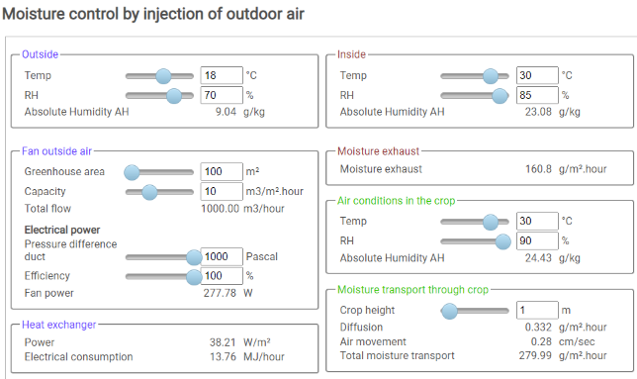
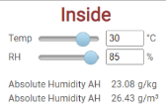
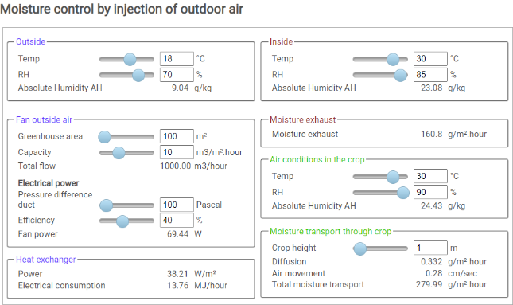
Moisture Control
dT = T_{inside} - T_{outside}
Moisture exhaust= Fan capacity x AH_{dif} (g/m³)
= 10 m³/m².h * (26.43 – 10.87) g/m³ = 155.6 g/m².h
Moisture exhaust= Fan capacity x AH_{dif} (g/kg) x density_{insideAir}
= 10 m³/m².h x (23.08 – 9.04) g/kg x (26.43/23.08) kg/m³ = 160.778 g/m².h
10.87 | g/m³
26.43 | g/m³
dP
_{Air density}
_{= (26.43/23.08) = 1.1451473}
Heat Exchanger (HX) Power = f(dT, fan capacity)
If dT or fan capacity = 0, HXPower=0
HXPower=Cp*dT*(capacity/3.60)*density_{in}
= 1.001 * 12 * 10 /3.6* (26.43/23.08) = 38.2 W/m²
Elec. Consumption = HXPower *GHarea
= 38.21*100 = 3821 W
= 3821*3600/10⁶ MJ/h
= 3.821*3.6 = 13.7556 MJ/h
Fan power = dP x (total flow/3600) / Efficiency
= 1000 x (1000/3600) /1 = 277.78 W
dP
Fan power = = 100 x (1000/3600) /0.4 = 69.444 W

Slide 17
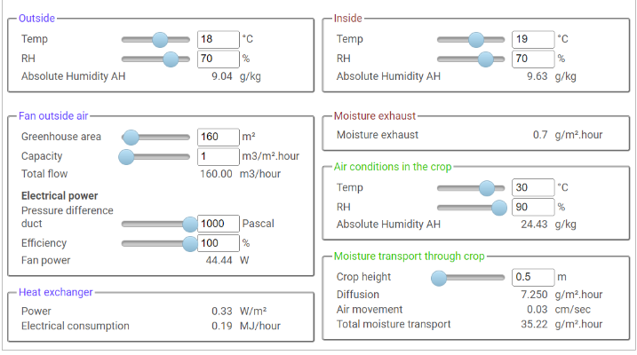
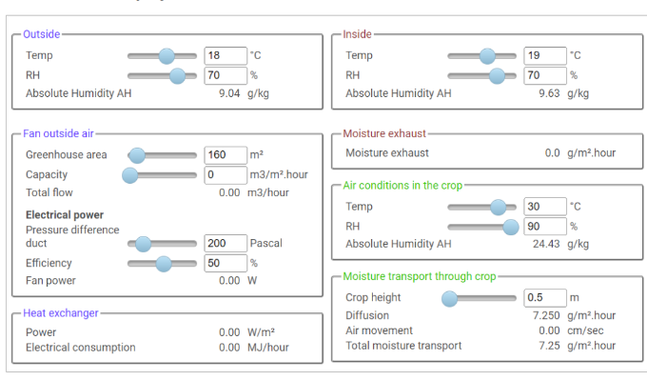
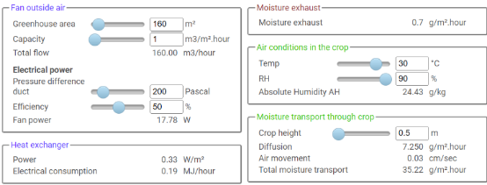
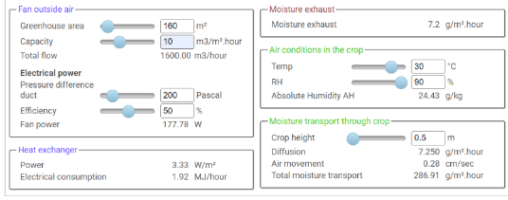
11.54 g/m³
dP
dP
HXPower = Cp * dT * capacity/3.6 * density
= 1.001 * 1 * 1/3.6 * (11.54/9.63) = 0.333 W/m²
Elec.Consumption = HXPower *Gharea * 3.6/1000
= 0.3184*160 = 50.944 W= 50.944*3600/10⁶
= 0.18336 MJ/h
Total flow = Capacity * GH area
Fan power = dP x (Total flow/3600)/ Efficiency
= 1000 x (0/3600) /1 = 0 W
Fan power = dP x (Total flow/3600)/ Efficiency
= 1000 x (160/3600) /1 = 44.44 W
Fan power = 200 x (160/3600) /0.5 = 17.78 W
Fan power = 200 x (1600/3600) /0.5 = 177.78 W

Slide 18
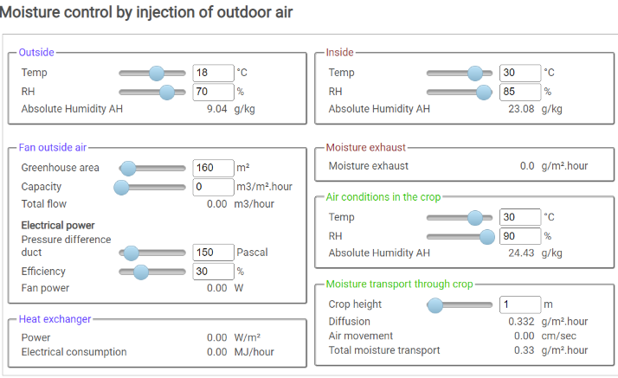
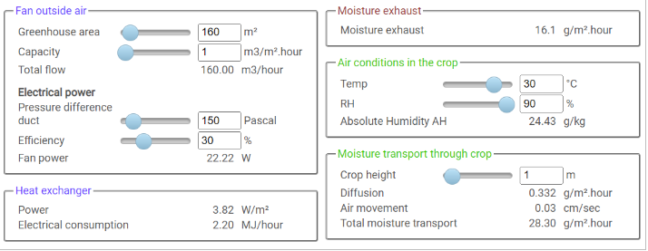
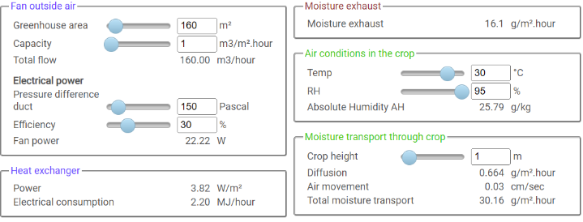
When fan capacity = 0 m³/m².h,
There is no air exchange between in & outdoor, thus, Moisture exhaust = 0
However, there still exist AH difference between indoor and micro-climate around crop AH_{dif} = 24.43 – 23.08 = 1.35 g/kg
When Crop height =1 m, Air volume around crop per unit area (1 m²) = 1 m³
An empirical equation to derive Diffusion:
Diffusion = 0.214375 * AH_{dif} * density /crop height
= 0.214375* 1.35 * 1.1449 /1 = 0.331 g/m².h
Fan capacity = 0, air movement through crop = 0 cm/s
Total moisture transport (TMT) = Diffuse
density = 27.97/24.43 = 1.1449
density = 27.97/24.43 = 1.1449
density =29.5/25.79 = 1.1438
Diffusion = 0.214375 * 1.35 * 1.1449 /0.5 = 0.663
Diffusion = 0.214375 * 1.35 * 1.1449 /1 = 0.331
Diffusion = 0.214375 * 2.71 * 1.1438 /0.5 = 1.329
Diffusion = 0.214375 * 2.71 * 1.1438 /1 = 0.664

Slide 19
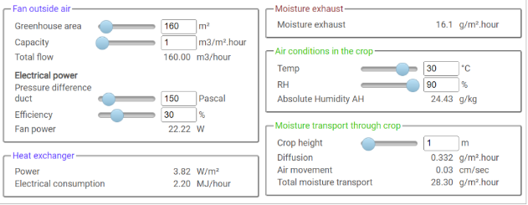
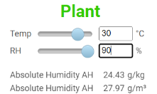
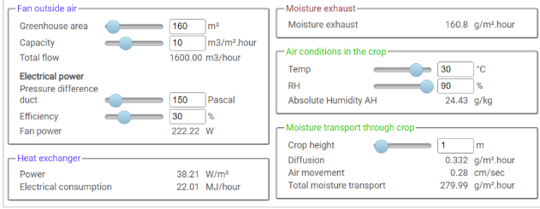
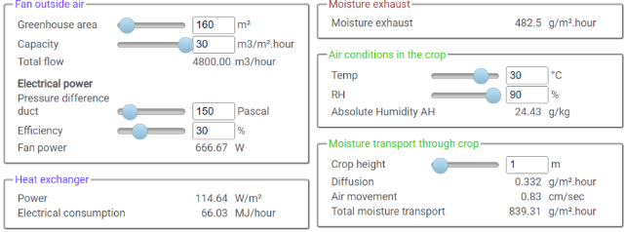
Air movement = f(fan capacity)
Total moisture transport (TmT)
= moistureTransport_{fan} + moistureTransport_{diffuse}
= Fan capacity * AH + Diffusion
in m³/m².h * g/m³ + g/m².h
1 m³/m².h = 100 cm/3600 s = air movement 0.0277 cm/s
TmT = 1 * 27.9658 + 0.332 = 28.2978 ≈ 28.30 g/m².h
10 m³/m².h = 10 * 100/3600 = 1/3.6 = 0.2777 cm/s
TmT = 10 * 27.9658 + 0.332 = 279.99 g/m².h
30 m³/m².h = 30 * 100/3600 = 0.8333 cm/s
TmT = 30 * 27.9658 + 0.332 = 839.306 ≈ 839.31 g/m².h

Slide 20
Psychrometrics
Simulation models
Radiation monitor

Slide 21
Introducing LetsGrow
[ATGS 7140] Plant Factory – Theory and Practice
Greenhouse Simulation
https://gpe.letsgrow.com/
Wei FANG
NTU_BME and Global ATGS
National Taiwan University
2022/03/16

Slide 22
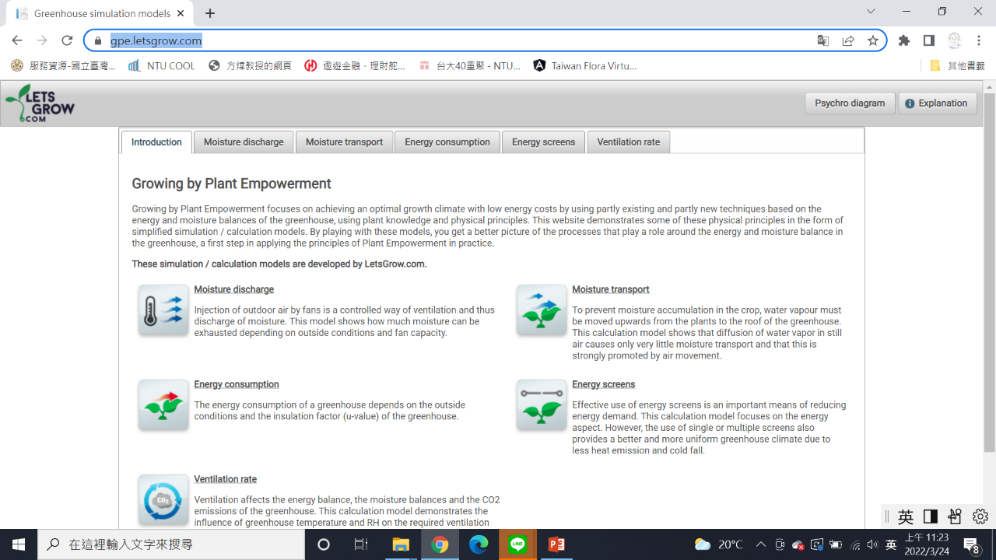

Slide 23
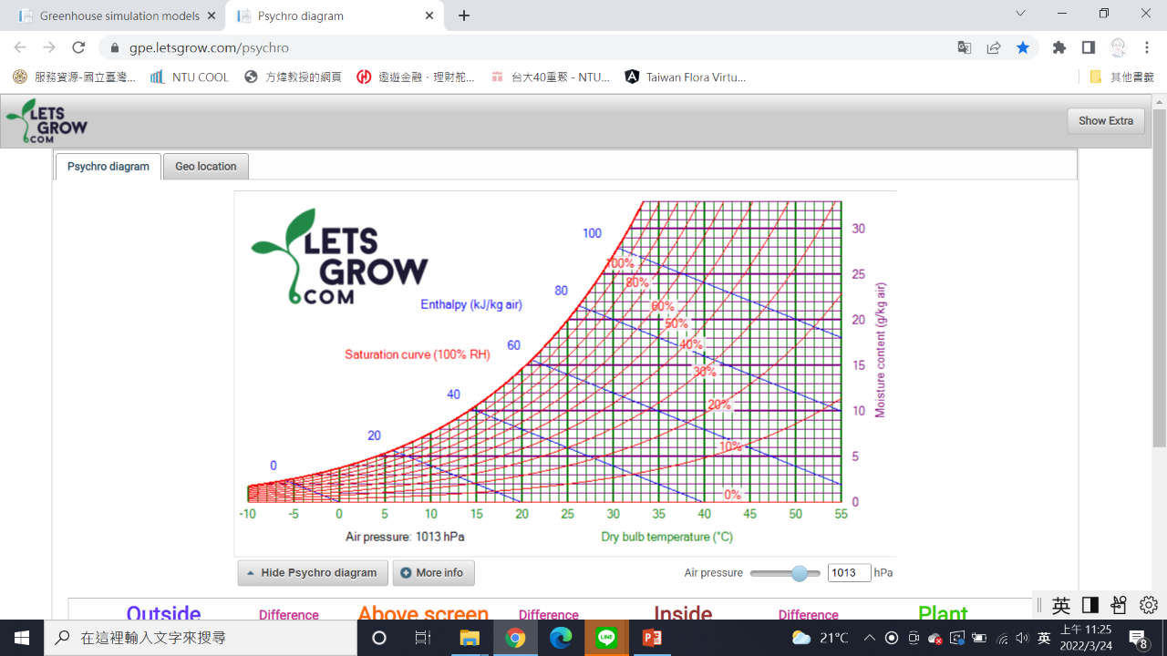

Slide 25
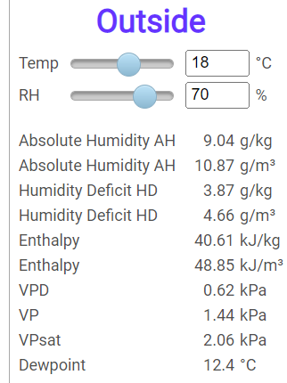
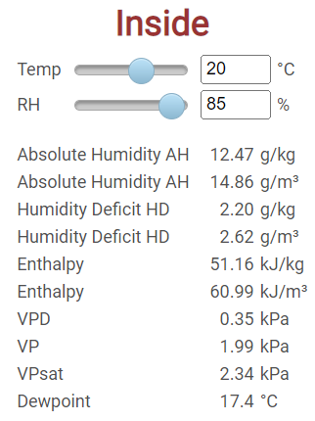
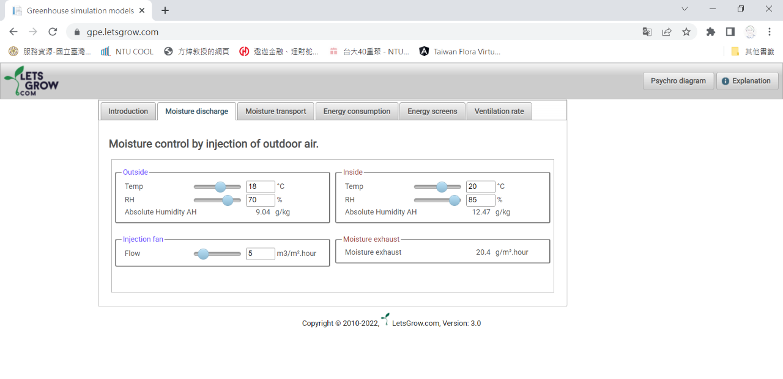
AH_{dif}=12.47-9.04=3.43 g/kg
= 3.43 * (10.87/9.04)= 4.12 g/m³
Moisture exhaust= Flow * AH_{dif}
= 5 * 4.12 = 20.6 g/m².h

Slide 26
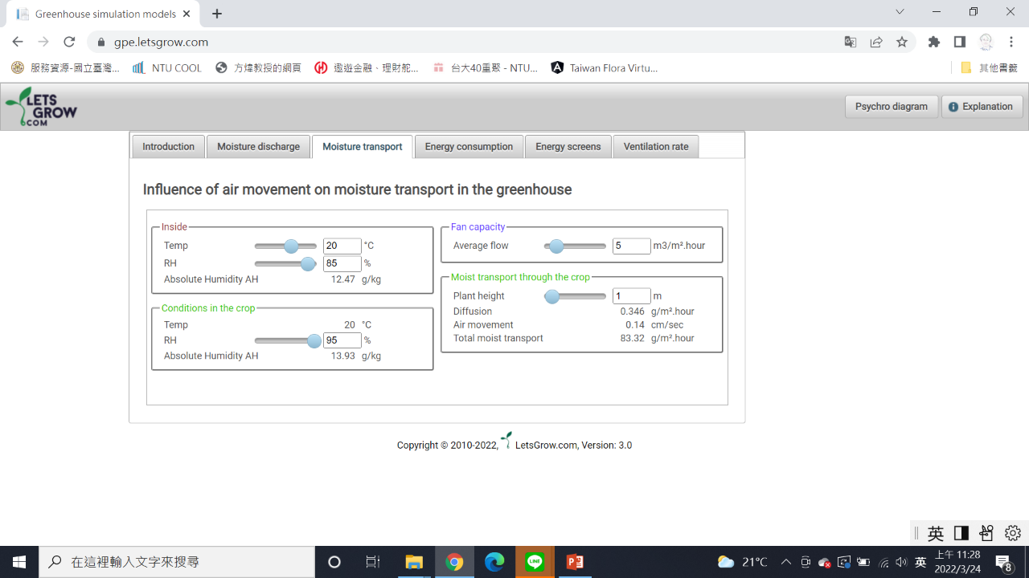
Check
Moisture Control
of
Psychro diagram

Slide 27
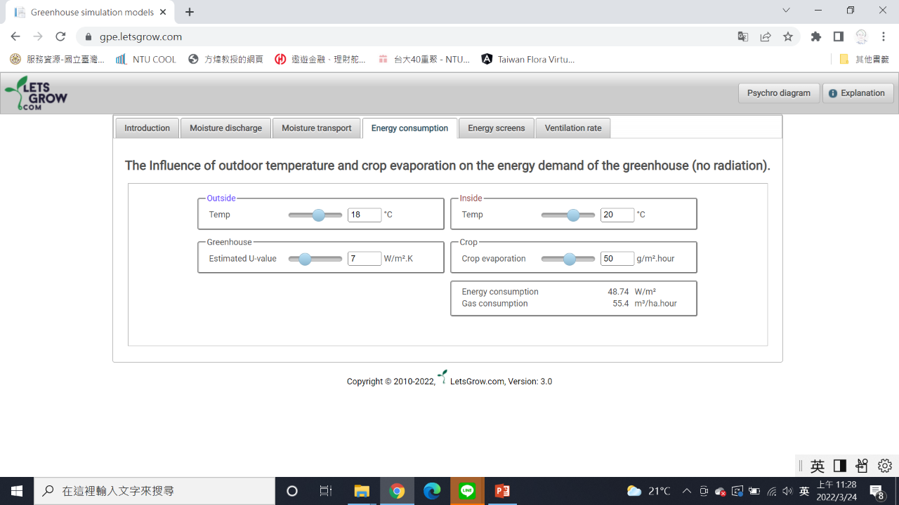
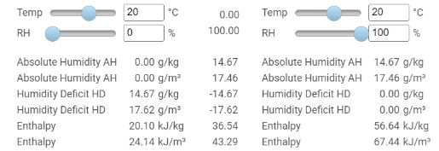
Heat of vaporization =
dEnthalpy / dAH
= 36.54 / 14.67 = 2.49 kJ/g
Energy consumption =
U*dT + H_{fg} * crop evaporation
= 7*2+2.49 kJ/g * 50 g/m².h /3.6
= 14 + 34.58 = 48.58 W/m²
Gas consumption (Nature gas) =
= 48.74 * 10⁴⁻³ * 3600 / (37377 heat value熱值 * 0.84 efficiency) = 48.74 * 36000 /(31672 kJ/m³) = 48.74/0.8797= 55.4 m³/ha.h

Slide 28
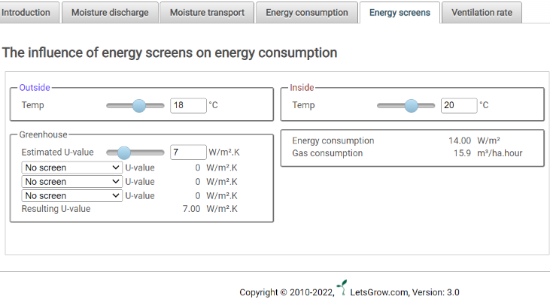
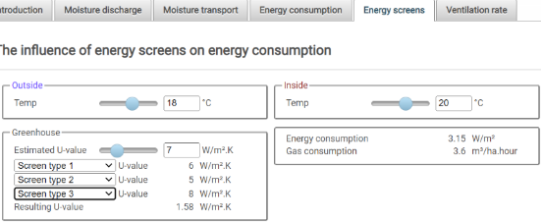
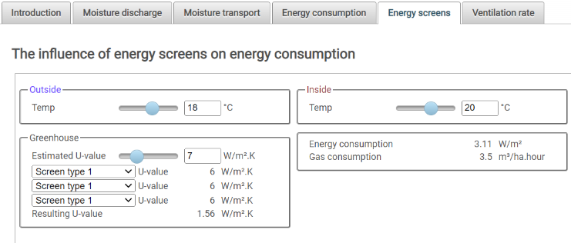
Q = U * dT = 7* (20-18) = 14 W/m²
Gas consumption =
Resulting U = 1/(1/5+1/6+1/7+1/8)
=1.576
14 * 10* 3600 /(31672 kJ/m³) = 14/0.8797 = 15.9 m³/ha.h
Q = U * dT = 1.576 * (20-18) = 3.15 W/m²
Gas consumption =
3.15 / 0.8797 = 3.58
Q = U * dT = 1.56 * (20-18) = 3.12 W/m²
Resulting U = 1/(1/7+1/6+1/6+1/6)=42/27=1.56
Gas consumption =
3.11 / 0.8797 = 3.53 m³/ha.h

Slide 29
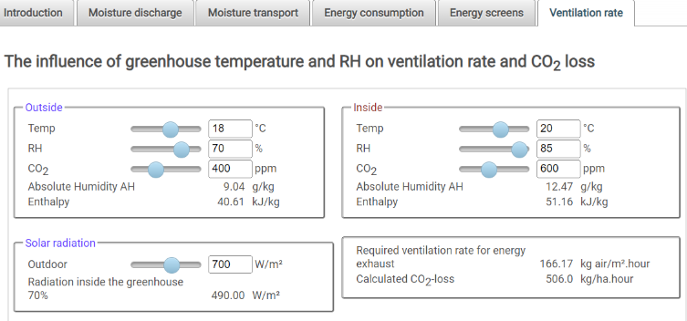
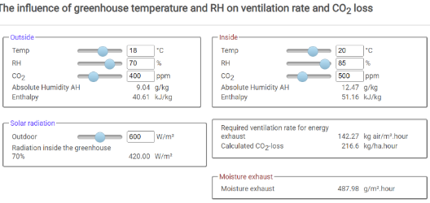
Qin = (700 * 0.7 * 3.6) in kJ/m².h
dEnthalpy = (51.16 – 40.61) in kJ/kg
Vent. rate = Qin / dEnthalpy
= (490 * 3.6) / (51.16-40.61) = 167.2 kg/m².h ~ 166.17
dCO2 = 600-400=200 ppm = 200 * 1.522 mg/kg
CO2 loss = Vent.rate * dCO2/(10⁶⁻⁴)
= 166.17 * (200*1.522)/100=505.8 kg/ha.h
Moisture exhaust = Vent.rate * dAH
= 166.17 * (12.47-9.04) = 569.96
Qin = (600 * 0.7 * 3.6) in kJ/m².h
dEnthalpy = (51.16 – 40.61) in kJ/kg
Vent. Rate = Qin / dEnthalpy
= (420 * 3.6) / (51.16-40.61) = 143.31 kg/m².h ~ 142.27
dCO2 = 500-400=100 ppm = 100 * 1.522 mg/kg
CO2 loss = Vent.rate * dCO2/100
= 142.27 * (100*1.522)/100=216.53 kg/ha.h
Moisture exhaust = Vent.rate * dAH
= 142.27 * (12.47-9.04) = 488.00

Slide 30
Psychrometrics
Simulation models
Radiation monitor

Slide 31
More models from WUR
https://www.glastuinbouwmodellen.wur.nl/radiationmonitor/?user=Lg_ENC_ext

Slide 32
Enter ENF for degree F temperature input version
Enter ENC for degree C temperature input version

Slide 33
https://www.glastuinbouwmodellen.wur.nl/radiationmonitor/Content/HlpEN.pdf
88 pages in total

Slide 35
88 pages in total
https://www.glastuinbouwmodellen.wur.nl/radiationmonitor/Content/HlpEN.pdf

Slide 36
started at page 5

Slide 44
最後一頁技術相關資訊
之後的都是贊助商相關

