Slide 1
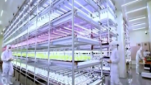
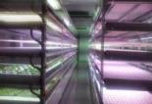
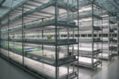
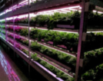
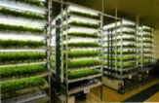
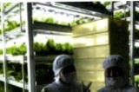
Plant Factory – Theory and Practice
Development of Plant Factory Industry in Taiwan
Wei FANG
Dept. of Biomechatronics Engineering
Global ATGS
Center of Excellence for Controlled Environment Agriculture (CCEA)
National Taiwan University
Notes:
1

Slide 2
About myself
1977~1983 BS, MS @NTU
1984~1985 Military service
1989 Ph.D.
Dept. of Bioresource Engineering, Rutgers – The State University of NJ., USA
1989~1992 Post Doc., CCEA, Rutgers Univ.
1992~1997 Associate Prof., NTU
1997~now Professor, Dept. of BIME/BME, NTU
2013~2015 Head, Dept. of BIME, NTU
2016~now Director, CCEA, NTU
Chief Consultant of Chung-Hwa Plant Factory Association (CHPFA)
International Consultant of Japan Plant Factory Association (JPFA)

Slide 3
Outline
Introduction
Recent researches
Conclusion

Slide 4
What is PFAL/VFAL?
Plant factory (Vertical Farm) with artificial lighting
A closed plant production system
Using least amount of resources (water, land, etc.), generate minimum pollution, producing high quality of food, fiber and beneficial components in an efficient way.

Slide 5
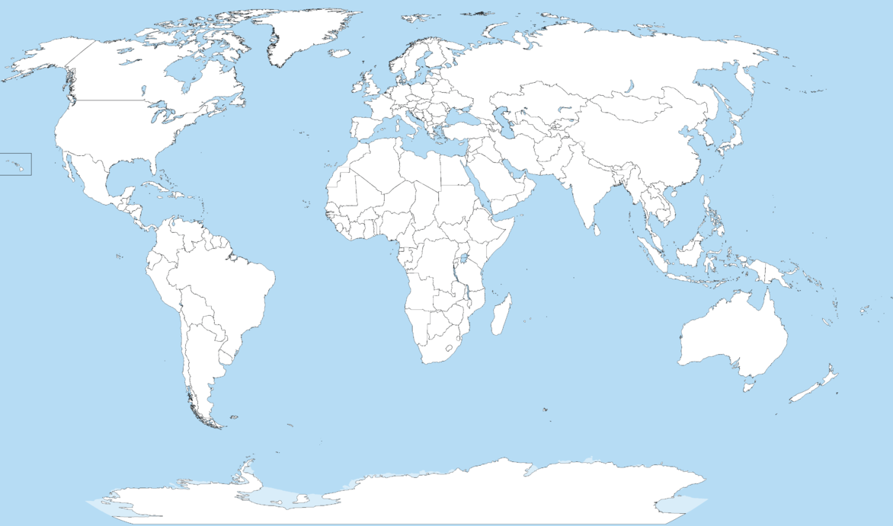
PF, VF, and more
Europe
North America
VF
VF
Asia
PF
EU：City Farm, Urban Agriculture, Vertical Farm
US：Vertical Farm, Indoor Agriculture
Asia：Plant Factory with Artificial Lights (PFAL)

Slide 6
Various terms converged into ONE
PF, PFAL
VF, VFAL
Urban Agriculture
Urban Horticulture
Indoor Agriculture
Indoor Horticulture
City Farm
Smart Farm
….
^{CEA}

Slide 7
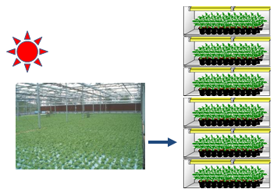
Controlled Environment Agriculture (CEA)
Greenhouse: Plant Factory with sunlight and/or supplemental light
Plant Factory/Vertical Farm with Artificial Lighting
Notes:
Greenhouse and plant factory are both controlled environment agriculture. Most greenhouses grow plants in one layer and most plant factories grow plants in mutilple layers. It is also termed ‘vertical farms’

Slide 8
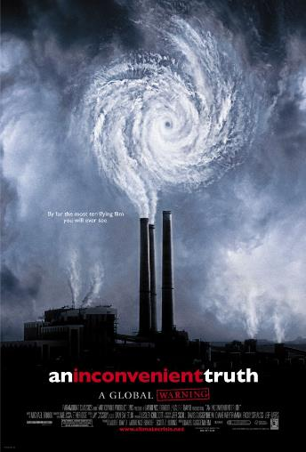
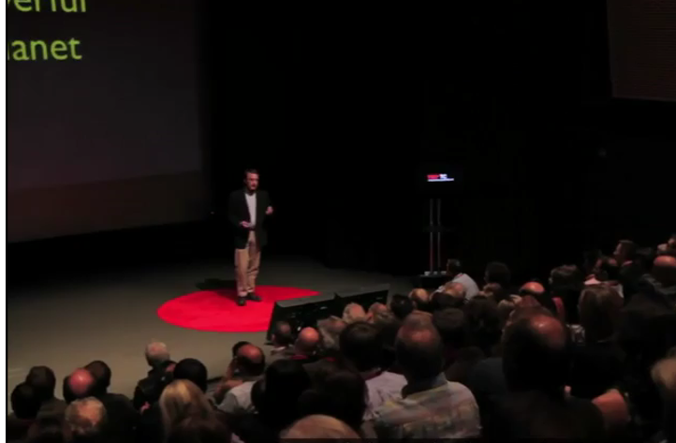
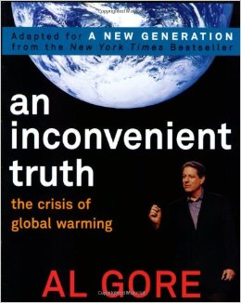
Global Trends
An Inconvenient Truth (2006, AL Gore, TEDtalk)
The Other Inconvenient Truth (2010, Jonathan Foley, TEDtalk) https://www.ted.com/talks/jonathan_foley_the_other_inconvenient_truth
40% land, 70% water, 30% carbon
Link
http://www.imdb.com/title/tt0497116/mediaviewer/rm2695729664
https://images-na.ssl-images-amazon.com/images/I/51JgxCOl9qL._SX258_BO1,204,203,200_.jpg

Slide 9
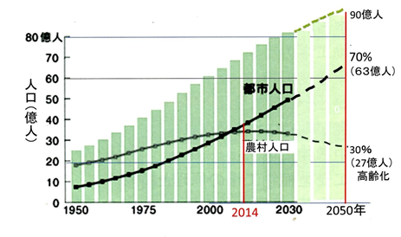
Population & Migration
1.65 M people move to urban area per week

Slide 10
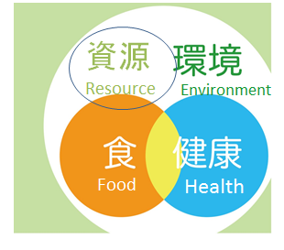
GloNacal Issues
Global
National
Local

Slide 11
Energy
Oil
Natural gas
Freshwater
Arable land
…
Global warming
Extreme weather
elevated CO₂
Polluted river, lake, ocean
Polluted earth
有限
永續
Awareness
Food mileage
Carbon footprint
Local for local
充足
確保
Food security
need for stable food supply
Freshness, tasty
Food Safety
need for safe food
LCA (Life Cycle Assessment/Analysis)
GAP (Good Agricultural Practice)
Nutritious

Slide 12
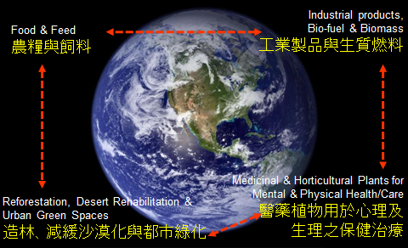
Billions of plants of various kinds are needed to solve ‘glonacal’ issues on environment, food/feed and bio-resource

Slide 13
Is there any plant production system capable of producing mass amount of high quality products in the shortest time, use the least amount of resource (land, water, labor, energy, etc.), and has the least amount of impact on environment?

Slide 14
Plant Production Systems
Value Created or Yield
R&D
Plant factory
Greenhouses
Open &
Extensive
Open fields
Amounts of Resource Input or Cost

Slide 15
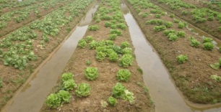
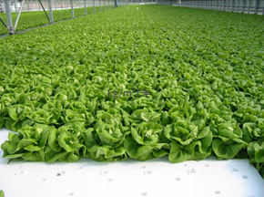
Controlled Environment Agriculture (CEA)
Greenhouse: Plant Factory with sunlight and/or supplemental light
Open field
Semi-closed: Greenhouse
< 3 kg/m²/year
69 kg/m²/year

Slide 16
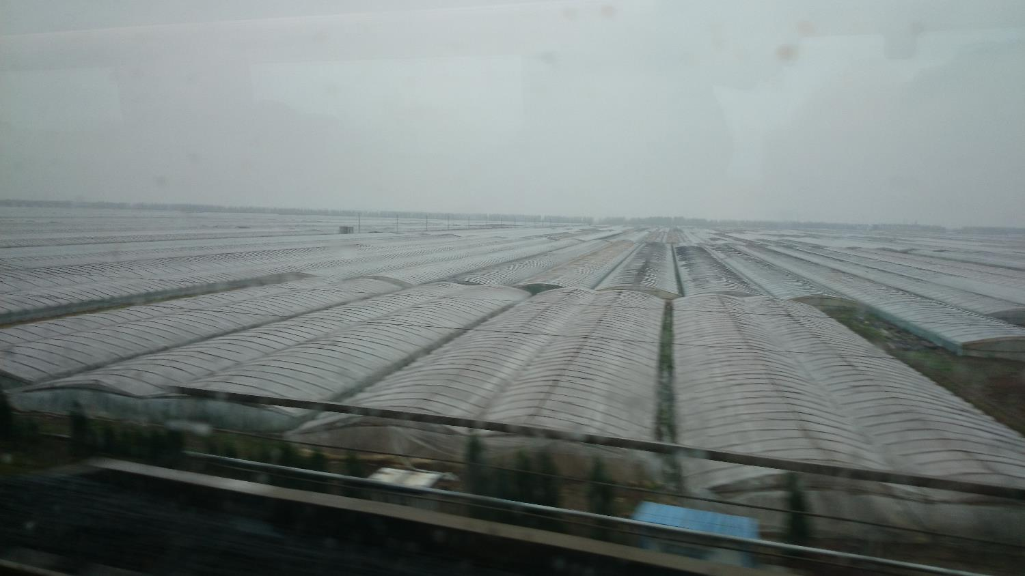
Weifang, Shendon, China

Slide 17
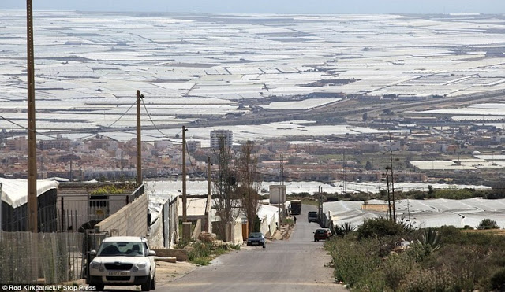
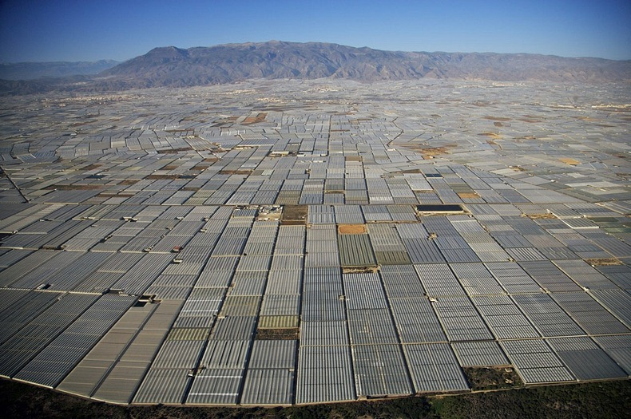
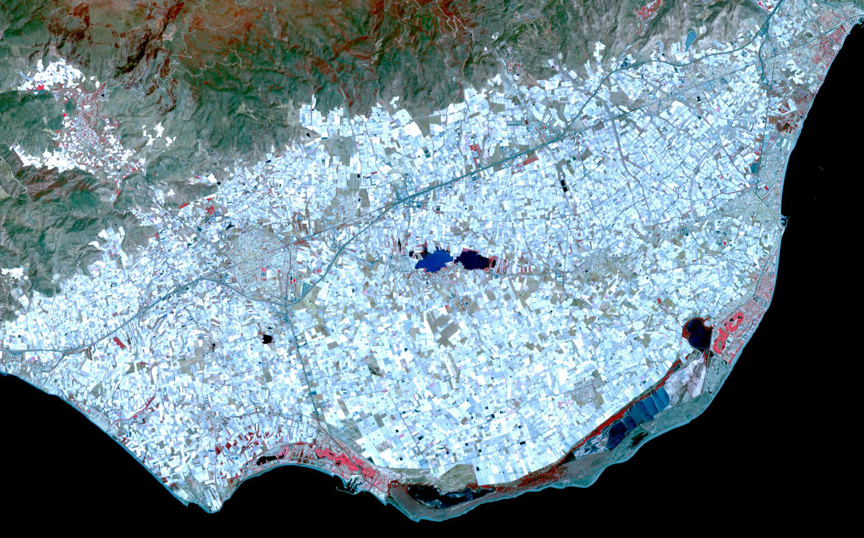
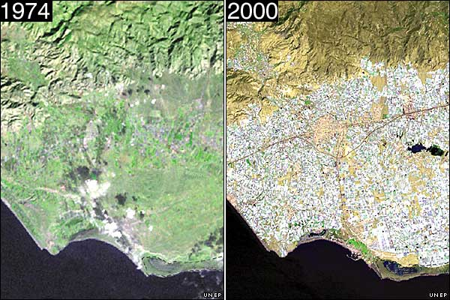
Almeria of Spain

Slide 18
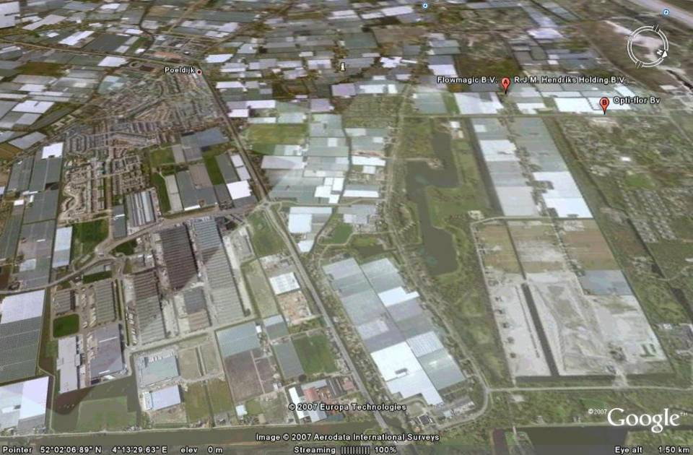
Westland, the Netherlands

Slide 19
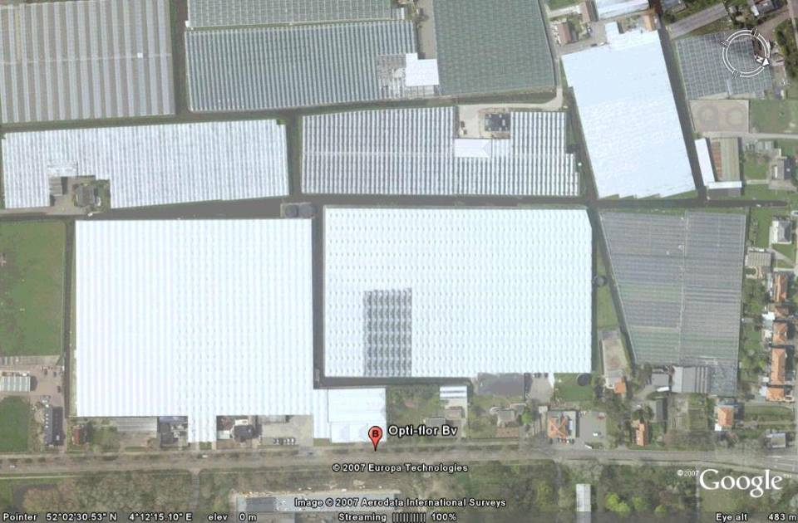
Opti-Flor Corp., Westland, the Netherlands
5 hectare
5 hectare

Slide 20
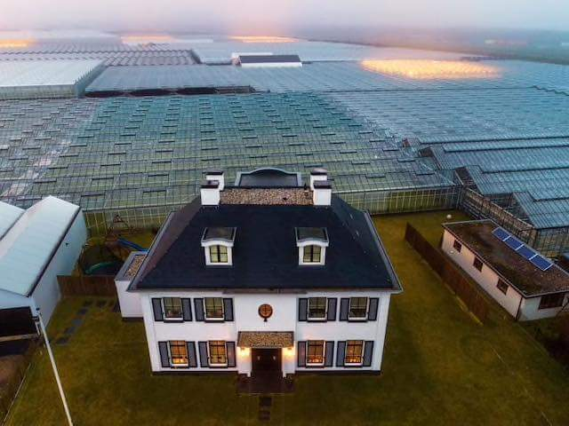

Slide 21
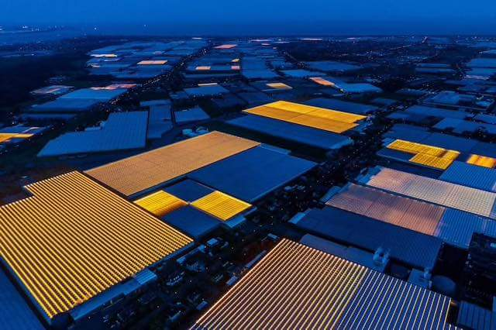

Slide 22
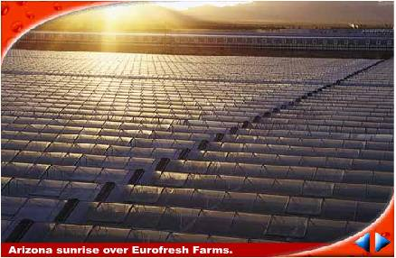
Eurofresh farm, Arizona, USA

Slide 23
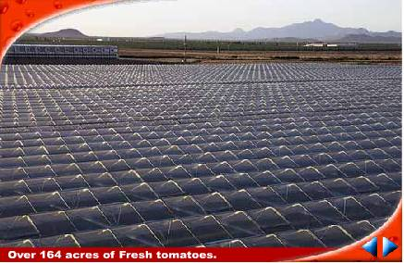
74.5 hectare of tomato farm under one roof

Slide 24
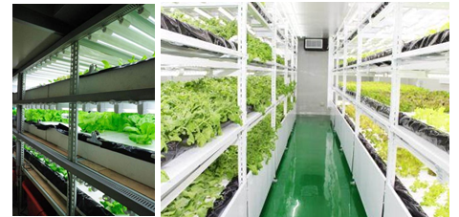
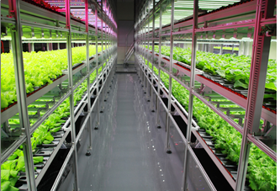
Closed & Intensive PPS
3 layers > 100 kg/m²/year
6 layers > 200 kg/m²/year
9 layers > 300 kg/m²/year

Slide 25
What is Plant Factory?
An environmental controlled
An environmental friendly
A highly efficient
A steady state
A product quality guaranteed
A product safety guaranteed
Closed & Intensive
Plant Production system

Slide 26
Global trends favor the development of PFAL/VFAL
Globalization
Global warming, extreme weather
Growing population and Urbanization
Limited resources, such as farm land, fresh water, etc.
Polluted air, land and water
Consumer awareness
on Food Security / Food Safety
on Carbon Footprint / Food Mileage
Growing of ABC (AI, Big data, Cloud computing) intelligent embedded
Advancement of LED and other lighting technology

Slide 27
Advantages

Slide 28
Advantages

Slide 29
Places suitable to develop PFAL/VFAL
Places with high population density/high income
PLUS locations
too hot to grow vegetables
too cold to grow vegetables
with too little rain, such as South CA
with shortage of fresh water, such as middle East
with cheap electricity fee, such as middle East
relied on import of agricultural products
with lots of unused buildings/factories/basements
with little farm land, such as SG, HK

Slide 30
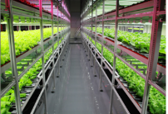
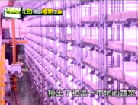
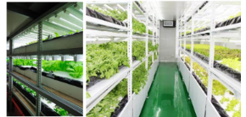
Worldwide Associations and Centers
Taiwan
CHPFA、 TPFIDA
CCEA @ NTU
Japan
JPFA
US
CEAC, CCEA
Panama
VFA
Germany
AVF

Slide 31
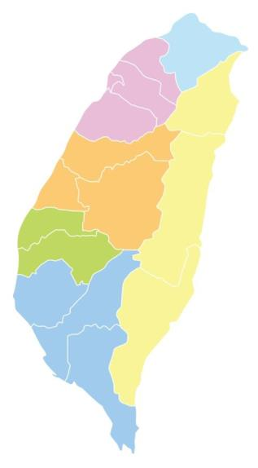
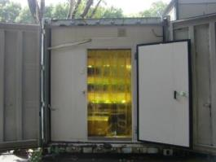
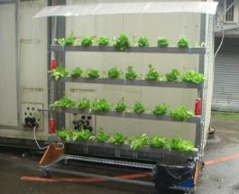
A brief history of PFAL in Taiwan (1/3)
NTU
National Taiwan University supported by NSF, Taiwan
First PFAL related research
1993
20 ft. container with thermally insulated walls

Slide 32
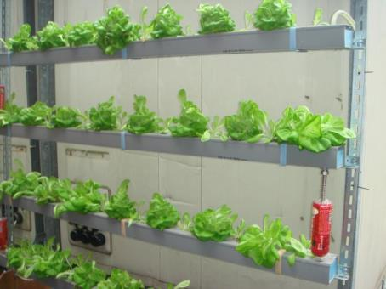
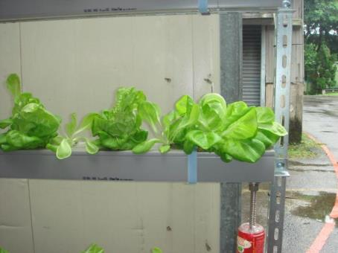
Lots of stress

Slide 33
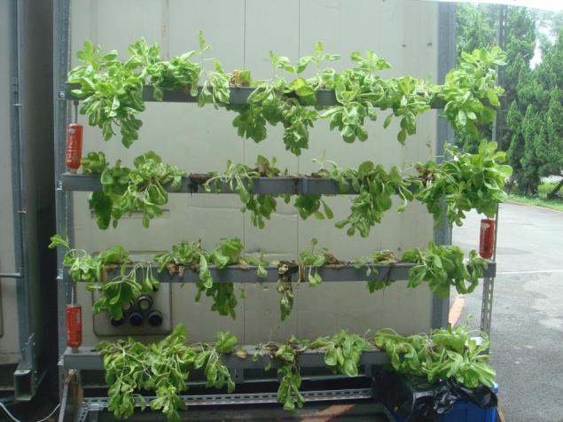
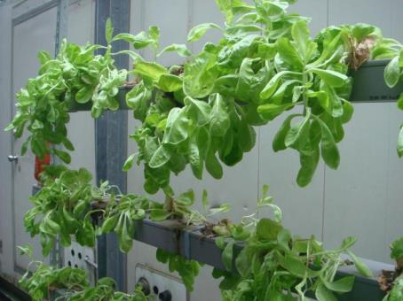
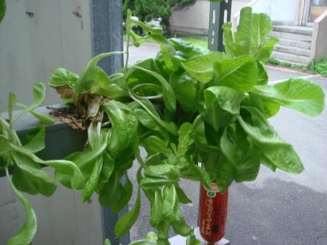
If the plant can talk,
S O S
!!HELP!!

Slide 34
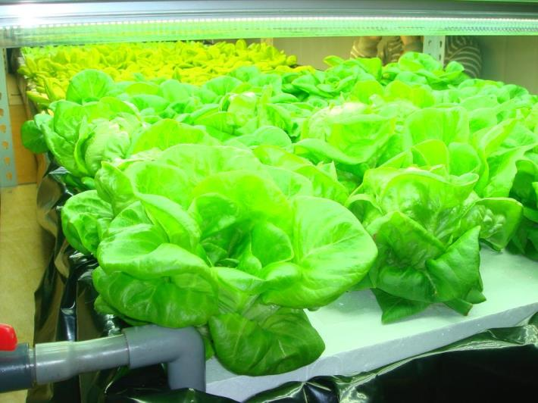
SOP based CEA
Much less in risk / stress

Slide 35
Can PFAL make us richer, smarter, greener, healthier, and happier?

Slide 36
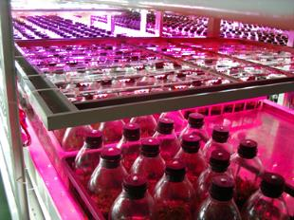
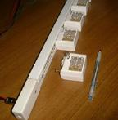
A brief history of PFAL in Taiwan (2/3)
1996 LED related research
NTU
Pulse light with adjustable intensity, duty ratio, frequency
Central
Taiwan
PF_AL for tissue culture and for Phalaenopsis seedling production with movable light was developed in 2001.
Two stories building with 7 layers each.

Slide 37
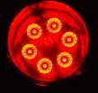
Caps with various spectrums were developed Essential 8 for Tissue culture Fang，2008
 | B 401~500nm | G 501~600nm | R 601~700nm | FR 701~800nm
CW (5500 K) | 26 % | 46 | 26 | 2
WW (2700 K) | 10 | 45 | 41 | 4
8R1B | 13 |  | 87
7R1G1B | 13 | 7 | 80
3R3B3IR | 46 |  | 42 | 12
6R |  |  | 100
6B | 100
6IR |  |  |  | 100

Slide 38
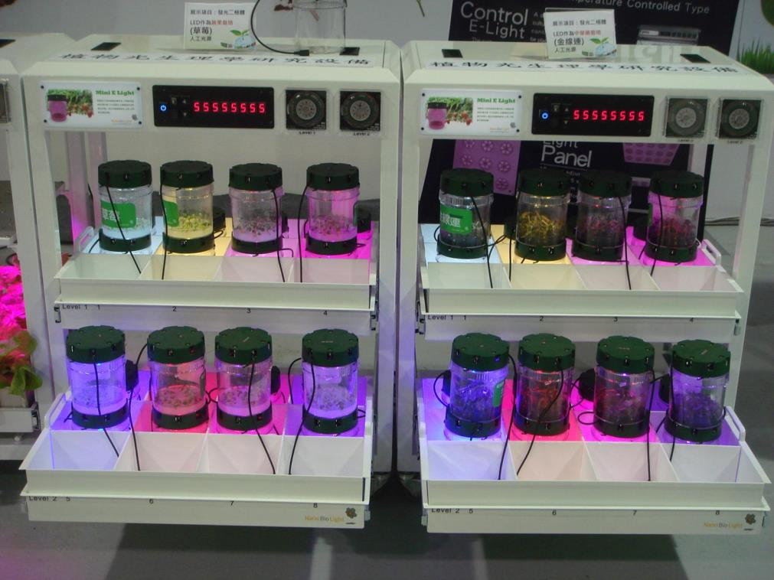

Slide 39
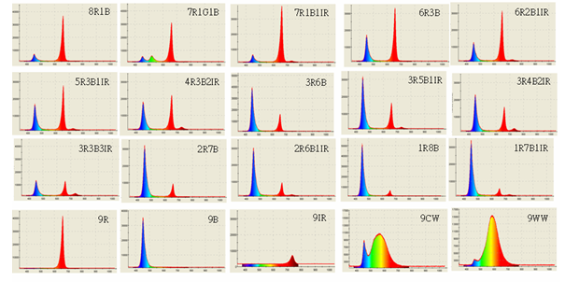
Totally 27 spectra of caps and tubes were developed for TC and PF applications Fang, 2009

Slide 40
Can PFAL make us richer, smarter, greener, healthier, and happier?

Slide 41
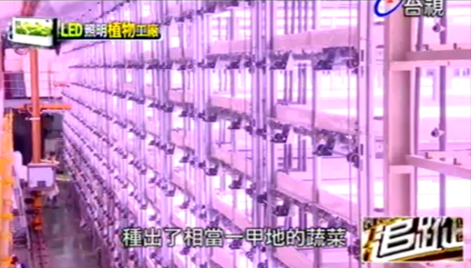
Closed: PFAL
10 layers > 300 kg/m²/year
More than 100 times compare with open field production

Slide 42
More than 100 times?
Same amount of floor area → 100 times of yield/value
Same amount of yield → 99% of floor area can be saved Paid for only 1% of land
Labor cost can also be reduced

Slide 43
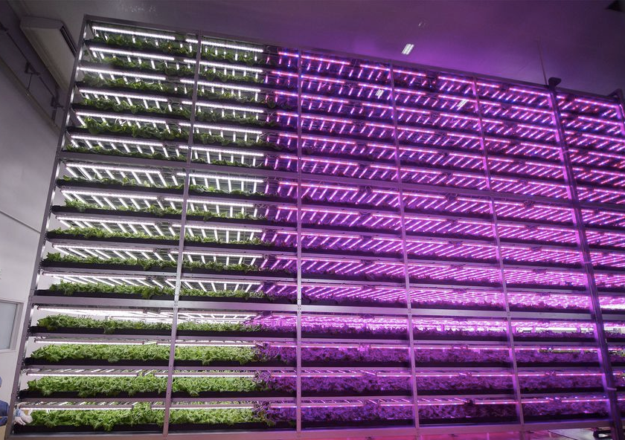
150 times of open field production

Slide 44
Can PFAL make us richer, smarter, greener, healthier, and happier?

Slide 45
Price of Land vs. cost of Lamp
When the land is limited or very expensive, PFAL is a good option for food production.

Slide 46
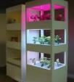
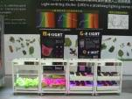
A brief history of PF in Taiwan (3/3)
Public attention of PFAL for the first time :
2010 Taipei Floral Expo
booth of PF: 8 m x 50 m
duration: one month, 8:00~21:00
Taipei
NTU

Slide 47
Extension (step 1/4)
Demo facility
An experimental pilot plant factory was setup in NTU (2011.1.1)
Up to now, more than 2900 visitors
Renovated from a discarded roof-top greenhouse
Wind + solar power assisted: 13 kW

Slide 48
Extension (step 2/4)
Books published
2010
Fang
2011
Kozai
2011
Takatsuji
2012
Kozai
2013
Fang

Slide 49
Extension (step 3/4)
Workshops
2010, 2 semester courses
2011~2016, 30 hrs Once per semester (2 /yr)
2016~now, 16 hrs Once per season (4 /yr)
Totally, almost 1000 trainee from various Industrial/Business/Agriculture sectors

Slide 50
Extension (step 4/4)
Partners and Interested Parties
Research and educational institutions
Governments
Real estate developers and builders
Construction companies
HVAC industry
Electronics industry
Supermarkets
Restaurants
Institutional food services (hospitals, schools, etc.)
Consumers
Media
Etc.
NGOs
TPFIDA
CPFA

Slide 51
PFAL related organizations including companies, universities & research institutes
台北:太平洋森活、美蔬菜(庭茂)、樂鮮良房(勃翔) 、創森、樂活(大眾) 、澄谷、台灣大學
新北:麗萊登、鼎豐康、慶聲、光茵、金寶、東大一、苗廣豐、飛弘、三愛農業、凱傑林
桃園:台達電、欣鮮圃(欣興)、賽門、北一農場、三商光電、菁菜園、山福、源鮮、強復、珊蒂妮 、萬能科大
2013→ 61家
新竹、苗栗:綠四季(詮興) 、晶發半導體、中國砂輪、永盟、元通綠能、綠品生物、菁翠、工研院
基隆:紫山村(海灣國際)
宜蘭、花蓮:宜蘭大學、花蓮農工
嘉義、台南、高雄、屏東:
綠陽光電、燦鋐、金發、富綠寶、金工中心、成大、高海大、屏科大、中研院生物技術中心(南分院)
台中、彰化、南投、雲林:家樂、旺永、志聖、世華、鋐洲、菁饌、臻里、好田生機、群荃養菌場、台灣堂華、吾邦土、中興大學、大葉大學
Note:
黑體字:投入植物工廠廠商，()內為投資企業
藍體字:相關公協會、研究單位
Source：PIDA

Slide 52
PFAL related organizations including companies, universities & research institutes
台北:太平洋森活、美蔬菜(庭茂)、映鮮(大同)、樂鮮良房(勃翔)、創森、綠光能、樂活(大眾)、澄谷、台灣大學、中研院生物技術中心
新北:麗萊登、灃品、鼎豐康、慶聲、研華、光茵、金寶、寰宇、連淨(連展) 、鐳德、中福、東大一、苗廣豐、飛弘、台灣農好、三愛農業、凱傑林
桃園:台達電、欣鮮圃(欣興) 、賽門、北一農場、三商光電、菁菜園、山福、源鮮、紅柿子、台灣神農、強復、珊蒂妮、萬能科大
2014→ 89家
新竹:綠四季(詮興)、晶發半導體、中國砂輪、互光、永盟、元通綠能、綠品生物、益華、工研院
基隆:光苗科技、紫山村(海灣國際)
宜蘭、花蓮:宜蘭大學、花蓮農工
苗栗:雅聞香草、菁翠
嘉義、台南、高雄、屏東:
四季洋圃(李時珍)、翠活(樂佳) 、碩園、蔬食樂(聚陽) 、綠陽光電、山汰、燦鋐、金發、富綠寶、 山水資產、庚晉、昊耕、金工中心、成大、高海大、屏科大、中研院生物技術中心(南分院)
台中、彰化、南投、雲林:家樂、欣陽、安芯養生菜(映興) 、旺永、志聖、世華、鋐洲、菁饌、臻里、群荃養菌場、好田生機、台灣堂華、吾邦土、中興大學、大葉大學、亞洲大學、農試所
Note:
黑體字:投入植物工廠廠商，()內為投資企業
藍體字:相關公協會、研究單位
Source：PIDA

Slide 53
PFAL related organizations including companies, universities & research institutes
台北:太平洋森活、美蔬菜(庭茂)、星芝、映鮮(大同)、樂鮮良房(勃翔)、費思科、先端農業、創森、綠光能、樂活(大眾)、澄谷、台灣大學、中研院生物技術中心
新北:根根相連(太極光)、光合齋(驊陞)、麗萊登、灃品、鼎豐康、慶聲、研華、光茵、金寶、寰宇、連淨(連展)、鐳德、中福、輕蔬食(君邦)、東大一、OPCOM Farm(敦樸)、艾佳、苗廣豐、飛弘、威晶、台灣農好、三愛農業、凱傑林、坪林A廠
桃園:台達電、欣鮮圃(欣興)、賽門、北一農場、三商光電、菁菜園、山福、源鮮、紅柿子、台灣神農、強復、威晶、漁裕、珊蒂妮、萬能科大
新竹:綠四季(詮興)、晶發半導體、中國砂輪、互光、永生、元通綠能、綠品生技、益華、工研院
2015→ 111家
基隆:光苗科技、紫山村
宜蘭、花蓮:宜蘭大學、花蓮農工
苗栗:雅聞香草、藝軒、菁翠、研耘
台中、彰化、南投、雲林:景澤、家樂、欣陽、安芯養生菜(映興)、旺永、志聖、世華、鋐洲、菁饌、臻里、群荃養菌場、好田生機、台灣堂華、吾邦土、晁陽、埔里A(植光畝)、中興大學、大葉大學、亞洲大學、農試所
嘉義、台南、高雄、屏東:
四季洋圃(李時珍)、翠活(樂佳*4)、碩園、益菱工業、蔬食樂(聚陽)、綠陽光電、山汰、燦鋐、金發、富綠寶、 山水資產、庚晉、昊耕、震健康、金工中心、成大、高海大、屏科大、中研院生物技術中心(南分院)
Note:
黑體字:投入植物工廠廠商，()內為投資企業
藍體字:相關公協會、研究單位
綠色字體:興建中的廠商
Source：PIDA

Slide 54
PFAL related organizations including companies, universities & research institutes
台北:太平洋森活、美蔬菜(庭茂)、星芝、映鮮(大同)、樂鮮良房(勃翔)、先端農業、創森、綠光能、樂活(大眾)、澄谷、台北A廠、台灣大學*2、中研院生物技術中心
新北:根根相連(太極光)、光合齋(驊陞)、麗萊登、灃品、鼎豐康、慶聲、研華、光茵、金寶、寰宇、連淨(連展)、鐳德、中福、輕蔬食(君邦)、東大一、OPCOM Farm(敦樸)、艾佳、苗廣豐、飛弘、威晶、台灣農好、三愛農業、凱傑林、佰鴻、坪林A廠、金山A廠、金山B廠、新店廠、瑞芳
桃園:台達電、欣鮮圃(欣興)、賽門、北一農場*2、三商光電、菁菜園、山福、源鮮、紅柿子、台灣神農、強復、漁裕、珊蒂妮、萬能科大
新竹:綠四季(詮興)、晶發半導體、中國砂輪、互光、永盟、元通綠能、綠品生技、益華、源鮮、新光綠寶*4、新竹廠、工研院*2
2016→ 136家
基隆:光苗科技、紫山村
宜蘭、花蓮:宜蘭A廠、宜蘭大學、花蓮農工
苗栗:雅聞香草、藝軒、菁翠、研耘
台中、彰化、南投、雲林:景澤、家樂、欣陽、安芯養生菜(映興)、旺永、志聖、世華、鋐洲、菁饌、臻里、群荃養菌場、好田生機、台灣堂華、吾邦土、晁陽、埔里A(植光畝)、台中A廠、劦輝、彰化廠、埔里B、中興大學、大葉大學、亞洲大學、農試所
嘉義、台南、高雄、屏東:
翠活(樂佳*4)、蔬食樂(聚陽)、四季洋圃(李時珍)、碩園、益菱工業、綠陽光電、山汰、燦鋐、金發、富綠寶、 山水資產、庚晉、昊耕、震健康、曾鮮的生菜、綠寶鮮、台南善化廠、高雄廠、屏東廠、金工中心、成大、高海大、屏科大、中研院生物技術中心(南分院)
Note:
黑體字:投入植物工廠廠商，()內為投資企業
藍體字:相關公協會、研究單位
綠色字體:興建中的廠商
Source：PIDA，2016／10止

Slide 55
PFAL related organizations including companies, universities & research institutes
台北:美蔬菜(庭茂)、星芝、樂鮮良房(勃翔)、先端農業、創森、綠光能、樂活(大眾)、澄谷、台北A廠、台灣大學*2、中研院生物技術中心
Location TDA: 2
新北:根根相連(太極光)、光合齋(驊陞)、麗萊登、鼎豐康、慶聲、研華、光茵、金寶、寰宇、連淨(連展)、鐳德、中福、輕蔬食(君邦)、東大一、OPCOM Farm(敦樸)、艾佳、苗廣豐、飛弘、威晶、台灣農好、三愛農業、凱傑林、佰鴻、坪林A廠、新店廠、瑞芳、健行科大
桃園:台達電、欣鮮圃(欣興)、北一農場*2、三商光電、菁菜園、山福、源鮮、紅柿子、台灣神農、強復、漁裕、珊蒂妮、萬能科大
2017→126家
新竹:綠四季(詮興)、晶發半導體、中國砂輪、互光、永盟、元通綠能、綠品生技、益華、源鮮、工研院*2
基隆:光苗科技、紫山村
宜蘭、花蓮:宜蘭A廠、宜蘭大學、花蓮農工
苗栗:雅聞香草、藝軒、菁翠、研耘
台中、彰化、南投、雲林:景澤、家樂、欣陽、安芯養生菜(映興)、旺永、志聖、世華、鋐洲、菁饌、臻里、群荃養菌場、好田生機、台灣堂華、吾邦土、晁陽、台中A廠、劦輝、彰化廠、魚池鄉、中興大學、大葉大學、亞洲大學、農試所
嘉義、台南、高雄、屏東:
翠活(樂佳*4)、蔬食樂(聚陽)、四季洋圃(李時珍)、碩園、益菱工業、綠陽光電、山汰、燦鋐、金發、富綠寶、 山水資產、庚晉、昊耕、震健康、曾鮮的生菜、綠寶鮮、台南善化廠、高雄廠、屏東廠、金工中心、成大、高海大、屏科大、中研院生物技術中心(南分院)
Note:
黑體字:投入植物工廠廠商，()內為投資企業
藍體字:相關公協會、研究單位
綠色字體:興建中的廠商
Source：PIDA，2018／1止

Slide 56
PFAL related organizations including companies, universities & research institutes
台北:美蔬菜(庭茂)、星芝、樂鮮良房(勃翔)、先端農業、創森、綠光能、樂活(大眾)、澄谷、台北A廠、台灣大學*2、中研院生物技術中心
新北:根根相連(太極光)、光合齋(驊陞)、麗萊登、鼎豐康、研華、金寶、寰宇、連淨(連展)、鐳德、中福、輕蔬食(君邦)、東大一、OPCOM Farm(敦樸)、艾佳、苗廣豐、飛弘、威晶、台灣農好、三愛農業、凱傑林、佰鴻、坪林A廠、新店廠、樂佳、漢科、瑞芳、健行科大、聖約翰科大、 慕里諾餐飲
桃園:美蔬菜(庭茂)、台達電、欣鮮圃(欣興)、北一農場*2、三商光電、菁菜園、山福、源鮮*2、紅柿子、台灣農神、強復、漁裕、珊蒂妮、萬能科大
2013→61場
2014→89場
2015→111場
2016→136場
2017→126場
2018→136場
新竹:綠四季(詮興)、晶發半導體、中國砂輪、互光、永盟、元通綠能、綠品生技、益華、蔬食樂(店)、工研院*2
基隆:光苗科技、紫山村
宜蘭、花蓮:宜蘭A廠、宜蘭大學、花蓮農工
苗栗:雅聞香草、藝軒、菁翠、研耘
台中、彰化、南投、雲林:家樂、欣陽、安芯養生菜(映興)、旺永、志聖、世華、鋐洲、菁饌、臻里、群荃養菌場、好田生機、台灣堂華、吾邦土、晁陽、台中A廠、劦輝、彰化廠(劦輝二廠)、原力、中興大學、大葉大學、亞洲大學、農試所
嘉義、台南、高雄、屏東:
翠活(樂佳*5、店*1)、蔬食樂(店*1、場1)、四季洋圃(李時珍)、碩園、益菱工業、綠陽光電、山汰、燦鋐、金發、富綠寶、 山水資產、庚晉、昊耕、震健康、曾鮮的生菜、綠寶鮮、台南善化廠、高雄廠、三愛、庭茂、屏東農業城、金工中心、成大、高海大、屏科大、中研院生物技術中心(南分院)
Note:
黑體字:投入植物工廠廠商，()內為投資企業
藍體字:相關公協會、研究單位
綠色字體:興建中的廠商
Source：PIDA，2018／5止

Slide 57
PFAL related organizations including companies, universities & research institutes
2013→61場
2014→89場
2015→111場
2016→136場
2017→126場
(2018→136場)
70 + 8 = 78
18 + 4 = 22
21 + 5 = 26
Source：PIDA，2018／5止

Slide 58
Vegetables consumption per person per day
Country | Daily consumption of vegetables /person/ day
South Korea | 578 g
Spain | 392 g
France | 389 g
USA | 337 g
Japan | 285 g
Singapore | 260 g (95 kg/yr)
Australia | 255 g
UK | 249 g
The Netherland / Taiwan | 200 g (73 kg/yr)

Slide 59
How big is the market in Taiwan
Local for Local
1 % of population (0.23 million)
200 g of leafy greens per day per person
→ 460 PFALs with daily production of 1000 plants@100 gFW per plant

Slide 60
What is the present status in Taiwan
Target
required 200 g of leafy greens per day per person
for 1% of population in Taiwan
Current status
Daily sum of 2000 tons at full capacity for the nearly 100 PFALs in Taiwan
It is only 0.125% of the amount needed.

Slide 61
Future for PFAL industry?
Very Promising due to ..
Increasing profit
price increase for value added crops, which is different from traditional crops
Traditional crops: Leafy Vegetables/baby leafs
Value added crops: Aromatic crops?? (still traditional crop)
Reducing cost
fixed cost to build a PFAL system drops dramatically
operating cost drops a lot due to efficiency increase of LEDs, AC, thermally insulated materials

Slide 62
Value-Added crops for PFAL
Vegetables with special flavors
Oyster leaf (Mertensia maritima), Ice plant,
Price at 20 US$/50 g in Taiwan
rich in myoinositol, Vit.K, β-carotene

Slide 63
Value-Added crops for PFAL
Functional plants:
provide
bioactive substances
beneficial phytochemicals

Slide 64
Homology of medicine and food
source：William Li, TED 2010

Slide 65
Pharmaceutical Market
Why bio-pharmaceutical medicine?
◈ Various functions within the body ◈ A lot of resources to use
◈ Few side effects when used for a long time ◈ High cost-effectiveness
Million $
2000
General medicine
Bio-pharmaceutical medicine
1500
1000
500
0
2010
2011
2012
2013
2014
2015
http://m.biospectator.com
10
Notes:
Then, why bio-pharmaceutical medicine?
There are several advantages, various functions within the body, few side effects when used for a ling time, a lot of resources to use,
There are a lot of medicinal plants we don’t use. And high cost-effectiveness.
We can see explosive growth of the bio-pharmaceutical market worldwide than general medicine.

Slide 66
Secondary Metabolites in Plants
Optimal production site of phytochemical
Plants
Carbohydrates
Primary and secondary metabolites
Photosynthesis
Secondary
metabolites
Alkaloids, Terpenoids,
Phenylpropanoids
Antioxidant, Anticancer,
Antibacteria….
Efficiency
Notes:
Let’s move on the secondary metabolites in plants.
Plants produce phytochemicals by themselves. Plants produce carbohydrate and primary metabolites by photosynthesis. These primary metabolite is used to make secondary metabolites which are composed of alkaloids, terpenoids and phenylporphonoids.
These bioactive compounds have antioxidant, anticancer, and antibacterial effects.

Slide 67
Secondary Metabolites in Plants
Vit.C, Vit.E, β–carotene: Lutein, Lycopene
Antioxidant
Vit.
Enzyme
Phyto-chemicals
phenols, flavonoids,
terpenoids, anthocyanin
SOD, CAT, GSH-Px

Slide 68
Elicitors
Elicitors
Gene
expressions
Bioactive Compounds
Defense
reactions
Plasmatic
membrane
Receptor
Abiotic stress
Light quality
Photoperiod
Irradiance
Temperature
Ozone
Water
Biomass &
Phytochemicals
Nutrient solution
Notes:
Elicitor is a compound derived from a pathogen, disease, environment stress in plant.
The elicitor enhances synthesis of metabolites which reduce damage and increase resistance to pathogen, disease or environmental stress.
This is an immune response known in plant body.
There are a lot of abiotic stress such as temp. irradiance, light quality, photoperiod, ozone gas, nutrient solution, drought stress which can be controlled in plant factory.
These kinds of environmental stress help secondary metabolite increase.

Slide 69
Value-Added crops for PFAL
Edible flowers

Slide 71
三色堇 Pansy

Slide 72
琉璃苣 Borage

Slide 73
紫羅蘭 Violet (gillyflower)

Slide 75
Recent R&D topics to improve cost performance of PFAL business
Total management system
IT, software & Renewable energy
Aero-zone
Environment Control
Root zone
Cultivar selection & breeding
Yield & quality improvements
Minimizing the residue
Sanitary
R & D topics
LED & its lighting system
Electricity
Air conditioning
Operations by humans
Semi-automation
Labor
Automation/robotics
Initial Investment
Building
Closed system
Facilities
Cultural system

Slide 76
Conclusions
PFAL
A new industry is formed in Taiwan
Local for local
healthy and pesticide-free vegetable provider
Goal: to replace imported leafy greens
Value added crops with great potential
Food → health, life style → beauty → medicinal
Can play important role in urban agriculture

Slide 77
PFAL/VFAL can make us richer, smarter, greener, healthier, and happier.
Q & A
Line and Wechat ID: weifang0257

