Slide 1
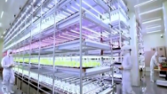
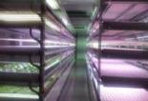
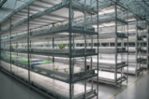
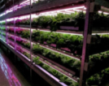
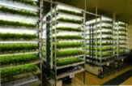
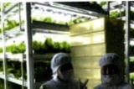
Business Models & Revenue Streams of PFAL industry in Taiwan
Wei FANG
Dept. of Biomechatronics Engineering
Center of Excellence for Controlled Environment Agriculture (CCEA)
National Taiwan University
Notes:
1

Slide 2
What is the Business Model?
It related to your
Value propositions
Business Alliances (partners), Activities, Resources
Customer relationship/Customer segments/Channels
Cost structure/revenue streams
BM canvas: 9 steps
https://youtu.be/CakUeC1sCSs
https://youtu.be/IP0cUBWTgpY

Slide 3
BM Canvas

Slide 6
FRESH core value of the PFAL
F | Food safety
R | Reduce, Reuse, Recycle
E | Environmental friendly
S | Sustainability
H | Healthy

Slide 7
BM is all about VALUE
Enhance VALUE by
reducing pain (risk, poor quality, poor taste, poor nutrient content, ...)
increasing pleasure (high yield, high efficient, less pollute, low resource used, …)

Slide 10
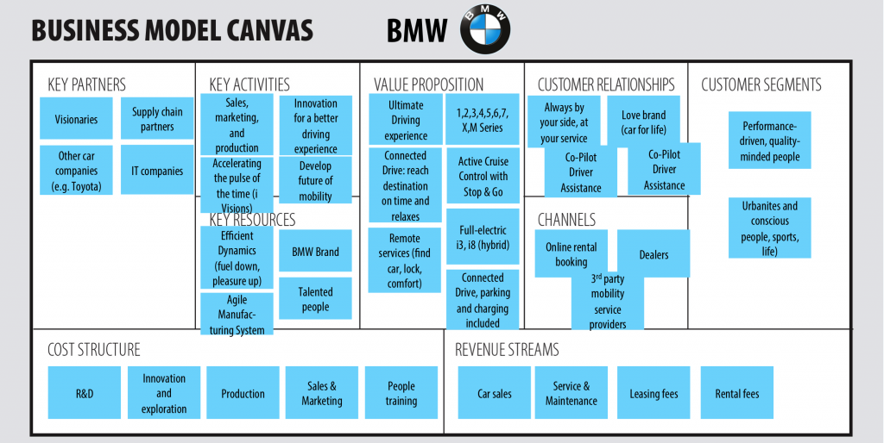

Slide 13
Value Proposition of a PFAL
Safe and Healthy food
High efficient: saved land, water
High yield
Low risk in production
Local for local
Low carbon footprint
…

Slide 14
Cost structure
You need to
Build a PFAL to start (Fixed cost)
Operate a PFAL to produce (Operating cost)
Sell your product (Revenue) in a timely fashion

Slide 15
Build a PFAL from …
from discarded indoor space is the most cost effective start.
PFAL
Farm Land
Non Farm Land

Slide 18
To produce… The top priority is to replace imported leafy greens
Replaced Imported Veggie market share
Local for local
Promotion of PFAL industry in Taiwan
Farm Land
Non Farm Land

Slide 19
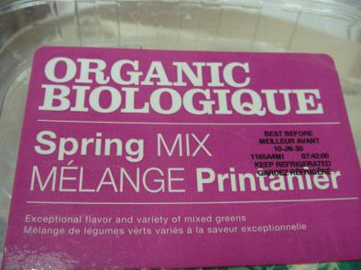
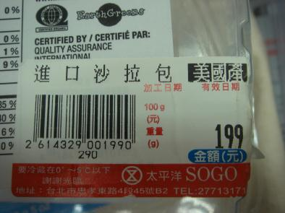
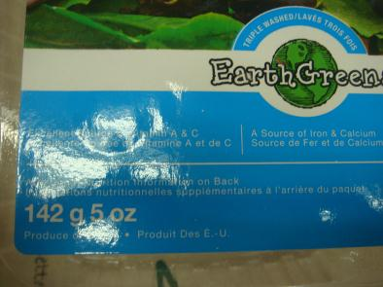
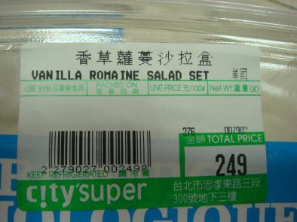
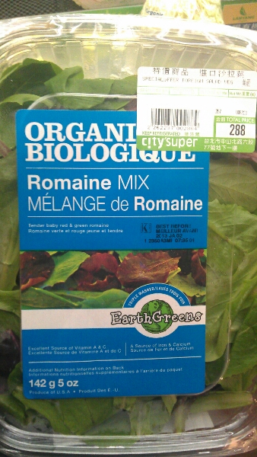
2011: 199NT$/142 g
2012: 249NT$/142 g
2013: 288NT$/142 g
2014: 315NT$/142 g
2015: 288NT$/142 g
2016: 288NT$/142 g
2017: 288NT$/142 g
2018: 288NT$/142 g
1.4 NT$/g
1.75 NT$/g
2 NT$/g

Slide 20
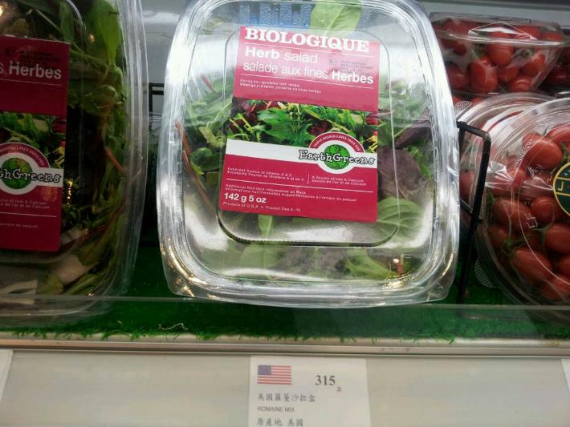
Say no to imported Veggie
142 g 315 NT$/10 US$
When cost is less than 20 NT$ and can have year-round production,
do I still need to import?

Slide 21
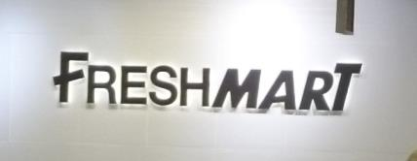
Price of Veggie in HK
Source | Market | Varieties | Unit price HK$/100 g | NT$/g (1:4.167)
HK | 7/11 | 混裝苗菜 (16 HK$/30 g by iVeggie) | 53.3 | 2.22
US | Wellcome | 各種生菜與混裝苗菜 (盒裝) | 48.9 | 2.03
HK | FreshMart | 菠菜 (by UF) | 45 | 1.87
US | Wellcome | 各種生菜與混裝苗菜 (袋裝) | 44.9 | 1.87
US | CitySuper | 混裝苗菜 (62 HK$/142g) | 43.7 | 1.82
US | Wellcome | 各種生菜與混裝苗菜 | 34.9 | 1.41
HK | FreshMart | 奶油、皺葉生菜 (by UF) | 40 | 1.67
HK | FreshMart | 羅馬、橡葉、綠卷鬚生菜(by UF) | 30 | 1.25
US | Wellcome | 奶油萵苣 | 27.9 | 1.12
AU | FreshMart | 混裝苗菜 | 21 | 0.87
AU | Wellcome | 各式芽菜 (15.9/125 g) | 12.72 | 0.53
price of Imported
price at NTU

Slide 22
To Ensure Successful Business
You need to have
Engineering success (HW/SW)
Management success in operational, tactical, strategical levels
Financial success (Cash flow)
Revenue stream is the most vital

Slide 23
Various revenue streams
Mass production + sale of vegetable
Mass production + sale of various product lines
Mass production + Restaurant chain
Mass production + Experience Economy
Mass production + (organic) food store chain
Home appliance provider (including indoor green-wall)
Home appliance provider + Construction company
Shop use appliance provider
Aquaponics system provider focusing on CSA
Education: workshop, conference, forum
International PFAL tour guide
Consultation
Turnkey provider who never grow plants
Turnkey provider with demo site

Slide 24
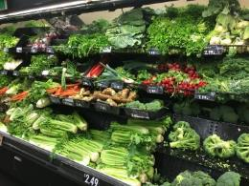
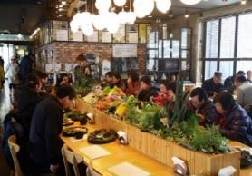
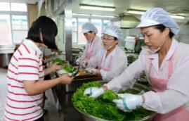
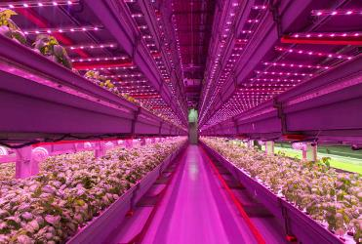
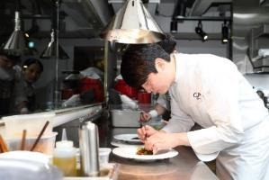
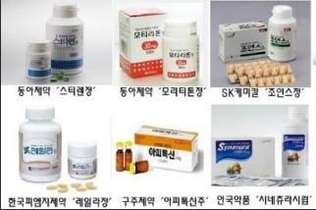
Revenue streams of PFALs
market
Restaurant
School meals
Restaurant

Slide 25
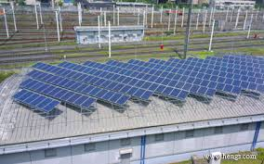
PFAL generate Renewable Energy
Roof top
PFAL

Slide 26
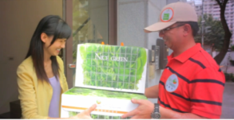
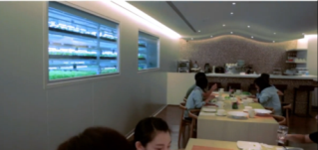
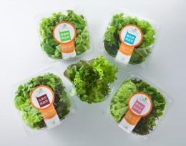
sale of fresh vegetable
RTE, RTC
membership
Web
High price Restaurants
EAW, CAW
Regular Restaurant
Wholesale
Supermarket

Slide 27
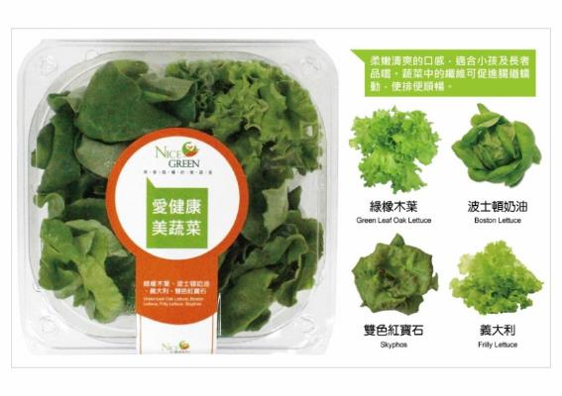
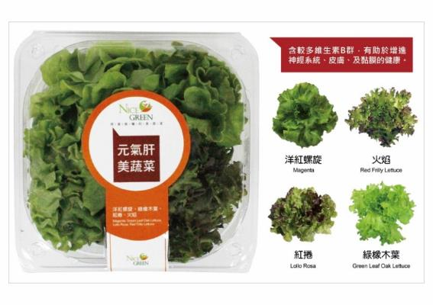
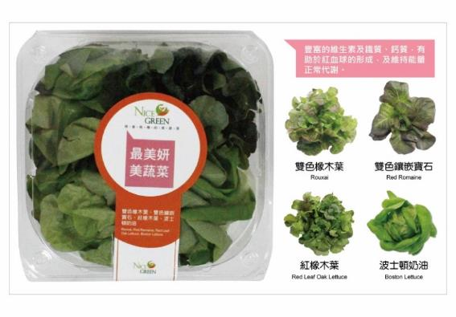
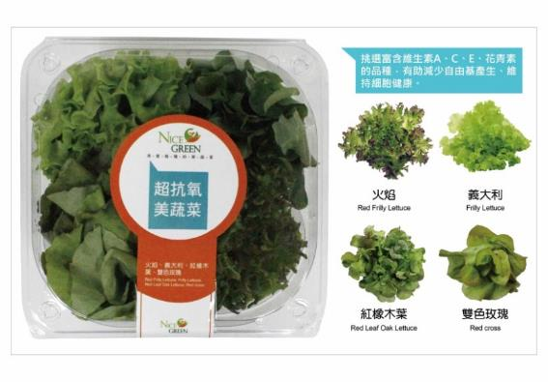
Ready To Eat (RTE) Veggie
250 NT$／Box（200g）

Slide 28
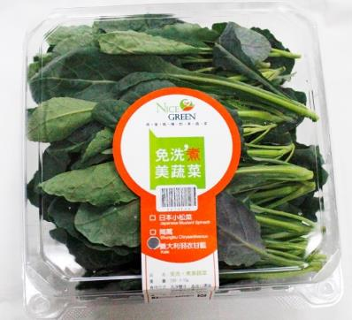
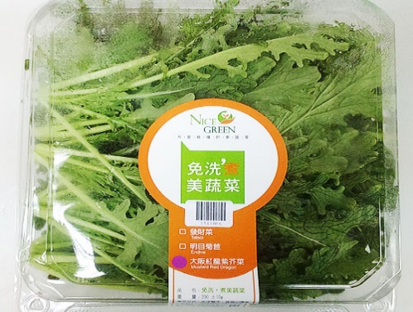
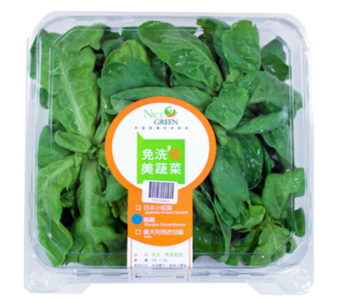
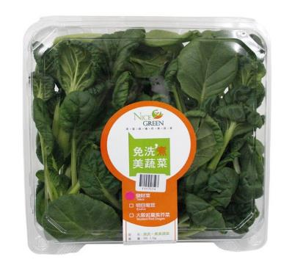
Ready To Cook (RTC) Veggie
義大利羽衣甘藍
大阪紅龍紫芥菜
發財菜
茼蒿
250 NT$／Box（200g）
發財菜

Slide 29
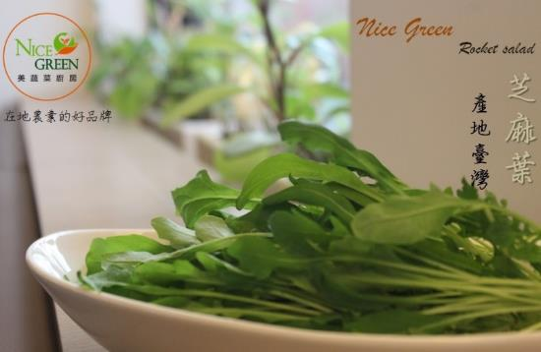
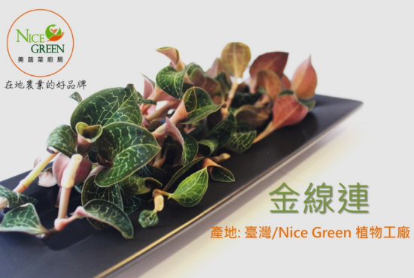
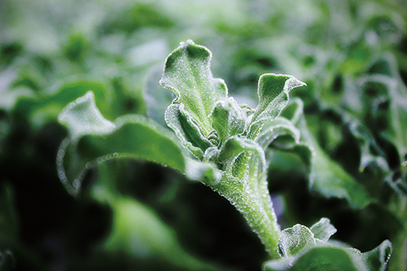
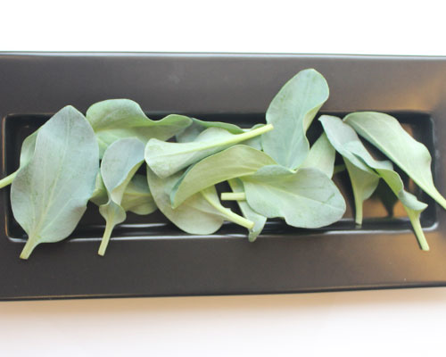
With Special Flavor
(Anoectochilus roxburghii)
Rucola 180NT$/Box（30 g）
Jewel Orchid 600 NT$/Box（50 g)
Ice plant 600 NT$/Box（50 g）
Oyster leaf 600 NT$/Box（10 leaves）

Slide 30
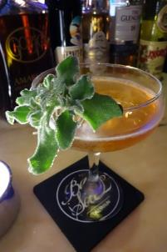
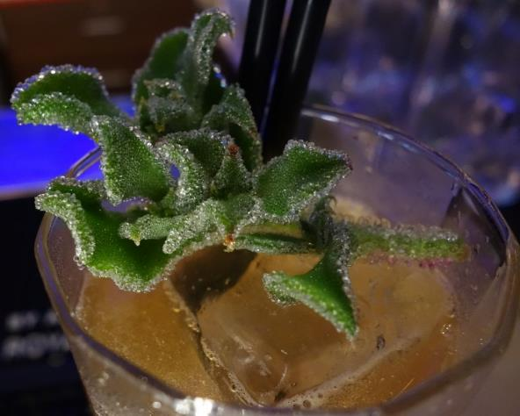
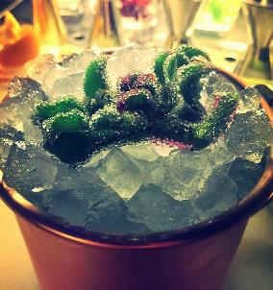
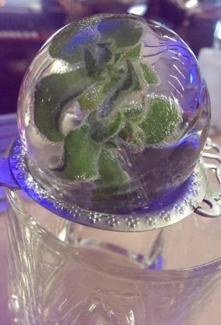
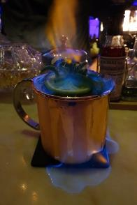
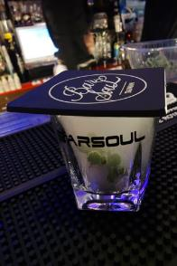
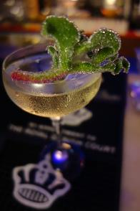
Ice Plant in night club

Slide 31
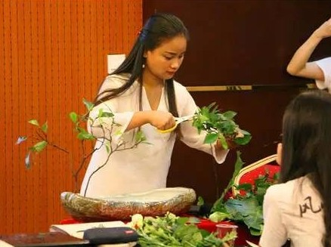
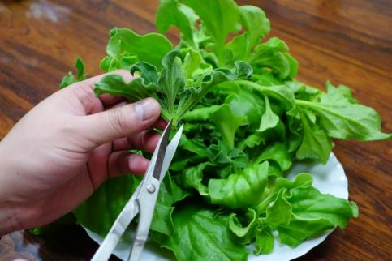
Learn from skillful flower arrangement teacher

Slide 32
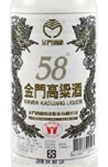
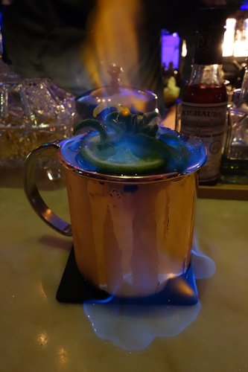
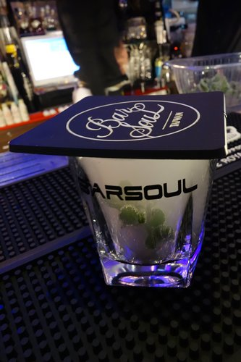
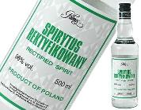
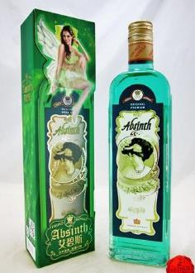
Bartending
淋酒、火燒
煙燻

Slide 34
Juice
萵苣可爾必思

Slide 35
Powder: Savior to Meat lovers
戰斧豬排沾玫瑰鹽與萵苣粉
烤羊排佐萵苣粉
手工嫩炸雞塊沾煙燻起司醬搭萵苣粉
比目魚鰭邊肉搭萵苣粉

Slide 36
Vege-Powder solves the pH balancing problem
Vege-Powder replace potato
漢堡肉佐萵苣粉

Slide 37
Vege-Powder solves the constipation problem

Slide 38
Mass production + various product lines
Food related

Slide 39
Cosmetic related

Slide 40
Various revenue streams
Mass production + Restaurant chain (light meal)
Mass production + Experience Economy
Mass production + (organic) food store chain

Slide 41
Mass production + chain Restaurant
2010: 1 mass production center + 1 restaurant
2014: 1 mass production center + 8 restaurants
2015: 1 + 9
2016: 1 + 14
2010
2013
2014

Slide 42
Mass production + light meal

Slide 43
Mass production + (organic) food store chain

Slide 44
Mass production + Experience Economy
Full of great memories and great taste

Slide 45
Various revenue streams
Home appliance provider (including indoor green-wall)
Home appliance provider + Construction company
Shop use appliance provider
Aquaponics system provider focusing on CSA
Education: workshop, conference, forum
International PFAL tour guide
Consultation
Turnkey provider who never grow plants
Turnkey provider with demo site

Slide 46
Energizing green life style with PFAL related Home appliance

Slide 49
Notes:
Another company.

Slide 51
Notes:
Another company.

Slide 52
Home appliance + Accessory kit

Slide 53
Shop appliance

Slide 54
Shop appliance
Notes:
Store unit or community unit from 4 companies

Slide 55
Vertical Wall_1.0

Slide 56
UV
+
T_{i}O₂
Vertical Wall_2.0

Slide 57
Most profitable Business Model
house selling strategy | Traditional Style | New Style
Accessory or Complimentary | Indoor decoration (furniture) | Indoor decoration (furniture) + Green Life Style by providing vertical wall & home appliance of PFAL
Price | 3000 US$/m² | 5000 US$/m²

Slide 58
PFAL at home started in 2011

Slide 59
PFAL at home

Slide 60
PFAL in the community

Slide 61
Replaced Imported Veggie market share
Export PFAL Turnkeys
Local for local
Promotion of PFAL Industry in Taiwan
Farm Land
Non Farm Land

Slide 62
Turnkey provider with demo site
2013.11
400 plts/day, 300 m²
2014.4
300 plts/day, 165 m²
2014.9
800 plts/day, 495 m²
2015.4 (under construction)
300 plts/day, 165 m²
PF_AL inside an office building

Slide 63
Turnkey Provided by Taiwan companies
SEA:
Singapore
Middle East:
Dubai
Kuwait
S.E.A.

Slide 64
PFAL/VFAL can make us richer, smarter, greener, healthier, and happier.
Q & A
Line and Wechat ID: weifang0257

