Slide 1
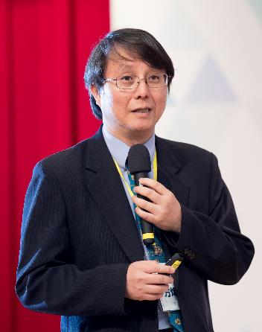
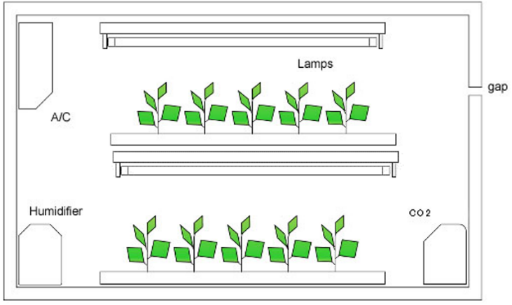
全人工光型植物工廠 (PFAL)
之整廠績效評估 (TPE)
18th SSLCHINA
方煒
台灣大學生物機電系
Total Performance Evaluation of Plant Factory with Artificial Light
Dec. 6–8th, 2021

Slide 2
摘要
績效評估是用來比較國與國之間、組織間、團隊間或團隊內個人表現的方法，譬如人均 GDP用來比較各國人民的國內生產毛額。這評估指標涉及國內的所有產業，範圍廣泛，但不失為一個方便做比較的指標。植物工廠內作物的栽培涉及多種環境參數 (風、光、水、養、氣)、不同操作流程 (播種/灑種、疏植、定植、採收)、多種軟硬體的整合(光源、安裝、光配方、水培系統、養液配方等)。收獲的產物可能是針對地上部或地下部鮮重、葉片內植化素或果實等，不同目標產物就有不同的優化目標，所以如何針對某一種栽培的對象作物，找出最適當的光源與安裝方式，須有一套系統性的方法。本研究針對萵苣的栽培，結合過去建立的兩個指標，以能量產能 (Energy Yield) 與光子產能 (Photon Yield) 為X, Y 軸，組成整廠績效評估 (Total Performance Evaluation, TPE) 圖，各參數組合與產能數據經計算後在圖上的落點可由能量與光子兩個面向找出最適合該種作物的最適合光配方。TPE 圖除了可用於比較不同光源、不同光譜、不同廠牌燈具之外，也可用來比較不同品種的作物、不同操作流程、不同養液配方、不同水培系統等。

Slide 3
Target | Performance Evaluation Index
Nation | GDP, GNP, Gini coefficient,…
Company, Organization | Stock price、CP ratio,…
Investment | IRR、CP ratio、Payback Year
AC、Heat Pump | Fan | EER, COP | VER
Engine | Torque/Oil consumption
Hot air Burner/Boiler | Energy/Oil consumption
Light | μmol / J
PFAL | EY, PY (Fang, 2013) and more…

Slide 4
Fang, 2013
Fang, 2013
益本比P2Cr
Price / (varCost+fixCost)
電力產能EY
g kWh⁻¹
OLe = EY/PY
mol kWh⁻¹
益本比PVr
Price / Varcost
光子產能PY
g mol⁻¹
整廠效能評估 TPE 量化指標
全人工光型植物工廠 PFAL
Chung and Fang, 2020
Chung and Fang, 2020

Slide 5
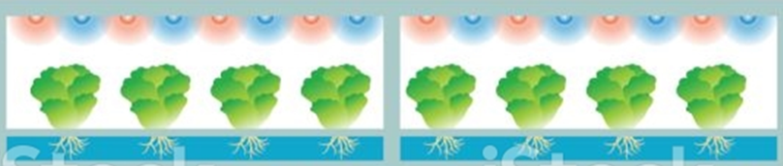

Photon Yield, PY
光子產能
g mol⁻¹
mg mol⁻¹
μg mol⁻¹
Daily Light Integral (DLI) in mol day⁻¹ m⁻²
  PPFD (400-700 nm, PAR, μmol m⁻² s⁻¹ ) ×Light period (h d⁻¹) ×3.6/1000
  BPFD (400-800 nm, BAR, μmol m⁻² s⁻¹ ) ×Light period (h d⁻¹) ×3.6/1000
Total light integral per plant at stage i, TLI(i) in mol/plant
  TLI(i) = DLI(i) × Duration(i) / cropping density(i)
Overall Total Light Integral per plant
OTLI = $\sum_{i=1}^{n}{TLI(i)}$
PY (g mol⁻¹) = g_FW/plant / OTLI (mol/plant)
PY_{A} (mg mol⁻¹) = mg.Anthocyanin/plant / OTLI
PY_{D} (mg mol⁻¹) = mg.Vit.E/plant / OTLI

Slide 6
Photon Yield, PY
光子產能
g mol⁻¹
From sowing to harvest, calculate DLI of each stages (mol/m²/day), times duration of each stage to get TLI (mol/m²)
Divide TLI by the density (plts/m²) of each stage to derived mol/plt of each stages.
Sum up for all stages to derive OTLI (in mol/plt)
Derive PY by divide the avg. harvested FM (g/plt) to OTLI to derive g FM/mol.

Slide 7

Energy Yield, EY
電力產能
g kWh⁻¹
mg kWh⁻¹
μg kWh⁻¹
Power consumption per unit area, PCA (W m⁻²)
  Power consumption per lamp (W) × number of lamps per unit area (m⁻²)
Daily power consumption per unit area per day, DPI (kWh d⁻¹ m⁻²)
  PCA (W m⁻²) × light period (h d⁻¹) / 1000
Total power integral per plant, TPI(i) (kWh/plant)
  DPI(i) × duration(i) / cropping density(i) (plant m⁻²)
Overall Total Power Integral (OTPI) per plant
OTPI = $\sum_{i=1}^{n}{TPI(i)}$
EY (g/kWh) = g_FW /plant / OTPI (kWh/plant)
EY_{A} (mg/kWh) = mg Anthocyanin /plant / OTPI
EY_{D} (mg/kWh) = mgVit.E/plant / OTPI

Slide 8
Energy Yield, EY
電力產能
g kWh⁻¹
From sowing to harvest, calculate power consumption per unit area per day of each stage (kWh/m²/day), times duration of each stage to get TPC (kWh/m²), then divided by the density (plts/m²) of each stage to derived kWh/plt of each stages (TPI).
Sum up for all stages to derive OTPI in kWh/plt
Derive EY by divide the avg. harvested FM
(g /plt) to OTPI to derive g FM/kWh.

Slide 9
TPE diagram: PY vs. EY or EY vs. PY
Light source has better spectrum to grow the crop
Toward optimum light source
Light Efficacy (LED晶片):
in μmol / J
Light Efficacy (燈具安裝於床架後於栽培前量測):
in μmol / J
Overall Lighting Efficacy
OLe = EY/PY
in mol / kWh
栽培全程燈具發光效能
光子產能 (PY, g or mg or μg /mol)
Light source has
higher efficiency and less power consumption to grow the crop

Slide 10
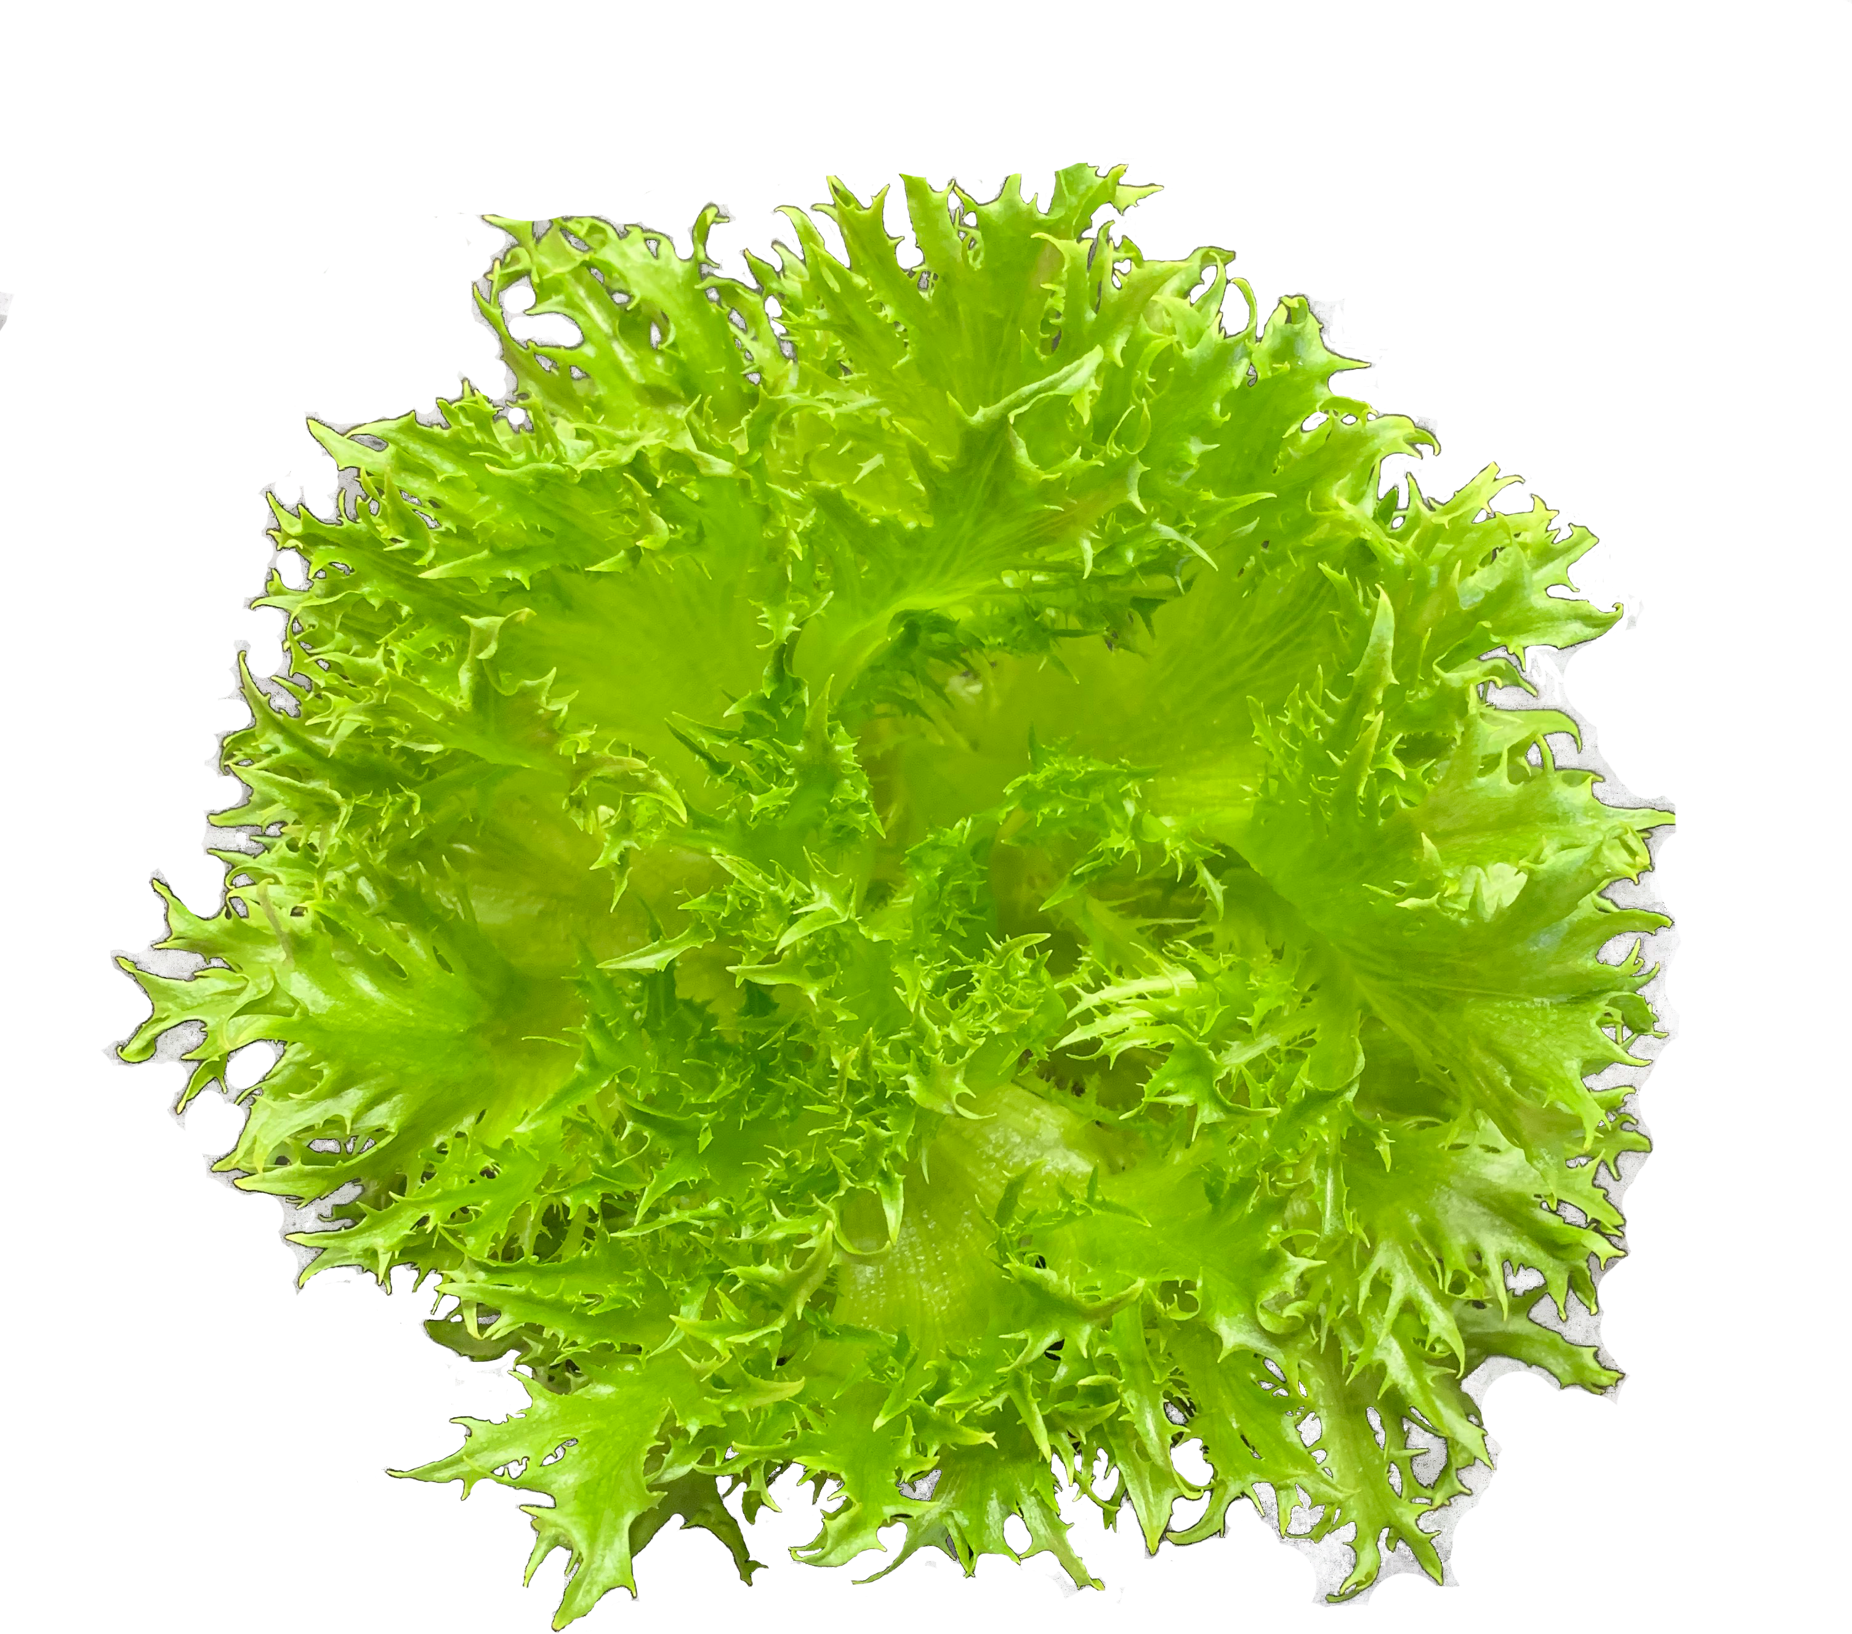
Total Performance Evaluation (TPE) 圖
TPE 圖以 EY 與 PY 為 X 軸或Y 軸
以 PY 為 X 軸， EY 為 Y 軸時，斜率 (EY/PY) 代表栽培全程的燈具發光效能 Overall Lighting efficacy (OLe in mol kWh⁻¹)
每一批次的栽培結果呈現於 TPE 圖上就是一個狀態點，不同批次的栽培結果在TPE圖上的落點可能在不同位置，狀態點朝右上方移動就是系統邁向優化的過程。
不同批次的栽培可以是使用不同光譜配方、不同養液配方、不同栽培密度、不同作物品種、不同廠牌光源、不同環控條件、不同操作者、不同操作流程、或是在栽培過程中做了任何環控參數 (光量、光週期、光譜、養液配方、水培系統等) 與/或操作參數的調整 (栽培階段、密度、期程等)，對 EY 與PY 值都會有不同程度的影響。

Slide 11
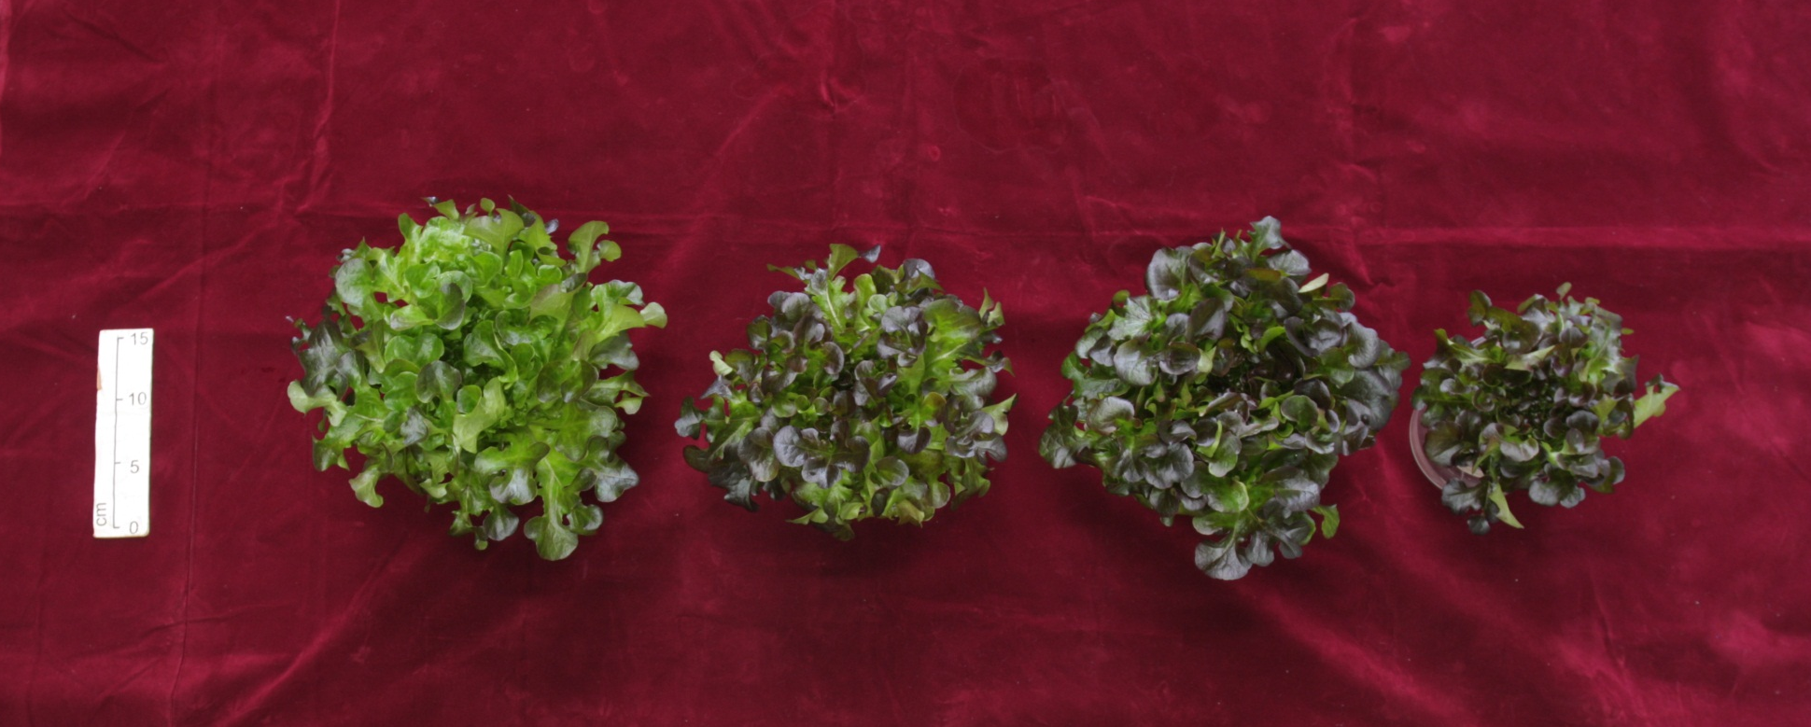
栽培過程中調整紅藍光比例對
紅橡萵苣中花青素含量的影響
^{x5}
^{x3 +}
^{x2}
^{x4+}
^{x1}
^{x5}
SR5: 栽培期為五週，
全程採較強紅光
SR3SB2: 前三週採較強紅
光，後兩週採採較強藍光
SR5
SR3SB2
SR4SB1
SB5
bar=15
Treatment | g/plt | Anthocy. mg/g | Anthocy. Content per plant mg/plt | EY g/kWh | EY_{A} mg/kWh | PY gFW/mol | PY_{A} mg/mol
SR5 | 54.06 | 0.0138 | 0.74 | 47.03 | 0.65 | 11.01 | 0.15
SR3SB2 | 38.77 | 0.0168 | 0.65 | 32.29 | 0.54 | 7.89 | 0.13
SR4SB1 | 50.12 | 0.0124 | 0.62 | 42.65 | 0.53 | 10.20 | 0.13
SB5 | 22.14 | 0.0179 | 0.40 | 30.58 | 0.55 | 4.51 | 0.08

Slide 12
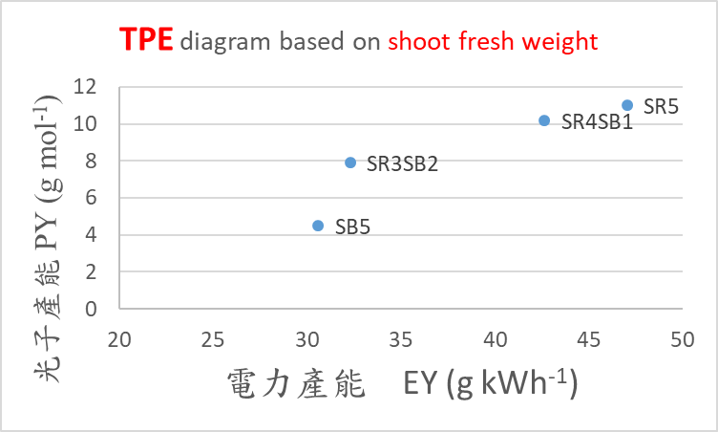
鮮重

Slide 13
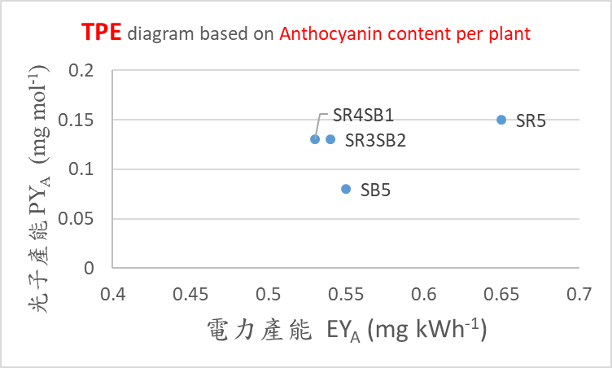
花青素含量

Slide 14
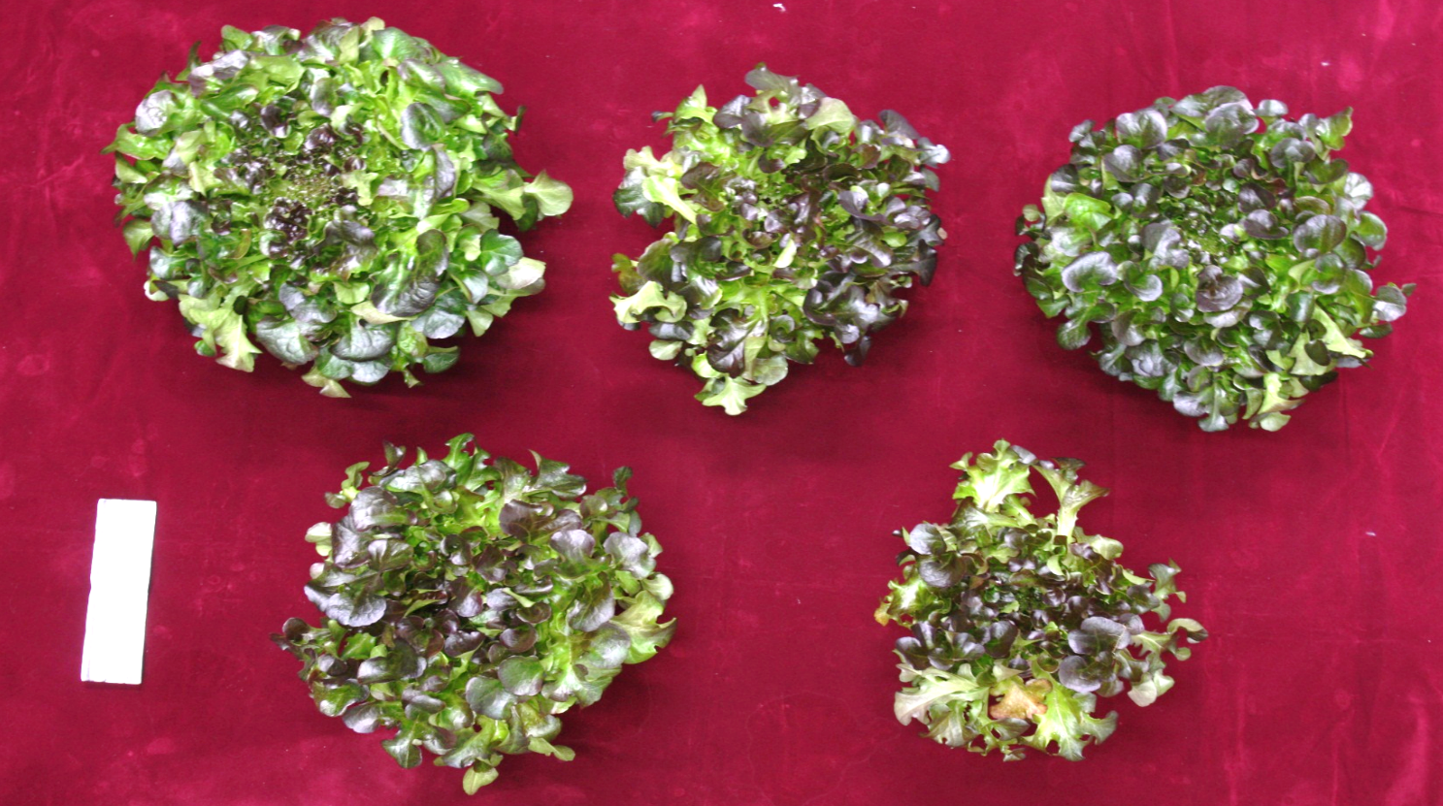
SR3SB3
SR4SB2
PY Photon Yield of fresh mass
PY_{A} Photon Yield of Anthocyanin
EY Energy Yield of fresh mass
EY_{A} Energy Yield of Anthocyanin
SR6
Overall Lighting Efficacy, in mol/kWh
(OLe) = EY / PY
SR5SB1
SB6
Treatments | FW gFW/plt | Anthocya. concentration mg/g | Anthocya. content mg/plt | EY gFW/kWh | EY_{A} mg/kWh | PY gFW/mol | PY_{A} mg/mol | OLe mol/kWh
SR6 | 108.30 | 0.0138 | 1.49 | 67.15 | 0.93 | 15.72 | 0.22 | 4.271
SR3SB3 | 70.11 | 0.0149 | 1.04 | 43.47 | 0.65 | 10.17 | 0.15 | 4.272
SR4SB2 | 88.70 | 0.0147 | 1.31 | 55.00 | 0.81 | 12.87 | 0.19 | 4.273
SR5SB1 | 87.75 | 0.0197 | 1.73 | 54.41 | 1.07 | 12.73 | 0.25 | 4.274
SB6 | 43.24 | 0.0159 | 0.69 | 26.81 | 0.43 | 6.27 | 0.10 | 4.276

Slide 15
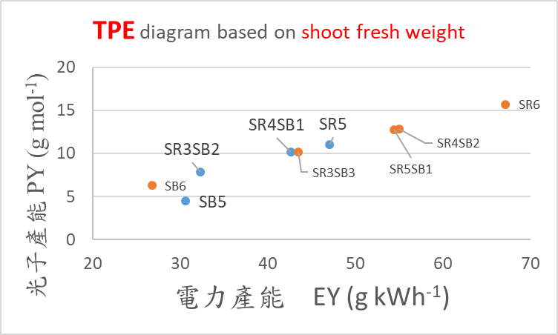
鮮重

Slide 16
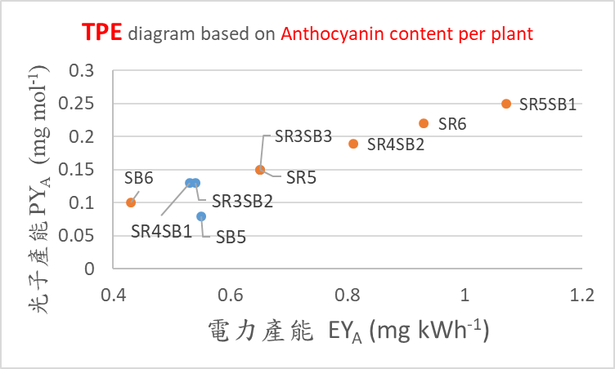
花青素含量

Slide 17
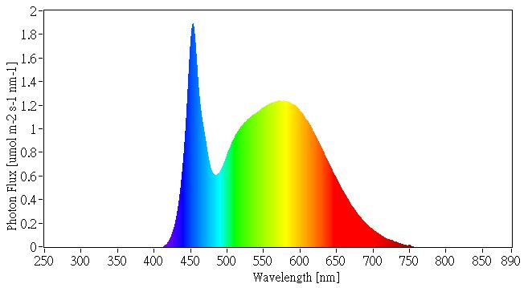
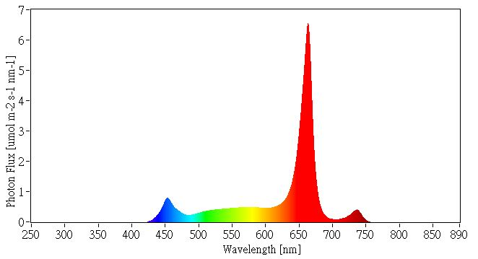
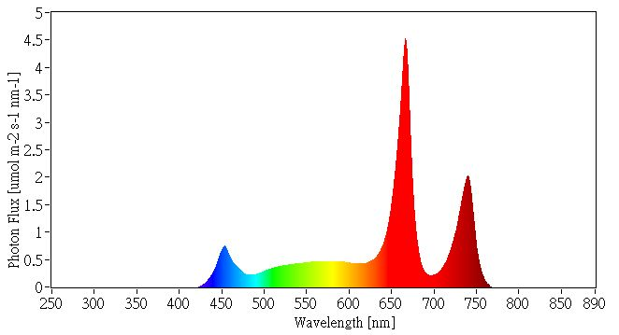
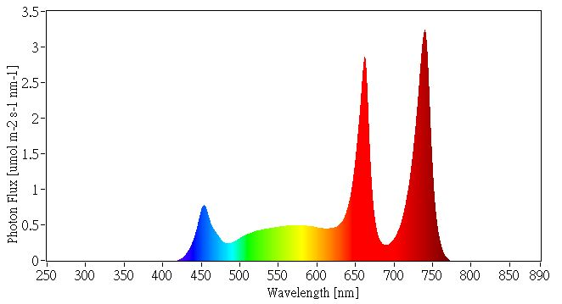
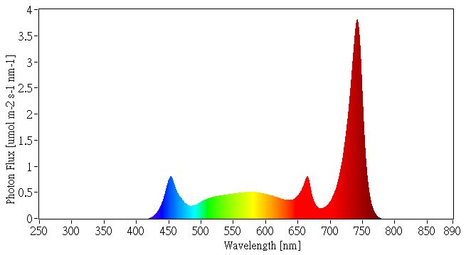
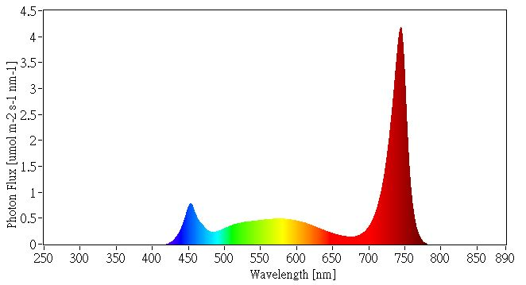
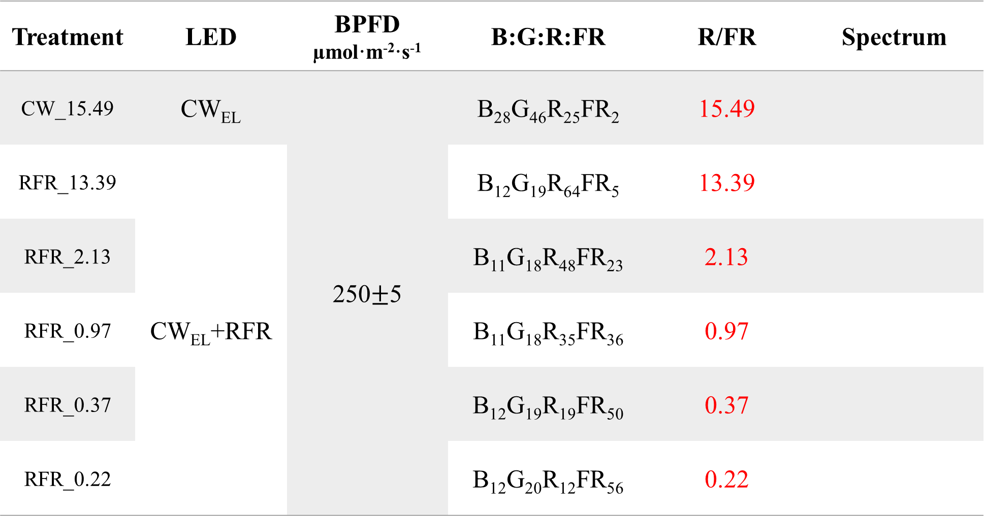
植物工廠中栽培香波綠火焰萵苣最適光譜的探討—針對紅光與遠紅光比例
Treatment | LED | BPFD µmol·m⁻²·s⁻¹ | B:G:R:FR | R/FR | Spectrum
CW_15.49 | CW_{EL} | 250$±$5 | B₂₈G₄₆R₂₅FR₂ | 15.49
RFR_13.39 | CW_{EL}+RFR |  | B₁₂G₁₉R₆₄FR₅ | 13.39
RFR_2.13 |  | 250$±$5 | B₁₁G₁₈R₄₈FR₂₃ | 2.13
RFR_0.97 |  |  | B₁₁G₁₈R₃₅FR₃₆ | 0.97
RFR_0.37 |  |  | B₁₂G₁₉R₁₉FR₅₀ | 0.37
RFR_0.22 |  |  | B₁₂G₂₀R₁₂FR₅₆ | 0.22

Slide 18
 | Stage 1 DAS 0~3 | Stage 2 DAS 4~14 | Stage 3 DAS 15~21 | Stage 4 DAS 22~35
Density(plant·m²) | 772 |  | 181.8 | 36.4
Nutrition | Tap water | NTU nutrient solution
EC (mS·cm⁻¹) | 0.1 | 1.4 ± 0.1
pH | 7.0 | 6.0 ± 0.1
Light period (h) | 24 |  | 16/8
DLI (mol m⁻²) | 21.6 |  | 14.4
Temperature (℃) | 24 |  | 24/22
CO₂ (µmol．mol⁻¹) | 1200

Slide 19
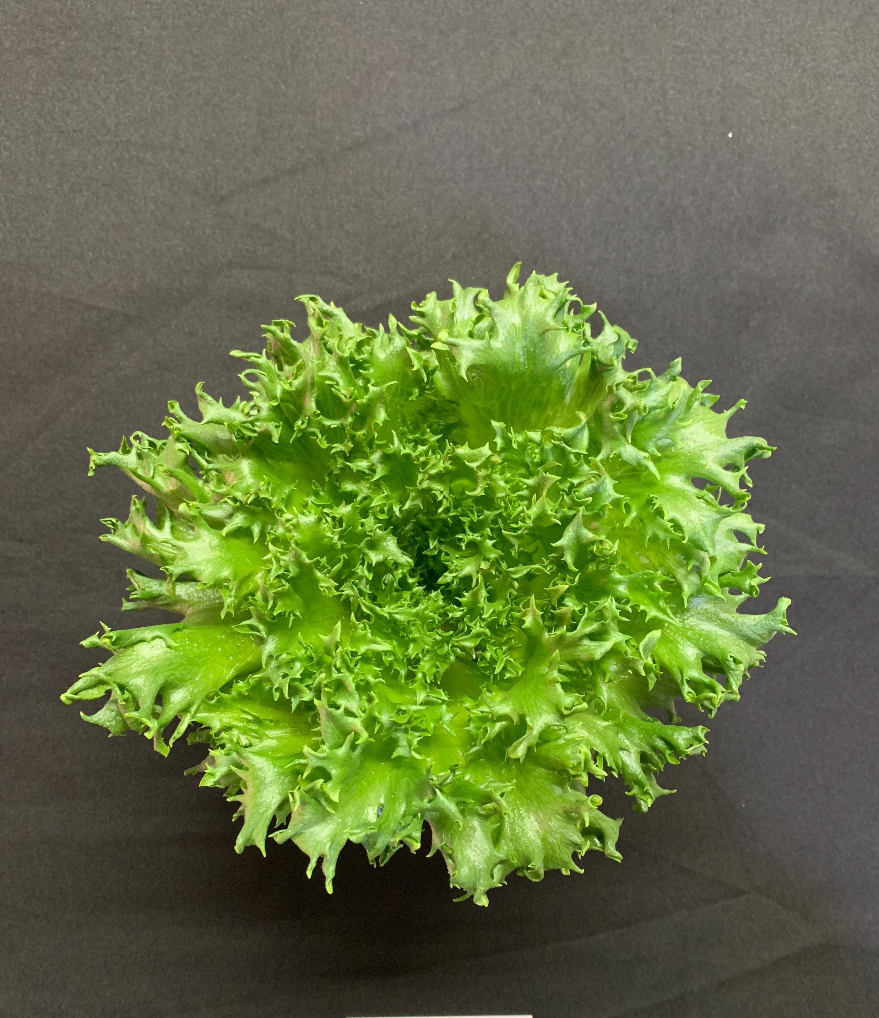
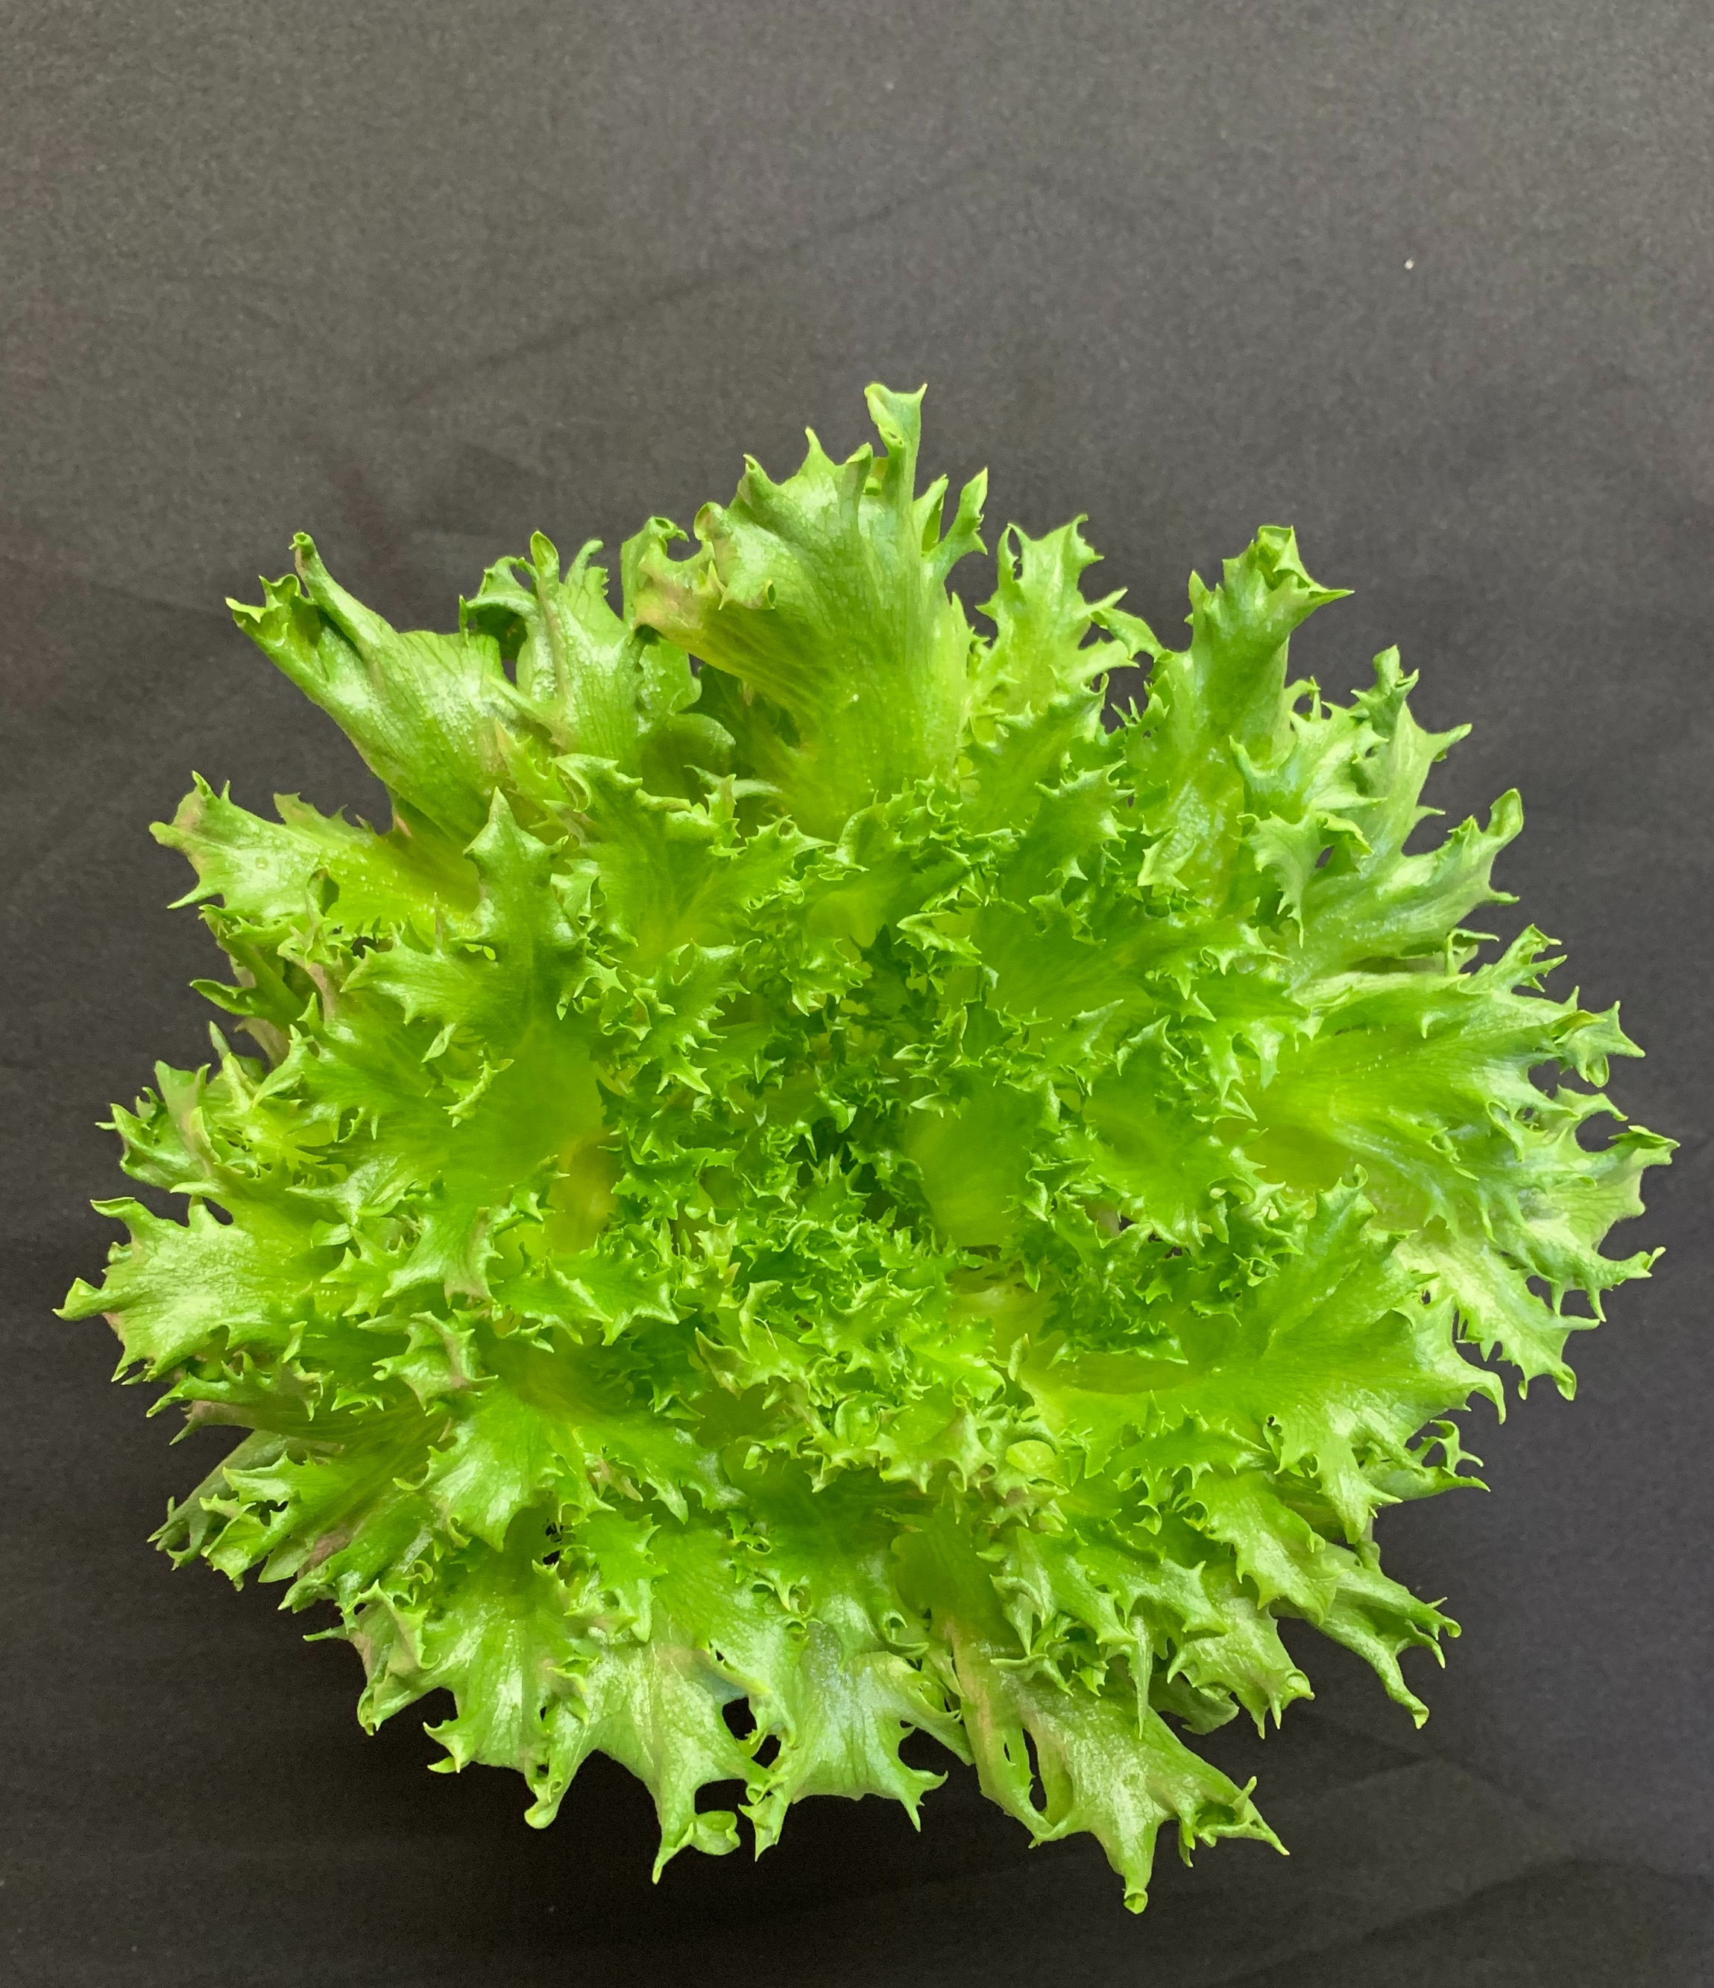
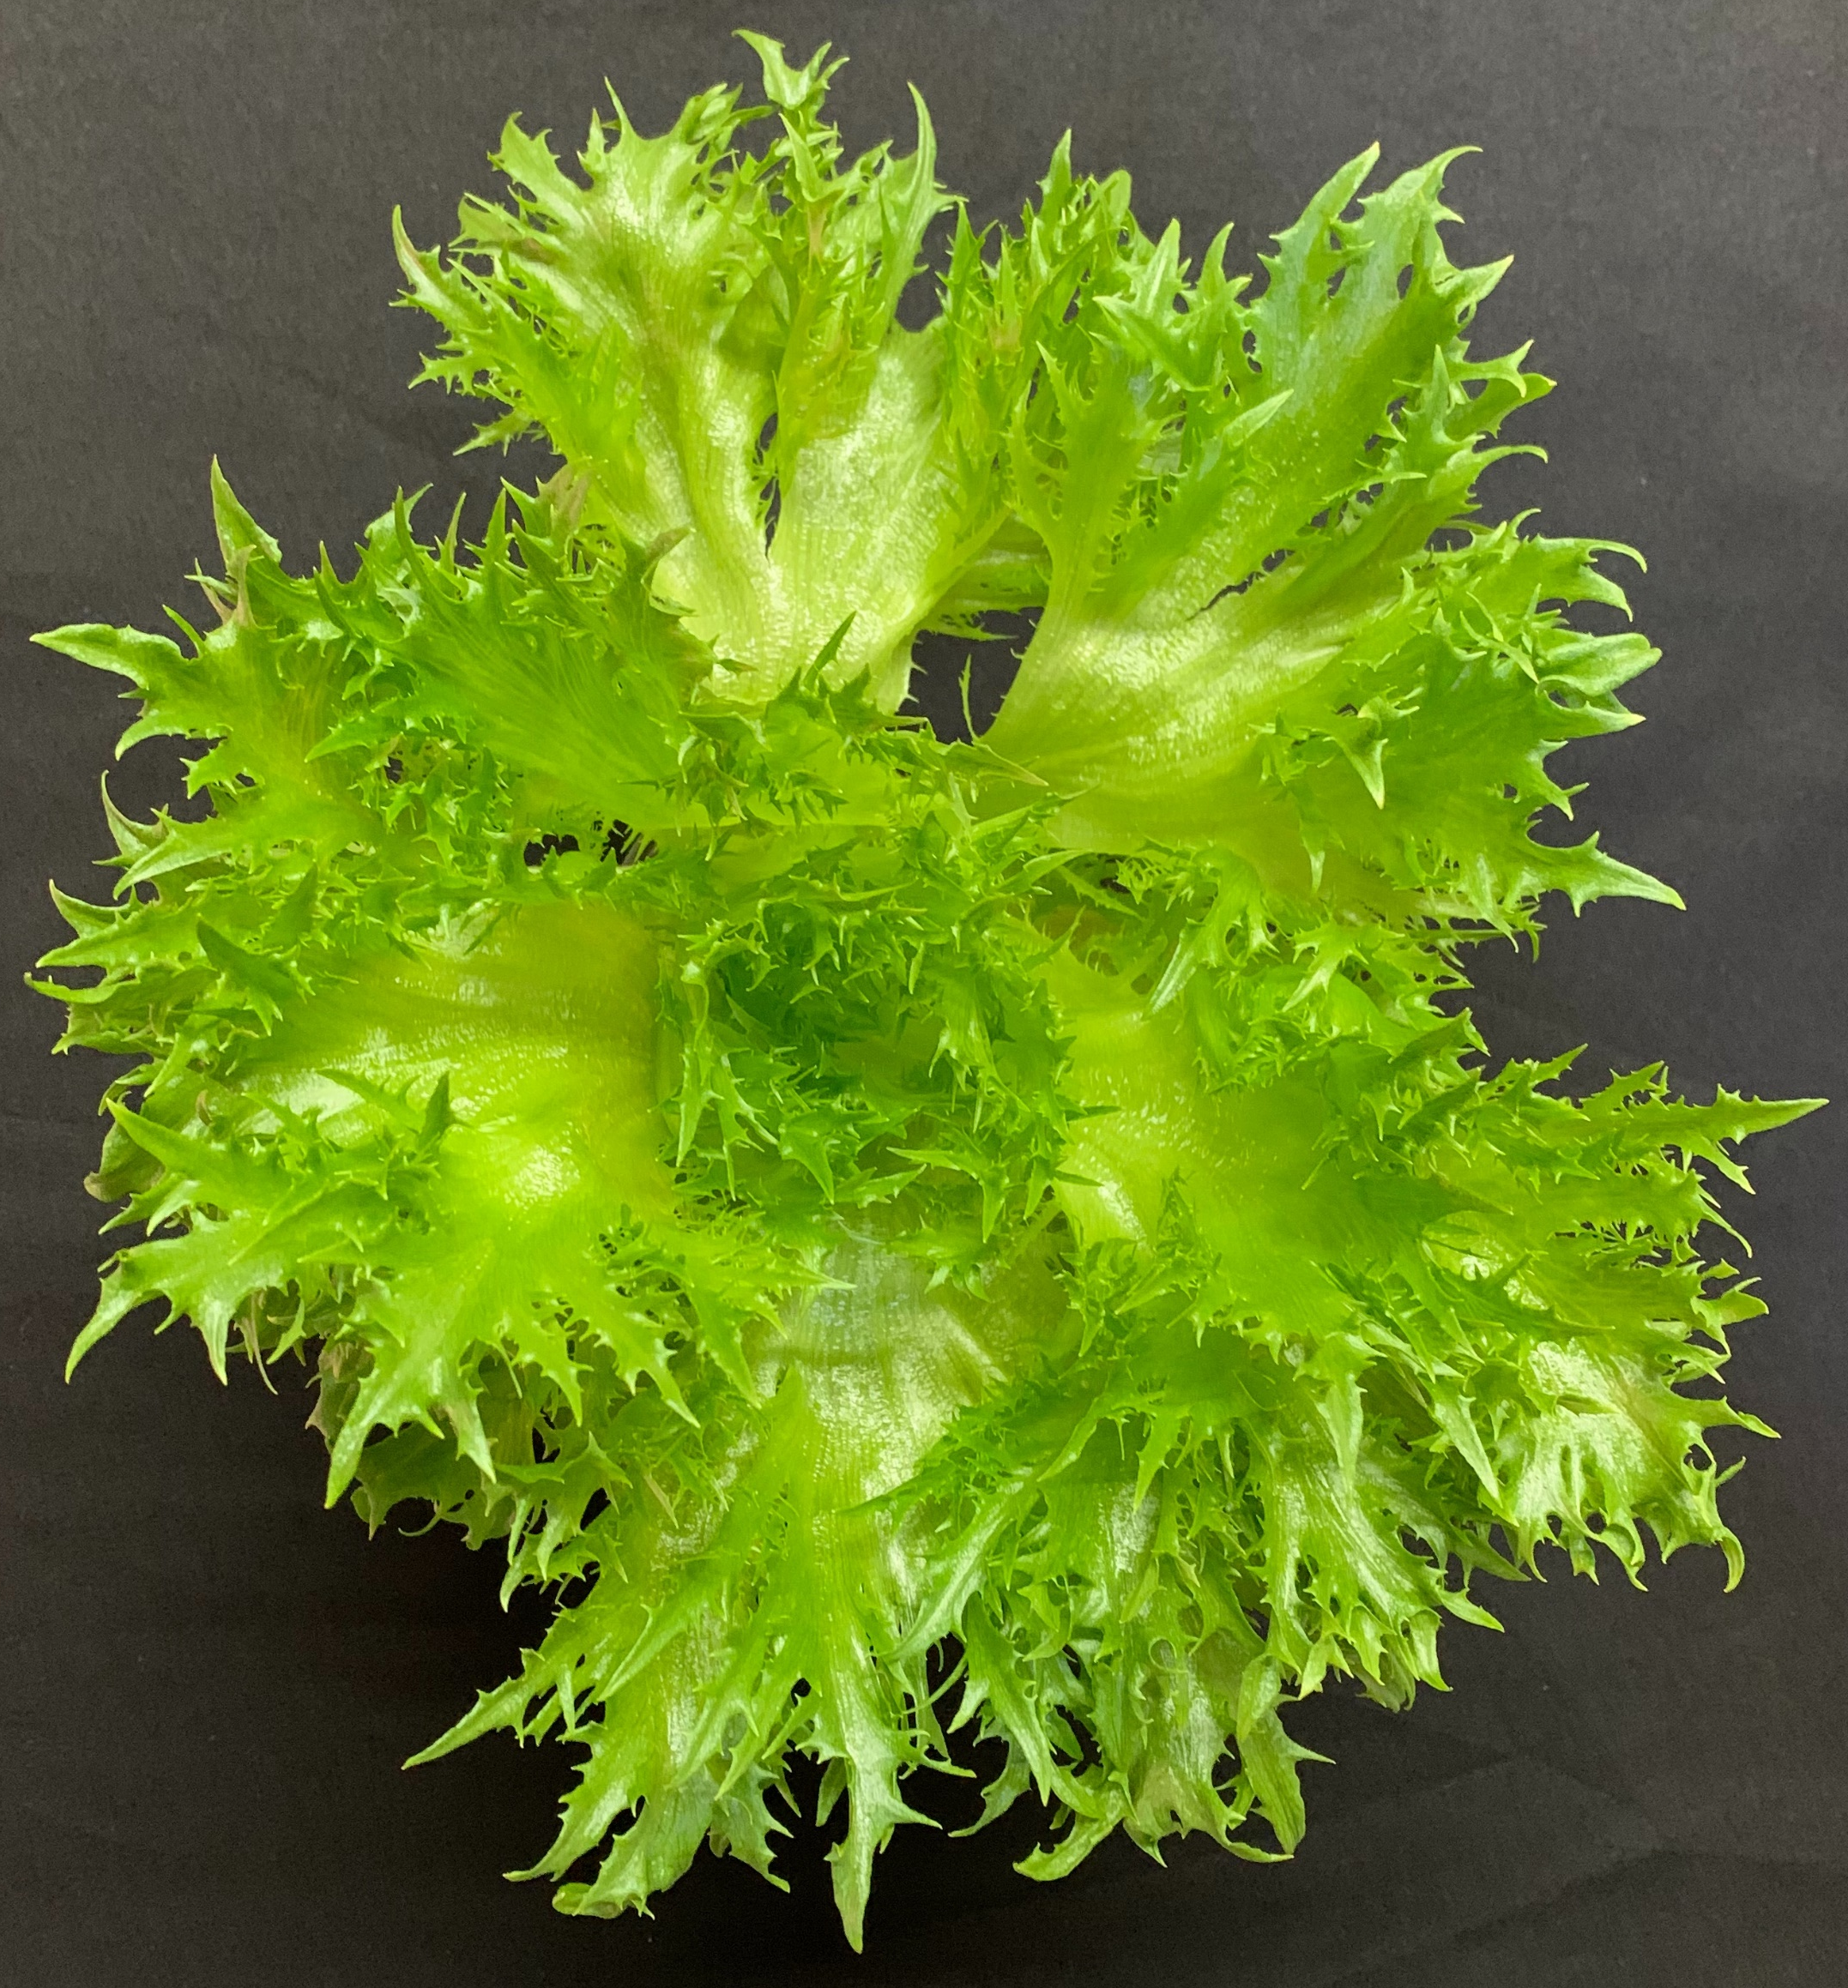
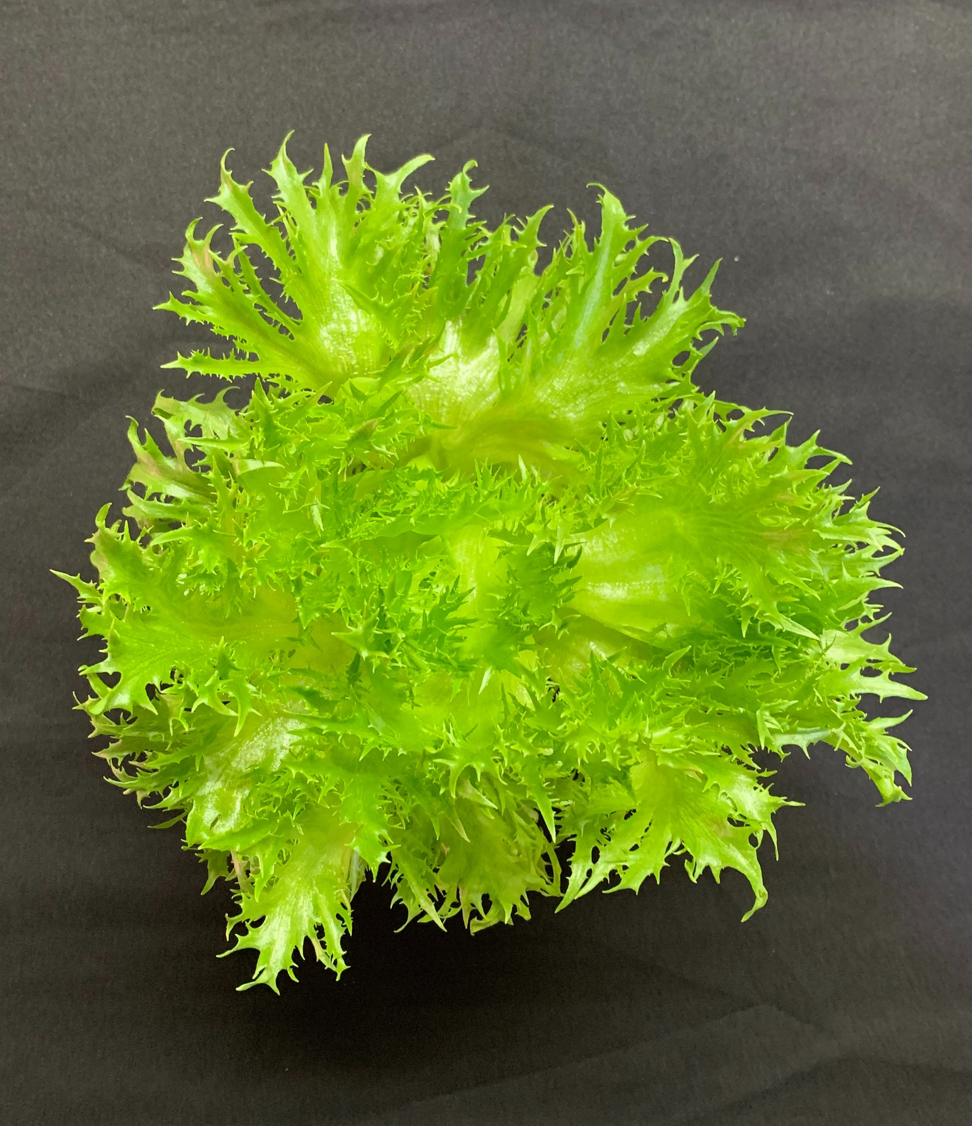
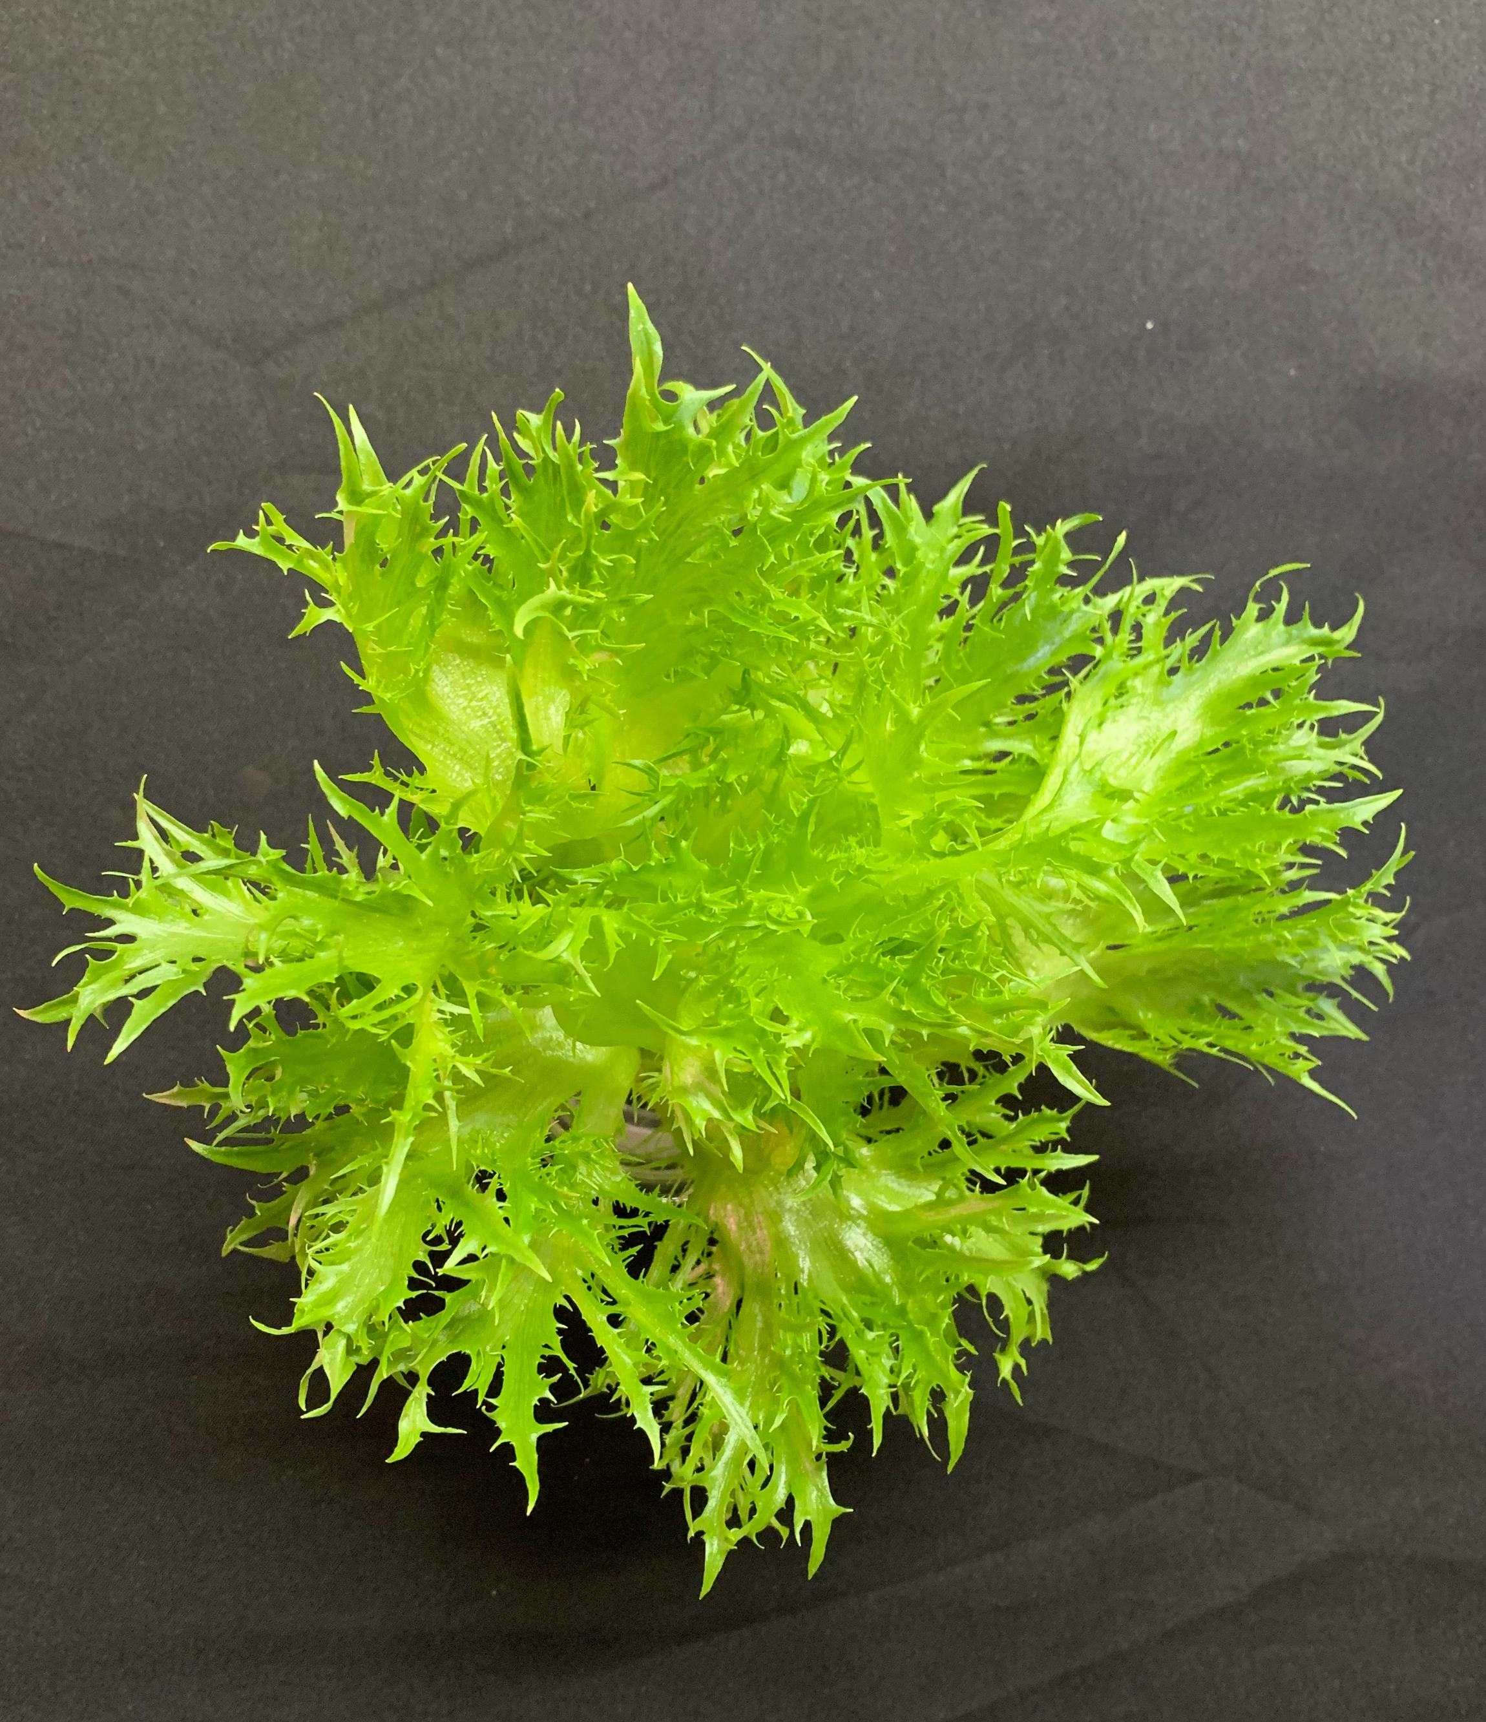
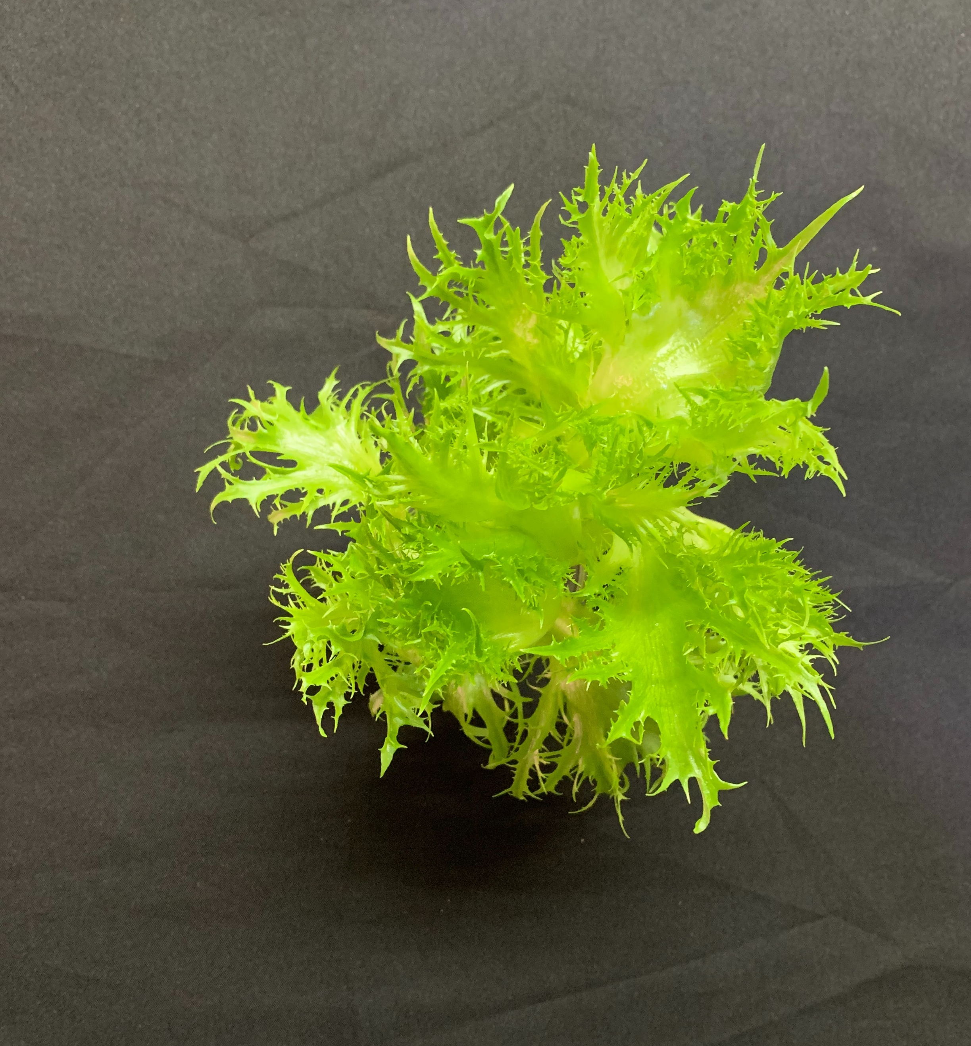
DAS=35
CW_15.49
RFR_13.39
RFR_2.13
bar=9 cm
RFR_0.97
RFR_0.37
RFR_0.22

Slide 20
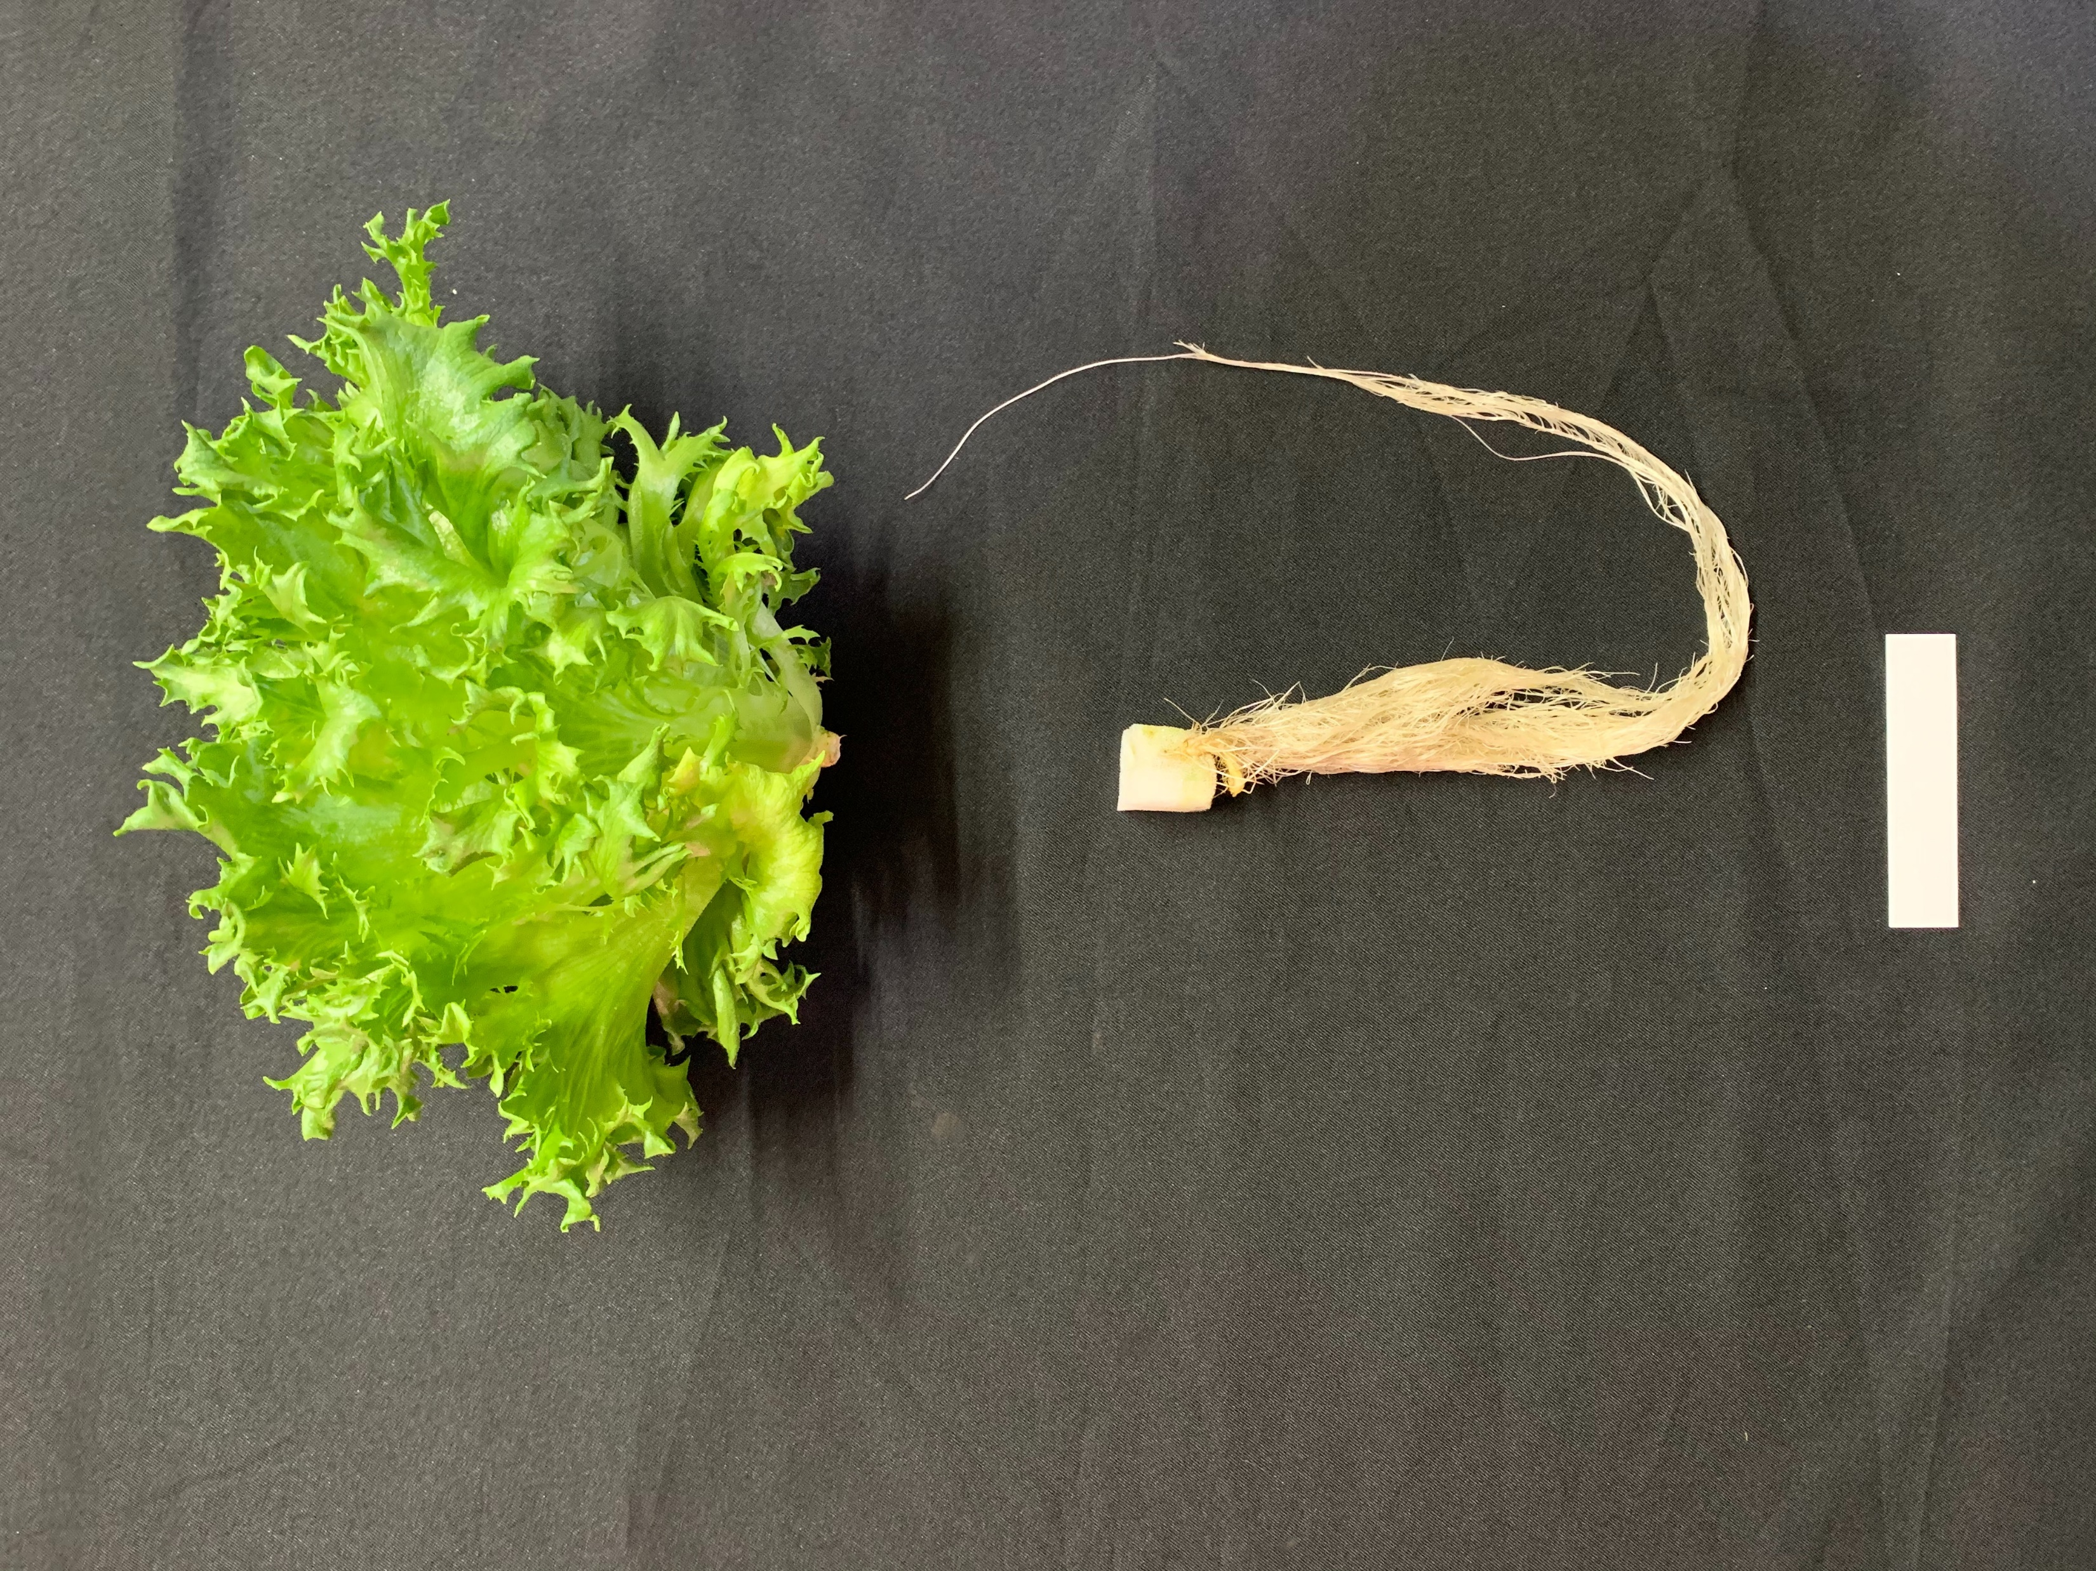
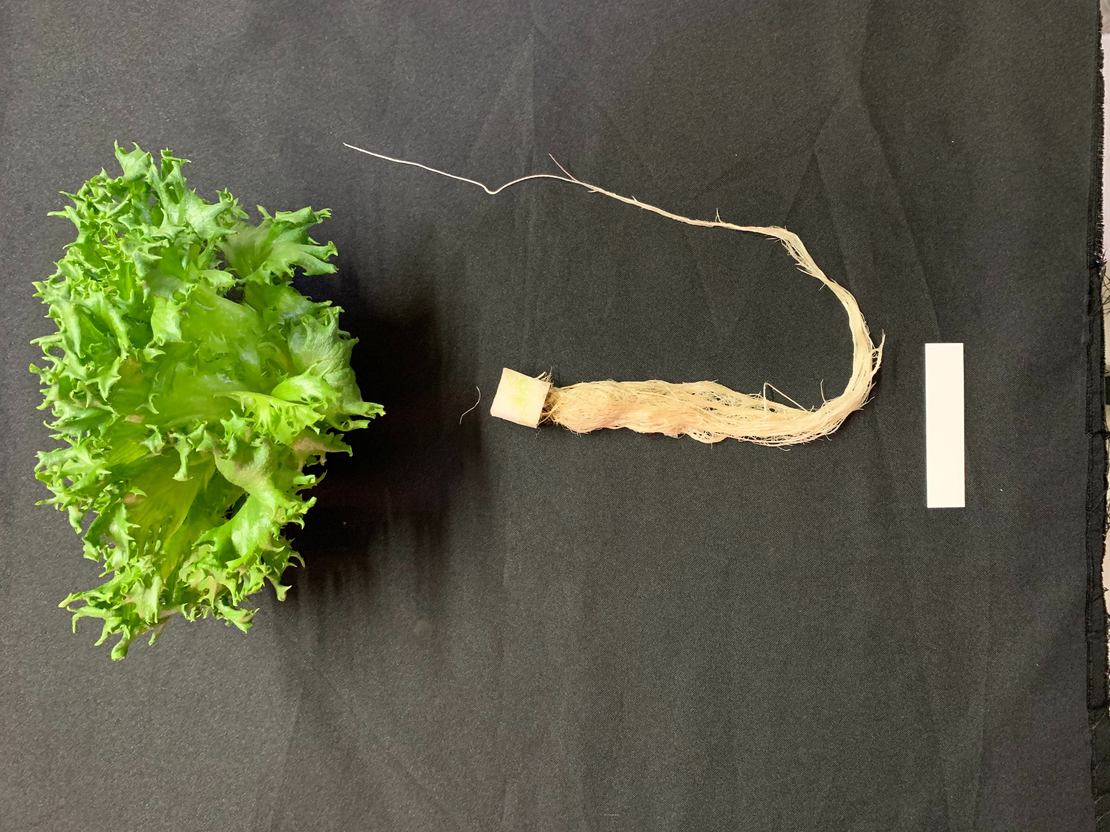
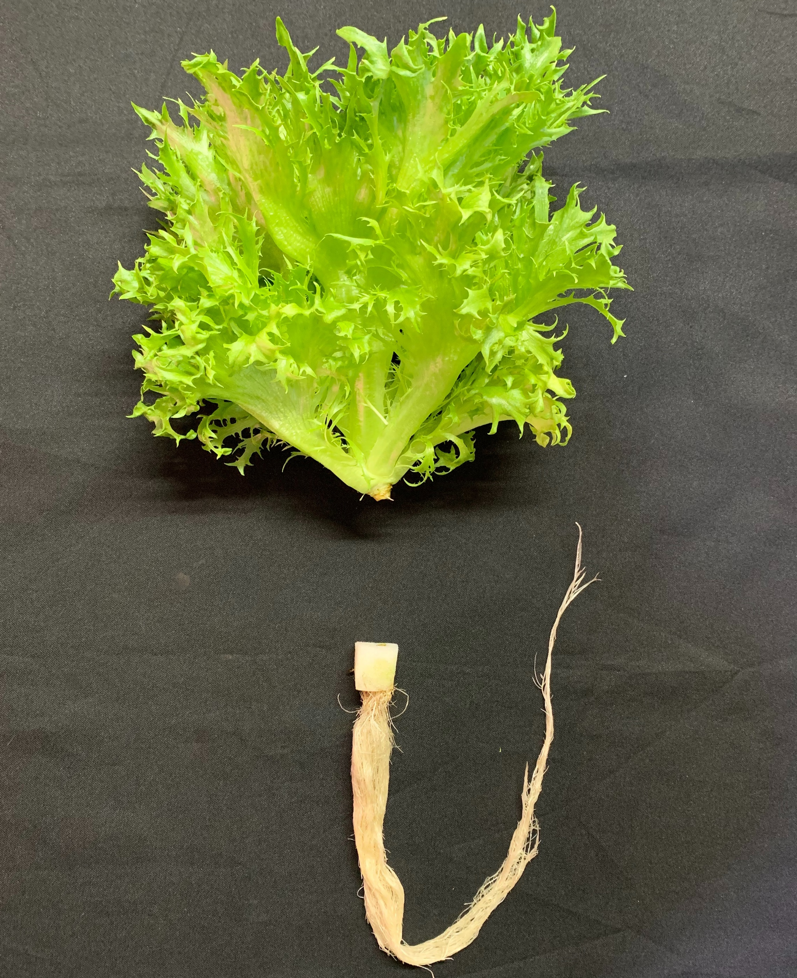
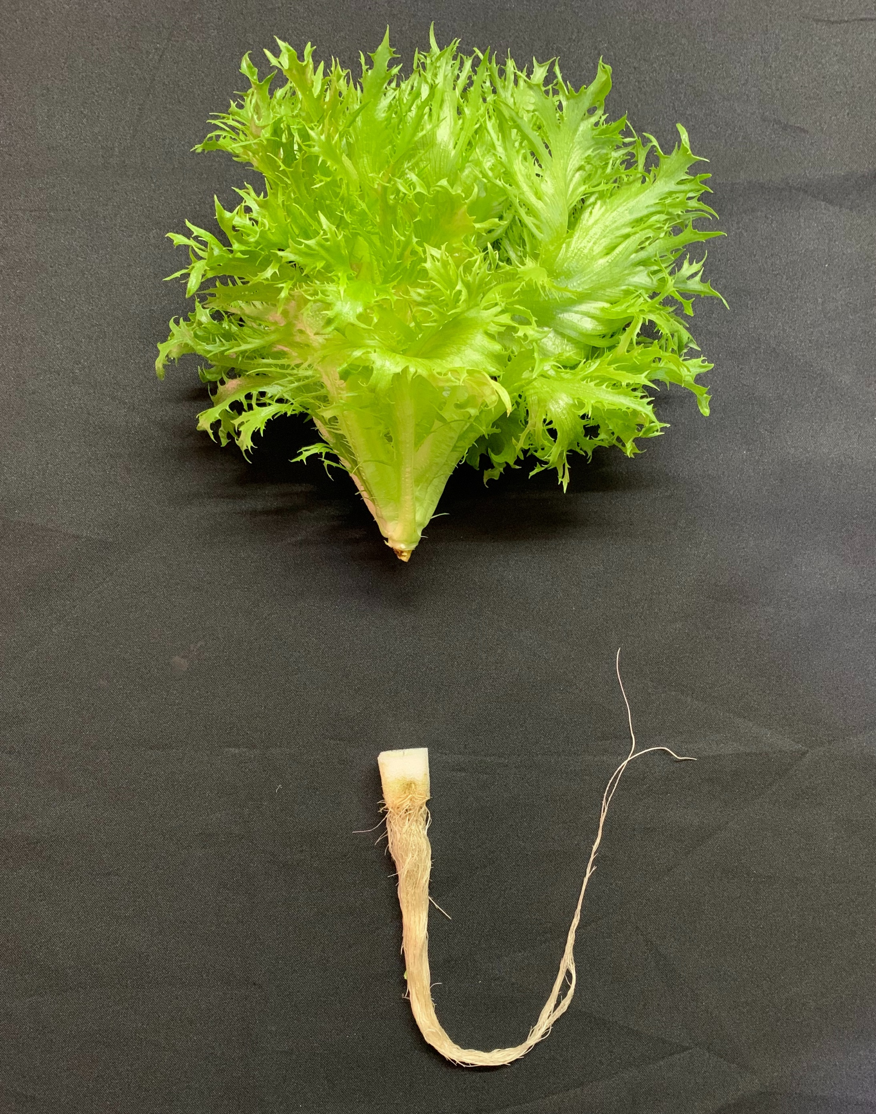
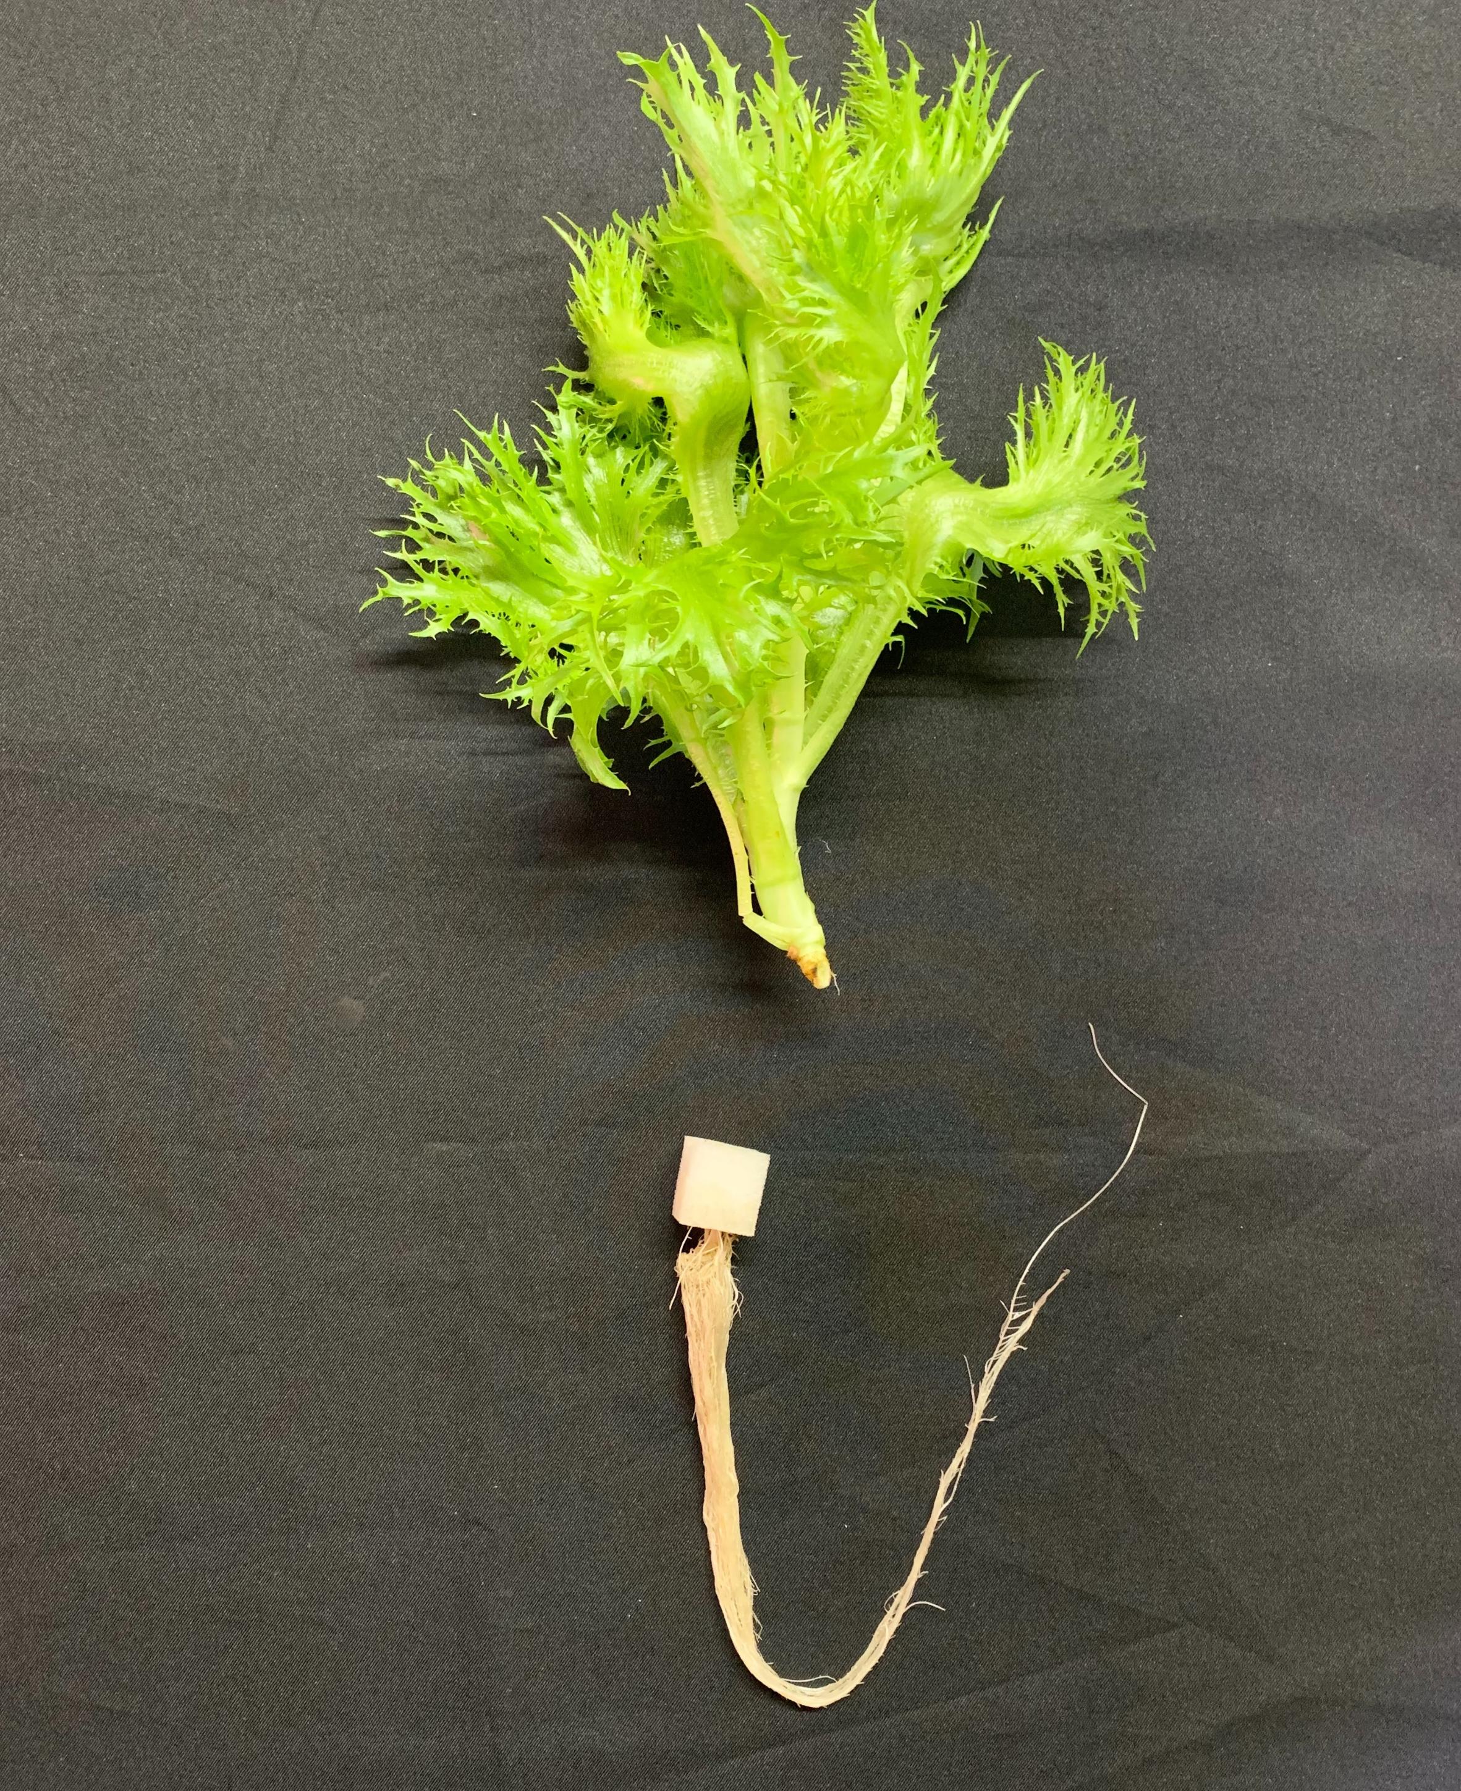
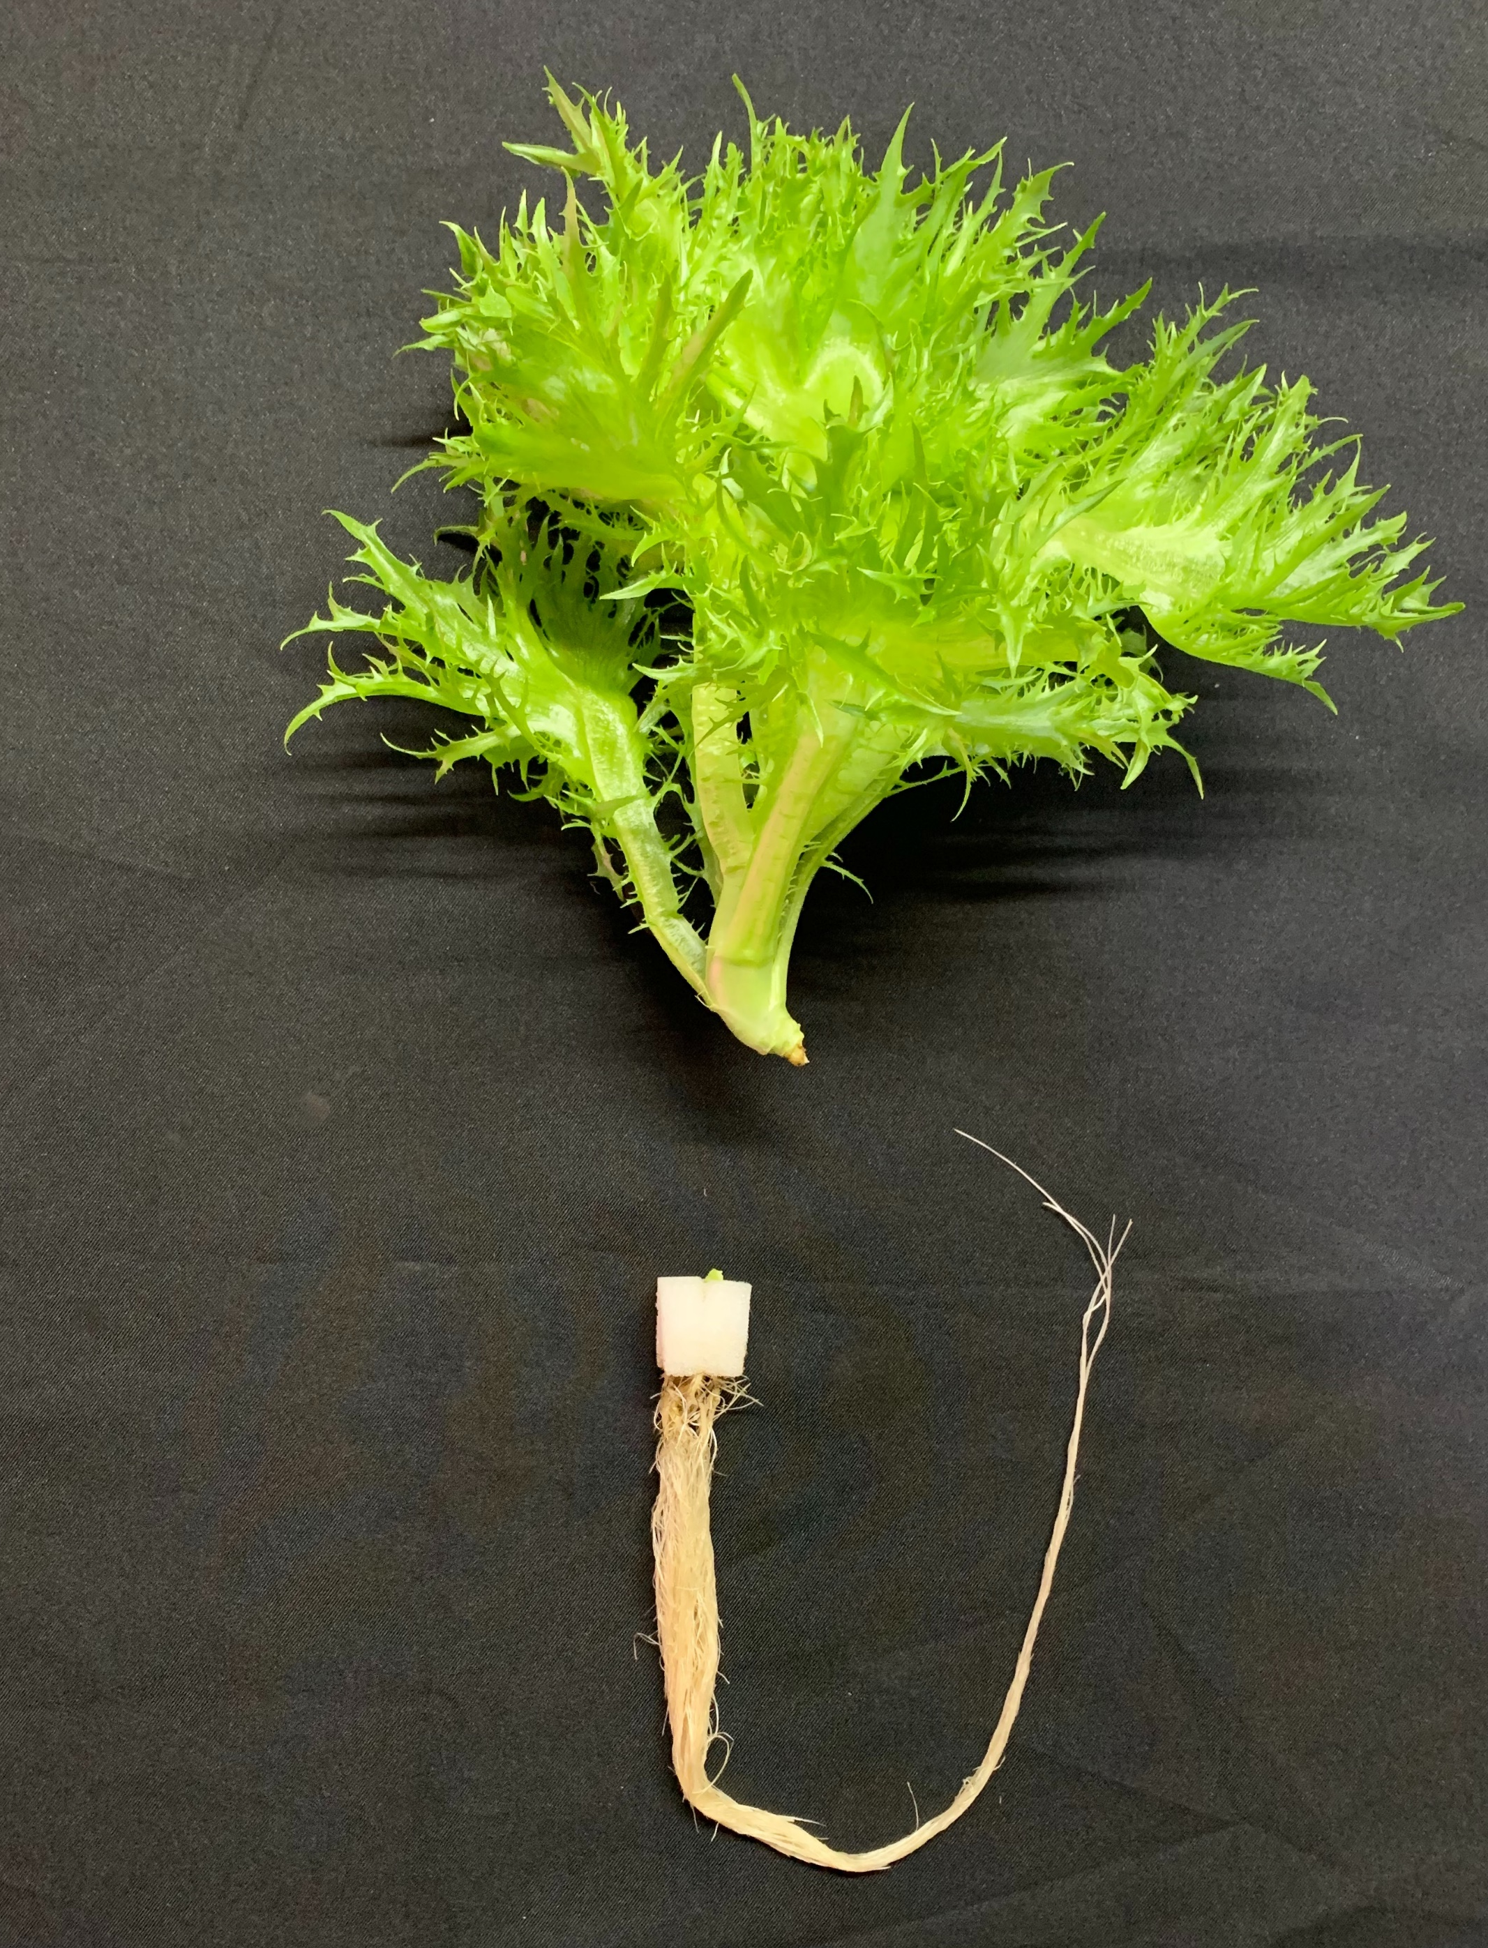
DAS=35
CW_15.49
RFR_13.39
RFR_2.13
bar=9 cm
RFR_0.97
RFR_0.37
RFR_0.22

Slide 21
DAS=35
Treatment | Plant height cm | Leaf length cm | Leaf width cm | Leaf length/width | Leaf number
CW_15.49 | 12.7 c | 13.2 c | 14.9 c | 0.89 | 20.3 a
RFR_13.39 | 15.5 b | 14.7 c | 16.7 b | 0.88 | 19.5 ab
RFR_2.13 | 22.2 a | 21.0 a | 19.3 a | 1.09 | 18.8 b
RFR_0.97 | 22.0 a | 20.1 a | 16.6 b | 1.22 | 17.2 c
RFR_0.37 | 23.3 a | 17.2 b | 15.6 bc | 1.10 | 13.0 d
RFR_0.22 | 21.8 a | 17.9 b | 17.1 b | 1.06 | 11.2 e
Note : plant height, leaf length, leaf width, n=6. leaf number, n=3

Slide 22
DAS=35
Treatment | FW g·plant⁻¹ | NO₃⁻ mg·kg⁻¹ | EY g·kWh⁻¹ | PY_{BAR} g·mol⁻¹ | yield kg·m⁻²·year⁻¹
CW_15.49 | 127.9 c | 3346 ab | 77.4 d | 19.4 c | 80.9
RFR_13.39 | 159.1 b | 4331 a | 102.5 b | 24.5 b | 100.7
RFR_2.13 | 205.5 a | 3850 ab | 127.4 a | 31.4 a | 130.0
RFR_0.97 | 154.7 b | 4023 a | 89.2 c | 23.4 b | 97.9
RFR_0.37 | 91.6 d | 2797 b | 51.1 e | 14.2 d | 58.0
RFR_0.22 | 74.2 e | 3921 a | 41.3 e | 11.5 e | 46.9
Note : FW、EY、PY_{BAR}, n=6. NO₃⁻, n=5

Slide 23
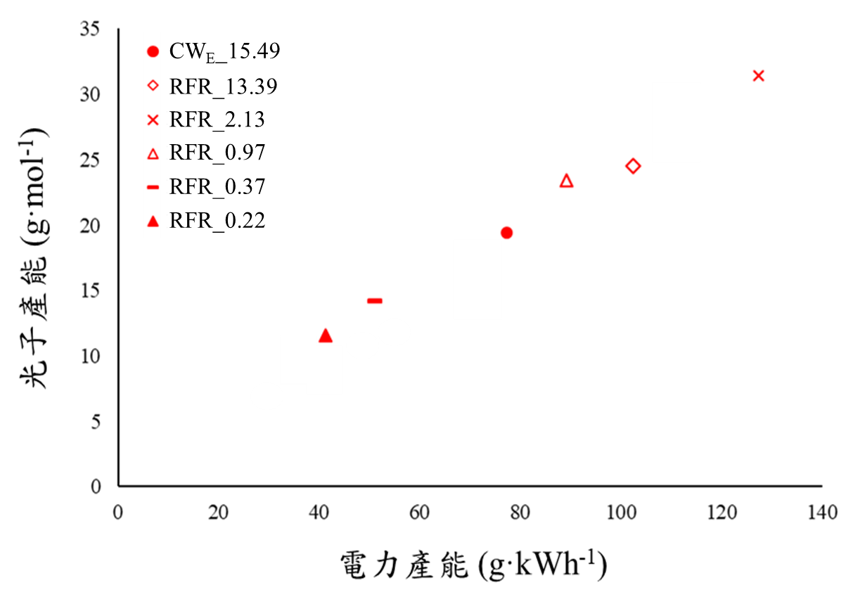
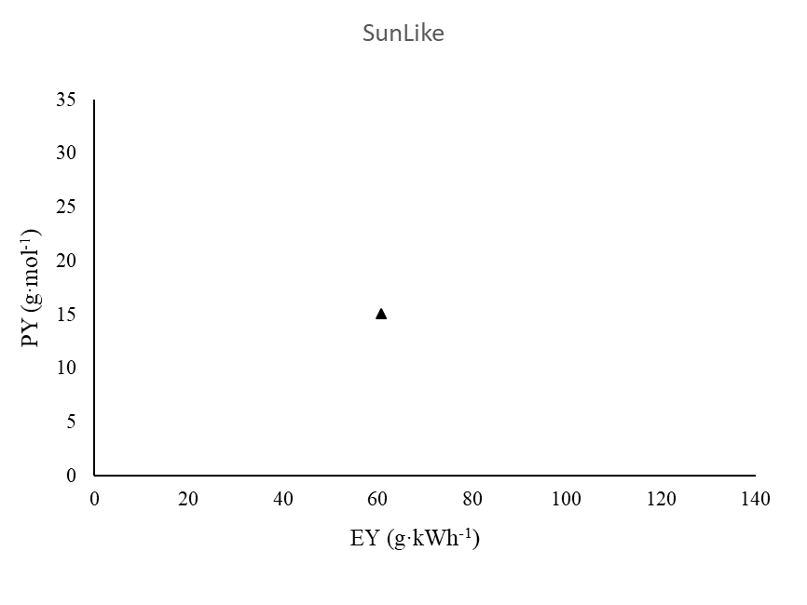
TPE diagram
There are 4 spectrums better than SunLike energy-efficient wise and spectrum wise
RFR_2.13
RFR_13.39
RFR_0.97
There are 3 spectrums better than CW energy-efficient wise and spectrum wise
光子產能 PY (g·mol⁻¹)
CW_15.49
SunLike
RFR_0.37
RFR_0.22
電力產能 EY (g·kWh⁻¹)

Slide 24
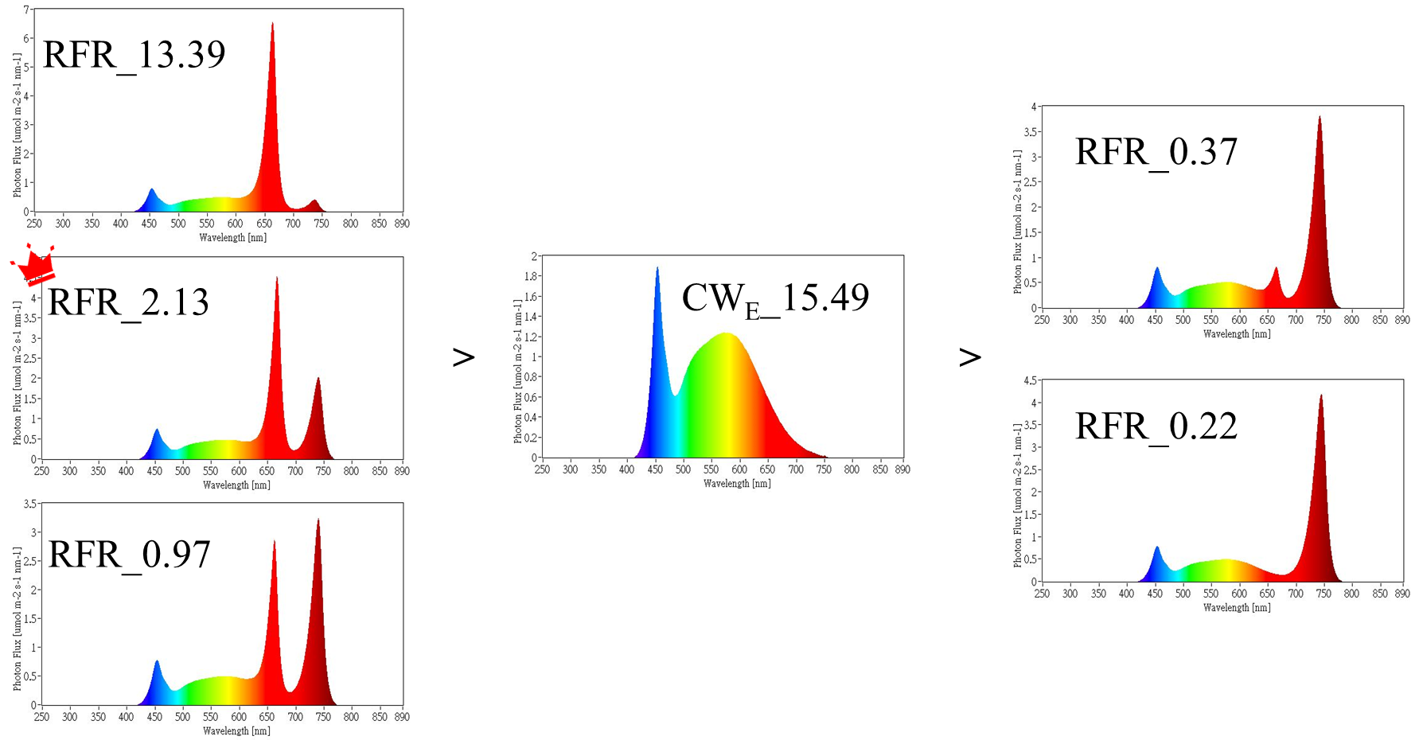
Summary

Slide 25
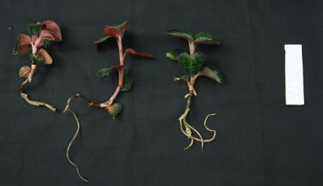
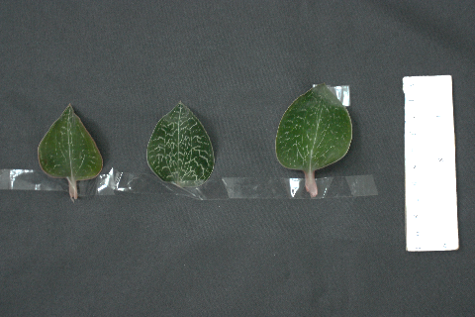
Effects of OLED as light source to the growth and antioxidants-concentration of Taiwan jewel orchid
Bar =10 cm
Bar =10 cm
OLED 1
OLED 2
LED CW
OLED 1
OLED 2
LED CW
Treatment | g/plt | Gastrodin concentration μg/g | Gastrodin content μg/plt | DPPH concentration vit C mg/g | DPPH content mg/plt
OLED 1 | 9.6 | 12.7 | 121.3 | 0.03 | 0.28
OLED2 | 10.6 | 13.1 | 138.5 | 0.04 | 0.42
CW LED | 10.9 | 5.0 | 54.0 | 0.03 | 0.28
Treatment | PY g/mol | PY_{G} μg Gastrodin/mol | PY_{D} mg DPPH/mol | EY g/kWh | EY_{G} μg/kWh | EY_{D} mg/kWh
OLED 1 | 3.17 | 40.24 | 0.09 | 6.8 | 86.3 | 0.20
OLED2 | 3.52 | 45.96 | 0.14 | 4.8 | 62.0 | 0.19
CW LED | 3.60 | 17.93 | 0.09 | 7.0 | 34.7 | 0.18

Slide 26
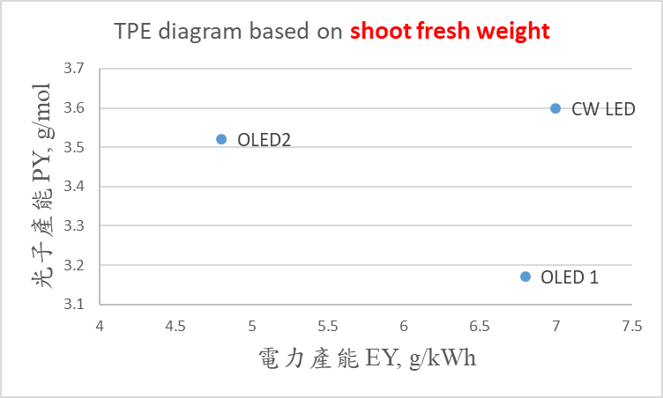
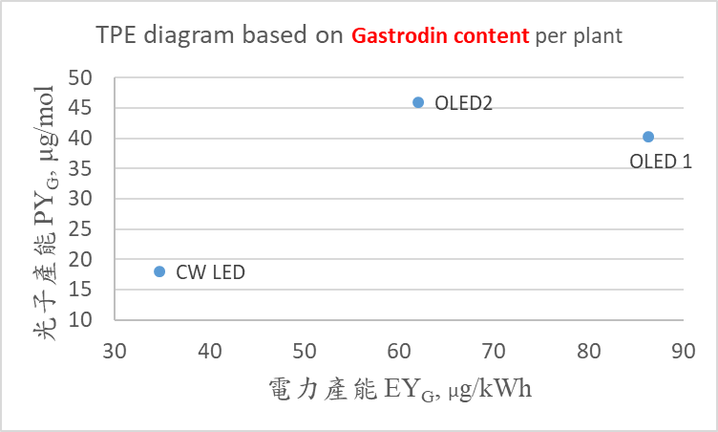
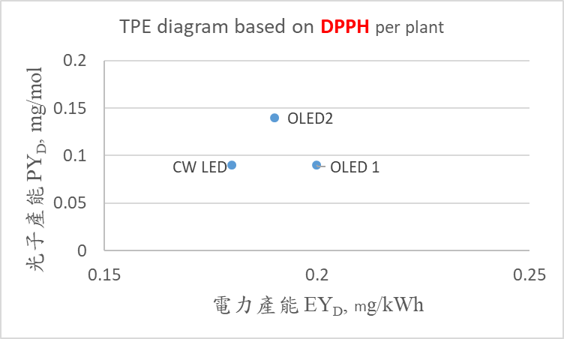
鮮重：CW LED 最佳
天麻素：OLED 優於 CW LED
光譜：OLED2 > OLED1 > CW
節能：OLED1 > OLED2 > CW
自由基清除力：OLED2 優於CW LED
光譜：OLED2 > OLED1 = CW
節能：OLED1 > OLED2 > CW

Slide 27
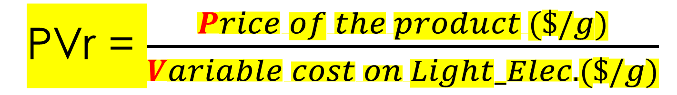
本益比 vs. 益本比
本益比：為獲得 1 元的收益，願意付出的成本
益本比 (benefit/cost簡稱B/C比)：本益比的倒數
投資計畫之效益現值與成本現值之比值 = 總效益/總成本
在 TPE 圖中導入 益本比的概念
益本比: 粗收益 / 燈光電力成本 $/gFW / $/gFW
PVr = $\frac{Price of the product (\$/g)}{Variable cost on Light_Elec. (\$/g)}$

Slide 28
PVr
EY
(g/kWh)
Market Value (mVal) /
Electricity Fee on Lighting
蔬菜 | 價格 (元/g) | 參考
紫甘藍芽 | 0.9 | 綠藤生機
青花菜芽 | 0.9
蘿蔔嬰 | 0.3
萵苣類 | 1.0 | 庭茂
金線連 | 15.0
芝麻葉 | 7.2
機能性萵苣 (低鉀、高花青素) | 2.0 | 日本富士通
萵苣有機水耕 | 1.3
PVr = Pg / Vg = P_{g} * EY / U_{kwh}
V_{g} = U_{kwh} / EY
where,
PVr: 益本比, in $/$
P_{g} : 產品售價 per gram, in $/g
V_{g} : 燈光電費 per gram, in $/g
U_{kwh} : 單位電價 per kWh, in $/kWh
EY: 電力產能, in g/kWh

Slide 29
TPE diagram : 營養液配方、萵苣
3 種萵苣：波士頓、香波綠火焰、皺葉
3 種養液配方: 山崎、低鉀、有機養液
PVr
為
各圓點的
半徑
一般萵苣 | 1.0 NT$/g
低鉀萵苣 | 2.0
有機萵苣 | 1.3

Slide 30
TPE diagram : 光譜、芽菜
3 種芽菜：紫甘藍芽、蘿蔔嬰、青花菜芽
3 種燈具: OLED, R_LED, 紅藍LED
PVr
為
各圓點的
半徑
紫甘藍芽 | 0.9 NT$/g
青花菜芽 | 0.9
蘿蔔嬰 | 0.3

Slide 31
TPE diagram : 芝麻菜、萵苣、光譜
5 種作物: 芝麻葉 + 4 種萵苣，
其中綠葉萵苣3，紅葉萵苣1
2 種燈具: 冷白, 紅藍LED
PVr
為
各圓點的
半徑
一般萵苣 | 1.0 NT$/g
芝麻葉 | 7.2

Slide 32
TPE diagram :萵苣、芽菜、光譜
PVr
為
各圓點的
半徑
3 種芽菜：紫甘藍芽、青花菜芽、蘿蔔嬰
3 種燈具: OLED, R_LED, 紅藍LED
4 種萵苣：綠葉 3，紅葉1
2 種燈具：CW,紅藍LED
32

Slide 33
TPE 圖導入PVr的適用範圍：燈具成本相近
PVr
為
各圓點的
半徑
PVr 未能反映出現階段(2021)的
OLED 既貴且使用壽命短的缺點

Slide 34
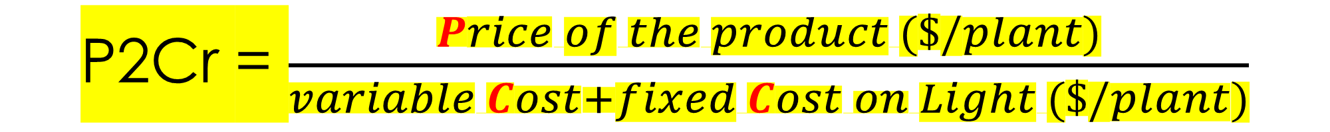
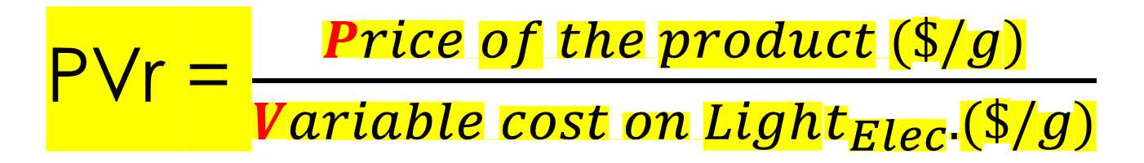
益本比
粗收益/燈光電力成本
PVr = $\frac{Price of the product (\$/g)}{Variable cost on Light_{Elec}. (\$/g)}$
只反映了燈具的用電成本
當燈具購入成本差異很大時，以 PVr 作圖會產生誤解，所以只適合用於燈具成本接近時的各項比較。
為解決上述缺點，建立加入燈具固定成本的新指標
益本比
粗收益/(燈具固定成本 + 燈光電力成本)
P2Cr = $\frac{Price of the product (\$/plant)}{variable Cost+fixed Cost on Light (\$/plant)}$

Slide 35
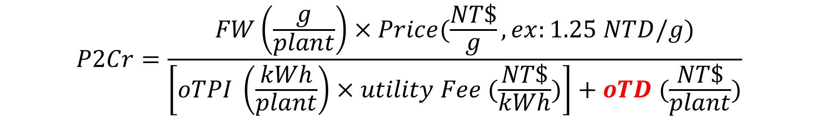
From PVr to P2Cr
PVr
Market Value (mValue) / Vari.Cost
P2Cr =
mValue /
(VC+FC)
$$P2Cr=\frac{FW\left(\frac{g}{plant}\right)×Price(\frac{NT\$}{g},ex:1.25 NTD/g)}{\left[oTPI \left(\frac{kWh}{plant}\right)×utility Fee (\frac{NT\$}{kWh})\right]+oTD (\frac{NT\$}{plant})}$$

Slide 36

Overall Total Depreciation of LED (OTD, NT$/plant)
Usable life of LED (h): 35000 (assuming)
Cost of light source (NT$/piece)：WW=1500 ，RB=1000，CW=390
3. OTD: Overall Totally Depreciation of LED per plant (NT$/plant)
De(i) = Plamp(i) * Noflamp(i) / Lf(i)
TD(i) = De(i) * LP(i) * Days(i) / density(i)
where,
De(i): Depreciation of light source per unit area per hour, in NT$ /(m² h)
Plamp: Unit price of lamp, in NT$/piece
Noflamp: number of lamps required per unit area, in piece/ m²
Lf: usable life time of the lamp, in h
TD(i): Total depreciation of light source per plant in stage i, in NT$ / plant
LP(i) : Duration of light period per day, in stage i in h/day
Days(i): duration of days in stage i, in days
density(i): crop density in stage i, in plant/m²
$$OTD=\sum_{i=1}^{n}{TD(i)}$$

Slide 37
PVr vs. P2Cr on TPE diagram
PVr 為各圓點的半徑
適合用於不考慮燈具固定成本差異時的比較
P2Cr 為各圓點半徑
適合用於燈具固定成本差異大時的比較

Slide 38

Factors affecting P2Cr
EY
(g/kWh)
Market price
PY
(g/mol)
$$P2Cr=\frac{FW×Price }{\left[oTPI ×utility Fee \right]+oTD }$$
Usable life of light source
Power consump. of light
Utility fee
Cost on light source

Slide 39
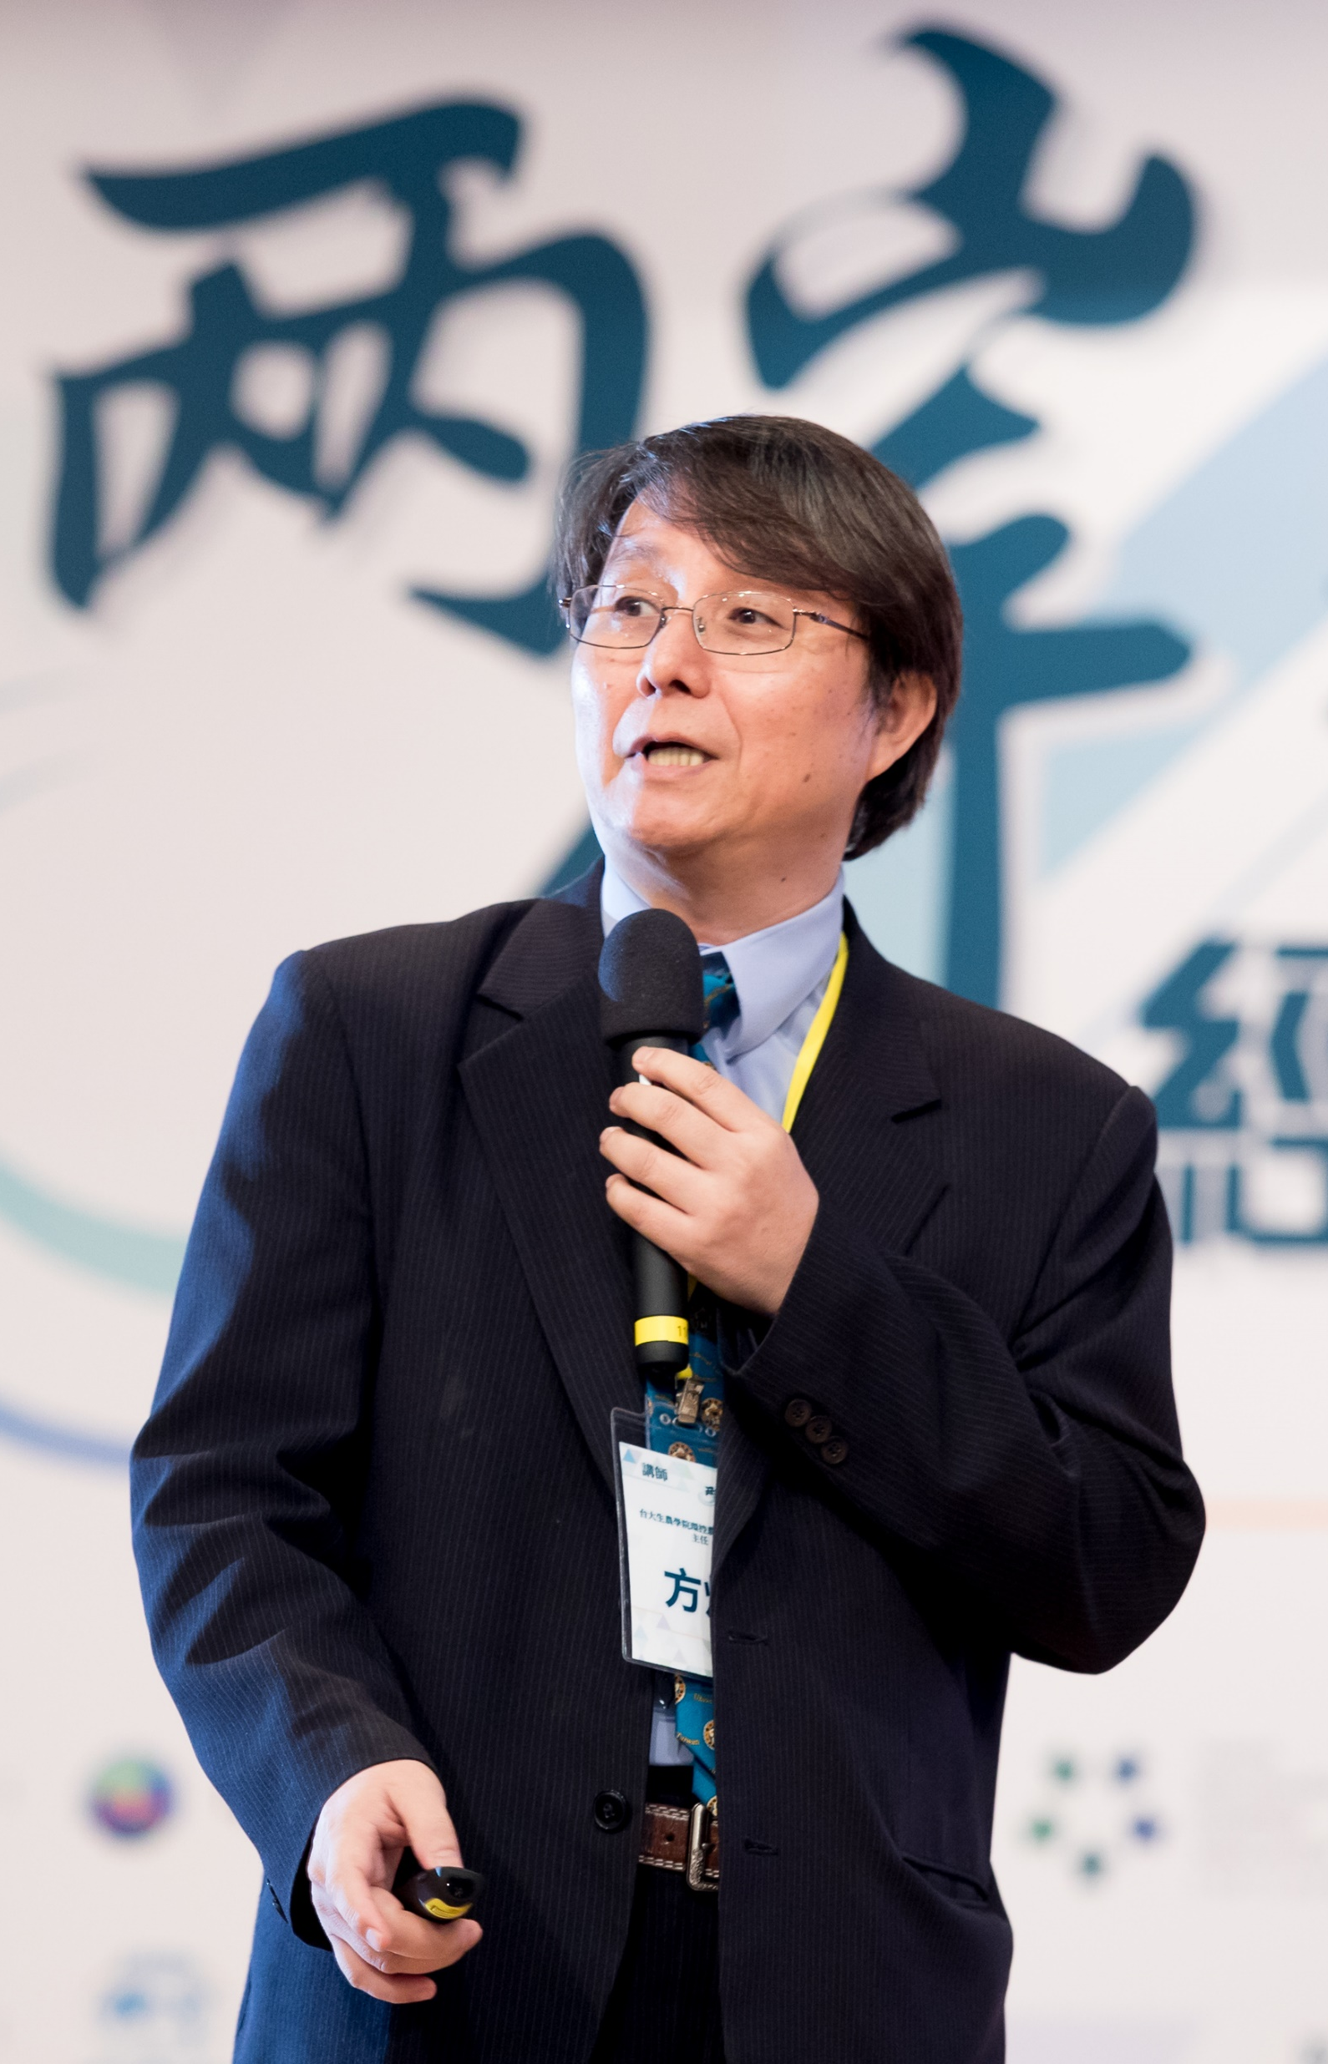
結論：全人工光型植物工廠整廠性能評估使用3~4個指標
PY and EY Global
O.L.e. Global
TPE diagram
PVr or P2Cr National/Local
39

Slide 40
結論
TPE 圖提供量化數據的視覺化效果
quantitative data visualization
40

Slide 41

Thank you
Question?
WeChat ID: weifang0257
weifang@ntu.edu.tw

