Slide 1
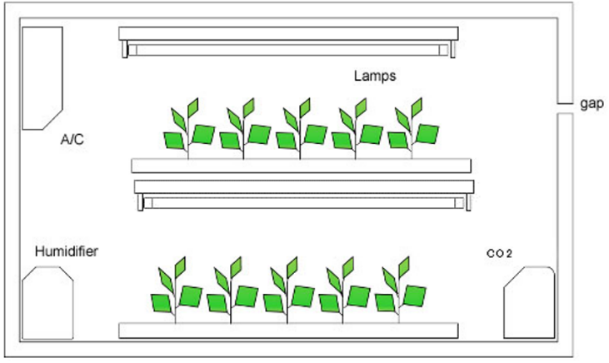
Total performance evaluation on plant factory with artificial lighting (PFAL)
Wei FANG, Ph.D., Professor
Dept. of Biomechatronics Engineering
National Taiwan University

Slide 2
Total performance evaluation
Area required to harvest 1 kg
Photons required to harvest 1 kg
Labor required to harvest 1 kg
Electricity cost required to harvest 1 kg

Slide 3
Area required to harvest 1 kg of vegetable
Tray or Plate (TorP)
Area, m2
Density, plt/TorP
Density, plt/m2
Duration, days
Area per 1000 plts
Area ratio
Area * days
Area&Time ratio
Assuming 100 g per plant, 10 plants can reach 1 kg
Area required for 1000 plants is 26.7 m², thus
harvesting 1 kg, you need 26.7*10/1000 = 0.267 m²

Slide 4
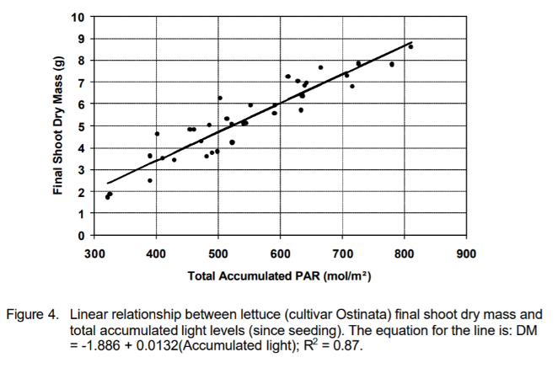
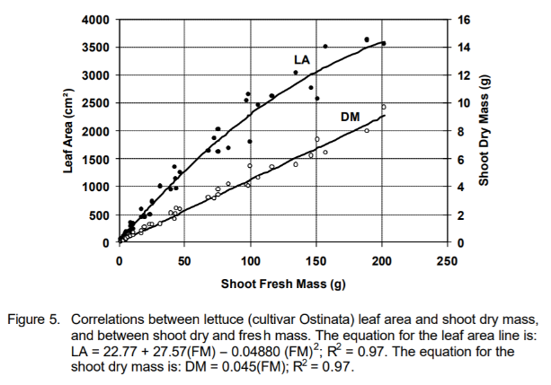
Photons required to harvest 1 kg of vegetable
DM = 0.045 * FM
FM = DM / 0.045
100 g FM * 0.045 = 4.5 g DM
35 days
DLI = 8.57 11.42 14.3 17.14 20 22.85
TLI = DLI * Days
45 g DM = -1.886 + 0.0132 (TLI)
TLI = 3552 mol/m²

Slide 5
Labor required to harvest 1 kg of vegetable
Need to have the operating time for all manual operated task.
OP.time(i) = Convert all values into per plant basis, in min/plt.
TOP.time = Sum of OP.time(i) of all task.
TOP.time * number of plants per 1 kg
Sowing
Spacing
Transplanting
Harvesting
Packaging

Slide 6
Electricity cost required to harvest 1 kg of vegetable
To harvest 1 kg, value of kWh needed = 1000 / EY
Where EY in g_FW/kWh (EY will be introduced later)
Given utility fee (U, in $/kWh)
Electricity cost on light to harvest 1 kg
= 1000 * U / EY
Given COP of AC,
Electricity cost on light and AC
= 1000 * U * (COP+1)/ (COP * EY)

Slide 7
Total performance evaluation
PVr and P2Cr
PY, EY and OLe

Slide 8
OLe = EY/PY
P2Cr
(Price / (varCost+fixCost)
EY
(g kWh⁻¹)
PY
(g mol⁻¹)
PVr
(Price / Varcost)

Slide 9
photon yield (PY)
From sowing to harvest, calculate DLI of each stages (mol/m2/day), times duration of each stage to get TLI (mol/m2)
Divide TLI by the density (plts/m2) of each stage to derived mol/plt of each stages.
Sum up for all stages
Derive PY by divide the avg. harvested FM (g/plt) to (mol/plt) to derive g FM/mol.

Slide 10
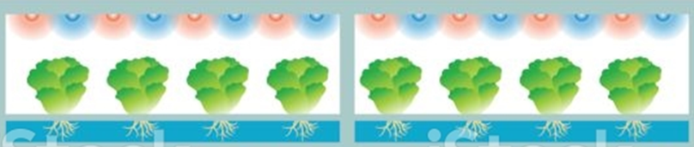

Photon Yield, PY
Area of cultural bed
Cropping density
Daily Light Integral (DLI) in mol day⁻¹ m⁻²
  PPFD (400-700 nm, PAR, μmol m⁻² s⁻¹ ) ×Light period (h d⁻¹) ×3.6/1000
Total light integral per plant at stage i, TLI(i) in mol/plant
  TLI(i) = DLI(i) × Duration(i) / cropping density(i)
Overall Total Light Integral per plant
OTLI = $\sum_{i=1}^{n}{TLI(i)}$
PY (g mol⁻¹) = g_FW / OTLI (g/plant / mol/plant)
PY_{A} (mg mol⁻¹) = mg.Anthocyanin/plant / OTLI (mol/plant)
PY_{D} (mg mol⁻¹) = mg.Vit.E/plant / OTLI (kWh/plant)

Slide 11
energy yield (EY)
From sowing to harvest, calculate power consumption (PC) per unit area of each stages (kWh/m2/day), times duration of each stage to get TPC (kWh/m2), then divided by the density (plts/m2) of each stage to derived kWh/plt of each stages.
Sum up for all stages
Derive EY by divide the avg. harvested FM (g /plt) to (kWh/plt) to derive g FM/kWh.

Slide 12
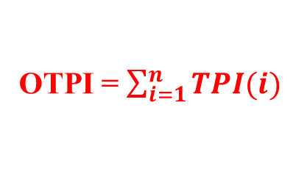
Energy Yield, EY
Power consumption per unit area, PCA (W m⁻²)
  Power consumption per lamp (W) × number of lamps per unit area (m⁻²)
Daily power consumption per unit area per day, DPI (kWh d⁻¹ m⁻²)
  PCA (W m⁻²) × light period (h d⁻¹) / 1000
Total power integral per plant, TPI(i) (kWh/plant)
  DPI(i) × duration(i) / cropping density(i) (plant m⁻²)
Overall Total Power Integral per plant
Area of cultural bed
Cropping density
OTPI = $\sum_{i=1}^{n}{TPI(i)}$
EY (g/kWh)= gFW (g/plant) / OTPI (kWh/plant)
EY_{A} (mg/kWh)=mg Anthocyanin (mg/plant) / OTPI (kWh/plant)
EY_{D} (mg/kWh)= mgVit.E/plant / OTPI

Slide 13

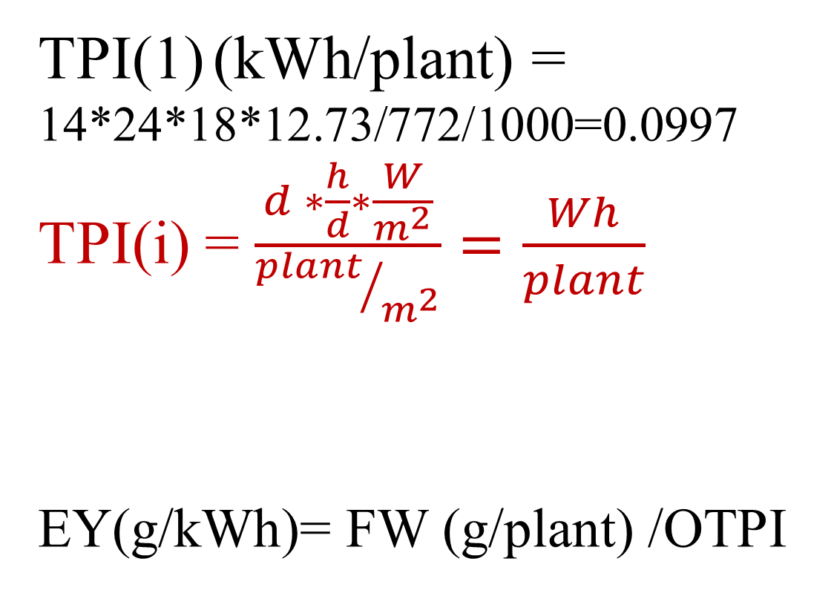
Details to EY calculation
  Stage 1
    duration (d):14
    Light period (h/d): 24
    Power (W) per lamp :18
    Area : 0.6 m²
    No.lamps : 7 tubes
      No.lamps/m²: 12.73 tubes/ m²
    No.plants: 433 plts
      Cropping density: 772 plt/m²
  Stage 2
    …………
TPI(1) (kWh/plant) = 14*24*18*12.73/772/1000=0.0997
TPI(i) = $\frac{d ∗\frac{h}{d}∗\frac{W}{m^{2}}}{{plant}/{m^{2}}}=\frac{Wh}{plant}$
_{EY(g/kWh)= FW (g/plant) /OTPI}
OTPI = $\sum_{i=1}^{n}{TPI(i)}$

Slide 14
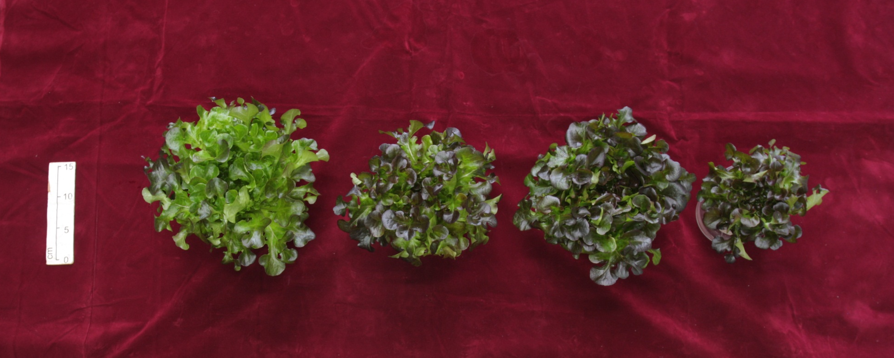
^{x5}
^{x3 +}
^{x2}
^{x4+}
^{x1}
^{x5}
SR5
SR3SB2
SR4SB1
SB5
bar=15
Treatment | g/plt | Anthocy. mg/g | Anthocy. Content per plant mg/plt | EY g/kWh | EY_{A} mg/kWh | PY gFW/mol | PY_{A} mg/mol
SR5 | 54.06 | 0.0138 | 0.74 | 47.03 | 0.65 | 11.01 | 0.15
SR3SB2 | 38.77 | 0.0168 | 0.65 | 32.29 | 0.54 | 7.89 | 0.13
SR4SB1 | 50.12 | 0.0124 | 0.62 | 42.65 | 0.53 | 10.20 | 0.13
SB5 | 22.14 | 0.0179 | 0.40 | 30.58 | 0.55 | 4.51 | 0.08

Slide 15
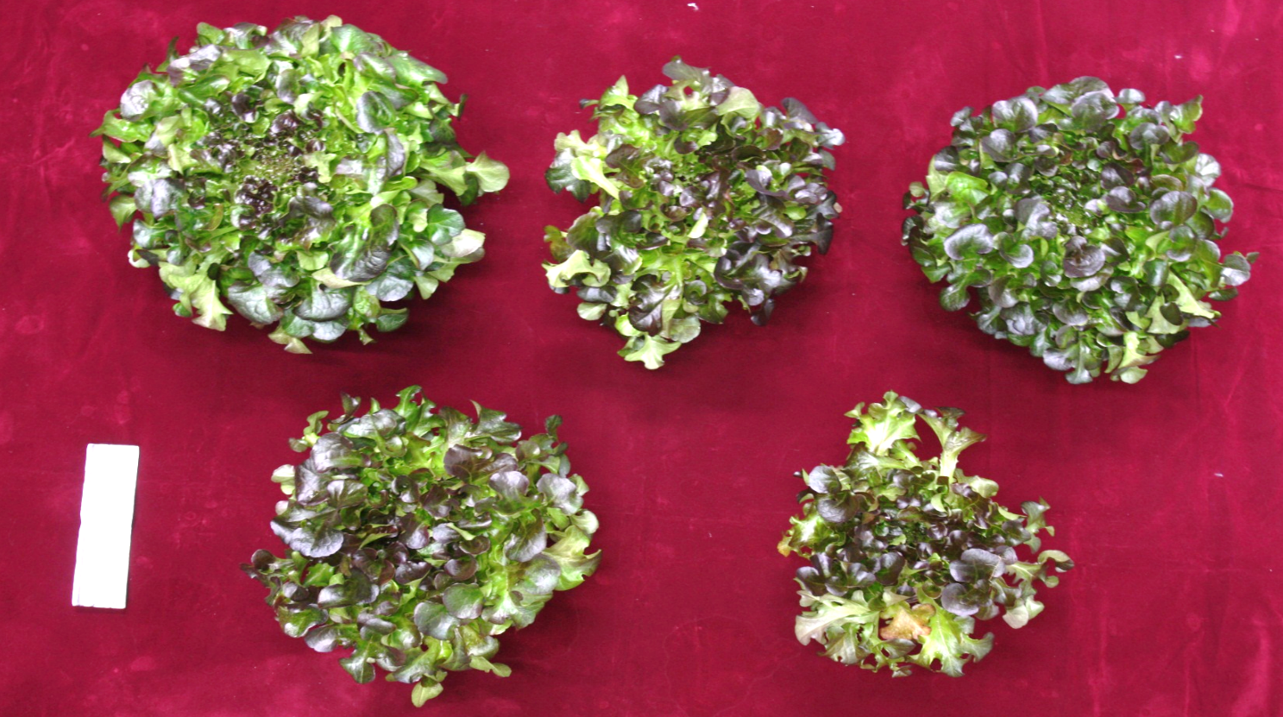
SR3SB3
SR4SB2
PY Photon Yield of fresh mass
PY_{A} Photon Yield of Anthocyanin
EY Energy Yield of fresh mass
EY_{A} Energy Yield of Anthocyanin
SR6
Overall Lighting Efficacy, in mol/kWh
(OLe) = EY / PY
SR5SB1
SB6
Treatments | FW gFW/plt | Anthocya. concentration mg/g | Anthocya. content mg/plt | EY gFW/kWh | EY_{A} mg/kWh | PY gFW/mol | PY_{A} mg/mol | OLe mol/kWh
SR6 | 108.30 | 0.0138 | 1.49 | 67.15 | 0.93 | 15.72 | 0.22 | 4.271
SR3SB3 | 70.11 | 0.0149 | 1.04 | 43.47 | 0.65 | 10.17 | 0.15 | 4.272
SR4SB2 | 88.70 | 0.0147 | 1.31 | 55.00 | 0.81 | 12.87 | 0.19 | 4.273
SR5SB1 | 87.75 | 0.0197 | 1.73 | 54.41 | 1.07 | 12.73 | 0.25 | 4.274
SB6 | 43.24 | 0.0159 | 0.69 | 26.81 | 0.43 | 6.27 | 0.10 | 4.276

Slide 16
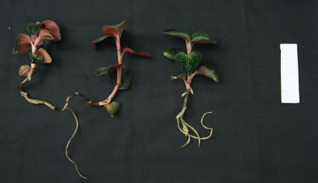
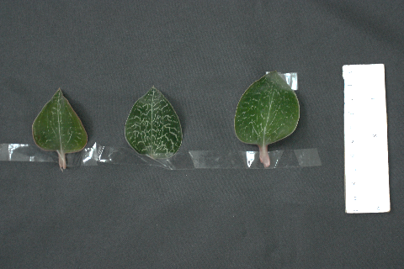
Effects of OLED as light source to the growth and antioxidants-concentration of Taiwan jewel orchid
Bar =10 cm
Bar =10 cm
OLED 1
OLED 2
LED CW
OLED 1
OLED 2
LED CW
Treatment | g/plt | Gastrodin concentration μg/g | Gastrodin content μg/plt | DPPH concentration vit C mg/g | DPPH content mg/plt | EY g/kWh | EY_{G} μg/kWh | EY_{D} mg/kWh
OLED 1 | 9.6 | 12.7 | 121.3 | 0.03 | 0.28 | 6.8 | 86.3 | 0.20
OLED2 | 10.6 | 13.1 | 138.5 | 0.04 | 0.42 | 4.8 | 62.0 | 0.19
CW | 10.9 | 5.0 | 54.0 | 0.03 | 0.28 | 7.0 | 34.7 | 0.18
Treatment | PY g/mol | PY_{G} mgGastrodin/mol | PY_{D} mgDPPH/mol | OLe
OLED 1 | 3.17 | 40.24 | 0.09 | 2.145
OLED2 | 3.52 | 45.96 | 0.14 | 1.363
CW | 3.60 | 17.93 | 0.09 | 1.944

Slide 17
Lighting Efficacy (Le) vs. Overall Lighting Efficacy (OLe)
Le in μmol/J, measured after the installation of light source prior to the growth of any plants.
OLe in mol/kWh, calculated after the growth, allow the adjustment of light source and light period during any growth stages.
If no alteration of light source during the growth period, two terms have the relationship as shown below:
Le = OLe / 3.6

Slide 18
TPE diagram: PY vs. EY
Light source has better spectrum to grow the crop
Toward optimum light source
Light source has
higher efficiency and less power consumption to grow the crop

Slide 19
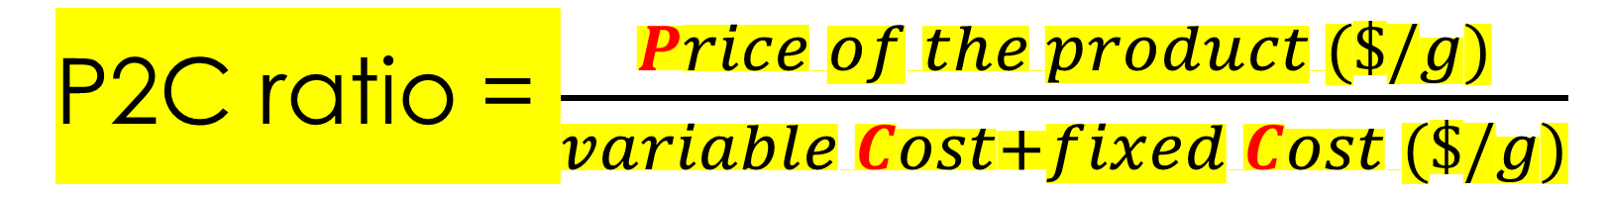
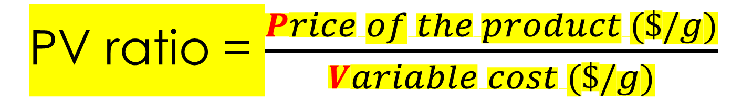
PV ratio = $\frac{Price of the product (\$/g)}{Variable cost (\$/g)}$
Price of the product vs. Variable cost on lighting
P2C ratio = $\frac{Price of the product (\$/g)}{variable Cost+fixed Cost (\$/g)}$
Price of the product vs. variable Cost + fixed Cost on lighting

Slide 20
PVr
EY
(g/kWh)
Market Value (mVal) / Electricity Fee on Lightg
蔬菜 | 價格 (元/g) | 參考
purple cabbage sprouts紫甘藍芽 | 0.9 | 綠藤生機 Green Vine, Taiwan
broccoli sprouts 青花菜芽 | 0.9
Radish Sprouts 蘿蔔嬰 | 0.3
Lettuce 萵苣類 | 1.0 | 庭茂 Nice Green, Taiwan
Anoectochilus roxburghii 金線連 | 15.0
Rucola 芝麻葉 | 7.2
Functional lettuce 機能性萵苣 (Low potassium 、high anthocyanin) | 2.0 | 日本富士通 Fujizu, Japan
Organic Lettuce 萵苣有機水耕 | 1.3

Slide 21
PVr = Pg / Vg
V_{g} = U_{kwh} / EY
where,
PVr: PV ratio, in $/$
P_{g} : Price per gram, in $/g
V_{g} : Variable cost per gram on lighting, in $/g
U_{kwh} : Utility.fee per kWh, in $/kWh
EY: Energy Yield, in g/kWh
PVr = P_{g} * EY / U_{kwh}

Slide 22
EY, PY and PVr (TPE diagram) of different sprouts
grown under various light quality
PVr is the radius of the circle

Slide 23
Lettuce and rucola grown under various light quality
shown on TPE diagram

Slide 24
Lettuce and sprout grown under various light quality
shown on TPE diagram

Slide 25
Impact of light quality on EY, PY and PVr
vegetable | Artificial Light |  | EY (g/kWh) | PY (g/mol) | PVr | Relative PVr
 | Light quality | Power (W·m^{–2})
紫甘藍芽 | OLED | 15.8 | 617 | 109 | 231 | 7.3
紫甘藍芽 | R₁₀₀ | 35.8 | 299 | 121 | 112 | 3.5
蘿蔔嬰 | R₁₀₀ | 72.7 | 445 | 114 | 56 | 1.8
蘿蔔嬰 | R₈₇:B₁₃ | 71.5 | 396 | 102 | 50 | 1.6
青花菜芽 | R₁₀₀ | 70.6 | 102 | 49 | 38 | 1.2
青花菜芽 | OLED | 31.8 | 218 | 48 | 82 | 2.6
芝麻葉 | CW | 218.18 | 21 | 9 | 63 | 2.0
香波綠萵苣 | CW | 185.14 | 75 | 17 | 32 | 1.0
紅橡萵苣 | CW | 185.14 | 37 | 10 | 15 | 0.5
皺葉萵苣 | CW | 185.14 | 57 | 13 | 24 | 0.8
紅橡萵苣 | SR5SB1 | 126.39 | 37 | 13 | 31 | 1.0
波士頓萵苣 | CW | 185.14 | 76 | 17 | 32 | 1.0
25

Slide 26
Impact of nutrient solution on TPE diagram

Slide 27
Impact of nutrient solution on EY, PY and PVr
Lettuce | Nutrient solution | EY (g/kWh) | PY (g/mol) | PVr | Relative PVr
皺葉 | BIO NK | 134 | 30 | 50 | 2.3
皺葉 | Yamazaki | 57 | 13 | 16 | 0.7
波士頓 | BIO NK | 70 | 16 | 26 | 1.2
波士頓 | Yamazaki | 76 | 17 | 22 | 1.0
香波綠 | BIO NK | 17 | 4 | 6 | 0.3
香波綠 | Yamazaki | 75 | 17 | 21 | 1.0
香波綠 | NTU_low_P | 49 | 11 | 28 | 1.3

Slide 28
Vege. | treatment | EY (g/kWh) | PY (g/mol) | PVr | Relative PVr | Value-added
紫甘藍 | OLED | 617 | 30 | 162 | 7.4 | 高抗氧化力
 | R₁₀₀ | 299 | 14 | 78 | 3.5
青花菜 | OLED | 218 | 10 | 57 | 2.6 | 高抗氧化力
 | R₁₀₀ | 102 | 20 | 27 | 1.2
蘿蔔嬰 | R₁₀₀ | 445 | 21 | 44 | 2.0
 | R₈₇:B₁₃ | 396 | 19 | 39 | 1.8 | 高抗氧化力
奶油萵苣 | BIO N | 49 | 11 | 18 | 0.8 | 民眾信賴
 | BIO NK | 70 | 16 | 26 | 1.2
 | 山崎湛液 | 76 | 17 | 22 | 1.0
 | 山崎潮汐 | 148 | 24 | 42 | 1.9 | 高產量
皺葉萵苣 | 山崎湛液 | 57 | 13 | 16 | 0.7
 | BIO N | 82 | 19 | 31 | 1.4 | 民眾信賴
 | BIO NK | 134 | 30 | 50 | 2.3
冰山萵苣 | 山崎湛液 | 75 | 17 | 21 | 1.0
 | 低鉀萵苣 | 49 | 11 | 28 | 1.3 | 腎臟病人專用
紅橡 | CW | 37 | 10 | 10 | 0.5
 | SR5SB1 | 37 | 13 | 21 | 1.0 | 高花青素
芝麻葉 | 山崎潮汐 | 52 | 8 | 107 | 4.9 | 高產量/藥味

Slide 29
Drawbacks of PVr leads to a new index
Only reflect the operating cost on electricity of lamps
Did not includes the cost to purchase the lamps
Can only be used for evaluation for cases with similar cost to purchase the lamps.
A new index was developed to include the fixed cost on lamps.

Slide 30
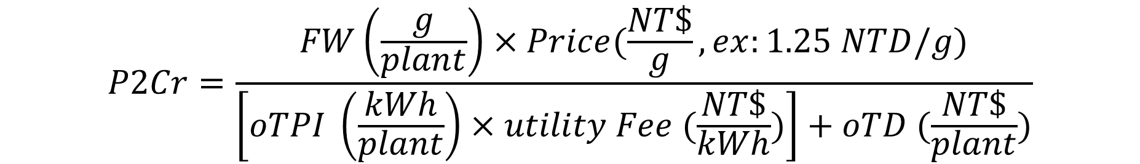
From PVr to P2Cr
EY
(g/kWh)
PVr
Market Value (mValue) / Vari.Cost
P2Cr =
mValue /
(VC+FC)
$$P2Cr=\frac{FW\left(\frac{g}{plant}\right)×Price(\frac{NT\$}{g},ex:1.25 NTD/g)}{\left[oTPI \left(\frac{kWh}{plant}\right)×utility Fee (\frac{NT\$}{kWh})\right]+oTD (\frac{NT\$}{plant})}$$

Slide 31

Factors affecting P2Cr
EY
(g/kWh)
Cultural practices
Market price
PY
(g/mol)
$$P2Cr=\frac{FW×Price }{\left[oTPI ×utility Fee \right]+oTD }$$
Power consump. of light
Utility fee
Cost on light source

Slide 32

Overall Total Depreciation of LED (OTD, NT$/plant)
Usable life of LED (h): 35000 (assuming)
Cost of light source (NT$/piece)：WW=1500 ，RB=1000，CW=390
3. OTD: Overall Totally Depreciation of LED per plant (NT$/plant)
De(i) = Plamp(i) * Noflamp(i) / Lf(i)
TD(i) = De(i) * LP(i) * Days(i) / density(i)
De(i): Depreciation of light source per unit area per hour,, in NT$ /m² h
Plamp: Unit price of lamp, in NT$/piece
Noflamp: number of lamps required per unit area, in piece/ m²
Lf: usable life time of the lamp, in h
TD(i): Total depreciation of light source per plant in stage i, in NT$ / plant
LP(i) : Duration of light period per day, in stage i in h/day
Days(i): duration of days in stage i, in days
density(i): crop density sta stage i, in plant/m²
$$OTD=\sum_{i=1}^{n}{TD(i)}$$

Slide 33
Impact of types of light source and crop on index for T.P.E.
Light source | Crop | EY (g/kWh) | PY (g/mol) | P2Cr | OTPI (kWh/plant) | Vari.Cost (NT$/plant) | OTD=FixCost (NT$/plant) | LED Cost (NT$/tube)
CW | 羽衣甘藍 | 26.6 d | 6.39 d | 2.6 | 7.69 | 26.9 | 0.9 | 390
 | 香波綠 | 37.1 c | 8.92 b | 3.7
 | 紅皺葉 | 22.4 e | 5.38 e | 2.2
WW_{P} | 羽衣甘藍 | 40.7 c | 5.29 e | 3.4 | 4.16 | 14.6 | 3.3 | 1500
 | 香波綠 | 83.8 a | 10.90 a | 7.0
 | 紅皺葉 | 68.3 b | 8.22 b | 5.7
RB_FR | 羽衣甘藍 | 27.5 d | 6.83 d | 2.6 | 7.94 | 27.8 | 2.2 | 1000
 | 香波綠 | 40.0 c | 9.91 a | 3.8
 | 紅皺葉 | 30.1 d | 7.47 c | 2.8
Means followed by the different letters in each column are significantly different at 5% level by LSD Test (n=5).

Slide 34
Impact of usable life of LEDs to P2Cr of 3 crops
羽衣甘藍
香波綠萵苣
紅皺葉萵苣
P2Cr
14000 hr (2.3year)
10000 hr (1.7 year)
3000 hr (0.5 year)
5000 hr (0.8 year)
2000 hr (0.3 year)

Slide 35
PVr vs. P2Cr on TPE diagram
PVr as the radius of the circle.
Ignoring the fixed cost leads to mis-leading results.
P2Cr as the radius of the circle

Slide 36
EY, PVr and P2Cr of leafy greens grown under various light quality and nutrient solution
Treatments | EY(g/kWh) | PVr | P2Cr | OTD (NT$/plt)
紫甘藍_{OLED} | 617 | 231.3 | 2.4 | 226.1
紫甘藍_{R100} | 299 | 112.2 | 112.2 | 0.001
蘿蔔嬰_{R100} | 445 | 55.6 | 55.6 | 0.001
蘿蔔嬰_{R87:B13} | 396 | 49.5 | 49.5 | 0.001
青花菜_{OLED} | 218 | 81.7 | 0.9 | 226.1
青花菜_{R100} | 102 | 38.3 | 38.3 | 0.001
皺葉_{BIONK} | 134 | 72.5 | 51.2 | 0.86
皺葉_{BION} | 82 | 44.6 | 31.5 | 0.86
三低冰山 | 49 | 40.5 | 29.8 | 0.86
奶油_{BIONK} | 70 | 37.9 | 27.8 | 0.86
奶油 | 76 | 31.7 | 23.3 | 0.86
冰山 | 75 | 39.0 | 22.9 | 0.86
奶油_{BION} | 49 | 26.4 | 19.4 | 0.86
皺葉 | 57 | 23.8 | 17.4 | 0.86
紅橡CW | 37 | 15.4 | 11.3 | 0.86
紅橡SR5SB1 | 37 | 30.5 | 22.4 | 0.86
OTD of OLED
Price: 30000 NT$/plate
Usable life: 200 h
Piece required: 400 piece/m2
Days：5 days
Duration per day：12 h
Depreciation per unit area = 30000*400*5*12/200 = 3600000 NT$/m²
Crop density: 15923 plant/m²
OTD = 3600000/15923 = 226.1

Slide 37
The end

