Slide 1
Psychrometrics
[ATGS 7140] Plant Factory – Theory and Practice
[ANISCI7047] Smart Production of Livestock
the study of moist air and its thermodynamic properties
Wei FANG
NTU_BME and Global ATGS
National Taiwan University

Slide 2
Moist air
Moist air: air with water vapor
Dry air: air without water vapor
Moist air = dry air + water vapor
Dry air: mixed gas (N₂: 80%, O₂: 19%, Others: including CO₂ 400 ppm = 0.04% and else)

Slide 3
Functions of moist air
As the heat source / sink
As the water source/ sink
As the N₂ source / sink
As the O₂ source / sink
As the source / sink of organic particles
As the source / sink of inorganic particles
others

Slide 4
Applications of moist air
HVAC
Drying
(De)humidification
Evaporative cooling
  Pad and Fan
  Fogging
else

Slide 5
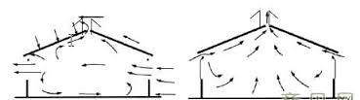
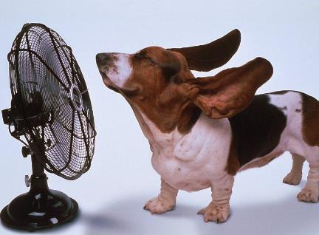
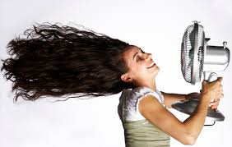
Natural Ventilation
Summer
Winter
Forced Ventilation

Slide 6
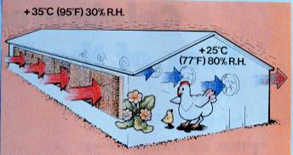
Pad and Fan system
Miss leading information in places other than extreme dry climate zone

Slide 7
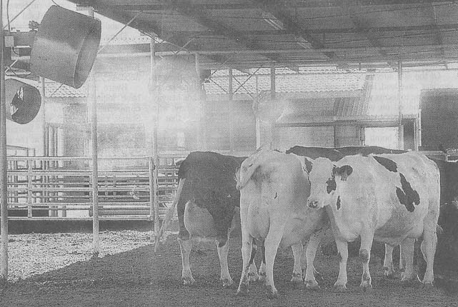
Fogging with fan

Slide 8
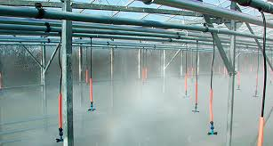
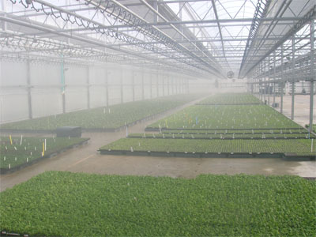
Fogging
Misting
Spraying
Evaporative cooling

Slide 9
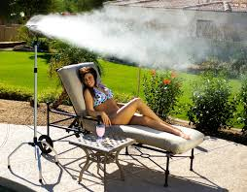
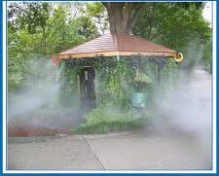
fogging for comfort

Slide 10
Temperature affects humidity
In general, it means
  Dry bulb Temperature
  affects
  Relative Humidity
But there are
  3 types of temperature and
  2 types of humidity

Slide 11
Thermodynamic Properties of moist air
乾球溫度
dry bulb T
濕球溫度
wet bulb T
露點溫度
dew point T
相對溼度
relative humidity
絕對溼度
absolute humidity
  (濕度比humidity ratio)
比容 specific volume
熱焓 enthalpy
蒸汽壓vapor pressure
飽和蒸汽壓 saturated vapor pressure

Slide 12
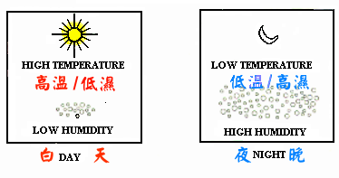
Daily variation of T and RH

Slide 13
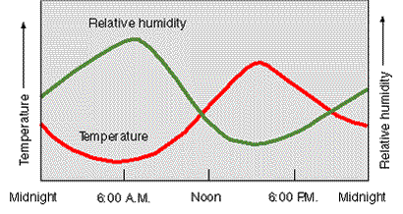
High T Low RH occurs at the same time
RH
T
午夜
中午
午夜

Slide 14
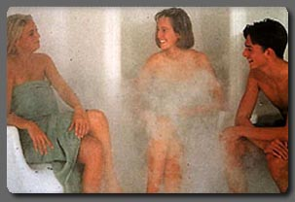
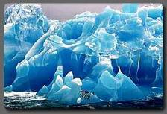

Which one is wrong
Low T
High RH
High T
Low RH
High T, high RH

Slide 15

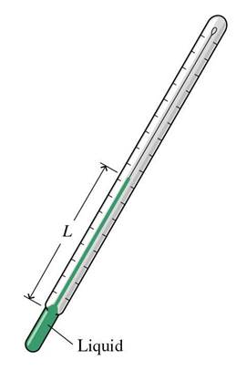

Dry bulb Temperature, T_{db}

Slide 16
Relative Humidity, RH
Ratio of the vapor pressure (VP) of the moist air vs. saturated VP of the moist air at the same T_{db}. in %
Saturated moist air means moist air at 100% RH
Air at higher temperature can absorb more water vapor
Moist air at same temperature, one with higher RH has less capacity left to absorb water vapor.

Slide 17
Wet Bulb Temperature, T_{wb}
Require device to measure RH
Without device,
RH can be derived from
given T_{db} and T_{wb}

Slide 18








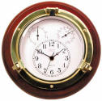
Dry and Wet Bulb Temperature

Slide 19
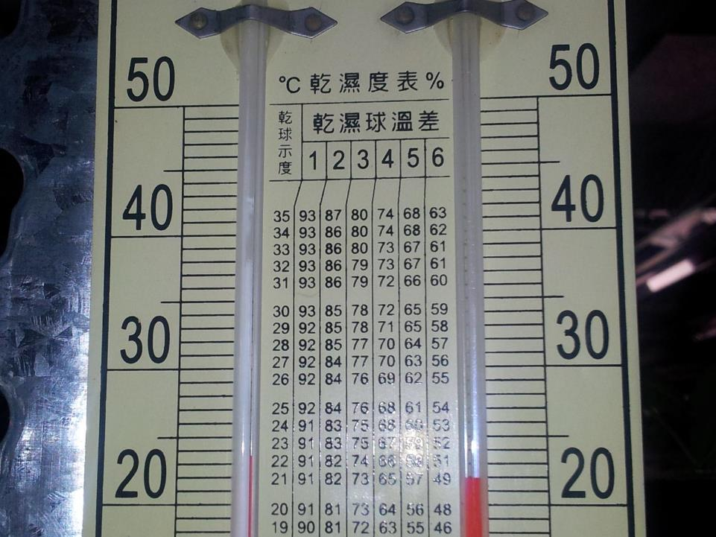
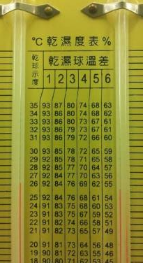

Slide 20
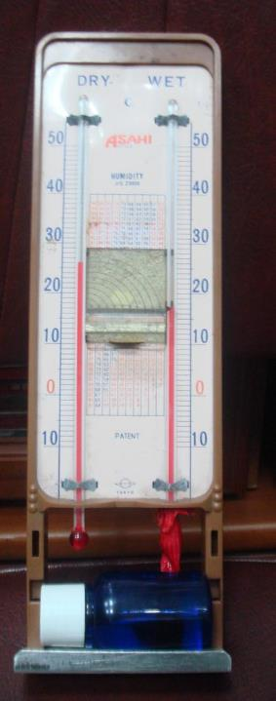
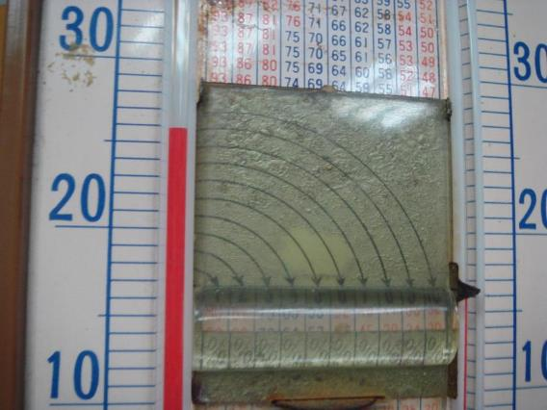
T_{db} and T_{wb}

Slide 21
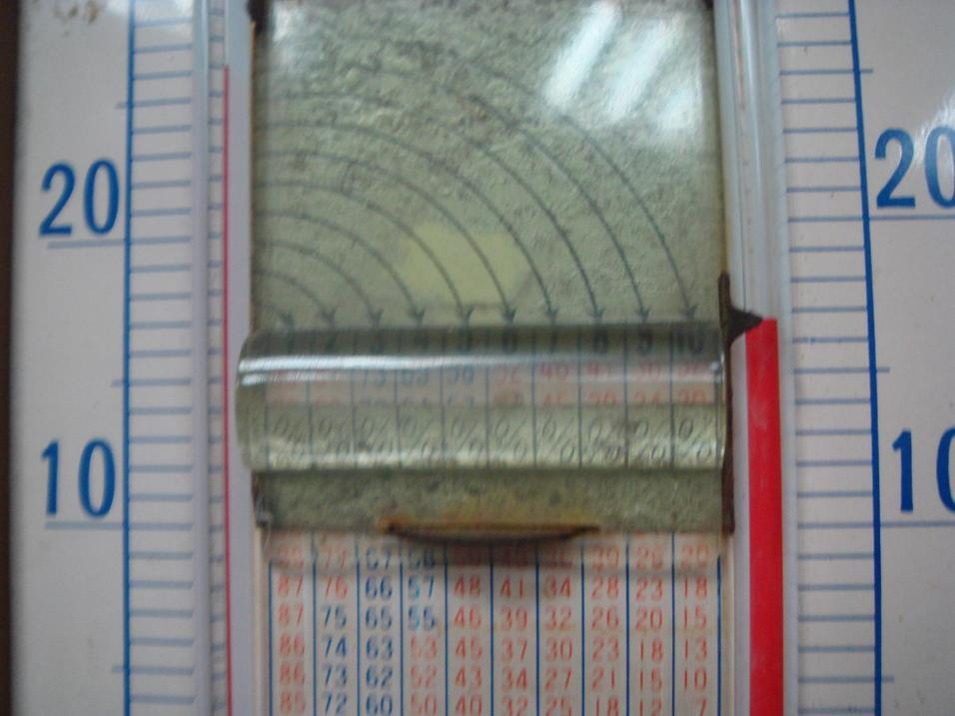
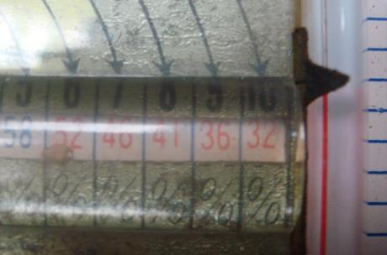
Tdb: 26 ºC
Twb:17 ºC
WBD: 9 ºC
RH ≈ 36 %

Slide 22
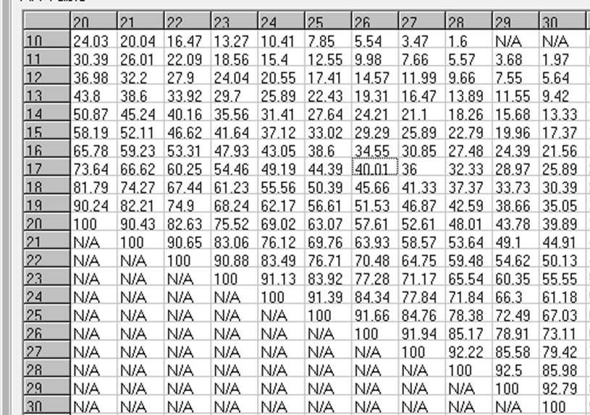

Slide 23
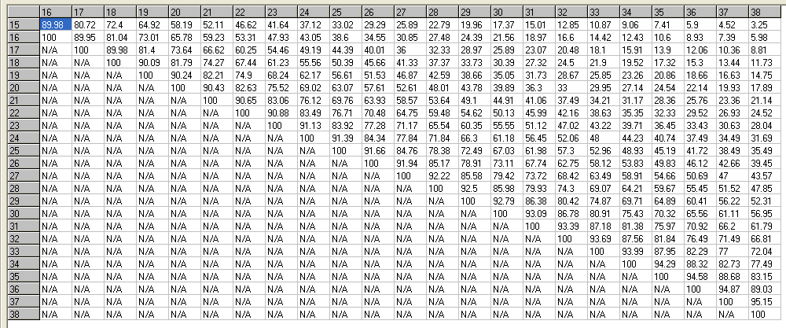
RH = f(T_{db} and T_{wb})
P_{atm} = 101.325 kPa = 1013.25 hPa

Slide 24
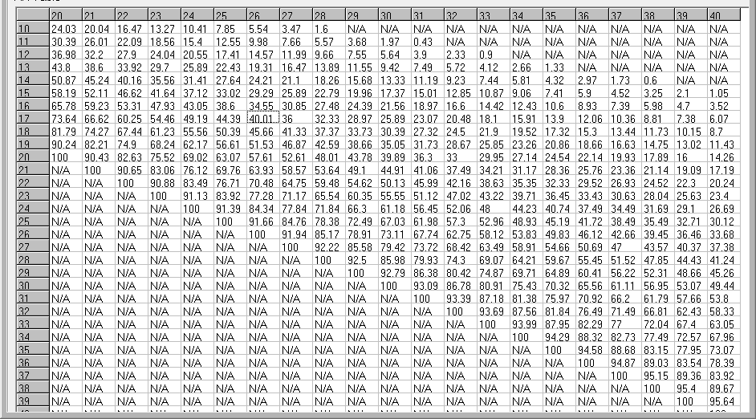
RH = f(T_{db} and T_{wb})

Slide 25
T_{wb} = f(T_{db}, RH)

Slide 26
Wet bulb depression, WBD
    WBD = Tdb – Twb
    Limit of the degree of temperature drop of the Evaporative cooling system

Slide 27
WBD= T_{db} – T_{wb} = f(T_{db}, RH)
Web Bulb Depression

Slide 28
Psychrometric properties
At given latitude (given P_{atm}) and
2 independent properties, others can be derived.
T_{db}、T_{wb} → RH
T_{db}、RH → T_{wb}
T_{wb}、RH → T_{db}

Slide 29
Psychrometric properties
3+1 T, 2 H and 2 P properties
  Tdb > Twb > Tdp (Dew point temperature)
  T_{sat}: Saturated T (T_{db} at RH=100%)
  Relative Humidity (RH), Absolute Humidity (AH)
  Water vapor pressure (P_{w})
  Saturated water vapor pressure (P_{ws}, P_{w} at T_{sat})

Slide 30
3+1 T
T_{db} T_{sat}
T_{wb}
T_{dp}: lowest temperature with no condensation occurred
  When surface T is lower than T_{dp} of the moist air, condensation will be occurred on the surface such as the eyeglass, cup, flower, leaves, etc.

Slide 31
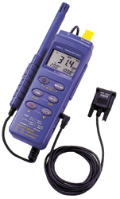
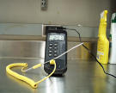

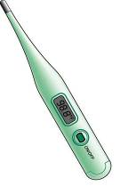
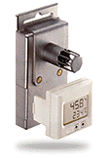
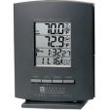

Portable digital T, RH measuring device

Slide 32
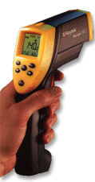
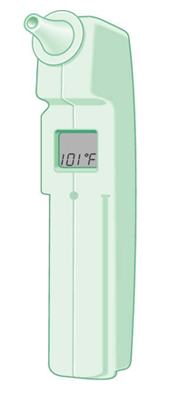
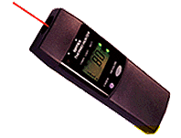
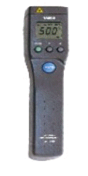
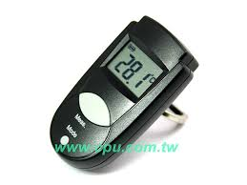
Infra-red Dry Bulb Temperature
Measuring only the surface T
Need to know the emissivity of the surface of interest to correctly measure the surface temperature.
Not for surface T measurement

Slide 33
Emissivity
Emissivity is a measure of a material’s radiating efficiency. An emissivity of 1.00 implies that the material is 100% efficient at radiating energy. An emissivity of 0.20 implies that the material radiates only 20% of that which it is capable of radiating. Black body ε= 1, Grey body ε < 1
Tables of emissivity values are only approximated values for real materials. A range of emissivity values is usually given for many materials whose emissivity can be affected by surface roughness or finish. Additionally, thin sheets of material such as plastics may be semi-transparent in the infrared and therefore have reduced emissivity

Slide 34
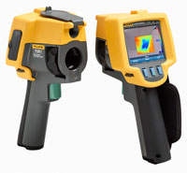
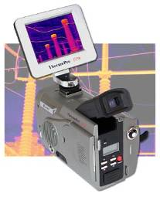
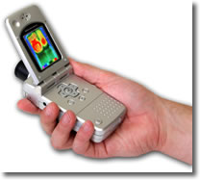
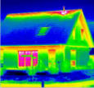
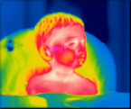
Thermal Imager
http://www.landinst.com/infrared/products/thermal_imaging/tp8_portable_imager.htm
http://us.fluke.com/usen/products/CategoryTI/
http://www.landinst.com/infrared/products/thermal_imaging/guide_M4_thermal_imager.htm

Slide 35
2 H
Relative humidity (RH) in %
  Ratio of vapor pressure (mass) of moist air vs.
  saturated vapor pressure (mass) at same T_{db}
  is called Relative Humidity (Degree of Saturation, DOS)
Absolute humidity (AH) in g/kg or kg/kg or
g/m³ or kg/m³
  Mass (g or kg) of water vapor per kg or m³ of dry air

Slide 36
AH
AH in g or kg/kg Dry Air (DA) divided by specific volume (SV) of DA is the AH in g or kg/m³ DA.
SV (m³/kg) is the inverse of air density (kg/m³)
At normal temperature range, mass of water vapor per 1 kg of dry air is 0 ~ 30 g
At same T_{db}, air with higher RH has higher AH
At same RH, air with higher T_{db} has higher AH

Slide 37
How many PSY. related terms you have learned so far?
4 T, 2 H, 2 P
DOS
WBD
SV, Density

Slide 38
Psychrometric Chart

Slide 39
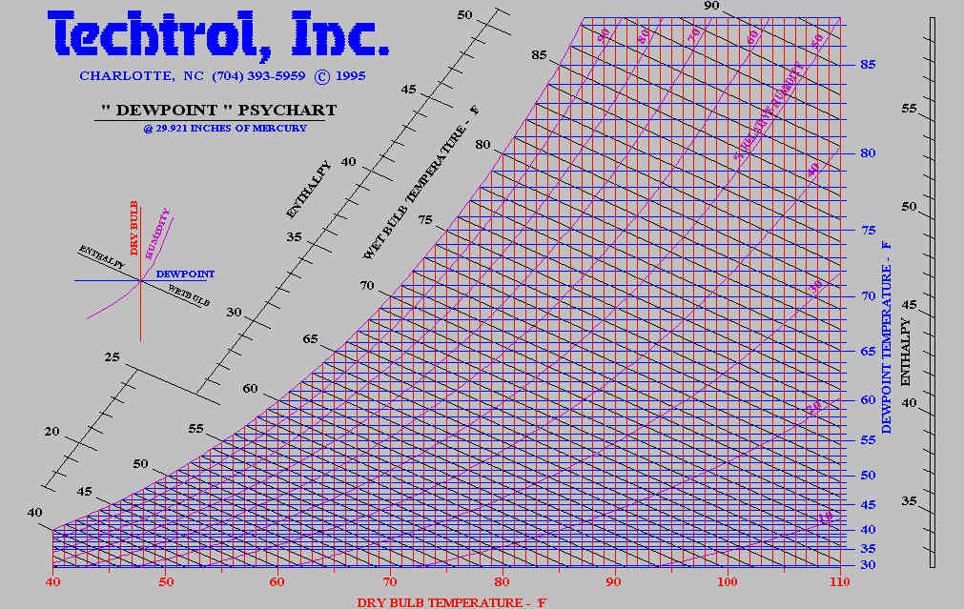
Psychrometric Chart

Slide 40
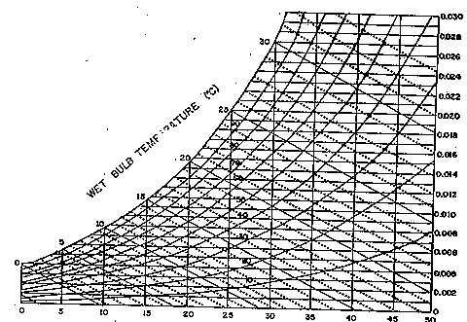

Slide 41
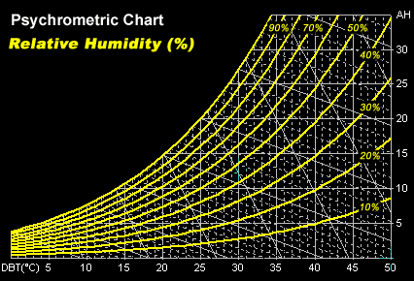

Slide 42
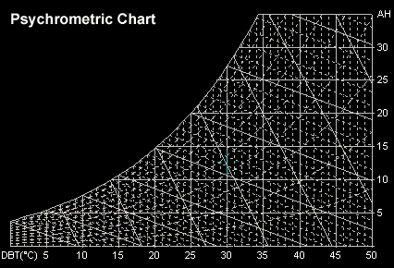

Slide 43
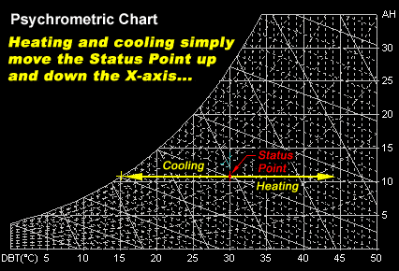
Process: from one state to another

Slide 44
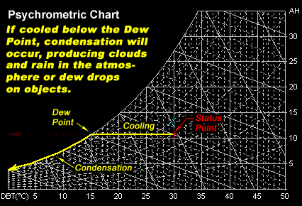

Slide 45
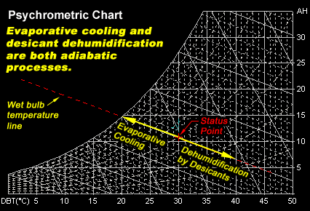

Slide 46
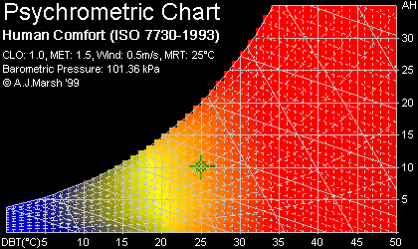
人體的溫溼度舒適帶

Slide 47
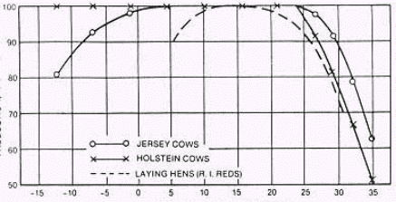
Comfort zone of 3 animals
Productivity
Dry bulb temperature

Slide 48
Psychart software

Slide 49
RH = f(Tdb, Twb)

Slide 50
WBD= Tdb – Twb = f(Tdb, RH)

Slide 51
RH range for plant growth
Tdb, ºC | RH too low (humidification required) | Proper RH | RH too high (dehumidification required)
15 | - | 50 % | 73
20 | 46 | 64 | 80
25 | 60 | 73 | 86
30 | 70 | 80 | 89

Slide 52
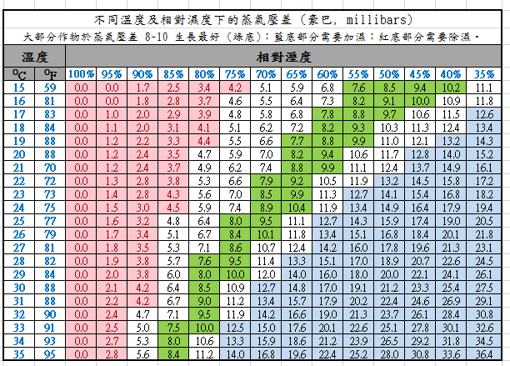

Slide 53
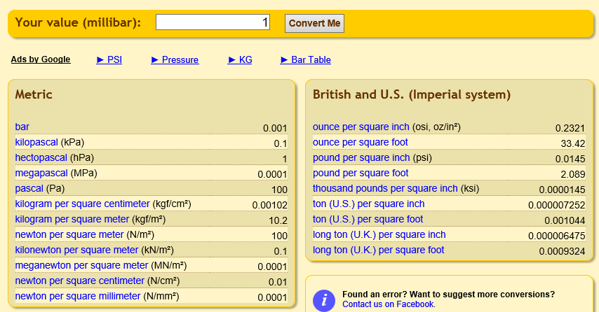
unit conversion millibar to others

Slide 54
VPD
1 millibar = 0.1 kPa
VPD too big (humidification or cooling required) | Proper VPD | VPD too small (dehumidification or heating required)
1.25 kPa | 0.85 kPa | < 0.45 kPa (Suitable for bacterial to survive) < 0.2 kPa (suitable for bacterial invasion)

Slide 55

VPD = f(Tdb, RH)

Slide 56


VPD is a better index for humidity control
Vapor Pressure Deficit

Slide 57

https://cals.Arizona.edu/vpdcalc/
Saturated Vapor Pressure
Vapor Pressure Deficit
Humidity Deficit

Slide 58

VPD is the driving force for the transpiration to occur.
Proper VPD leads to proper transpiration, proper water/nutrient uptake and proper growth.
VPD too high, stomata tends to close, no CO₂ intake and no water/nutrient uptake.
VPD too low, less transpiration occur, leads to less water/nutrients uptake, slow growth.

Slide 59

Psychart 軟體
Pws – Pw = VPD

Slide 60

VPD of GH_A during the night time
VPD too low at night.

Slide 61

VPD of GH_B during the night time
VPD too low at night.

Slide 62
Dehumidifier ON from 6 pm to 6 am
RH > 90% with dehumidifier OFF
Dehumidifier ON, RH at 80%
RH increase rapidly due to turn off of the dehumidifier, later decrease rapidly due to T increase inside the greenhouse after sunrise

Slide 63
VPD difference due to ON/OFF of the dehumidifier
VPD > 0.45 kPa is safer compare with VPD < 0.2

Slide 64


When outdoor RH is higher than indoor, ventilation can still be used to reduce the water content inside the greenhouse.
RH_{outdoor}
RH_{GH}
AH_{GH}
AH_{outdoor}

Slide 65

Natural ventilation can also remove indoor water vapor
when indoor AH is higher than outdoor AH
Notes:
即溫暖和潮濕的空氣大多比室外空氣輕
自然煙囪效應 氣流往上

Slide 66
How many PSY. related terms you have learned so far?
4 T, 2 H, 2 P
DOS, WBD
SV, Density
VPD_{air}, VPD_{airTdbwb}, VPD_{air_leaf}
HD_{air}, HD_{airTdbwb}, HD_{indoor_outdoor}

Slide 67
Tutorial for Psyc0226
Wei Fang, Ph.D., Professor
Dept. of Bio-Industrial Mechatronics Engineering
National Taiwan University
Software last updated: 2002/02/26

Slide 68
Psyc0226
Allow alteration on atmospheric pressure
Provide handy PsyTables
  Totally 11 tables are available
Provide PsyCharts
  State calculation: besides AtmP, values of 2 independent states are required to calculate others
  Process calculation: find differences between 2 states
  More process calculation:
    Evaporative cooling
    Vapor pressure deficit on leaf

Slide 69

Psyc0226 software
Tdb: dry bulb Temp.
RH : relative humidity
Twb: wet bulb Temp.
Tdp: dew point Temp.
AH : absolute humidity
H: enthalpy
SV : specific volume
Hfg: evaporated latent heat
DOS: degree of saturation
Pws: saturated water vapor pressure
Pw: water vapor pressure
Further illustration of the cell

Slide 70

Red zone is the chart

Slide 71


Two ways to set the atmospheric pressure

Slide 72

11 handy PsyTables

Slide 73


User friendly 3-step design in PsyTable
2. Set the intervals
3. List the values
1. Define the ranges

Slide 74

Table 1: Twb = f(Tdb, RH)
Twb
RH (50 – 100%)and Tdb (20 – 44 ºC)

Slide 75

Table 2: WBD = f(Tdb,RH)
WBD
Wet Bulb Depression is the limit of evaporative cooling methods.

Slide 76

Table 3: RH = f(Tdb,Twb)
RH
Twb (20 – 44 ºC) and Tdb (20 – 44 ºC)

Slide 77

Table 4: VPD of air, Table 10: AHD

Slide 78

VPD=Pws@Tdb – Pw@Tdb
AHD=Sat.AH@Tdb – Sat.AH@Tdp
VPD/AHD of air

Slide 79

Table 5: VPD’ of air, Table 11: AHD’

Slide 80
VPD’=Pw@Twb – Pw@Tdb
AHD’=Sat.AH@Twb – Sat.AH@Tdp
VPD’/AHD’ of air

Slide 81



Table 6: Tdp
Table 7: Tdp
6
7

Slide 82



Table 8, 9: THI, Temperature Humidity Index
8
9

Slide 83

Impact of T and RH on milk production of cows
82.49
64.65
63.39
68.47
72.32
76.68
64.31
65.05
75.73
79.96
63.7
87.09
90.09
88.06
86.01
82.09
84.21
82.36
THI >85, no recovery
Adapted from ASHRAE Fundamentals, 1999

Slide 84

Milk production decline vs.
Temperature-Humidity Index (THI)
Adapted from ASHRAE Fundamentals, 1999

Slide 85
MP = f(HD74, HA80S)
MP = 21.48 – 0.051 * HD74 – 0.0099 * HA80S
where,
MP: milk production per cow per day (in kg/day/cow)
21.48: regular MP amount (in kg)
HD74: total hours of THI > 74 for previous 4 days
HA80S: square of total hours of THI > 80 for previous day
  Linvill and Pardue (1992)

Slide 86

Iso-THI lines

Slide 87

Table 10: AHD or HD
10

Slide 88

Table 11: AHD’ or HD’
11

Slide 89

VPD
AHD or HD
VPD’
AHD’ or HD’
T_{dp}

Slide 90
Psycharts
Besides atmospheric pressure, values of 2 independent states are required to derive others
Evaporative cooling process calculation
find differences between 2 states
Vapor pressure deficit on leaf

Slide 91

State Calculation

Slide 92
Independent Properties (IP)
 | Twb | RH | Tdp | AH | SV | H | hfg | DOS | Pws | Pw
Tdb | IP | IP | IP | IP | IP | IP |  | IP |  | IP
Any pair of IP can be the given values to derive others.

Slide 93
One click in Psychart window using left button of the mouse can define a state

Slide 94


Process Calculation

Slide 95


Use mouse to define 2 states
To define 2nd state, change from ‘Inactive’ to ‘Active’ first.
Click in the Psychart window at the selected state or click on the crosshair region to move along constant lines or curves.
Click on ‘Cal.’ to calculate the difference.

Slide 96

Move along prefix lines or Curves
Constant Twb
Constant Tdb
Constant RH
Constant Tdp, Pw, AH
Constant Tdp, Pw, AH
Constant RH
Constant Tdb
Constant Twb

Slide 97

Process: Move from 1 state to another
Sensible Heating (3->4)
Sensible Cooling (4->3)
Humidification (4->5)
Dehumidification (5->4)
Heating (3->5, 3->1)
Cooling (5->3, 1->3)
Air Mixing (1, 2->3)
Evaporative Cooling, Drying (1->2, 1->3)
Combination of above (1->2->3->4->5)

Slide 98
Sensible heat gain

Slide 99
Evaporative cooling
Limit: Outdoor WB Temperature
  Pad and Fan system
  Misting/Fogging with nozzle at one side of the wall
Limit: INDOOR WB Temperature
  Indoor Spraying/Misting/Fogging

Slide 100

How to derive ΔT
ΔT = WBD of outdoor air x Pad Efficiency
T
T- ΔT

Slide 101


Evaporative cooling of a pad
Enter T outdoor
Enter Pad efficiency
Derive others
2. Enter T after Pad
3. Derive others

Slide 102

Click on “Draw” icon to visually see the outcome
ΔT
WBD

Slide 103

Pad Efficiency vs. Air velocity
(2 thickness of pad)
20 cm 厚
10 cm 厚

Slide 104

∆P vs. Air velocity (2 thickness of pad)
10 cm 厚
20 cm 厚

Slide 105

Efficiency vs. Air velocity
Pressure drop vs. Air velocity

Slide 106

Fan curves

Slide 107


Vapor pressure deficit (VPD) of leaf
Enter Leaf temperature, then click on Draw icon.
VPD

Slide 108

Shows the line/curves of the selected properties
Other handy features

Slide 109








Shows the line/curves of the selected properties

Slide 110


Zoom in
Zoom out
Other handy features

Slide 111

Unit label: to hide or not to hide the labels
Other handy features

Slide 112

Centralize: allow the state that user chose to appear at the center of the chart
Other handy features

Slide 113
Introducing LetsGrow
[ATGS 7140] Plant Factory – Theory and Practice
[ANISCI7047] Smart Production of Livestock
A psychrometric software
https://gpe.letsgrow.com/psychro
Wei FANG
NTU_BME and Global ATGS
National Taiwan University

Slide 114







Slide 115

1 個大氣壓 = 海平面，海拔 0 m
假設氣孔內相對濕度為100%
此值>0 確保水汽也由氣孔出來

Slide 116

作物範圍內微氣候
此值>0 確保水汽也散逸到溫室上方
= VPsat - VP

Slide 117
詳細版本

Slide 118

精簡版本

Slide 119


更多分析

Slide 120



ExtraHeat = (Radiation*穿透率) – (U*dT)
=[500*0.8 - 0*(30-18)]*3600/1000 kJ/m².h
∆Enthalpy=87.54-40.61=46.93 kJ/kg
Ventilation=ExtraHeat/∆Enthalpy
=400*3.6/46.93=30.69 kg/m².h
ExtraHeat=[500*0.8 - 10*(30-18)]*3600/1000 kJ/m².h
∆Enthalpy=87.54-40.61=46.93 kJ/kg
Ventilation=ExtraHeat/∆Enthalpy=(400-120)/46.93=21.48

Slide 121


Net Moisture balance = Moisture removed – Crop evaporation – fogging rate
= 301.58 – 50 - 0 = 251.58 g/ m².h
Value from Energy balance
AHD = 23.08 - 9.04 = 14.04 g/kg air
Moisture removed=
21.48 * 14.04 = 301.58 g/m².h
Net Moisture balance = Moisture removed – Crop evaporation – fogging rate
= 301.58 – 50 - 100 = 151.58 g/ m².h

Slide 122


Moisture exhaust= AHD x Fan capacity x Density_{insideAir}
= (23.08 – 9.04) x 10 x (26.43/23.08) = 160.778 g/m².h
_{Air density}
_{= (26.43/23.08) = 1.1451473}
_{= (4.66/4.07) = 1.144963}
Elec. Consumption =
Power * Area = 38.21*100 = 3821 W = 3821*3600/10⁶ MJ/h = 3.821*3.6
= 13.7556 MJ/h
Fan power = dP x 0.27778 / Efficiency
= 1000 x 0.27778 / 1 = 277.78 W
Fan power = dP x 0.27778 / Efficiency
= 100 x 0.27778 / 0.4 = 69.445 W

Slide 123
Examples of using Psychart

Slide 124
Properties
Under 1 ATM, the Tdb of moist air is 20 ºC，RH is 50 %，what is the humidity ratio (absolute humidity, AH), degree of saturation (DOS), dew point temperature (Tdp), enthalpy (h), and wet bulb temperature (Twb)?

Slide 125

Set the atmospheric pressure
Patm

Slide 126


Slide 127


Slide 128
Properties
Continue, What is the wet bulb depression (WBD) and vapor pressure deficit (VPD) ?

Slide 129
WBD = Tdb – Twb = 20 – 13.79 = 6.21 deg. C

Slide 130
VPD = Pws – Pw = 2.339 – 1.169 = 1.17 kPa

Slide 131
Properties
Complete the following Tables
 | #1 | #2 | #3 | #4
Atmospheric pressure, kPa | 101.325 | 101.325 | 101.325 | 89.874
Dry-bulb T, deg.C | 20 | 20 | -10 | 20
Relative humidity, % | 50 | 80 | 50 | 50
Humidity ratio, kg/kg
Dew point T, deg.C
Wet bulb T, deg.C
Specific volume, m³/kg

Slide 132


Slide 133

A bug was found in the software.
Twb should vary according to Patm.

Slide 134

From one state to another state is called process

Slide 135

Process
Determine the final state of moist air originally at 20 deg.C and 50 % relative humidity if 10 kJ are removed from 1.2 kg of the air.

Slide 136
Answer to Q4
Δ T = q/(Ma*Cp)=(-10 kJ)/(1.2 kg*1.006 kJ/kg.K)= -8.28 K
The final dry bulb T will be 20 – 8.28 = 11.72 deg.C if this is a sensible heating process.
The dew point T of moist air at initial state = 9.15 deg.C
The final dry bulb T > the dew point T of initial state, this is a sensible cooling process.
Δ h =q/Ma = (-10 kJ)/(1.2 kg) = - 8.333 kJ/kg
The initial h = 38.5 kJ/kg
The final h = 38.545 – 8.333 = 30.212 kJ/kg
The initial dew point T = final dew point T.
Final state can be found based on final Tdb and Tdp, or Tdb and h, or Tdp and h

Slide 137

State 2 was determined based on Tdb and H
H = 38.545 – 8.333 = 30.212 kJ/kg
Diff. of Tdp should be 0.

Slide 138

State 2 was determined based on Tdb and Tdp
ΔH = 8.591 kJ/kg which is a little bit off from 8.33 kJ/kg, also Diff. of AH should be 0.

Slide 139
Process
Determine the final state of moist air originally at 20 deg.C and 50 % relative humidity if 20 kJ are removed from 1.2 kg of the air.

Slide 140
Answer to Q5
Δ T = q/(Ma*Cp)=(-20kJ)/(1.2kg*1.006kJ/kg.K)= -16.56 K
The final T will be 20 – 16.56 = 3.44 deg.C if this is a sensible heating process.
The dew point T of moist air at initial state = 9.1 deg.C
The final dry bulb T < dew point at initial state, this is a cooling with condensation/dehumidification process.
The final relative humidity is 100 %.
Δ h =q/Ma = (-20 kJ)/(1.2 kg) = - 16.66 kJ/kg
The initial h = 38.545 kJ/kg
The final h = 38.545 – 16.66 = 21.885 kJ/kg

Slide 141

State 2 can be determined based on RH and H,
however, this software does not provide this option. We need to use trial and error method on Tdb of state 2 to derive ΔH = -16.66 kJ/kg..

Slide 142
Process
Greenhouse in tropical and subtropical regions often encounter high humidity problem. For some floral industries, dehumidifier is used in the greenhouses. Assuming the night time Tdb and RH in a 3 m height 1000 m² greenhouse before turn on the dehumidifier is 18 degree C, 91 % respectively. After turn on the dehumidifier for a while, the Tdb remain the same and RH drop to 80 %. How much water was removed from the moist air inside this greenhouse ?

Slide 143


Slide 144
Answer to Q6
Before use
  Specific volume = 0.8404 m³/kg
  AH = 0.0117 kg vapor/kg dry air
After use
  AH = 0.0103 kg vapor/kg dry air
Difference in AH
  AH₁ – AH₂ = 0.0014 kg vapor/kg dry air
  Air volume 1000 x 3 = 3000 m³
  Air weight = 3000 / 0.8404 = 3569.7 kg
  Total water condensed = 3569.7 * 0.0014 = 4.997 kg

Slide 145
Process
Air at 30 deg.C and 60% relative humidity in a growth chamber is cycled past the cooling coils and is returned back to the chamber at a temperature of 15 deg.C. Determine the psychrometric properties of the air after it is cooled, the sensible and latent heat removed, and the water vapor condensed per kg of dry air moved past the coils.

Slide 146
Growth Chamber
30 deg.C
60 % relative humidity
Cooler
15 deg.C

Slide 147

29.16 kJ/kg is the total heat removed, including the sensible heat and the latent heat.

Slide 148

15.378 kJ/kg is the sensible heat removed

Slide 149

13.782 kJ/kg is the latent heat removed
0.0054 kg/kg dry air is the amount of water removed
13.782/ 2428.4 = 0.00567 kg/kg dry air is the amount of water removed based on H_{fg}.

Slide 150
Process
When ambient conditions are 35 deg.C and 25 % relative humidity, (a). determine the dry bulb temperature to which ventilation air could be cooled if drawn through an evaporative cooler with an efficiency of 75%. (b). Calculate how much water must be added to each cubic meter of the air drawn through the cooler. (c). Redo problem 7(a) with the ambient conditions at 35 deg.C and 80 % relative humidity.

Slide 151
Answer to 8a
(a). At the given condition:
    Tdb = 35 deg.C
    RH = 25 % (Very dry weather)
Answer
    Twb = 20.15 deg.C
    WBD = 35 – 20.15 = 14.85 deg.C
    ΔT = 0.75 * WBD = 11.13 deg.C
    Final T = 35 – 11.13 = 23.87 deg.C

Slide 152

WBD

Slide 153
Answer to 8c
(c). At the given condition:
    Tdb = 35 deg.C
    RH=80 % (Regular humid weather)
Answer
    Twb = 31.64 deg.C
    WBD = 35 – 31.64 = 3.36
    ΔT = 0.75 * WBD = 2.52 deg.C
    Final T = 35 – 2.52 = 32.48 deg.C

Slide 154

WBD

Slide 155
Answer to 8b
(b). At initial conditions,
  Tdb = 35 deg.C
  RH = 25 %
Answer
  the specific volume is 0.8853 m³/kg, humidity ratio is 0.0088 kg/kg of dry air.
  At wet bulb of 20.15 and dry bulb of 23.87, the humidity ratio is 0.0132 kg/kg of dry air.
  A cubic meter of air will contain 1 m³/0.8853 m³/kg = 1.13 kg.
  The change of humidity ratio is 0.0132 – 0.0088 = 0.0044 kg/kg dry air.
  Thus, the total water gained by each cubic meter of outdoor air will be 1.13 kg * 0.0044 kg/kg = 0.005 kg.

Slide 156
A small bug was found in the software. Both Twb should be the same.

Slide 157
Process
A ventilation system for a calf nursery draws 1 m³/s of air from the nursery, exhausts 0.2 m³/s of the air to the outside, and replaces the exhausted air with fresh air. Air in the nursery is at 20 deg.C and 50 % relative humidity, and outdoor air is at 5 deg.C and 80 % relative humidity. Determine properties of the mixed air when it is returned to the nursery.

Slide 158
1 m³/s
Calf Nursery
20 deg.C,
50 % relative humidity
Outdoors
0.2 m³/s
②
5 deg.C
80 % relative humidity
①
Mixing chamber
③
 | #1 | #2 | #3
T, deg.C | 5 | 20 | 16.86 (cal.)
RH, % | 80 | 50 | 53.37 (psychart)
V, m3/s | 0.2 | 0.8 | 0.999
ν, m3/kg | 0.7935 | 0.8402 | 0.83
M, kg/s | 0.252 | 0.952 | 1.204
W, kg/kg | 0.0043 | 0.0073 | 0.0066 (cal.) / 0.0064 (psychart)
h, kJ/kg | 15.859 | 38.545 | 33.796 (cal.) / 33.054 (psychart)
W₃ = (M₁*W₁+M₂*W₂)/(M₁+M₂)
T₃ = (M₁*T₁+M₂*T₂)/(M₁+M₂)
h₃ = (M₁*h₁+M₂*h₂)/(M₁+M₂)

Slide 159

State 3

Slide 160


Slide 161
Process
You are designing an evaporative cooling system to ventilate a controlled environment, totally enclosed, poultry house in a hot and dry climate.
Summer design weather conditions for your location are 40 degree C Tdb and 20 % RH.
75 m³/s of outdoor air will be drawn by the evaporative cooling system (75% efficiency) and 15 m³/s of outdoor air will be drawn into the house through infiltration.
The birds in the house are expected to produce 250 kW of total heat of which 40% is latent heat. Determine
    the psychrometric properties of the air mixed by air through evaporative cooling pad and air through infiltration.
    the psychrometric properties of the exhausted air.
    the volumetric flow rate of air exhausted from the house.
    the rate (L/s) at which water must be supplied to the evaporative cooling pads by a water pump. When a (water flow/evaporation rate) ratio of 3 is desire.

Slide 162
infiltration
15 m³/s
1
Poultry House
3
Evaporative cooler
2
4
75 m³/s

Slide 163

= 16.66, = 86.3, = 102.96 kg/s
T₃ = ( * T₁ + * T₂) / = 28.69 deg. C
W₃ =( * W₁ + * W₂) / = 0.0137 kg/kg
State 3
Zoom out
State 2
State 1

Slide 164
= 15 m³/s
ν₁ = 0. 9003 m³/kg
= 16.66 kg/s
T₁ = 40 deg. C
RH₁ = 20 %
W₁ = 0.0092 kg/kg
T₄ = T₃ + ΔT = 28.69 + 1.448 = 30.138 deg. C
W₄ = W₃ + ΔW = 0.0137 + 0.0004 = 0.0141 kg/kg
infiltration
Poultry House
1
T₃ = 28.69 deg. C
W₃ = 0.0137 kg/kg
= 102.96 kg/s
3
100 kW latent
150 kW sensible heat
4
Evaporative cooler
ΔT = 150 / ( * Cp) = 150 / (102.96*1.006) = 1.448 deg. C
h_{fg} = 2501 – 2.42 * (28.69+1.448) = 2428 kJ/kg
ΔW= 100 / ( * h_{fg}) = 100 / (102.96 * 2428) = 0.0004 kg/kg
2
= 75 m³/s
ν₂ = 0.8689 m³/kg
= 86.3 kg/s
T₂ = 26.51 deg. C
RH₂ = 67.1 %
W₂ = 0.0146 kg/kg

Slide 165

The volumetric flow rate and properties of states 3 and 4
State 4
State 3
Zoom in to the limit.

Slide 166
the rate (L/s) at which water must be supplied to the cooling pad = 3 * (0.0146 – 0.0092) * 75 / 0.9003 = 1.3495 kg /s

Slide 167
Reference on Psy. Examples
Albright, L.D. 1990. Chapter 2 – Psychrometrics. Environment Control for Animals and Plants. An ASAE Textbook. ASAE, St. Joseph, MI, USA.

