Slide 1
Environmental control in PFAL Air Temperature, Humidity and Velocity
[ATGS 7140] Plant Factory – Theory and Practice
Wei FANG
Dept. of Biomechatronics Engineering (BME) and Global ATGS
Center of Excellence for Controlled Environment Agriculture (CCEA)
National Taiwan University (NTU)

Slide 2
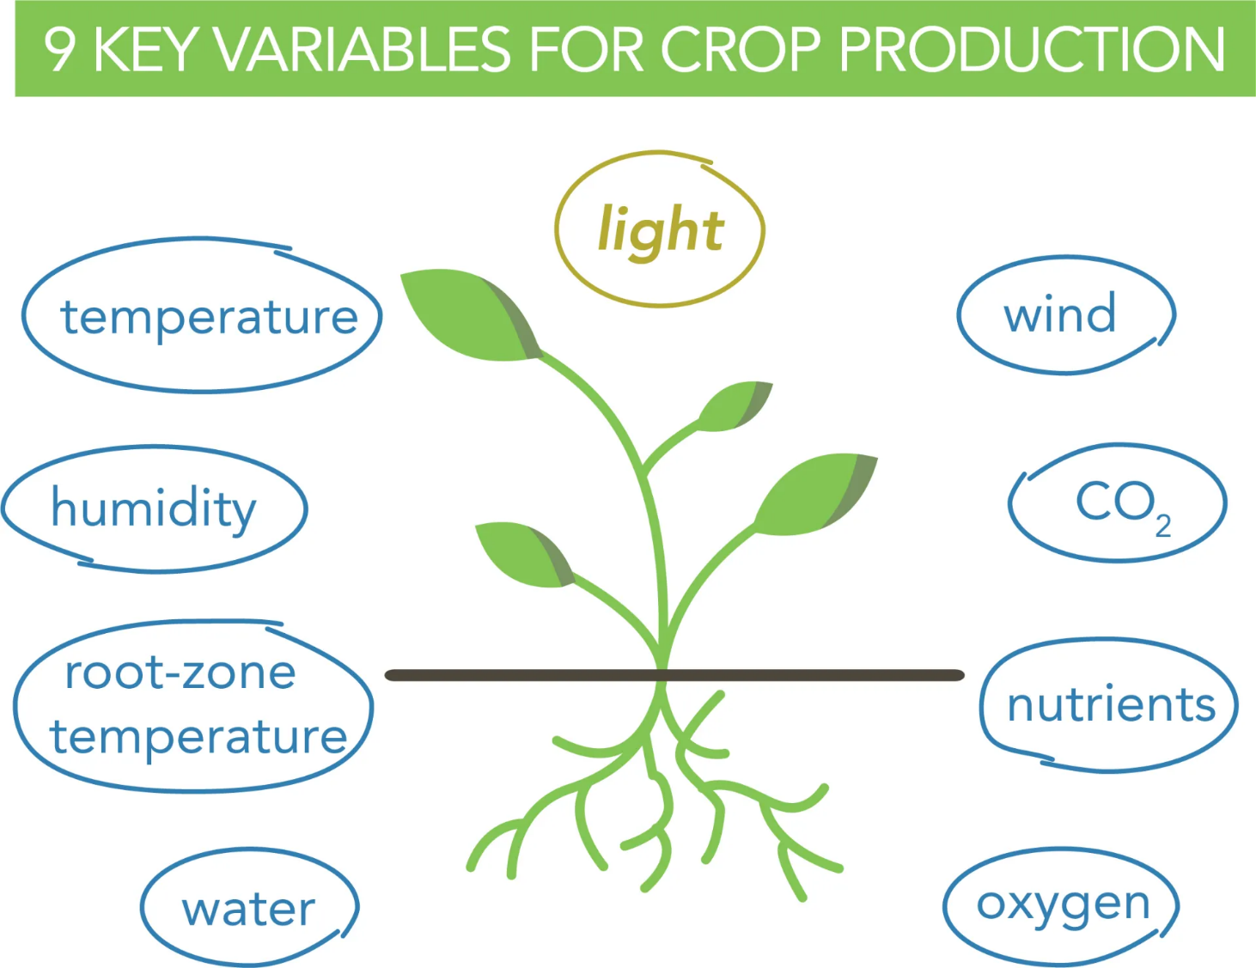
Topic 4 involved
air
leaf
Topic 5 involved
Topic 6 involved

Slide 3
Five governing factors in PFAL (PF with Artificial Lighting no sunlight)
Wind, Temperature, Humidity
Air
Light
Water
Nutrient
Gas
quality
Intensity: PPFD
duration
CO₂
concentration
receipt
concentration: EC
Availability: pH
When
Frequency
Dissolved Oxygen
Temperature

Slide 4
Must have monitoring items
T、 RH、Wind
Light Intensity, quality, duration
CO₂
Air Light Gas
Water Nutrient
Tw、DO
pH、EC

Slide 5
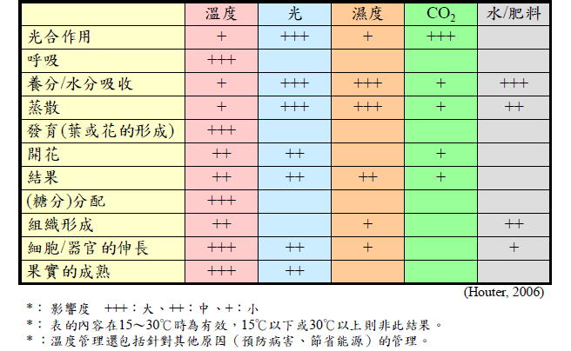
Factors affecting plant growth and development
Temperature
Light
Humidity
Nutrient+H₂O
photosynthesis
respiration
Absorb. of nutrient+H₂O
Transpiration
Development (leaf,flower formation)
booming
fruiting
Distribution of sugar
++
Formation of organ
Extension of cell/organ
Mature of fruit
Degree of influence: +++ large, ++ medium, + small
Suitable range in between 15 ~ 30 ºC
Modified by Fang, 2018

Slide 6
Outline
Fundamentals
Integrated Approach
Actuators of air control
T, RH, air velocity measurement
F
M
A
I

Slide 7
Temperature control
to Manipulate Crop Growth and Development.
Growth is an irreversible increase in mass (dry weight).
Development is a sequential movement through life stages.
Controlling temperatures involves moving heat into or out of a PFAL. Really though, we are talking about moving heat into or out of a plant to manipulate how it grows and develops.

Slide 8
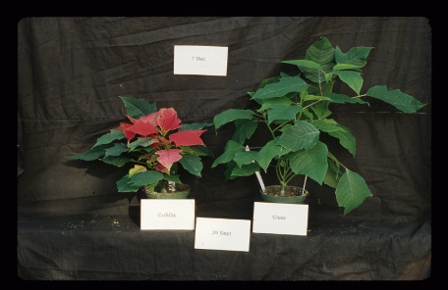
Temperature as a tool to manipulate growth and development
Which plant (both are the same age) has the most growth, the most development?
We use temperature to manipulate both growth and development.

Slide 9
Moving or transferring heat
Direct transfer of heat
Kinetic energy transferred due to collisions
Billiard balls, Boiling water on electric stove
Heat energy released as Electromagnetic Radiation (EMR)
Everything above absolute zero emits electromagnetic radiation
Wein’s law -- As temperature ↑, energy emitted as shorter λ
Plant loses most of heat this way
Some greenhouses use radiant heating systems
Conduction
Convection
Thermal Radiation
Evaporation / Transpiration
Heat transfer associated with phase change (liquid to gas)
Latent heat of vaporization
Water = 540 cal/mL = 540x4.2 J/mL
High compared to other liquids
Plant cools itself by evaporating water from stomates, termed transpiration
Evaporative cooling pads help cool some buildings
Air or fluid moves to new location to transfer heat
Chimney effect (Passive ventilation)
Hot air rises, cold air sinks
Convection oven
Forced air heating and air conditioning

Slide 10
Energy Budget of PFAL = Gains minus Losses
Heat Gains
Solar radiation and ‘trapped’ heat = 0
Heating system = 0
Other machines
Lamps
AC systems
Fan motors
Pumps
Heat Losses
Conduction
Direct transfer of heat through thermally insulated walls/roof/floor, assuming = 0
Ventilation/Infiltration
Loss of heat and openings
Depends on tightness of the PFAL.
ACH for PFAL, forced ventilated greenhouse
ACM for Naturally ventilated greenhouse

Slide 11
Energy Budget of a Plant in PFAL
Gains
Radiation (short wavelength) from light source in PFAL
Thermal radiation (Long wavelength)
Convection from warm air
Losses
Thermal radiation (Long wavelength)
Transpiration
Convection to cool air

Slide 12
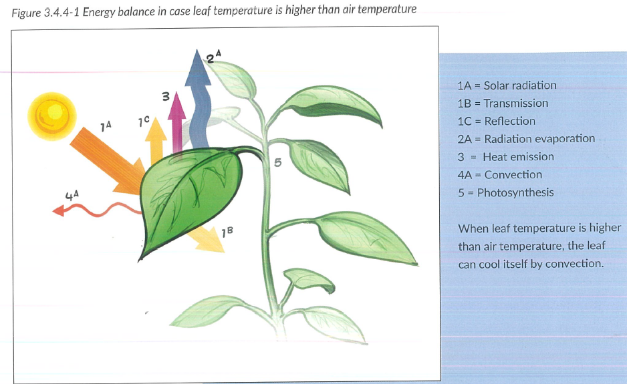
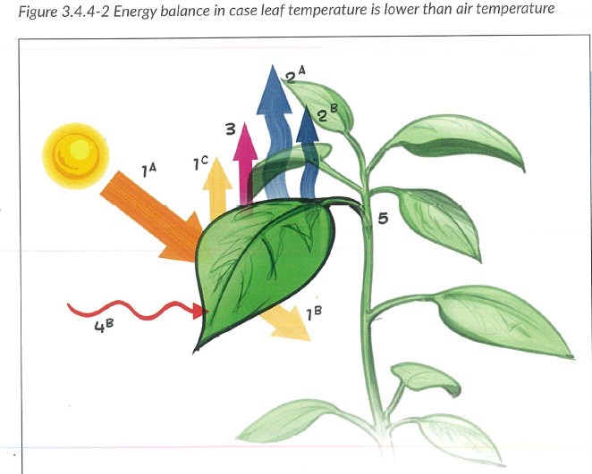
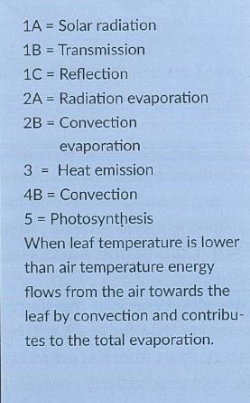
Energy balance of a leaf
Transpiration acquire energy from radiation - convection
Transpiration acquire energy from radiation + convection
T_{leaf} > T_{air}
T_{leaf} < T_{air}
Geelen, Voogt and van Weel, 2020 Plant empowerment
Geelen, Voogt and van Weel, 2020 Plant empowerment
More water transpired due to more energy acquired for transpiration
Air movement > 0, RH < 100%

Slide 13
Determining Greenhouse Heat Requirements
Calculate heat loss from greenhouse
Q = [(A₁* x U₁) + (A₂* x U₂)] x (T_{Inside}-T_{Outside}) x W x C
A = Surface Area of exposed walls calculated by grower
U = Conductance factor - provided by manufacturer
T_{i} – T₀ = Temperature Differential - calculated from climate data
W = Wind Factor - calculated from climate data
C = Construction Factor - provided by manufacturer
Q is how much heat need to be supplied by a heating system.
* The subscript indicates different wall/glazing materials, e.g. wood, glass, concrete, plastics, etc.)
Determining PFAL Heat Requirements
Calculate heat loss from PFAL
Q = 0

Slide 14
Cooling
PFAL
Reduce air temperature through AC
Replenish CO₂ through CO2 enrichment system
inside should at least 800 ppm
Reduce relative humidity
↓ Condensation on leaves
↓ Disease
Greenhouse
Reduce air temperature through natural or forced ventilation or AC
Replenish CO₂
Outside ~380 ppm, inside can be much lower
Reduce relative humidity
↓ Condensation on leaves
↓ Disease

Slide 15
Using temperature to control plant growth

Slide 16
Temperatures indoor
Air temperature
Most commonly and easily measured
Night temperature is easier to control than day temperature
Leaf temperature
Difficult to measure
Most likely different (>, =, < ) from air temp
Media temperature
Roots
Nutrient solution
Propagation

Slide 17
How Temperature Affects Plants
Flower induction in some species
e.g. Easter lily、Phalaenopsis
Interacts with photoperiod to control floral induction
Heat delay
Bud dormancy or vernalization
e.g. hydrangea & azalea
Controls rate of stem elongation
*Most important

Slide 18
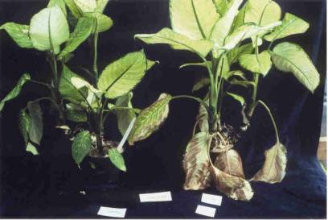
Adverse Effects of Temperature
Chilling injury often occurs at less than 50°F/10°C
African violets 紫羅蘭
Poinsettias 聖誕紅
Hibiscus 木槿
Gloxinia 大岩桐
Tomatoes 蕃茄
Foliage plants 觀葉植物
Phalaenopsis 蝴蝶蘭
Chilling injury - membrane dysfunction
Lipids in tropical and subtropical plant membranes solidify

Slide 19
Growth vs. Development
Growth
increase in size (volume or weight) of plant or organ that is irreversible and permanent
Development
Aging process of the plant – phases that plant goes through as gets older
Germination
Vegetative growth
Flowering
Fruit set
Seed release

Slide 20
Growth Rates of Plants
Growth rate = The speed at which an organ goes through a certain developmental stage
Stem growth
Flower production
Leaf unfolding
All growth processes have different temperature response curves
Even within species
Cultivar specific

Slide 21
Optimal Temperature
Every species has both optimal and tolerable temperature range for growth
Optimal range: produce high quality plants most rapidly
Mums = 16~17ºC (night)
Tolerable range: still grow but more time and lower quality
Mums = 4-15°C & 18-27°C (night)

Slide 22
Cumulative Growth
Instantaneous plant temperature controls growth at any moment
Cumulative growth in 24 h = average of individual growth rates during that period
Manipulating average daily temperature in the PFAL (within tolerable range) will change the rate of plant development
Fast growth ≠ high quality growth

Slide 23
Average Daily Temperature
Growers have target temps for day and night
Can calculate an average daily temp.
Weighted average
Day 16 h @ 25°C
Night 8 h @ 20°C
Weighted Avg. temp = [(16x25)+(8x20)]/24 = 23.33°C

Slide 24
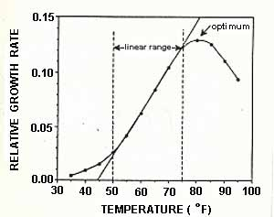
Relative growth rate = f(Tdb) Temperature affects growth rate
portion of curve that is a straight line
Maximum is usually not optimum.
Optimum is the temp. that has the plant at the stage you want it to be at!!!!!!
Base temperature : intersection of the straight line (linear range) and the X-axis (X-intercept)
Maximum temperature: peak of growth rate curve
Base temperature

Slide 25
Relative Growth Rate

Slide 27
More of the temperature related topics can be found in the sup. of this pptx.
Including concept of Degree-Days
DIF and DROP.
These concepts are used mostly in greenhouse for flowers and ornamental plants, not in PFAL.

Slide 28
From Psychrometrics, we learned
“Temperature affects humidity”
This is only partially true
Change of Dry bulb temperature affects relative humidity (RH)
But not affects absolute humidity (AH)

Slide 29
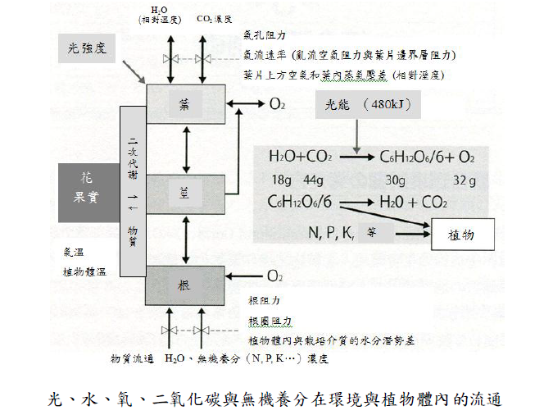
Plant growth and development involved many highly complicated and intercorrelated processes
H₂O CO₂ concentration
light
Stomata resistant layer of air and leaf
VPD/AHD between air and leaf affected by T and RH / AH
leaf
Energy_{light} (480 kJ)
2^{ndary} metabolites
_{Flower}
_{Fruit}
stem
_{etc.}
plant
T_{air}
T_{leaf}
materials
root
Resistant of root, root zone
Water potential difference between root and growth media
Material exchange: H₂O, inorganic macro/micro nutrients (N, P, K, …) concentration

Slide 30
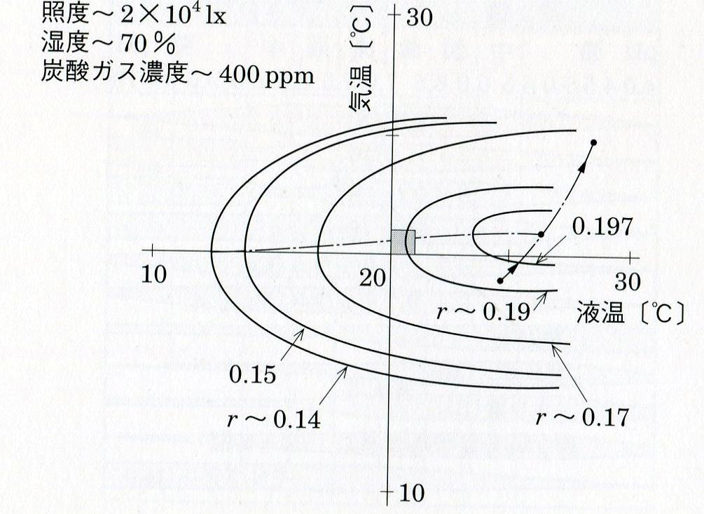
Iso-growth rate=f(T_{a}, T_{w}) and other 3 are fixed values
Light Intensity: 20,000 lux
Relative Humidity: 70%
CO₂ concentration: 400 ppm
Air T: T_{a} 20 ºC
Solution T: T_{w} 20 ºC
Relative growth rate: γ = 0.19
Ta
Temperature of air (T_{a}) and nutrient solution (T_{w}) affects
growth rate
At least 6 factors involved to derive Relative Growth Rate, air movement is the one that is missing
Tw

Slide 31
Influence of air movement

Slide 32
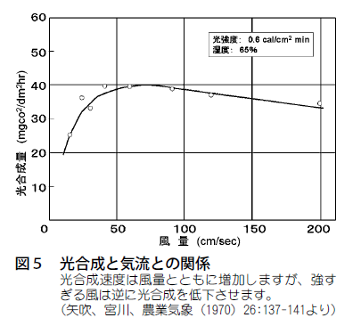
Pn=f(Air velocity) when Light, RH are fixed How about Ta, Tw, CO₂ ? Air Velocity affects photosynthetic rate
Photosynthetic rate
Air velocity

Slide 35
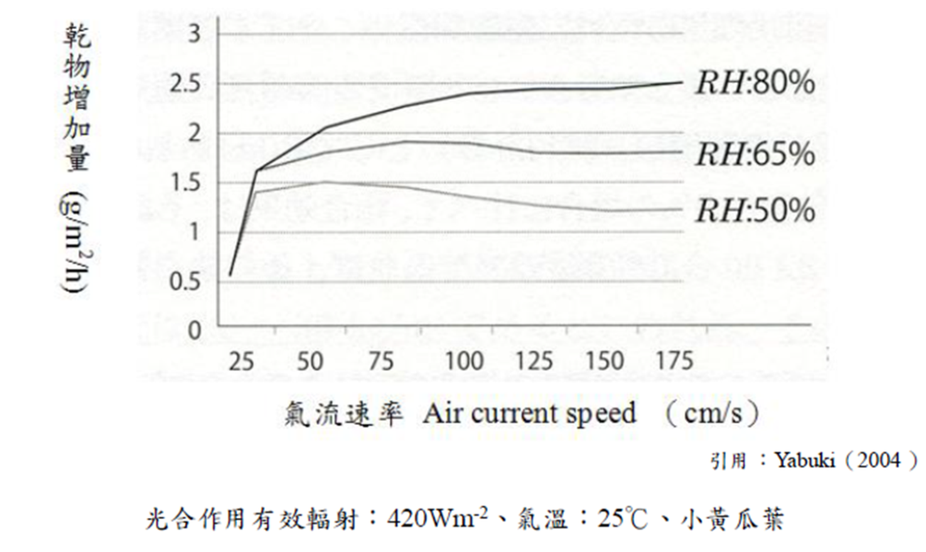
DM increment = f(Air velocity, RH) when Light and T_{db} are fixed, how about CO₂ ?
Air Velocity and RH affects growth rate expressed as hourly DM increment per unit leaf area
DM increment (g/m²/h)
Air velocity (cm/s)
PAR
T_{db}
Cucumber

Slide 36
Freshness
Dry mass
Leaf area

Slide 37
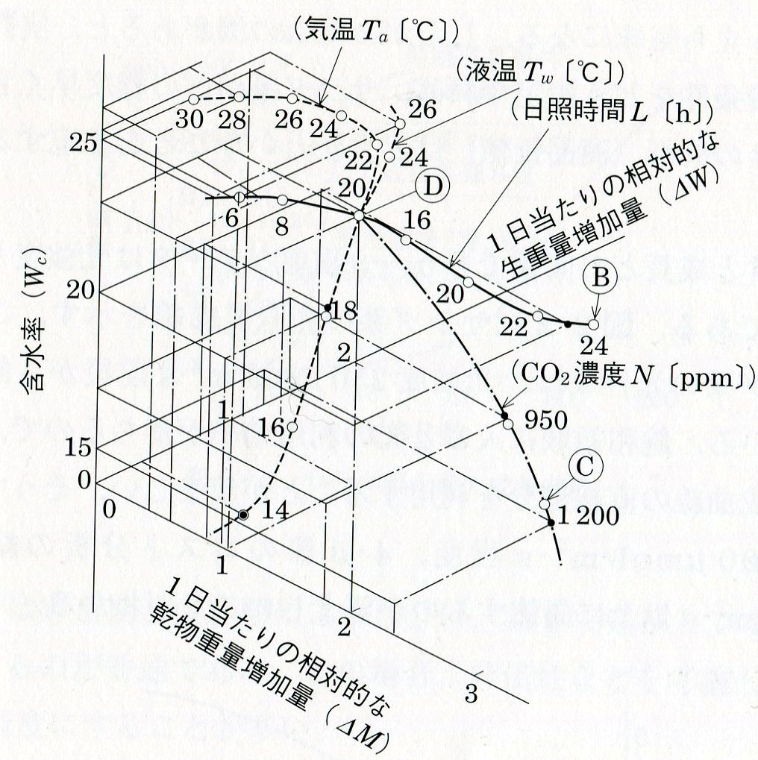
Air temperature (Ta),
solution temperature (Tw),
day length (L) and
CO₂ concentration (N)
affects
moisture content (Wc) and
growth rate, expressed in daily relative DM increment (∆M) and relative FM increment (∆ W)
of the plant
There is no air velocity involved in this study.
Dry-Base
moisture content
= moisture weight / dry weight
Intersection
Ta: 20 ºC
Tw: 20 ºC
L: 12 hr
N: 400 ppm

Slide 38
Observation (1/2)
Air T (Ta >24) does not affect moisture content (Wc=25)
Ta @20 has
best Wc@23
max daily dry weight increment (∆M)
Ta 22~24 has max daily fresh weight increment (∆W)
Ta 30 drop to 20, ∆M increase
Ta 28 drop to 20, ∆M increase from 0.5 to 2
Solution T (Tw@14~26) greatly affects Wc 15~25
Higher Tw, higher Wc, higher ∆W (0.4 to 1.5)
Tw@20 has greatest ∆M

Slide 39
Observation (2/2)
CO₂ (400~1200 ppm)
greatly affects Wc (23~15)， higher CO2 (1200), lower Wc (15)
Greatly affects ∆M, almost in direct proportion
greatly affects ∆W, but gradually decrease the degree of increment when CO2 increase
Day length (6~24 hrs)
does not affects Wc
greatly affects ∆M, almost in direct proportion
greatly affects ∆W, but gradually decrease the degree of increment when CO2 increase

Slide 40
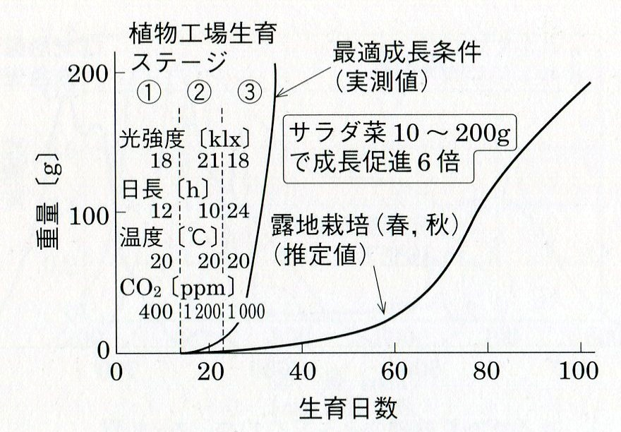
Optimum Growth can be reached through various settings in different stages in PFAL. To harvest 200 g FM/plant, required 105 days in open field (Spring / Autumn) and 35 days in PFAL
Optimum Growth Condition
Stages in PFAL
Lettuce 10 ~ 200 g Growth rate greatly enhanced in PFAL
Fresh Mass, g/plant
Spring/Autumn Open field production
Days after Sowing

Slide 41
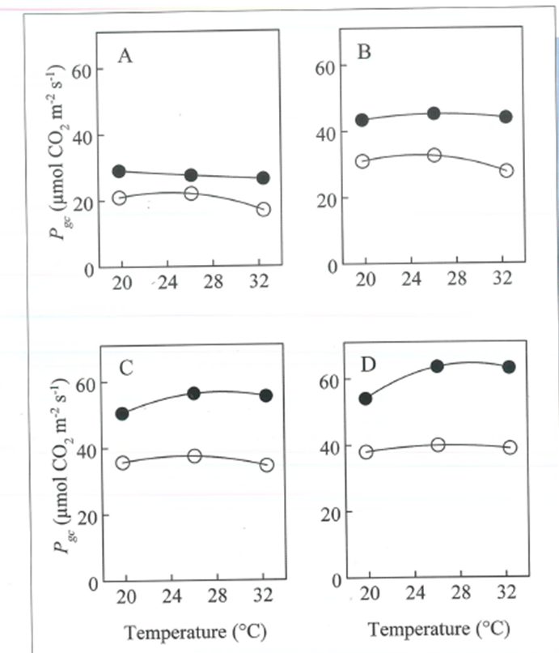
300 μmol/s.m²
600
Effects of CO₂ enrichment is substantially increased when under high PPFD and high air T
PPFD=900
PPFD=1200
CO₂ 1000 ppm
CO₂ 400 ppm

Slide 43
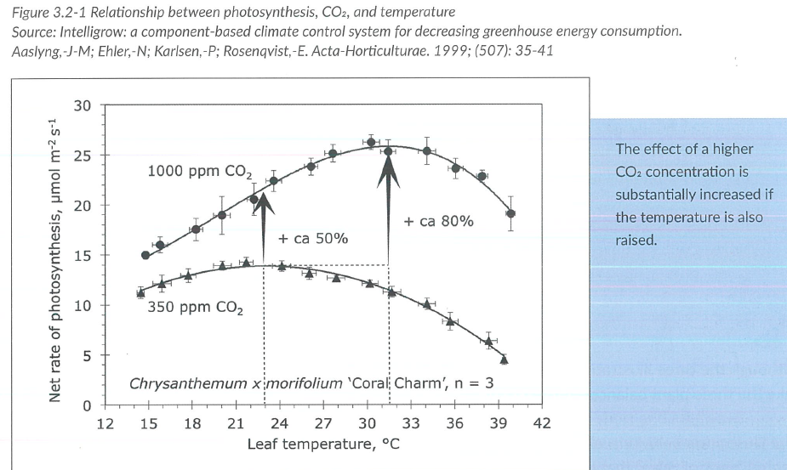
New trend using Leaf T instead of air T
Geelen, Voogt and van Weel, 2020 Plant empowerment

Slide 44
Outline
Fundamentals
Integrated Approach
Actuators of air control
T, RH, air velocity measurement
F
M
T
A
I

Slide 45
Installation/operation guidelines for Temperature measurement
Sensors
mounted close to plant canopy
should be shaded
should have proper ventilation
Air passing through sensing element
Air suction at negative pressure
Air pass through sensing element of Tdb first, then sensing element of Twb

Slide 46
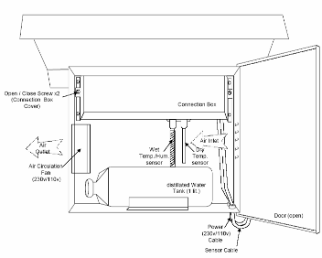
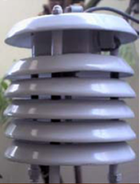
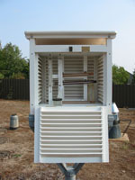
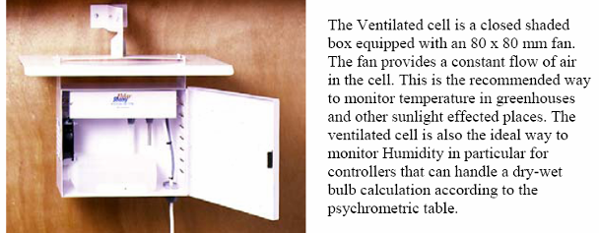
Dry and wet Bulb Temperature sensors in weather station and greenhouse

Slide 47
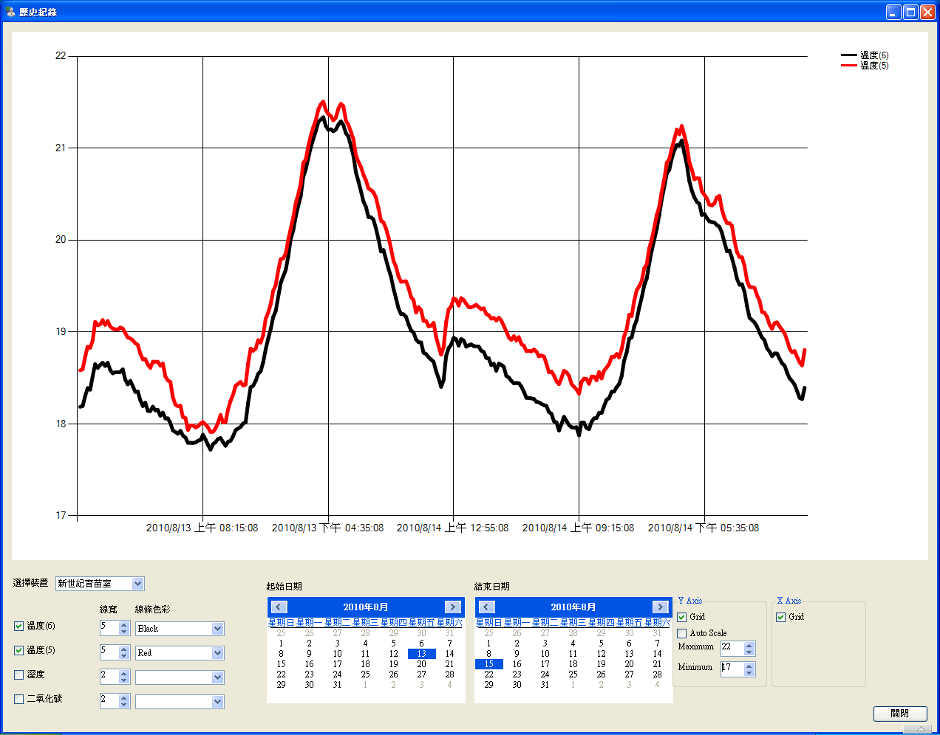
18 ~ 21 ºC

Slide 48
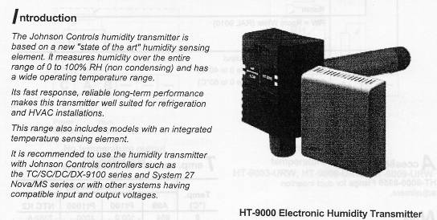
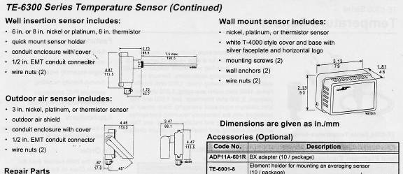
T_{db} and RH Sensors

Slide 49
T&RH sensors installed in PFAL

Slide 50
T&RH Data logger
(Temperature, Dry Bulb)

Slide 51
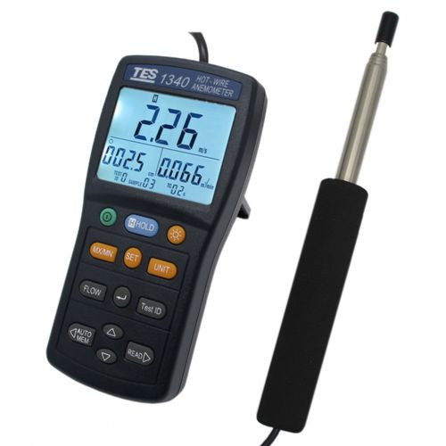
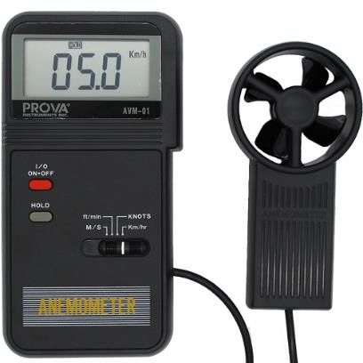
Wind velocity sensors / Anemometer
This type is not suitable for PFAL
A better choice:
Hot-wire anemometer
https://www.eyc-tech.com/show/eyc-hot-wire-type-air-velocity-series-product-principle-application.htm

Slide 52
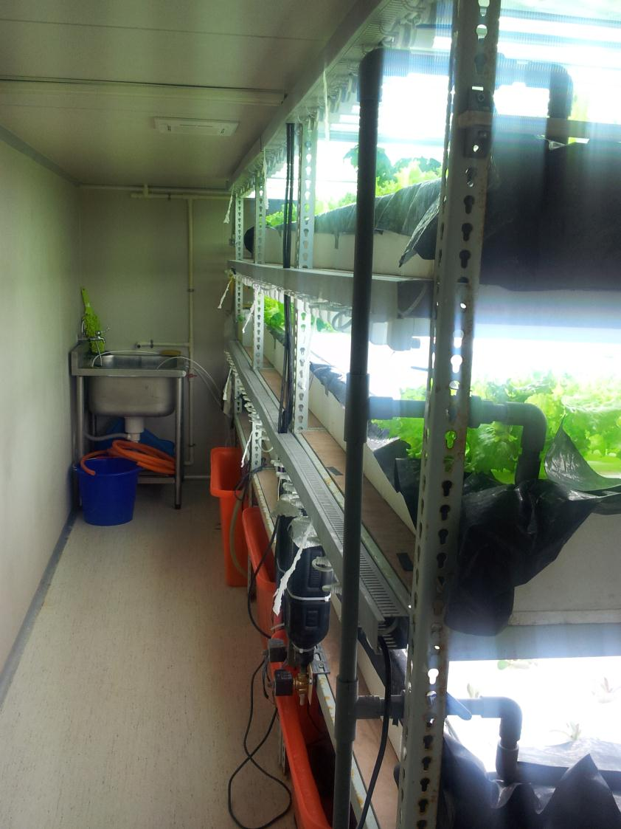
Cheapest wind velocity sensor
There are 9 wind velocity sensors can be found in this photo

Slide 53
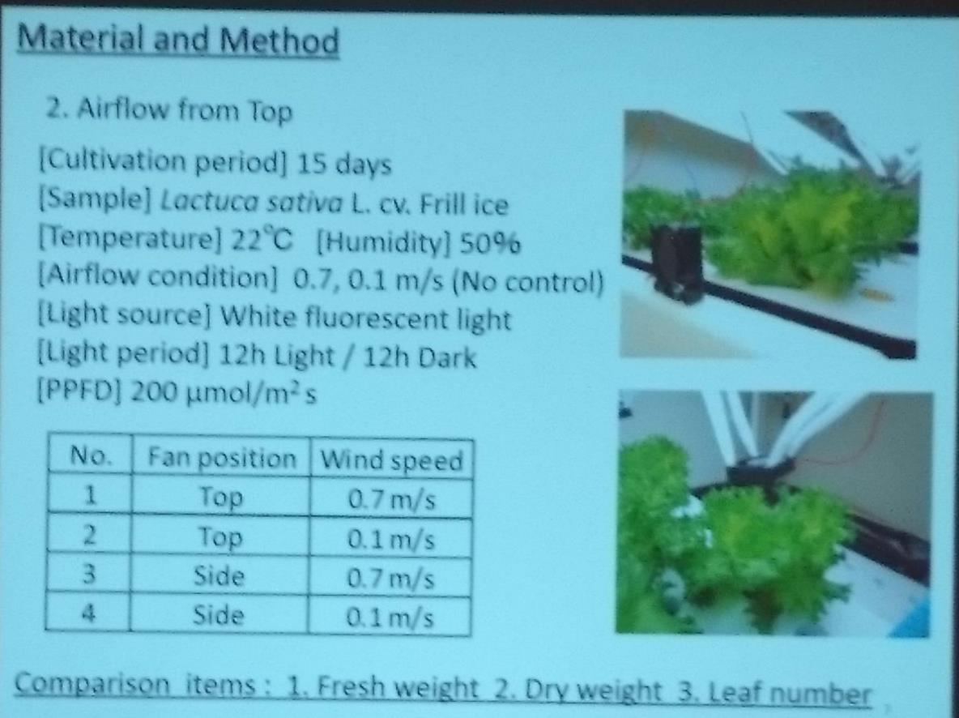
Sideward vs. downward air

Slide 54
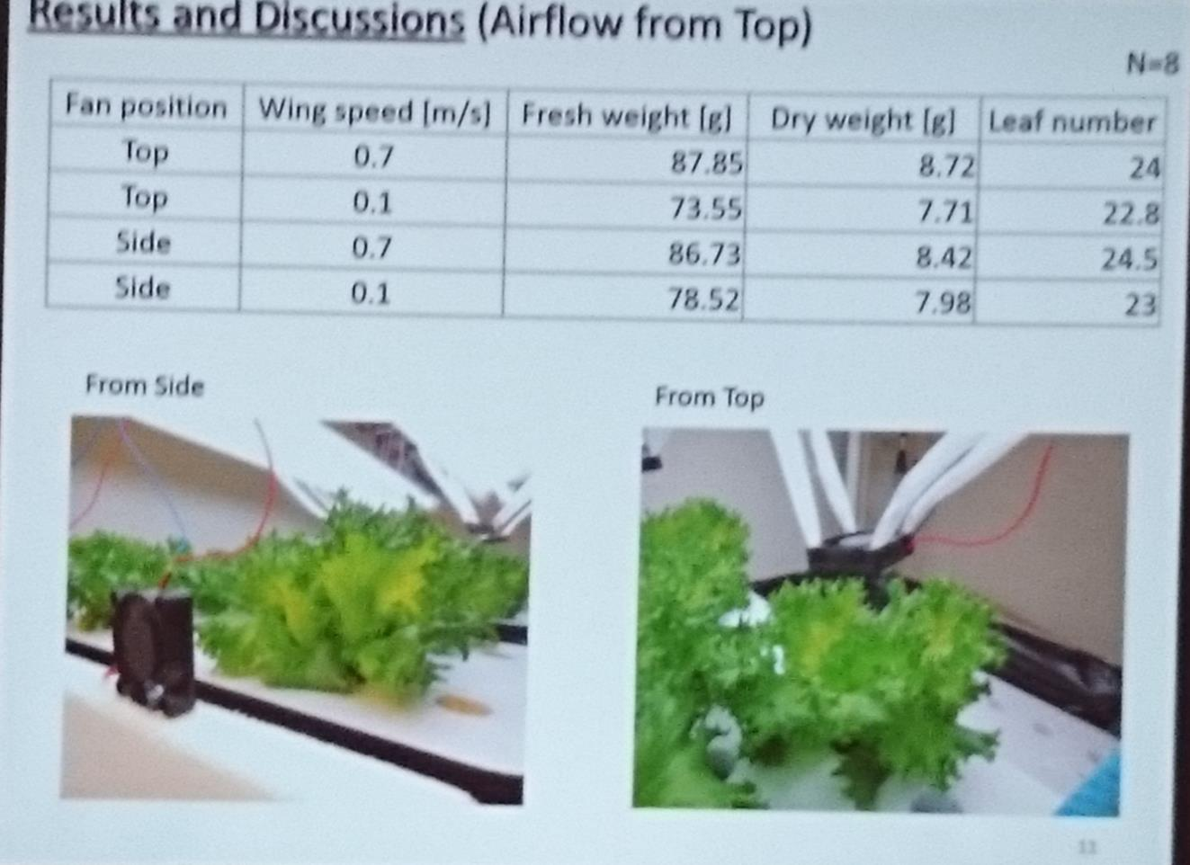

Slide 56
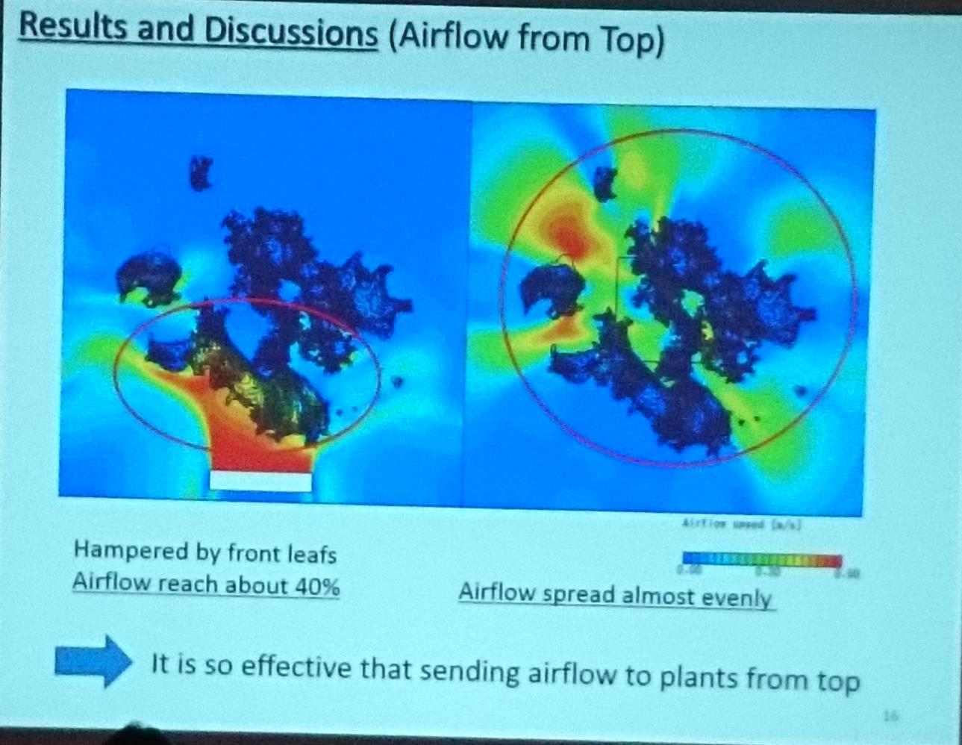

Slide 57
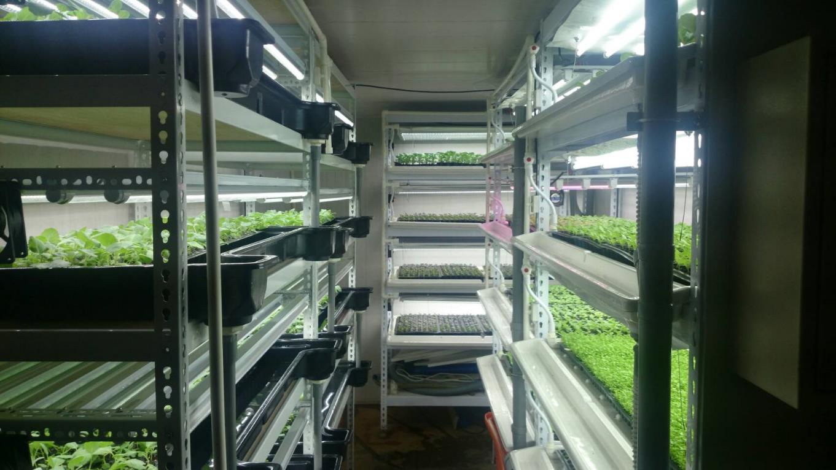
Cargo container PFAL for seedling production

Slide 58
Installation of circular fans
Sideward wind
4 x 72/128/288 plug trays x 4 layers/bench
每層可放四個72/128/288孔穴盤

Slide 59
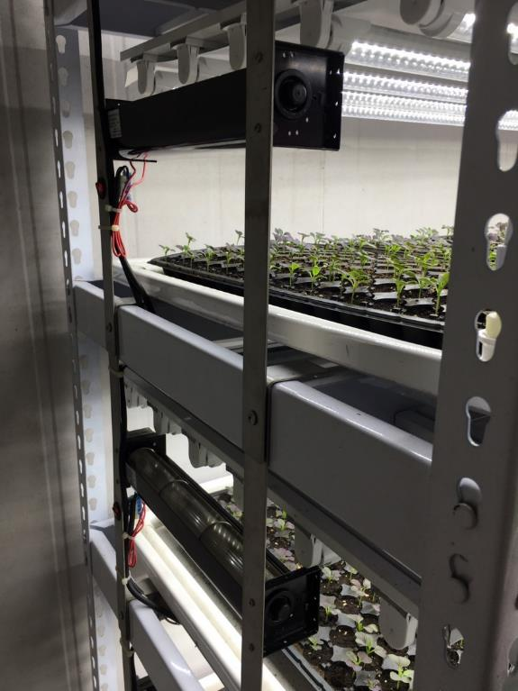
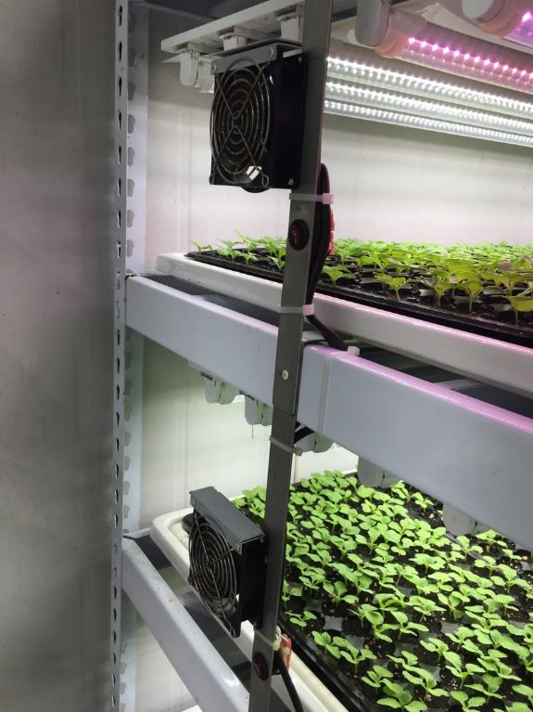
Sideward wind: Horizontal fans vs. Regular fans

Slide 60
Blower + pipe vs. sideward wind

Slide 61
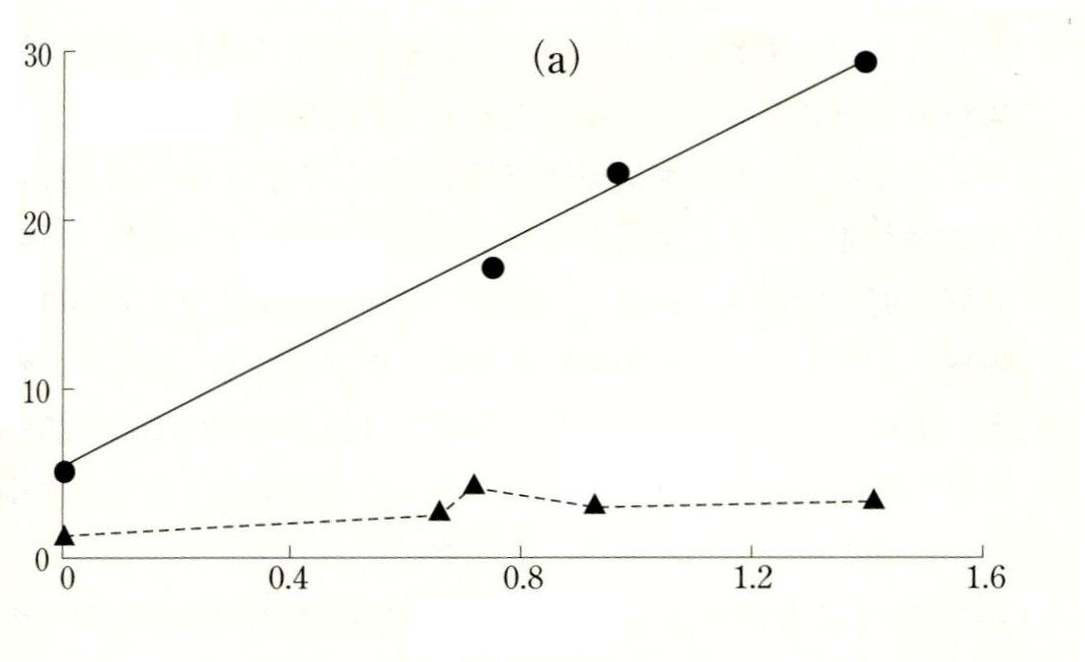
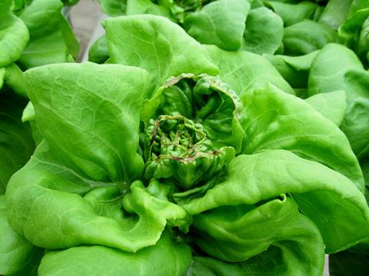
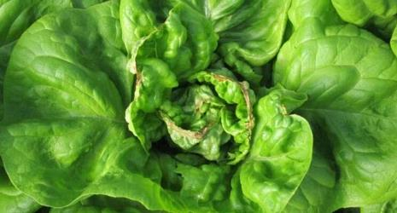
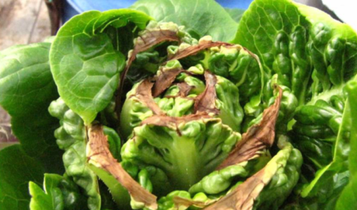
Without wind within microclimate, lettuce is easy to get tip burn, especially under vigorous growth condition
Tdb 25℃
Tip burn is easily to occur on inner leaf due to lack of Ca
⁴⁵Ca
Outside leaf (old leaf)
Inner leaf (new leaf)
High RH
VPD (kPa)
Low RH
Goto and Takakura, 1992a, b

Slide 62
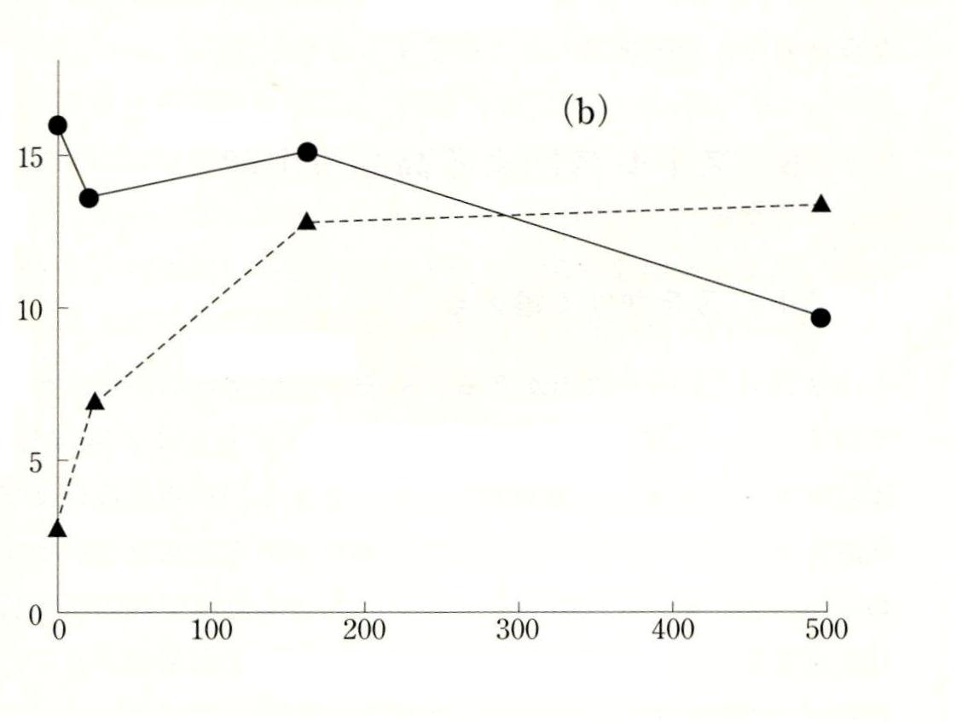
Outside leaf
Tip burn problem can be easily released by providing air velocity.
⁴⁵Ca
Inner leaf
Tdb 25℃
RH 76 %
VPD = 0.76 kPa
Air velocity（mL/min/plant）
Goto and Takakura, 1992a, b
More reading: https://urbanagnews.com/blog/prevent-tipburn-on-greenhouse-lettuce/

Slide 63
Outline
Fundamentals
Integrated Approach
Actuators of air control
T, RH and air velocity measurement
F
M
A
Air conditioning/dehumidification
Humidification：Humidifier
Air velocity: blower and/or horizontal fan
I

Slide 64
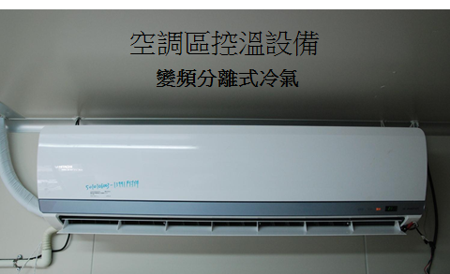
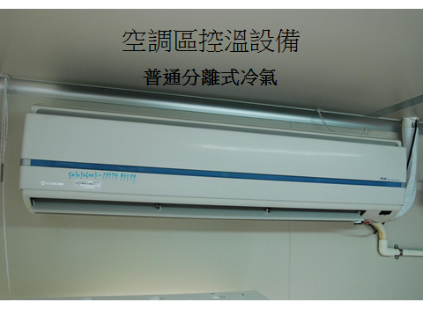
Cooling and humidity control Inverter Air Conditioning is preferred
Inverter AC system
Traditional AC system
When AC is ON, it also works as a dehumidifier
However, when T is in proper range but still humid, a dehumidifier is still needed.

Slide 65
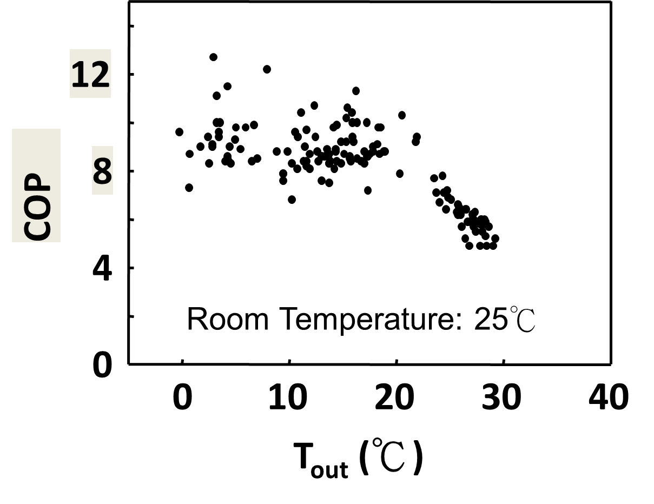
COP of an Inverter AC system
The electricity cost on AC system depends on the COP value. The sole cooling load in a well thermally insulated PFAL will be the heat from light source.
Assuming the COP is 5, the electricity cost of the AC system will be 20% (1/5) of the operating cost of the light.
COP

Slide 66
How to operate the AC system in PFAL?
Assuming D/N temperature settings at 23/18 ºC
One AC system
set at night setting: 18 ºC
Day period: indoor T < 22 ºC turn off, > 24 ºC turn on
Night period: Let AC controller work automatically
D/N temperature difference can be reached through on/off of the light source. TFL: 5 degree difference, LED: 2~3 degree difference
Two AC systems
Both set at 18 ºC
It is better to choose AC with Reset settings after power break off
Day period: indoor T < 22 ºC turn off, > 24 ºC turn on
Night period: Let AC controller work automatically
23 + 1

Slide 67
Overcome AC system with no reset settings use infra-red to mimic press down of ON button

Slide 68
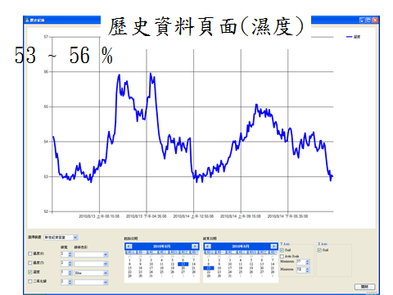
PFAL with no humidifier
With any hydroponic system using water culture, RH can be increase by just evaporation from the nutrient solution surface. For such system, humidifier might not be necessary.
As shown in the left diagram, RH might be too low for plant growth. It is better to turn on humidifier.

Slide 69
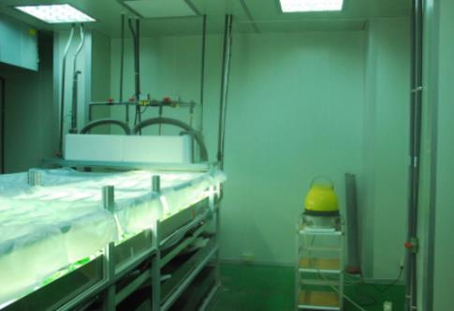
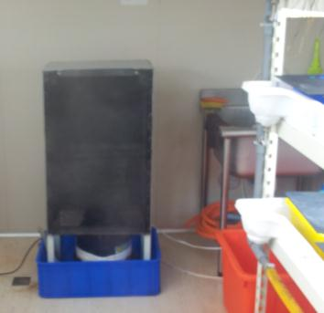
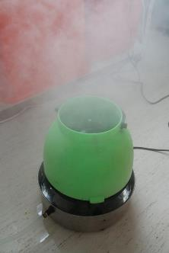
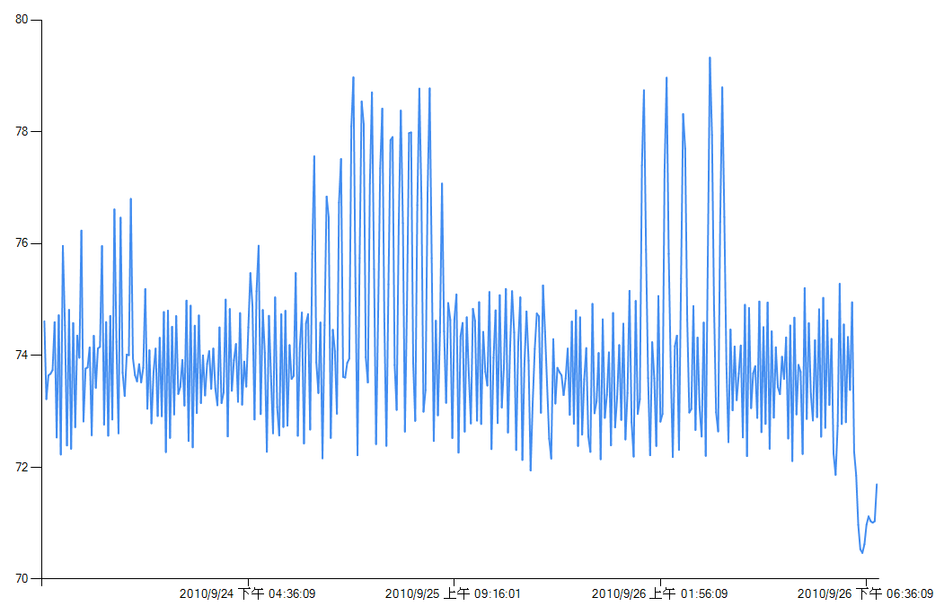
PFAL with humidifier
72 ~ 78 %
condensed fog was scrape off with multi-layer nets
1. Spinning atomizer
2. Ultrasonic humidifier
3. Pad and fan
As shown above, 3 types of humidifiers were developed.

Slide 70
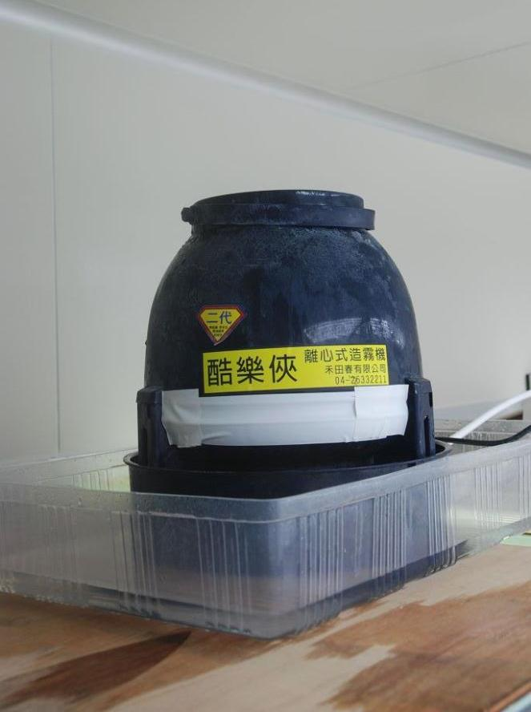
Spinning Atomizer
Circulating fan should be used together with humidifier

Slide 71
Ultrasonic humidifier
Circulating fan should be used together with humidifier

Slide 72
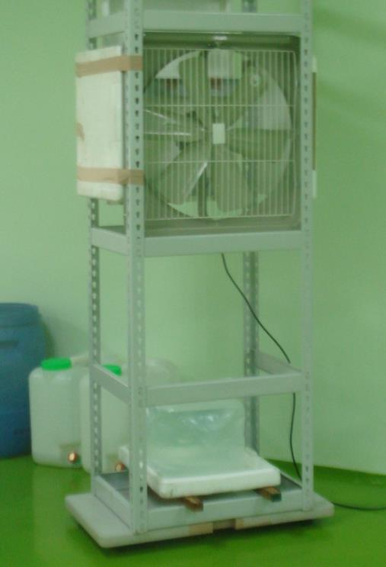
Pad and Fan for humidification

Slide 73
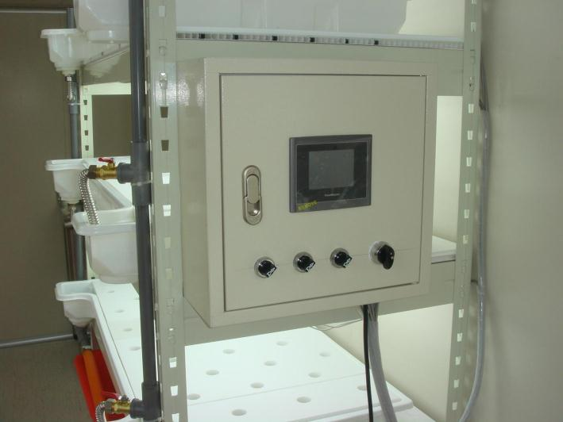
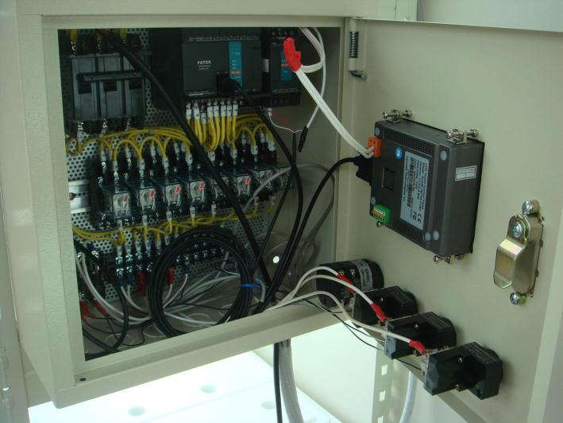
Controller using PLC

Slide 74
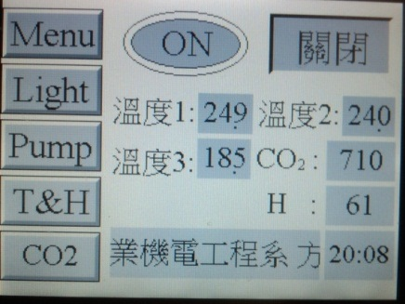
Menu page of the touch screen

Slide 75
Light control page of the touch screen

Slide 76
Pump control page of the touch screen

Slide 77
Temperature/Humidity control page of the touch screen

Slide 78
Temperature control
Chilled water T
Air Temperature

Slide 79
Humidity control
Air Humidity
Air Temperature

Slide 80
CO₂ control page of the touch screen

Slide 81
CO₂ control

Slide 82
Cloud based design
TCP/IP
TCP/IP
TCP/IP
Dropbox
(Excel)
遠端副PC
遠端主PC
PLC

Slide 83
Remote Control Software

Slide 84
Outline
Fundamentals
Integrated Approach
Actuators of air control
T, RH and air velocity measurement
F
M
A
I

Slide 85
Improvement of NTU PFAL performance
Wind velocity to reduce vertical T difference and improve uniformity
Humidity control
CO₂ control
EC、pH control
Remote control
Reduction of Air change per hour (ACH)
Replace TFLs to LEDs

Slide 86
1. Temperature control
Goals:
To reduce vertical temperature difference
To increase temperature uniformity
Before
Vertical temperature difference reaches 5°C
Poor uniformity on temperature distribution per layer

Slide 87
Improvement on temperature
After
Temperature of each layers reduced, especially in the upper layer
Uniformity on temperature distribution per layer increase

Slide 88
Uniformity on Temperature
Before
After

Slide 89
RH
Sensor
PLC
AD module
PLC (PID)
PLC (PWM )
Humidifier
2. Humidity control

Slide 90
Future work: From RH to AHD control
VP_{dif} of the air and leaf
VP of T_{leaf} – VP @T_{db},RH
VPD and Stomata opening
which one is the cause and which one is the outcome?
AH_{dif} of the air and leaf
AH of T_{leaf} –AH @T_{db},RH
Geelen, Voogt and van Weel, 2020 Plant empowerment

Slide 91
3. CO₂ enrichment
CO₂ Sensor
PLC
AD module
PLC (PID)
PLC (PWM)
Valve

Slide 92
4. Nutrient control
pH、EC
Sensors & transmitter
PLC
AD module
PLC (PID controller
PLC (PWM)
Peristaltic pump

Slide 93
5. Remote site: User Interface

Slide 94
6. Keep proper Air tightness of PFAL
Air change/minute (ACM) & ACH (AC/hour) as the index
ACM around 0.8~1 for forced air ventilated greenhouse
ACH range from 0~20 for naturally ventilated greenhouse
ACH no more than 0.01 in PFAL
High ACH means
loss of CO₂ enriched cooled humid air
low resource utilization efficiency on CO₂ , energy and water.

Slide 95
Steps to measure ACH
There are no plants and no workers in the PFAL/NVGH/TC. Vessel
Enrich CO₂ indoor to reach high concentration
NVGH: 3~4000 ppm
PFAL: 8000 ppm
Tissue Culture Vessel (T.C. vessel): 10000 ppm
Allow the CO₂ concentration to drop naturally.
Outdoor CO₂ concentration is C₀
Measuring the indoor CO₂ concentration in real time if possible
NVGH, PFAL, real time measurement is preferred
T.C. vessel: 30 min to 1 hour interval
Track the Time and the CO₂ concentration for at least 2 points (T₁, C₁; T₂,C₂)
with at least one hour interval

Slide 96
Measuring ACH
N=ln((C₁-C₀)/(C₂-C₀)) / T
where,
ln: natural log
T=abs(T₂ - T₁) (in h)
Time is the X axis,
Y is natural log of CO₂ concentration difference at Ti minus Co
N is the slope
T₁=2, T₂=3
C₀=360, C₁=10000, C₂=4000 (ppm)
→N=ln(9640/3640)/(3-2) = 0.97/h
T₁
T₂

Slide 97
PFAL with high air tightness and thermal insulated walls to ensure High Resource Utilization Efficiency (RUE)
High degree of tightness ensures high CO₂ concentration indoor. With min loss to outdoor, high RUE of CO₂ can be reached.
Water vapor transpired from the plant can be condensed by AC system and reused to ensure high RUE of water.
Thermally insulated walls allowed min heat from outdoor, no heating required and cooling load is the heat from light source. An AC system with a COP of 4, the elec.cost on AC will be ¼ of the lighting cost.
In light period, AC system will maintain RH at around 60-70%, which is close to optimum。

Slide 98
RUE of CO₂
High degree of tightness ensures high CO₂ concentration indoor. With min loss to outdoor, high RUE of CO₂ can be reached
Fixed
Supplied
Leak
RUE of CO₂
ACH = 0.01 h⁻¹
RUE of CO₂ = 0.87
ACH = 0.06 h⁻¹
RUE of CO₂ = 0.21
46/221 = 0.21
Fixed
46
Supplied
Leak
175
0.06

Slide 99
RUE of water with REUSE
Water vapor transpired from the plant can be condensed by AC system and reused to ensure high RUE of water.
Amount of water condensed by AC: 1186
1186
P: increase of water in plant 42
S: increase of water in substrate 414
Leak to outdoor: 39
Irrigated
Leak
ACH = 0.01 h⁻¹
RUE of water without REUSE
ACH = 0.01 h⁻¹
with Reuse
RUE of Water = 0.985
without Reuse
RUE of water = 0.273
P + S
42 +414
0.273
Amount of water condensed by AC: 1186
P: increase of water in plant 42
S: increase of water in substrate 414
Leak to outdoor: 39
Irrigated
ACH = 0.01 h⁻¹
Leak

Slide 100
7. PFAL cleanliness: Clean room standard
Clean rooms are classified according to the cleanliness level of the air inside the controlled environment.
The clean room class is the level of cleanliness the room complies with, according to the quantity and size of particles per cubic meters of air. The primary authority in the US and Canada is the ISO classification system ISO 14644-1.

Slide 101
PFAL dust free class
Class A
Dust Free Room
PFAL

Slide 102
Particle counter

Slide 103
Integrated Approach
Wind velocity at proper range 0.5~1.2 m/s
Air temperature keep at proper range
Clean room standard to maintain minimum bacteria counts
CO₂ keep at 1000~2000 ppm
DLI ≈ 14 for leafy veg. & ≈ 17 mol/m² semi-head veg.
Tightness of PFAL, ACH keep at no more than 0.01
RH keep at 70~85% (VPD at proper range)
W
H
L
A
C
T
B
Notes:
maintain

Slide 104
Integrated Control
Buckets effect
Cannikin Law
P_{n}
A: Temperature control
B: Air velocity control
C: CO₂ control
D: VPD/AHD control
E: Nutrient control
_{Light Intensity}

Slide 105
XX company vs. NTU PFAL
Items | XX | NTU PFAL
D/N Temp. difference | No | Yes
DLI DL PPFD | low 10~12 h/day < 150 μmol/m²/s | proper 16 h/day > 200 μmol/m²/s
Humidity control | No | Yes
Wind velocity | No | 0.5 ~ 1 m/s
CO₂ enrichment | No | 1200 ppm
EC level | 1.8 mS/cm (manual) | 1.2 mS/cm (Auto)
Harvested at | DAS=44 | DAS=35
FM/plant | 60 ~ 75 g/plant | 120 ~ 140 g/plant

Slide 106
Conclusion
Temperature control plays major role in GH
Light control is of great importance in PFAL
Three under-emphasize factors
Absolute humidity (AH) is a better index than relative humidity (RH) to estimate water balance
Adequate wind velocity (0.3~1.0 m/s) to ensure better uniformity and gas exchange around micro-environment of the plants
Tightness of PFAL should be kept, ACH no more than 0.01

Slide 107
The END

Slide 108
Supplements
Mostly frequent used in greenhouse, not in PFAL.
Degree-Days
DIF
DROP

Slide 109
Degree-day Concept
Slope: Dy/Dx Change in growth rate / change in temp
e.g.# leaves/day/°F → leaf unfolding
e.g. inches/day/°F → stem elongation
Daily increase in leaf production or stem elongation as you raise the average temp 1°F

Slide 110
Degree-day Concept
The amount of heat (or degree-days) above the base temp that must accumulate for a developmental event to occur
1 degree-day will accumulate when the day’s average temp is 1°F above base temp
Average temp = 55°F
Base temp = 50°F
5 degree-days will accumulate that day

Slide 111
Degree-day Concept
Degree-day constant associated with every development stage
e.g. 80 degree-days needed to reach a certain stage
All of the following would accumulate 80 degree-days
80 days @ 1° above base temp
40 days @ 2° above base temp
8 days @ 10° above base temp
Allows crop growers to schedule and time crop development

Slide 112
Application of Degree-days (hypothetical numbers)
Easter Lily production during leaf development
Slope = 0.02 leaves/degree-day
Degree-day constant = 1/0.02 ≈50
50 degree-days/leaf
What temp to produce 3 leaves in 10 days?
Avg daily temp = total degree-days + T_{base*}
desired time
* T_{base} = base temperature

Slide 113
Example cont’d
What avg. daily temp to produce 3 Easter lily leaves in 10 days?
Base temp = 55°F
Avg temp = 3 x 50 + 55
10
Maintain 70F avg. temp and you should have 3 new leaves in 10 days!
≈ 70F

Slide 114
Most E. Lily growers use a ‘bud meter’ once flower buds are visible
By measuring the length of the bud, the grower knows how warm to keep the greenhouse to get the bud to the selling stage by Easter. The bud meter is based on degree days.

Slide 115
Graphical Tracking
Let you know where your crop is compared to where it should be in height
IMPORTANT because of shipping container size and aesthetic appeal of crop

Slide 116
Graphical tracking used to determine temperature requirements and other growth regulating practices.
Acceptable finished height.
Measure representative plants once or twice a week and adjust growing techniques accordingly.
Before and just after visible bud is usually when plants are most responsive to growth regulation.
Above this line, plants too tall, need growth regulation
Above this line, plants too tall, need growth regulation
Below this line, plants too short, need to elongate plant
Below this line, plants too short, need to elongate plant
Pot height
Pot height

Slide 117
Original Applications of Degree-days
Field-grown crops
Count degree-days by measuring temp
Predict days to harvest
Apples: bloom → harvest = 2800 degree-days
Predict insect hatching/molting
Degree-days = (T_{max} – T_{min})/2 – T_{base}
Prediction only - growers of field-grown crops have no control over temperature

Slide 118
History of DIF
Originally discovered in 1944
“Rediscovered” and developed as a growth regulation technique in late 1980’s by Dr. Royal Heins at MSU
The DIFference between day and night temperature in a greenhouse will affect internode elongation and consequently, stem length.
DIF for Temperature and Growth (stem height) Regulation

Slide 119
DIF = Day temp – Night temp
+ DIF when Day temp > Night temp
0 DIF when Day temp = Night temp
- DIF when Day temp < Night temp
DIF effects on internode elongation Within normal growing temperatures, the more positive the DIF, the longer the internodes.

Slide 120
Greenhouse | A | B | C
Day temp | 60°F | 55°F | 50°F
Night temp | 50°F | 55°F | 60°F
Avg. Daily temp | 55°F | 55°F | 55°F
DIF | +10 | 0 | -10
Internode length (plant height) | Tall | Medium | Short

Slide 121
DIF Responding Species
Easter lilies 百合
Poinsettias 聖誕紅
Snapdragon 金魚藻
Rose 玫瑰
Petunia 牽牛花
Carnation 康乃馨
Impatiens 鳳仙花
Tomato 蕃茄
Pepper 小黃瓜
DO NOT RESPOND
Hyancith 風信子
Tulip 鬱金香
Narcissus 水仙
Squash 南瓜

Slide 122
Degree-days vs. DIF
Avg. daily temp (or degree-day accumulation) control rate of plant development
DIF responsible only for plant height regulation (internode elongation)
More positive DIF → the taller the plant
More negative DIF → the shorter the plant

Slide 123
 | A | B | C
Day temp | 60°F | 55°F | 50°F
Night temp | 50°F | 55°F | 60°F
Avg. Daily temp | 55°F | 55°F | 55°F
DIF | +10 | 0 | -10
Internode length (plant height) | Tall | Medium | Short
Which greenhouse would have the tallest plants? The shortest? The furthest along in development?

Slide 124
Side Effects of Extreme –DIF
Chlorosis (esp. DIF < -10F)
Bedding plants (e.g. salvia)
Leaf orientation
Problem on Easter Lily
(photos courtesy of Dr. Harold Wilkins)

Slide 125
Other effects of DIF
DIF response is quick and reversible
Adverse effects of –DIF can be fixed with a few days of 0 or + DIF
Effects show up quickly
DIF and photoperiod
As daylength ↓, greater response to –DIF

Slide 126
Limitations of DIF
Flower initiation
Poinsettia inhibited to flower at night temps above 72°F (22.2ºC)
Seasons
-DIF is not always achievable
Summer in warm climates
Sunny, clear days heat up greenhouse

Slide 127
DROP
Lowering temp first few hrs of day
More effective than lowering temp at the end of day
Majority of stem elongation occurs in these first morning hrs
Combining a morning DROP with slight – or 0 DIF is better than more –DIF
Drawing back thermal blanket or ventilating before sunrise, good way to achieve DROP

Slide 128
Temp.
8:00 pm
Midnight
Noon
Typical DROP daily temperature pattern

