Slide 1
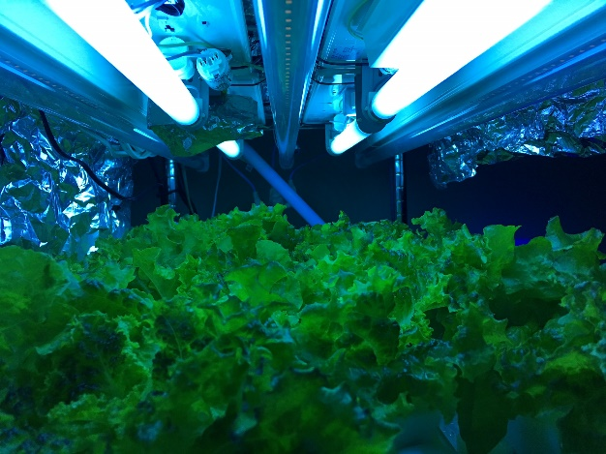
Applying UV & Far-Red in PFAL
The 4th Annual Indoor Ag-Con Asia
Wei Fang
Director, Center of Excellence for Controlled Environment Agriculture
Professor, Dept. of Bio-Industrial Mechatronics Engineering
National Taiwan University
January 15-17, 2019, Singapore

Slide 2
Contents
Applying UV in PFAL
Applying FR in PFAL
1
2

Slide 3
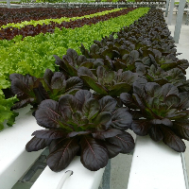
Part 1. Applying UV in PFAL

Slide 4
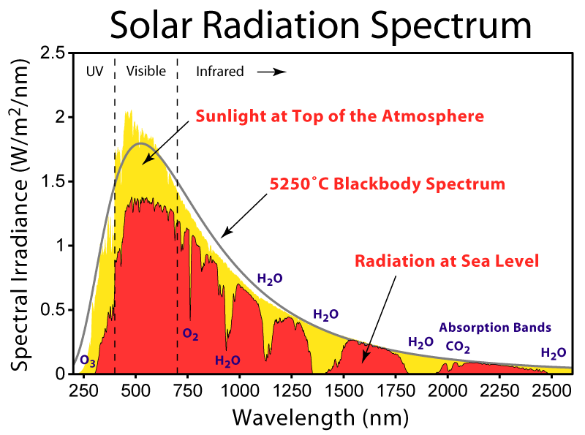

Slide 5
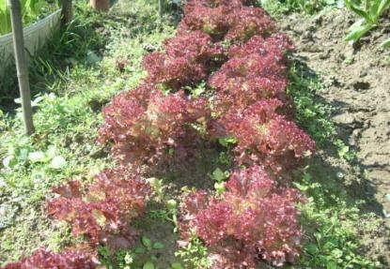
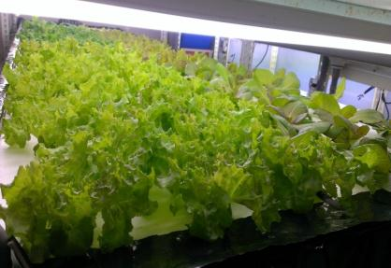
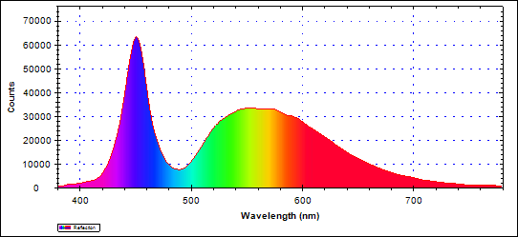
Greenhouse vs. PFAL grown
Greenhouse grown Red leaf lettuce
PFAL grown red leaf lettuce
LED 6500K Spectrum

Slide 6
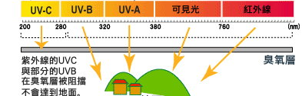
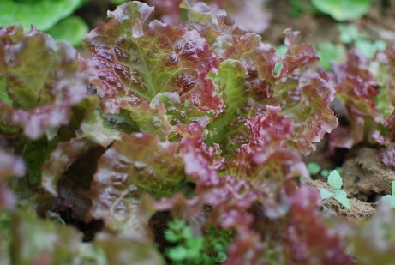
UVC and partial UVB are blocked by the ozone layer
Ozone layer
UVA and UVB are stress to the plants
Prevent stress from photo-oxidation → phytochrome → anthocyanin
(Giliberto et al., 2005)
Phytochrome/Anthocyanin can absorb UV to prevent DNA damage
(Stapleton, 1992)

Slide 7
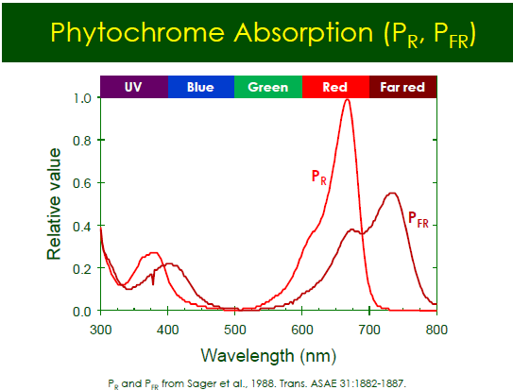
UVA: 320 to 400 nm
UVB: 290 to 320 nm

Slide 8
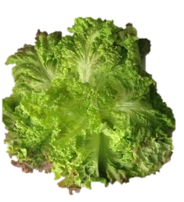
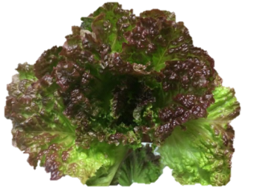
Outdoor vs. LED
Winter outdoor 60 days
LED 35 days
red leaf lettuce
How to increase
the red color (anthocyanin) on leaf?
We need UVA / UVB.

Slide 9
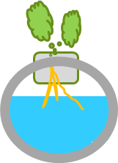
Purpose
Find the light receipt to grow
red-leaf lettuce to meet 2 goals:
w/o reduction of Fresh Mass
increase anthocyanin content by adding UVA radiation.
LED
UVA
LED
How strong the UVA required and
how many hrs. per day for
how many days
prior to harvest?

Slide 10
Crops
Lactuca sativa L.
Red lettuce (Know-You Seedling Corp., Taiwan)

Slide 11
Micro-Environment
Factor | Value
Temp.(D/N) | 24/20 ± 2℃
Rel. Humidity | 60~70%
CO₂ | 1200 ± 200 ppm
Nutrient solution stage 1 stage 2 | EC 0.4 mS cm⁻¹/pH 6.1 EC 1.2 mS cm⁻¹/pH 6.1
Density at stage 2 | 18 plts/ 0.405 m²

Slide 12
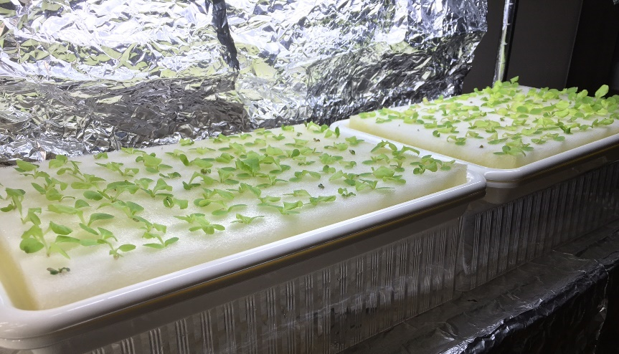
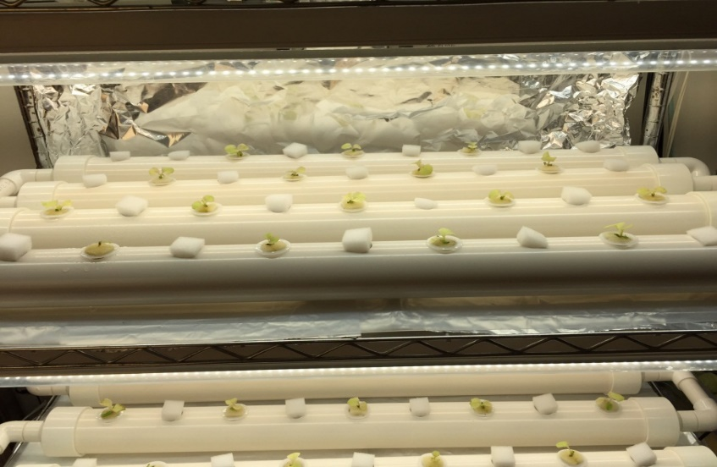
Artificial Light at various stages
Stage 1: Seedling stage
  14 days (DAS= 1~14)
  100 μmol m⁻² s ⁻¹
  24 hr. duration
  DLI = 8.64 mol m⁻²
Stage 2: Mature stage
  21 days (DAS=15~35)
  130 μmol m⁻² s ⁻¹
  16 hr. duration
  DLI = 7.49 mol m⁻²

Slide 13
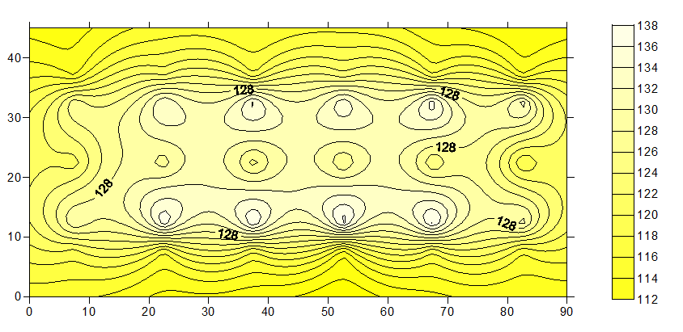
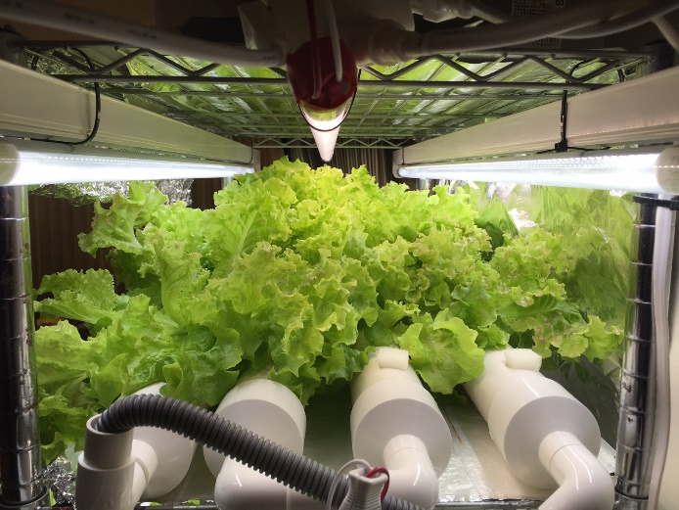
Warm White LED (18W, 3000K)
Light source
130 μmol ‧m⁻² ‧s⁻¹
reflector
LED
LED
LED
reflector

Slide 14
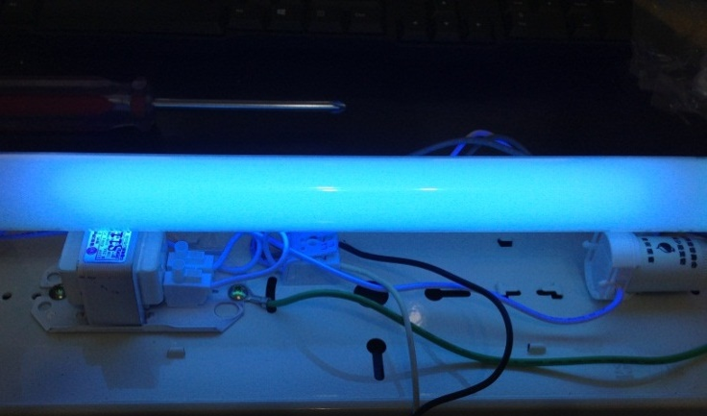
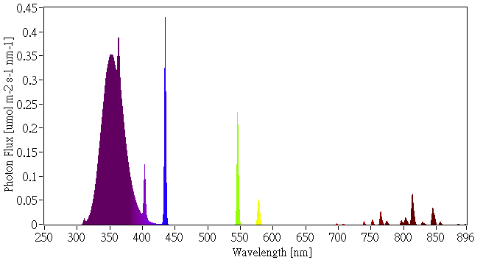
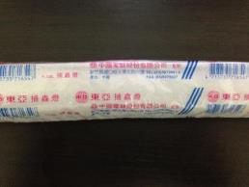
UVA source: florescent lamp
LED
UV
LED
UV
LED
reflector
UVA
15 cm under UVA lamp =>
11.85 W/m²

Slide 15
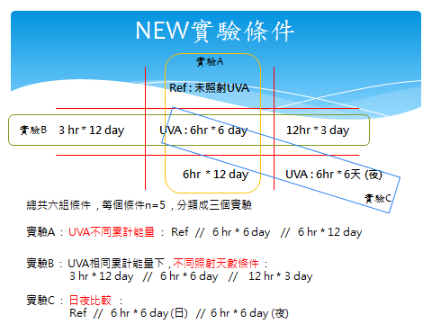
Experiment 1
Various dosing and duration of UVA
Applying UVA 0, 3, 6, 12 days prior to harvest
Totally 6 treatments (n=5), separated into 3 groups
  A. Same 6 hrs per day, but various (0, 6, 12) days
  B. Same dosing with various (3, 6, 12) hrs and 12, 6, 3) days
  C. Same 6 hrs and 6 days but applying UVA during the day or night period
Ref: no UVA
Group B
Group C
Group A

Slide 16
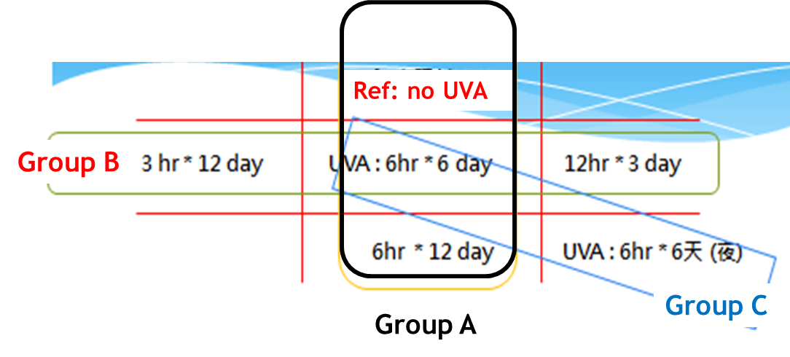
TLI, DLI of UVA
DLI of UVA
Group B
0 J/cm²
11.85 W/m²
/10000
* 3 hr * 3600 s
= 12.8 J/cm²
12.8 J/cm²
25.6 J/cm²
51.2 J/cm²
25.6 J/cm²
25.6 J/cm²
Group A
TLI of UVA
0 J/cm²
Group B
153.6 J/cm²
153.6 J/cm²
153.6 J/cm²
307.2 J/cm²
153.6 J/cm²
Group A

Slide 17
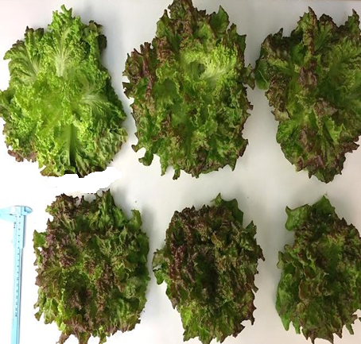
DAS = 35
Ref
6 hr/6 day (D)
6 hr/6 day (N)
12 hr /3 day
3 hr /12 day
6 hr /12 day

Slide 18
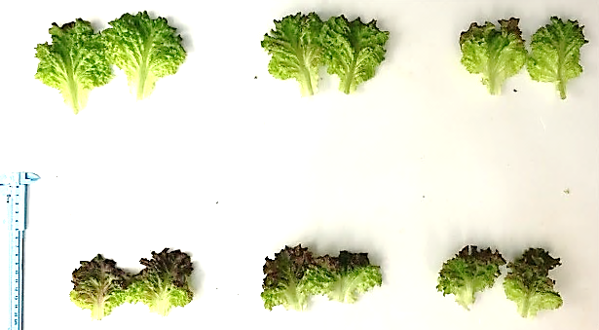
DAS = 35
Ref
6 hr /6 day(D)
6 hr /6 day(N)
葉緣呈深綠色
葉緣小區域變紅
葉緣小區域變紅
整片葉
變紅紫色
葉緣大面積
變紅紫
葉緣大面積
變紅紫
12 hr/3 day
3 hr /12 day
6 hr /12 day

Slide 19
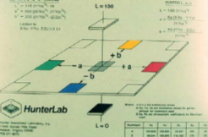
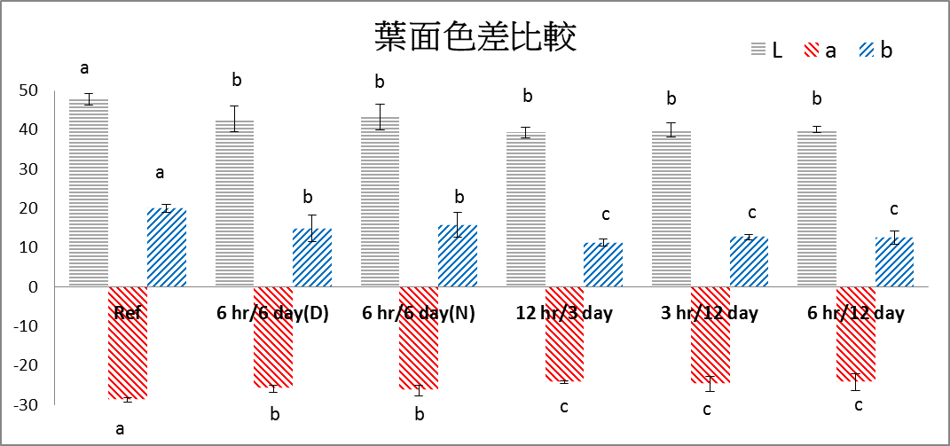
Color difference of leaf
L:
brightness
a:
red to green
b:
yellow to blue
(t test p<0.05 n=5)
All treatments with UVA all turn red
With significant difference with the ref. group

Slide 20
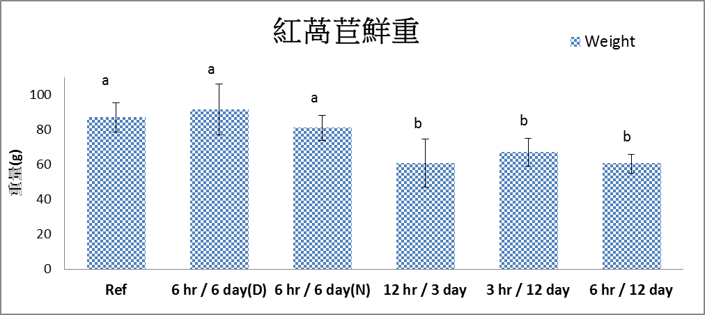
Shoot Fresh Weight (in gram)
(t test p<0.05 n=5)
Among 4 treatments with same TLA of UVA ,
treatment with highest DLI (12 hr) has the least FW
In 6 day treatment, 6 hrs of UVA will not affect FW.
No difference was found when providing same 6 hrs of UVA
either in day or night period

Slide 21
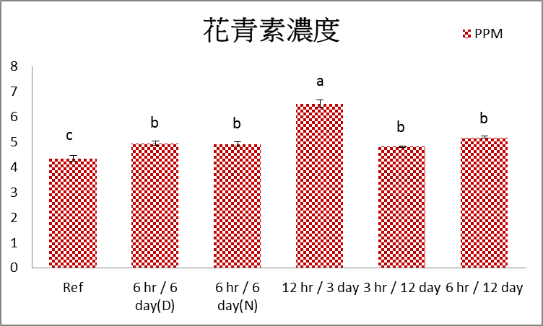
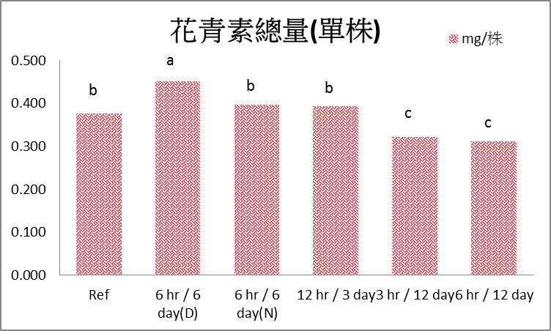
Anthocyanin
Anthocyanin concentration (ppm)
Anthocyanin content (mg/plant)
(t檢定 p<0.05 n=5)
UVA @ 12hr/3day has the highest anthocyanin concentration
UVA @ 6hr/6day has the highest anthocyanin content per plant
No difference on concentration was found when providing 6hr of UVA is during the light or dark period, but during the light period is better when focus is on ‘per plant basis’.

Slide 22
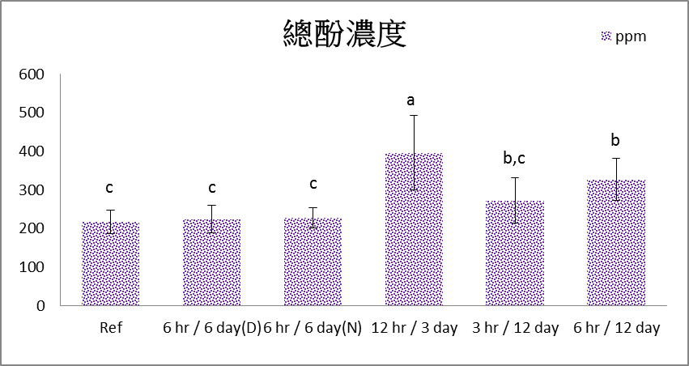
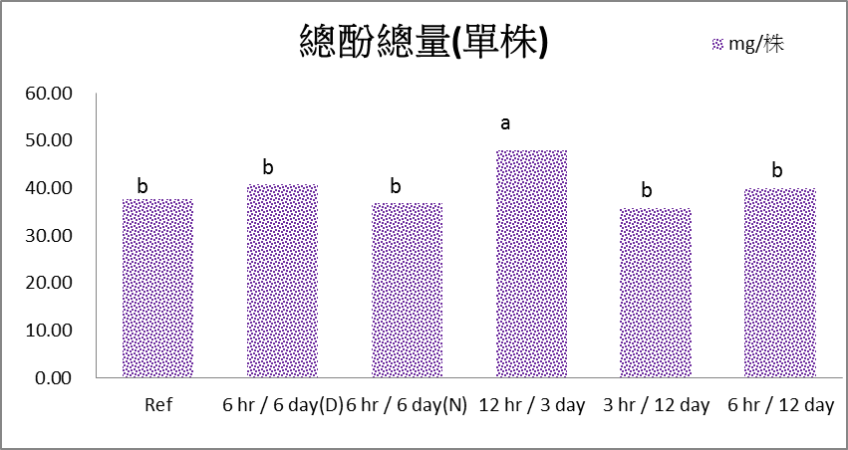
Total phenol
Total phenol concentration (ppm)
Total phenol content (mg/plant)
(t test p<0.05 n=5)
Treatment of 12hr/3day Has the highest total phenol
No significant difference on providing UVA
either in light or dark period

Slide 23
Conclusions
At various TLI of UVA (0, 153.6, 307.2 J/cm²)
At same TLI (153.6 J/cm²) of UVA, various DLI (12.8, 25.6, 51.2 J/cm²)
At same TLI and DLI, but applying UVA at light or dark period
Lettuce leaf will turn red in all UVA treatments
Higher TLI, lower the FW, higher the phytochemical concentration
6 hrs. of UVA for 6 days will not affect plant growth in terms of FW
Higher DLI of UVA, lower the FW, higher the phytochemical concentration
Has no significant difference
3 days of UVA will be enough.
Do we need to provide 12 hrs of UVA?

Slide 24
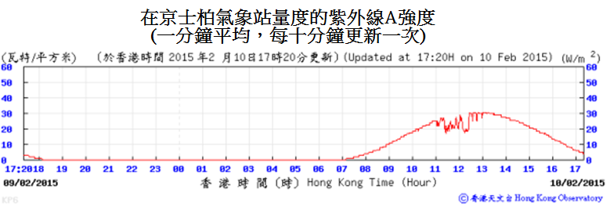
Experiment 2 mimicking outdoor UVA condition
Based on Winter data from Weather Bureau
UVA radiation: > 15 W/m²
UVA duration: 6 hr. (9:30~15:30)
DLI of UVA: 32.4 J/cm²
DLI of UVA radiation

Slide 25
Experiment 2 mimicking outdoor UVA condition
Turn on UVA light
3 days prior to harvest (DAS=33~35)
Treatments:
applying UVA for 0, 3, 6, 9, 12, 15 hrs.
DLI (in J/cm²) of UVA are as follows:
Ref. | 3 hrs. | 6 hrs. | 9 hrs. | 12 hrs. | 15 hrs.
0 | 12.8 | 25.6 | 38.4 | 51.2 | 64.0
32.4 J/cm²
DLI of UVA based on weather data

Slide 26
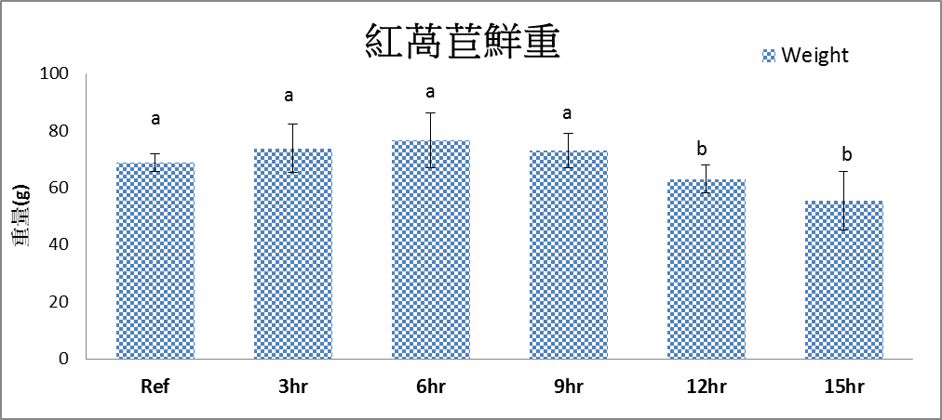
Shoot Fresh Weight (in gram)
(t test, n=5 , P<0.05)
No significant difference
if UVA is no longer than 9 hrs.

Slide 27
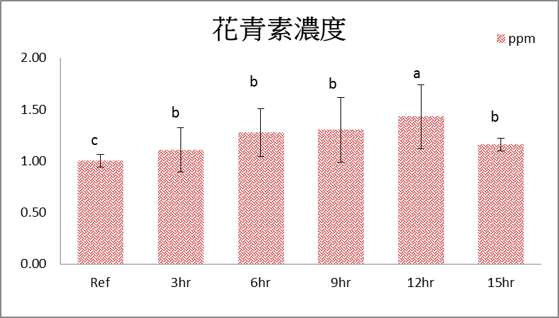
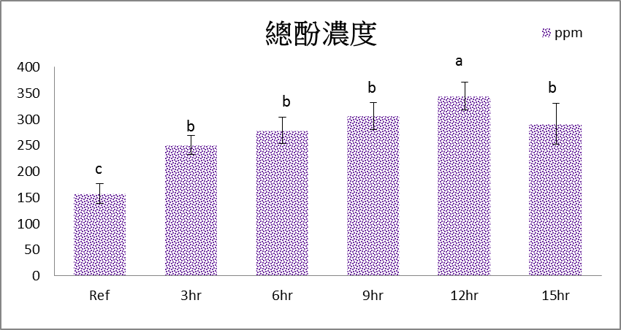
Anthocyanin & total phenol
Anthocyanin concentration (ppm)
Total phenol concentration (ppm)
(t test, n=5 , P<0.05)
12 hrs. of UVA, give the highest phytochemicals.
15 hrs. of UVA, poor performance.
From per plant basis, 9 hrs. of UVA is the best.

Slide 28
Conclusions
Applying UVA
at 9 hrs. per day, DLI of UVA: 38.4 J/cm²
for 3 days prior to harvest
Can have the best performance on
FW,
Phytochemicals, and
Electricity cost

Slide 29
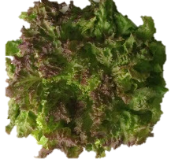
Outdoor vs. LED vs. LED+UVA
Winter outdoor 60 days
LED 35 days
LED 35 days + UVA 3 days
How to improve the uniformity on anthocyanin distribution?
Look like we need to have UVA light at various directions or rotating reflector.

Slide 30
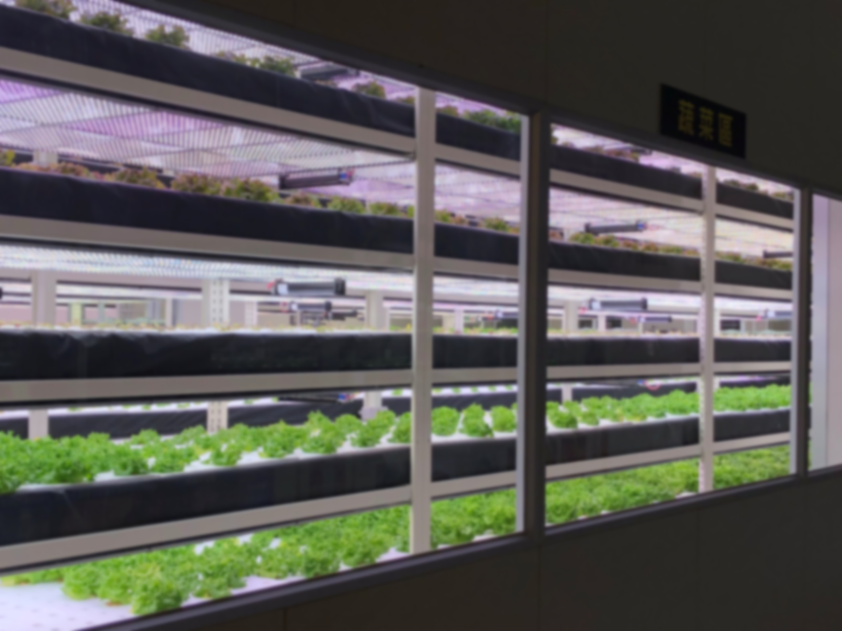
Part 2: Applying FR in PFAL

Slide 31
Contents
Photoperiodic responses
Reviews on FR applications
Inhibit flowering of LD plants
Edible flower plants in PFAL
1
2
3
4

Slide 32
Primary Photoperiodic Responses
Day-neutral plants:
photoperiod does not influence flowering
Short-day (SD) plants:
plants only flower, or flower faster,
when the night is long (the day is short)
Long-day (LD) plants:
plants only flower, or flower faster,
when the night is short (the day is long)

Slide 33
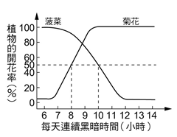
LD plants
LD plants
SD plants
Flowering percentage (%)
CDH < CNP
Spinach
CNP_{SD}
CNP_{LD}
SD plants
CDH > CNP
Chrysanthemum, strawberry
Continuous dark hours, CDH
Critical Night Period, CNP

Slide 34

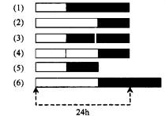




Chrysanthemum
Strawberry
Spinach

Slide 35
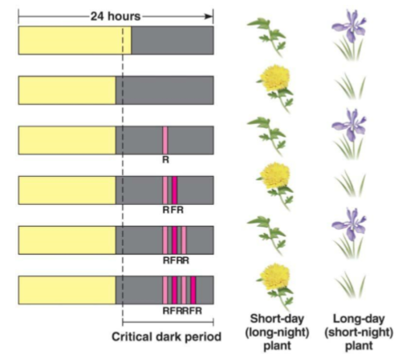

Slide 36
Phytochrome Absorption (P_{R}, P_{FR})

Slide 37
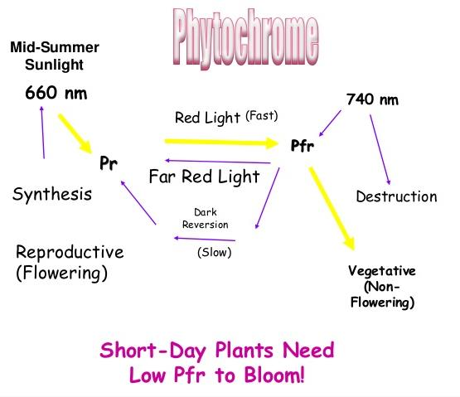
Phytochrome
SD Plants need Low P_{FR} to Bloom!
LD Plants need
Low P_{R} to Bloom!
Provide FR can reduced P_{FR}, promote flowering of SD plants, such as strawberry
, inhibit flowering of LD plants, such as spinach

Slide 38
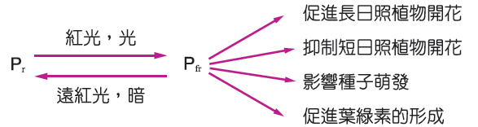
Applying R to promote / inhibit flowering of LD / SD plants
Promote flowering of LD plants
Red light
Inhibit flowering of SD plants
Far-Red
Dark
Promote germination of seeds
Promote formation of chlorophyll
Applying FR to promote / inhibit flowering of SD/LD plants

Slide 39
Contents
Reviews on FR applications
2

Slide 40
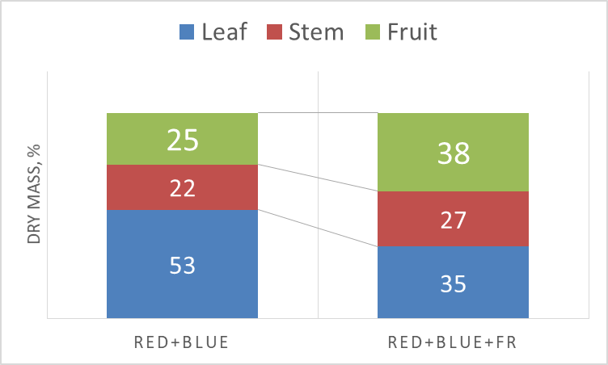
Far-Red improves partitioning to the fruits
FR is provided during the
Light-period
Heuvelink and Marcelis, 2018, SIIPFS

Slide 41
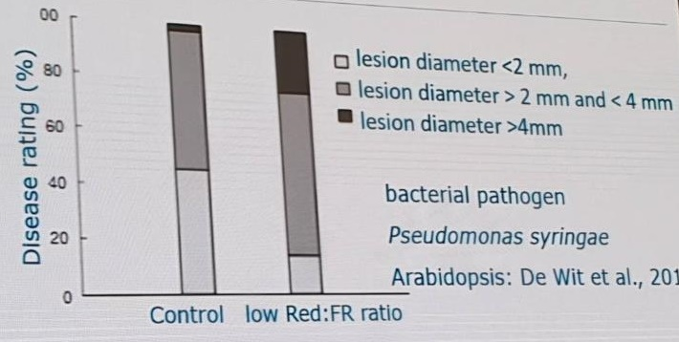
Far-Red inhibits disease resistance
Heuvelink and Marcelis, 2018, SIIPFS

Slide 42
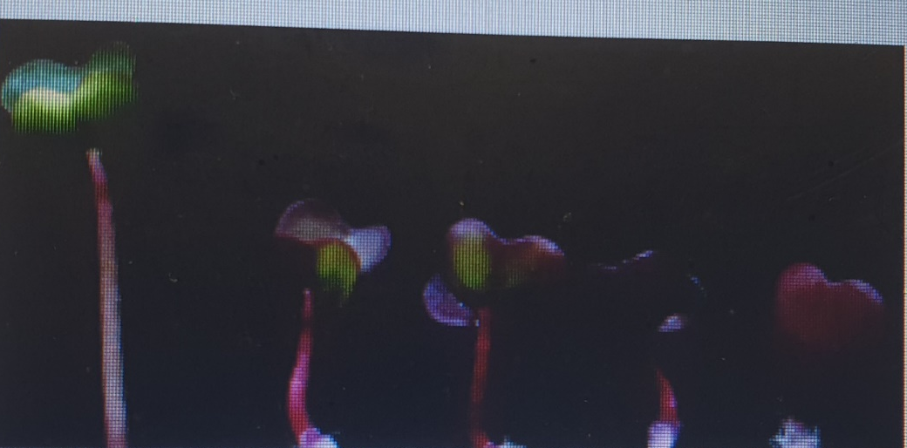

Red Russian Kale sprout
Sofia and Folta, 2014

Slide 43
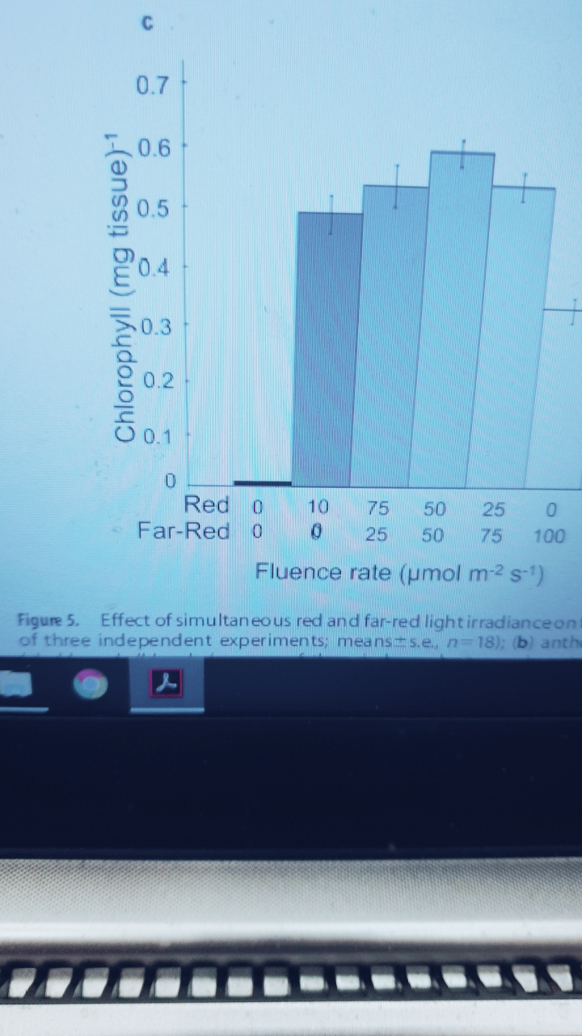
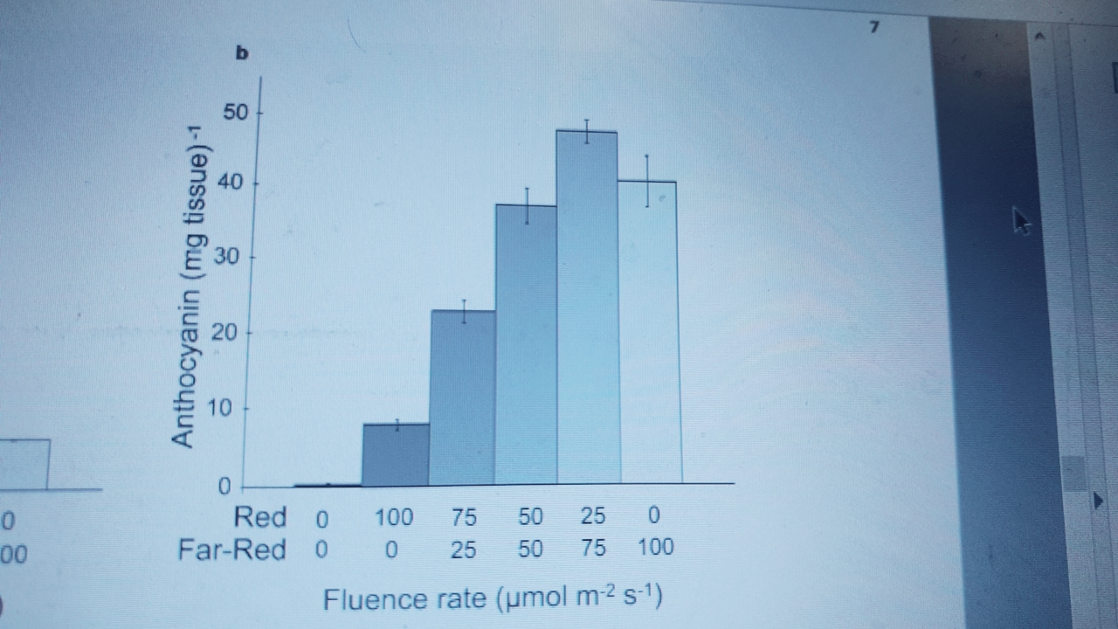
Far-Red promotes accumulation of Chlorophyll and Anthocyanin
Red Russian Kale sprout
Sofia and Folta, 2014

Slide 44
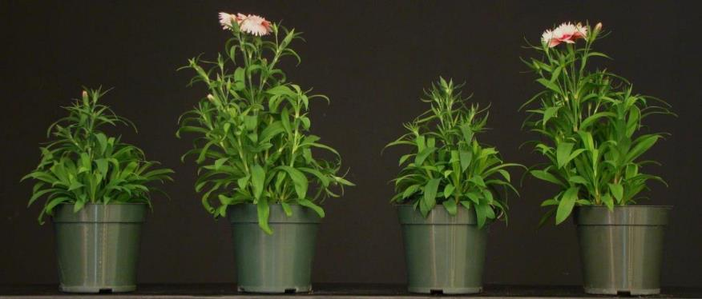
Long-Day Plant
Dianthus 9 weeks after transplant at 20 °C
9-hour day with 4-hour night interruption
FR is provided during the
Light-period
9-hour
short day
Incan.
R LEDs
R+FR LEDs
石竹
LD plant
Runkle, 2015

Slide 45
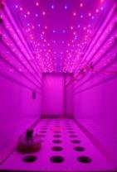
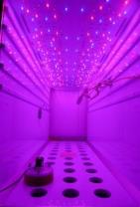
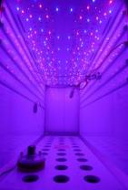



Sole-Source Lighting with Far Red
Treatment #1
Treatment #2
Treatment #3
Treatment #4
Treatment #5
Treatment #6
R₁₂₈+FR₀+B₃₂
R₉₆+FR₃₂+B₃₂
R₆₄+FR₆₄+B₃₂
R₁₂₈+FR₁₆+B₃₂
R₁₂₈+FR₃₂+B₃₂
R₁₂₈+FR₆₄+B₃₂
PPFD | 160 | 128 | 96 | 160 | 160 | 160
Total flux | 160 | 160 | 160 | 176 | 192 | 224
R:FR |  | 3:1 | 1:1 | 8:1 | 4:1 | 2:1
Values after each LED type and for flux represent intensity (µmol∙m⁻²∙s⁻¹).
Runkle, 2015

Slide 46







Petunia ‘Wave Blue’, Absolute LD plant
Preliminary Results
Seedlings grown at 20 °C for 24 days under LEDs (31 days after sow)
18-hour photoperiod all with B₃₂
R₁₂₈+FR₀ | R₉₆+FR₃₂ | R₆₄+FR₆₄ | R₁₂₈+FR₁₆ | R₁₂₈+FR₃₂ | R₁₂₈+FR₆₄
FR is provided during the
Light-period
0 %
90%
80%
100%
60%
90%
Flowering percentage
PPFD | 160 | 128 | 96 | 160 | 160 | 160
Total flux | 160 | 160 | 160 | 176 | 192 | 224
R:FR |  | 3:1 | 1:1 | 8:1 | 4:1 | 2:1
Runkle, 2015

Slide 47

Night Interruption effects with G, B, R, FR and W on Flowering &
Morphogenesis of Chrysanthemum under 16-hour photoperiod
Materials & Methods
Light period
Dark period
Designation
Long Day treatment
LD
16
SD
G
G
SD
B
B
SD
R
R
Short Day (SD) Treatment
SD
FR
FR
SD
W
W
0
10
SD
SD
0
10
15
19
24 (h)
Prof. B R Jeong and his group, Gyeongsang National University, Korea

Slide 48

Effects of night interruption as affected by light quality
Benefit for
cut flower?
Long Day
G
B
R
FR
W
Short Day
Stuck: June 11, 2013, Treatment: July 13, 2013, Photo.: Aug. 16, 2013
Prof. B R Jeong and his group, Gyeongsang National University, Korea

Slide 49
B
FR

Slide 50



Promote Photosynthetic rate
3 out of 6 CW LED tubes is replaced by 3 R/FR LED tubes
R: FR = 1: 1
Crop: Purple Romaine
DAS = 24
Bar=10 cm
3CW+3R/FR (120 W)
6CW (120 W)

Slide 51


Promote plant growth
3 out of 6 CW LED tubes is replaced by 3 R/FR LED tubes
R: FR = 1: 1
Crop: Frill-Ice lettuce
DAS = 24
Bar=10cm
3CW+3R/FR (120 W)
6CW (120 W)

Slide 52

RQE: Relative Quantum Efficiency

Slide 53
Contents
Edible flower plants in PFAL
3

Slide 54




Slide 55
Objectives
Can we promote flowering of SD/LD bedding plants?
  Applying Red light to promote flowering of LD plants
  Applying Far-Red light to promote flowering of SD plants
Investigate on Value-Added products with edible flowers

Slide 56





Slide 57





Slide 58





Slide 59





Slide 60


Slide 61

Supermarket in the Netherlands

Slide 62
Value-Added Products with Edible flowers

Slide 63

VA-dishes

Slide 64



Slide 65



Slide 66
VA-cakes

Slide 67


Edible flower cakes

Slide 68




Slide 69






Slide 70
VA-disserts

Slide 71


Slide 72


Slide 73



Slide 74



Slide 75



Slide 76
VA-ICE BAR

Slide 77


Edible flower in ice-bar/cube
Benefits
Longer shelf life for flowers
Multi-usage of the products:
  juice, wine, cocktail, beverage
  bring beauty to various products
  Enhance flavor
  Enhance taste

Slide 78


Slide 79



Slide 80

Contents
Inhibit flowering of LD plants
‘Mei-Ho’ Spinach
4

Slide 81
Objectives
Can we inhibit flowering of LD plant with LD photoperiod?
    Spinach (Mei-Ho)
    Light Period@12 h will induce flowering
    Light Period@11 h, lead to less Fresh Mass (80 g/plant @DAS=32)

Slide 82




6 ART (120 W)
6 ART +2 FR (160 W)
treatments | Red % | Green % | Blue % | FR % (700-800 nm) | R/B | R/FR
6 ART (120 W) | 25 | 49 | 26 | 1.8 | 1.0 | 14.18
6 ART+2 FR (160 W) | 25 | 48 | 26 | 37 | 1.0 | 0.667
6 ART (120 W)
6 ART +2 FR (160 W)
treatments | PPFD (μmol m⁻² s⁻¹ ) 400-700 nm | FR (μmol m⁻² s⁻¹ ) 700-800 nm | BPFD (μmol m⁻² s⁻¹ ) 400-800 nm
6 ART (120 W) | 306.4 | 5.4 | 311.8
6 ART+2 FR (160 W) | 300.1 | 112.5 | 412.6

Slide 83





















21 R/FR spectra in one LED tube
F0 (R:FR=100%:0%) | 15 (R:FR=93.8%:6.3%) | 11 (R:FR=91.7%:8.3%) | 9 (R:FR=90.0%:10.0%) | 7 (R:FR=87.5%:12.5%) | 5 (R:FR=83.3%:16.7%)
4 (R:FR=80.0%:20.0%) | 3 (R:FR=75.0%:25.0%) | 2.5 (R:FR=71.4%:28.6%) | 2 (R:FR=66.7%:33.3%) | 1.8 (R:FR=64.3%:35.7%) | 1.6 (R:FR=61.5%:38.5%)
1.4 (R:FR=58.3%:41.7%) | 1.2 (R:FR=54.5%:45.5%) | 1 (R:FR=50.0%:50.0%) | 0.8 (R:FR=44.4%:55.6%) | 0.6 (R:FR=37.5%:62.5%) | 0.4 (R:FR=28.6%:71.4%)
0.2 (R:FR=16.7%:83.3%) | 0.1 (R:FR=9.1%:90.9%) | 0F (R:FR=0%:100%)

Slide 84




Applying concurrent FR during 10, 11 and 12 hours light period
Light-period 10 ~ 12 hours
6 ART (10)
6 ART (11)
6 ART (12)
6 ART (10)+2 FR (10)
6 ART (11)+2 FR (11)
6 ART (12)+2 FR (12)

Slide 85






Spinach harvested at DAS = 32
Bar = 10 cm
★: flowering
6 ART (10 h )
6 ART (11 h )
6 ART (12 h) ★
6 ART+2 FR (10 h)
6 ART+2 FR (11 h)
6 ART+2 FR (12 h)

Slide 86
rPC / rFW
1.00 / 1.00
1.10 / 0.97
1.20 / 0.97
1.33 / 1.32
1.46 / 1.23
1.60 / 1.53
Treatments | Shoot FW (g plt⁻¹) | Nitrate (ppm) | Oxalate (mg/100g)
6 ART (10 hr) | 91.12±2.58 c | 2895.84±321.89 b | 687.60±21.99 bc
6 ART (11 hr) | 88.96±2.62 c | 2873.49±554.84 b | 756.88±83.64 ab
6 ART (12 hr) | 88.40±3.99 c | 2576.49±316.34 b | 802.55±31.35 a
6 ART+2 FR (10 hr) | 120.02±6.54 b | 3764.20±146.68 a | 638.78±48.01 c
6 ART+2 FR (11 hr) | 111.76±4.83 b | 2936.59±357.03 ab | 688.12±21.78 bc
6 ART+2 FR (12 hr) | 139.8±7.86 a | 3085.89±361.24 ab | 682.87±22.83 bc
n=5
n=5
n=4

Slide 87

Applying different hours of FR during the 12 hours light period
Light-period 12 hours
6 ART (12)
6 ART (12)+2 FR (2)
6 ART (12)+2 FR (4)
6 ART (12)+2 FR (6)
6 ART (12)+2 FR (8)
6 ART (12)+2 FR (10)
6 ART (12)+2 FR (12)

Slide 88

Spinach harvested at DAS=32
★:flowering
Bar = 10 cm

Slide 89
Treatments | Shoot FW (g plt⁻¹) | Nitrate (ppm) | Oxalate (mg/100g)
6 ART (12) | 88.40±3.99 d | 2576.49±316.34 a | 802.55±31.35 a
6 ART (12)+2 FR (2) | 90.04±1.23 d | 2708.94±382.73 a | 609.39±30.87 c
6 ART (12)+2 FR (4) | 99.64±1.18 c | 2582.28±434.30 a | 636.16±28.53 bc
6 ART (12)+2 FR (6) | 103.88±1.47 bc | 3277.04±437.46 a | 657.15±22.42 bc
6 ART (12)+2 FR (8) | 110.64±3.16 b | 2873.45±597.00 a | 679.20±24.03 bc
6 ART (12)+2 FR (10) | 131.32±2.62 a | 3057.86±213.17 a | 685.50±23.54 bc
6 ART (12)+2 FR (12) | 139.8±7.86 a | 3085.89±361.24 a | 682.87±22.83 b
n=5
n=5
n=4
Applying 2 h of FR during the light-period is enough to inhibit flowering and reduce Oxalate content
4 h of FR during the light-period can increase FW, longer duration (4 h → 12 h) leads to bigger FW

Slide 90
Far-Red prevent flowering of spinach & increase FW
To be published
Treatments | Shoot FW (g plt⁻¹) | EY (g kWh⁻¹) | PY_{BAR} (g mol⁻¹)
6 CW (12hr) (CK) ★ | 88.40±3.99 d | 41.97±1.90 b | 8.87±0.40 b
6 CW (12)+2 FR (2hr) | 90.04±1.23 d | 40.62±0.55 b | 8.56±0.12 b
6 CW (12)+2 FR (4) | 99.64±1.18 c | 42.81±0.51 b | 9.01±0.11 b
6 CW (12)+2 FR (6) | 103.88±1.47 bc | 42.61±0.60 b | 8.55±0.12 b
6 CW (12)+2 FR (8) | 110.64±3.16 b | 43.42±1.24 b | 9.10±0.26 b
6 CW (12)+2 FR (10) | 131.32±2.62 a | 49.39±0.98 a | 10.34±0.21 a
6 CW (12)+2 FR (12) | 139.8±7.86 a | 50.52±2.84 a | 10.55±0.59 a
Power consumption increased by 33%
FW increased by 58%

Slide 91

Timing in applying 2h of FR with 12 hours light period
Light-period 12 hours
6 ART (12) (CK)
Hours w/o mix light [12]
2 FR (2) _ 6 ART (12)
6 ART (12) _ 2 FR (2)
6 ART (12)+2 FR (2)
Hours w/o mix light [10]
6 ART (12)+2 FR (2)
6 ART (12)+2 FR (2)

Slide 92






Spinach harvested at DAS = 32
★:flowering
★:flowering
Bar = 10 cm
6 ART (12) (CK)★
2 FR (2) _ 6 ART (12)★
6 ART (12) _2 FR (2)
6 ART (12) +2 FR (2) 前段
6ART (12) +2 FR (2) 中段
6 ART (12) +2 FR (2) 后段

Slide 93
Treatments | Flower (%) | Shoot FW (g plt⁻¹) | Nitrate (ppm) | Oxalate (mg/100g)
6 ART (12) (CK) | 31.3 (A = 5) | 90.48±1.91 ab | 2952.32±309.82 ab | 886.53±45.79 a
2 FR (2) _ 6 ART (12) | 43.8 (A = 7) | 92.76±3.19 a | 3491.54±254.20 a | 848.74±91.18 ab
6 ART (12) _ 2 FR (2) | 0 | 92.12±3.59 a | 2982.57±391.52 ab | 777.88±29.72 ab
6 ART (12)+2 FR (2) first | 0 | 83.56±3.08 b | 2623.13±256.40 b | 762.13±12.94 ab
6 ART (12)+2 FR (2) mid. | 0 | 83.16±3.22 b | 2791.80±420.21 ab | 751.63±28.12 b
6 ART (12)+2 FR (2) final | 0 | 88.2±3.72 ab | 3095.95±316.65 ab | 788.37±58.25 ab
Note: flowering ratio $\frac{A}{16}$x 100 %，A : number of flowering plants
n=5

Slide 94

Applying FR in the 14 and 15 hours light period
Light-period 14 hours
6 ART (14)+2 FR (0)
[14] hrs w/o mixed light
43.8%
6 ART (14)+2 FR (2)
[12] hrs w/o mixed light
25 %
6 ART (14)+2 FR (4)
[10] hrs w/o mixed light
12.5 %
Light-period 15 hours
6 ART (15)+2 FR (0)
[15] hrs w/o mixed light
37.5%
6 ART (15)+2 FR (2)
[13] hrs w/o mixed light
18.8 %
6 ART (15)+2 FR (4)
[11] hrs w/o mixed light
25 %

Slide 95

Various lighting treatments and flowering ratio
6 ART (14) +2 FR (0)_[14]
6 ART (14) +2 FR (2)_[12]
6 ART (14) +2 FR (4)_[10]
DAS = 32
Bar = 10 cm
43.8%
25 %
12.5 %

Slide 96

Various lighting treatments and flowering ratio
6 ART (15) +2 FR (0)_[15]
6 ART (15) +2 FR (2)_[13]
6 ART (15) +2 FR (4)_[11]
DAS = 32
Bar = 10 cm
37.5%
18.8 %
25 %

Slide 97
Treatments | Flower (%) | Shoot FW (g plt⁻¹) | Nitrate (ppm) | Oxalate (mg/100g)
6 ART (14)+2 FR (0)_[14] | 43.8 (A = 7) | 108.48±2.25 c | 3023.66±704.66 a | 894.93±66.62 ab
6 ART (14)+2 FR (2)_[12] | 25.0 (A = 4) | 133.32±4.33 b | 3506.14±299.95 a | 659.25±40.17 c
6 ART (14)+2 FR (4) _[10] | 12.5 (A = 2) | 152.40±3.22 a | 3049.93±290.80 a | 942.69±26.05 a
6 ART (15)+2 FR (0) _[15] | 37.5 (A = 6) | 105.96±6.48 c | 3492.16±311.64 a | 849.26±85.03 ab
6 ART (15)+2 FR (2) _[13] | 18.8 (A = 3) | 125.48±8.07 b | 3269.21±208.04 a | 656.63±53.73 c
6 ART (15)+2 FR (4) _[11] | 25.0 (A = 4) | 149.2±8.58 a | 3671.68±304.00 a | 785.75±18.89 bc
n=5
n=5
n=4
Note：flowering ratio：$\frac{A}{16}$x 100 %，A : number of flowering plants

Slide 98

Flowering percentage
Hours without FR during the 14, 15 hours of light period

Slide 99

Applying FR within the dark period
Light-period 14 hours
6 CW (14) _ 2 FR (4)
12.5%
6 CW (14) _ 2 FR (4) mid
100 %
6 CW (14) +2 FR (2)_ 2 FR (2)
18.8 %

Slide 100

Spinach harvested at DAS = 40
Bar = 10 cm
6 CW (14) _FR (4)
6 CW (14) _FR (4) 中段
6 CW (14) +2 FR(2)_FR (2)
开花率 12.5 %
开花率 100 %
开花率 18.8 %
107.32±6.33 g
90.72±3.55 g
113.72±5.23 g

Slide 101
Summary

Slide 102




Light period (LP)
LP 12 h
‘Mei-Ho’ Spinach
12 hour
LP 11 h
11 hour
CDL (CNP) in between 11 and 12 h
Applying FR in Dark Period
12 hour
LP 12 h _ FR 2 h
Light period 12 h followed by
2 h FR in dark period
12 hour
12 hour

Slide 103

Applying FR in Light Period
LP 12 h + FR 2 h
Light period 12 h with
concurrent 2 h FR
Light period 12 h with concurrent FR for 2 ~ 12 h
2 h FR
4 h FR
6 h FR
8 h FR
10 h FR
12 h FR

Slide 104

LP 14 h
14 hour
43.8%
LP 14 h + FR 2 h
14 hour
Applying FR in Light Period
25%
2
LP 14 h + FR 4 h
14 hour
12.5%
4
14 hour
4
100%
Applying FR in Dark Period
LP 14 h _ FR 4 h
14 hour
4
12.5%
LP14 h + FR 2 h _ FR 2 h
14 hour
18.8%
2
2

Slide 105
Conclusions
Far-Red spectrum enable the production of
Value-Added unique produce, such as
edible flowers, early flowering
LD vegetables, increase fresh weight
(spinach 90 → 150 g/plant)
Various potential products of edible flowers were developed. At present, edible flowers were used in restaurants with French cuisine.

Slide 106

weifang@ntu.edu.tw
Line ID or WeChat ID: weifang0257

