Slide 1
Development of modified photostationary state model to relate phytochrome conversion and flowering of spinach 光敏素調節開花機制的數學模式 —以菠菜開花為例
Wei FANG 方 炜 Zong Han YANG 杨宗翰
Dept. of Biomechatronics Engineering 生物机电工程系
National Taiwan University 台湾大学

Slide 2
Light: Sun light or artificial light
Energy sources
(Photosynthesis)
Signal sources
(Photoperiod)
(Photomorphogenesis)

Slide 3
BAR (BPFD)
Biologically Active Radiation in W/m²
B.A.Range: 300 ~ 800 nm
Biological Photon Flux Density, μmol/m².s
Photosynthetically Active Radiation in W/m²
P.A.Range: 400 ~ 700 nm
Photosynthetic Photon Flux Density, μmol/m².s
PAR (PPFD)

Slide 4
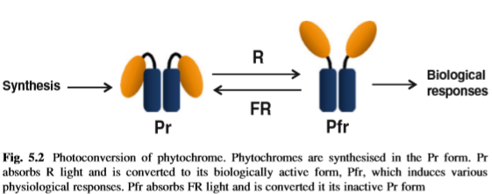
Phytochrome conversion
Active form
Inactive form
Dark

Slide 5
Photoreceptors

Slide 6
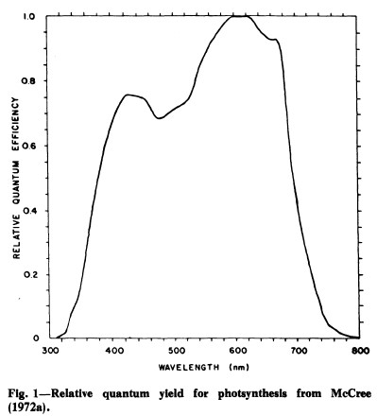
Yield Photon Flux (YPF)
$$\text{P}\text{PF}\text{D} \text{=}\sum_{\text{4}\text{0}\text{0}}^{\text{7}\text{0}\text{0}}{N_{λ}}$$
Relative Quantum Efficiency
$$\text{YPF} \text{=}\sum_{\text{3}\text{0}\text{0}}^{\text{8}\text{0}\text{0}}{N_{λ}∗{RQE}_{λ}}$$
Sager et al,1988
N_{λ}：Spectral photon distribution (SPD)
${RQE}_{λ}$：Relative quantum efficiency

Slide 7
One equation with various names
Phytochrome PhotoEquilibrium, PPE
Phytochrome Photostationary State, PPS
Phytochrome photoStationary State, PSS
PhotoStationary State, PSS
PSS, PPE, PPS ＝ $\frac{\text{Pfr}}{\begin{aligned}\text{P}\text{total} \text{(=}\text{Pr}\text{ + }\text{Pfr}\text{) } \\ \end{aligned}}$

Slide 8
Phytochrome photoStationary State
PSS ＝ $\frac{\text{Pfr}}{\begin{aligned}\text{P}\text{total} \text{(=}\text{Pr}\text{ + }\text{Pfr}\text{) } \\ \end{aligned}}$
Far red promotes Pfr → Pr
Less no. of Pfr lead to smaller PSS
Red promotes Pr → Pfr
Many Pfr lead to bigger PSS

Slide 9
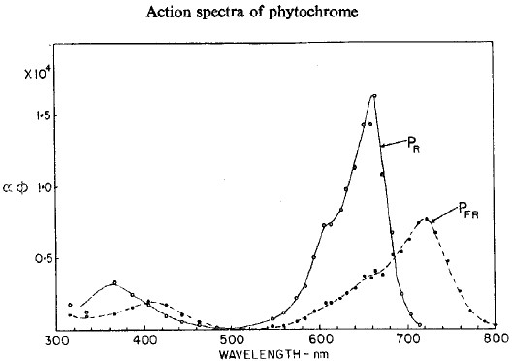
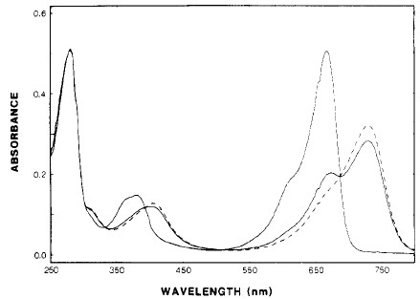
Butler et al., 1964
Kelly and Lagarias, 1985
Pratt and Briggs 1966
Sager et al., 1988

Slide 10
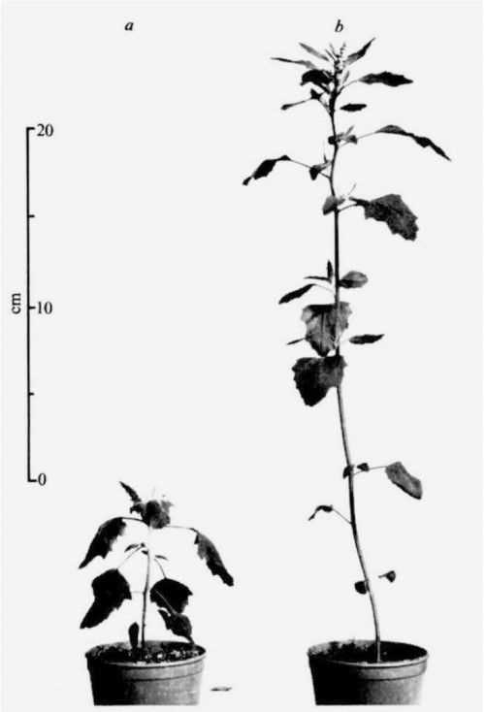
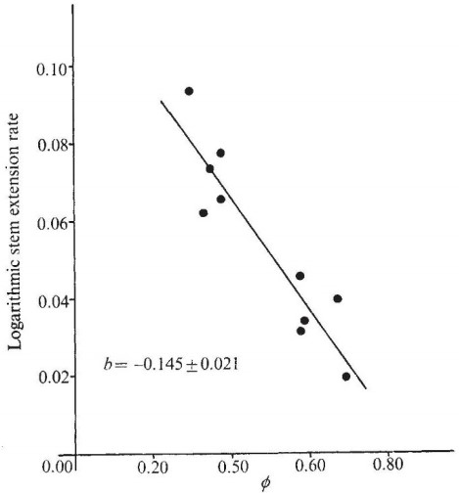
PSS vs. Photomorphogenesis
藜 Fat hen
Higher PSS, lower extension rate
PSS
(Morgan and Smith., 1976)

Slide 11
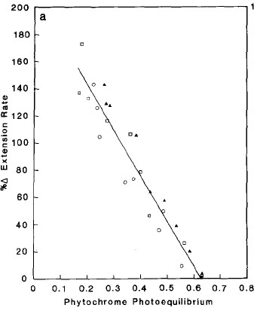
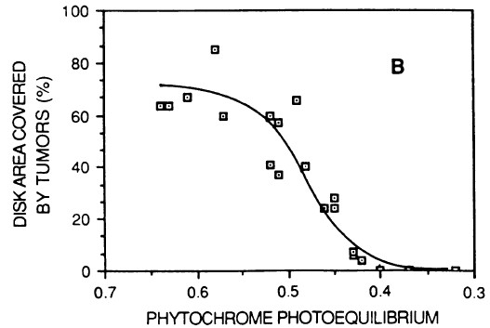
PSS vs. Photomorphogenesis
Mustard (Sinapis alba)
Higher PSS, more tumors
Higher PSS, lower extension rate
Tomato
(Morrow and Tibbitts., 1988)
Phytochrome PhotoEquilibrium, PPE
(Child and Smith., 1987)

Slide 12
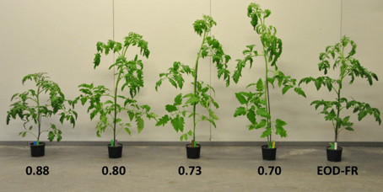
PSS vs. stem elongation
Higher PSS, lower plant
Tomato
Kalaitzoglou et al., 2019

Slide 13
$$\% FR= \frac{Far−red Photons}{Total Photons}$$
$$= \frac{700\sim 760nm}{400\sim 760nm}$$
$$PPE= \frac{Pfr}{Pr+Pfr}$$
PSS or PPS
Sun to shade: 0~1
Sun to shade: 1~0

Slide 14
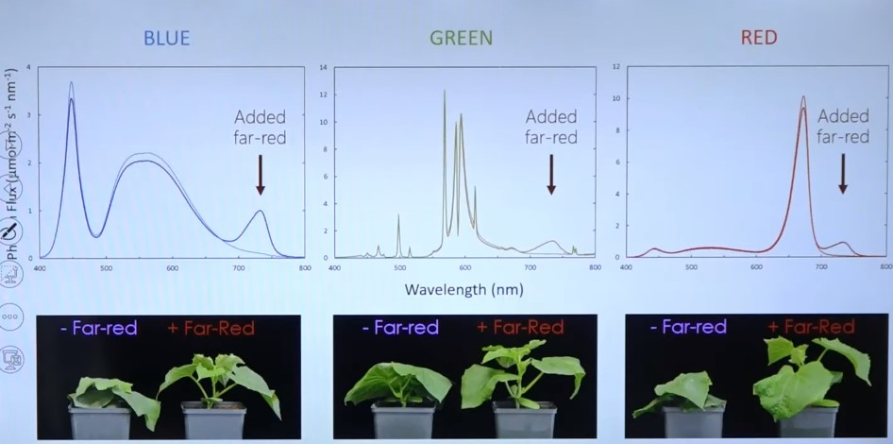
CW
HPS

Slide 15
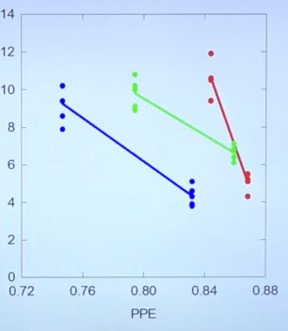
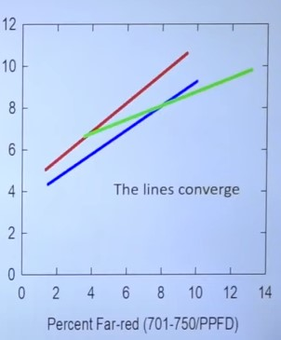
Stem elongation

Slide 17
Predicting Stem Elongation and Leaf Expansion: Percent far-red is a better predictor than PPE
I disagree
% far-red and PPE/PSS/PPS are similar predictors

Slide 18
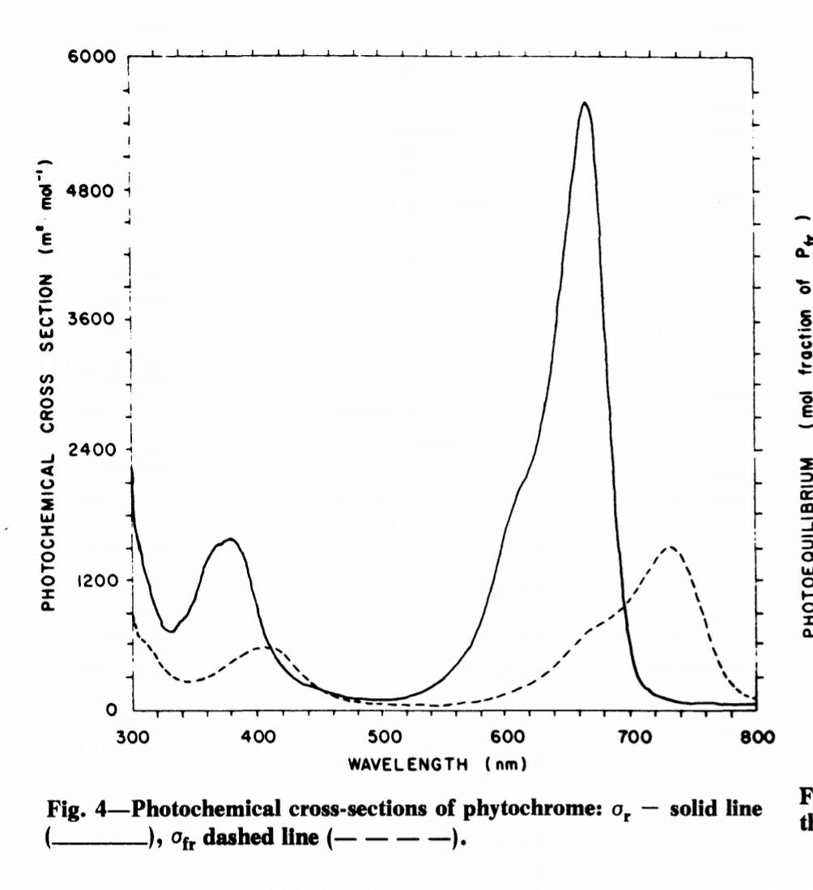
PhotoStationary State, PSS
$$K_{1}=\sum_{300}^{800}{N_{λ}}×σ_{rλ}$$
Photochemical crosssection
σ_{r}
K₁
$$K_{2}=\sum_{300}^{800}{N_{λ}}× σ_{frλ}$$
K₂
σ_{fr}
PSS ＝ $\frac{\text{Pfr}}{\text{Pr}\text{ + }\text{Pfr} }$ $=\frac{K_{1}}{{(K}_{1}+K_{2})}$
Sager et al,1988
Sager et al,1988

Slide 19
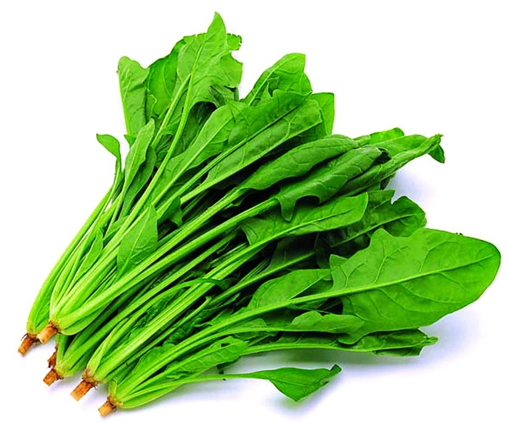
Objective
Spinach: Long-day plant
Light Period@11 h, no flowering
Investigate on PSS vs. flowering ratio
Light Period
T@L/D: 20 ºC/
ºC/
CW
CW
Dark Period
18 ºC
23 ºC
FR
LP: 12, 13, 14 h
PSS
+FR
FR
To inhibit flowering, FR is needed.
To promote flowering, R and LD are needed.
Targets: LD, no flowering, increased FW

Slide 20
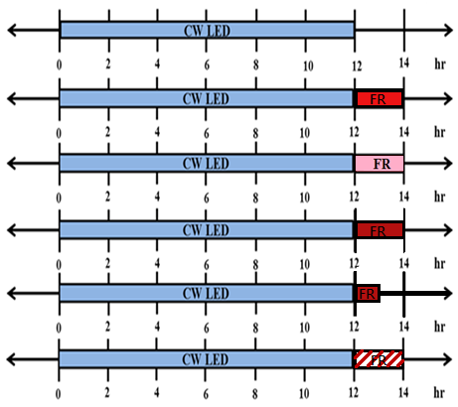
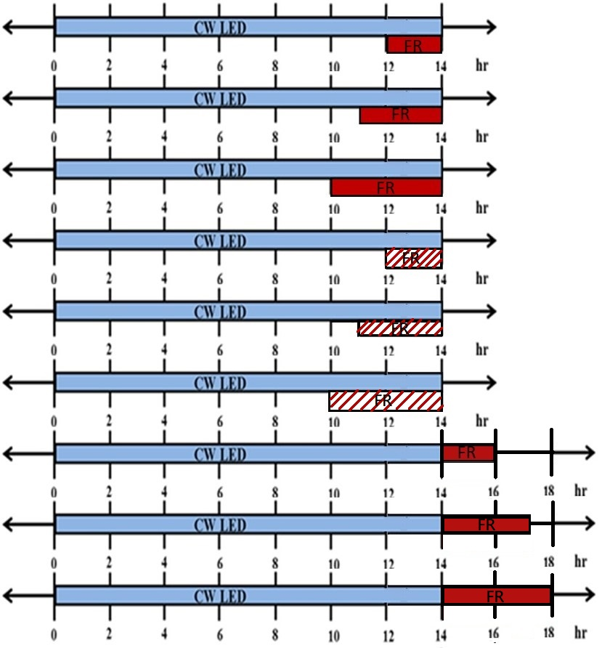
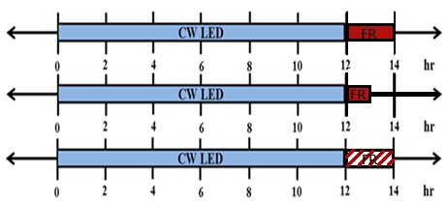
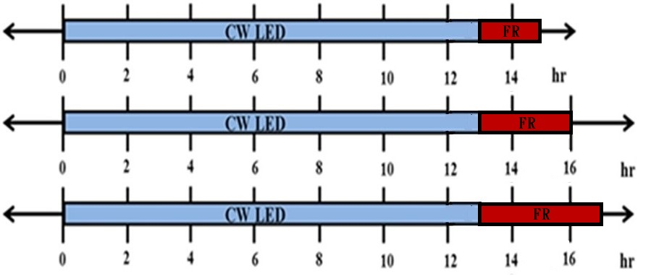
Treatments
Temperature : 20/18℃
Temperature : 25/23℃
12 14
FR (50 μmol m⁻² s⁻¹ x 2)
FR (50 μmol m⁻² s⁻¹ x 2
with diffuse film)
FR (50 μmol m⁻² s⁻¹ x 4)
FR (25 μmol m⁻² s⁻¹ x 4)
12 14
14 16
Totally 21 treatments with two dark period temperature (DT) and FR in dark or light period.
Totally 11 treatments with DT = 18℃ and FR in dark period.

Slide 21
Photosynthetic rate
Growth rate
fresh/dry weight
$$\begin{matrix}\text{PPFD} \\ \text{YPF}\end{matrix}×LP→Daily L.I.x Duration→ Total L.I.$$
Photomorphogenesis
$${PSS}^{′} Duration×PSS$$
extension/elongation rate
tumor area
Flowering ratio

Slide 22
Daily Integral of PhotoStationary State model (PSS’ )
$$K_{1}\left(CW\right)=\sum_{300}^{800}{N_{CWλ}× σ_{rλ}}$$
$$K_{2}\left(CW\right)=\sum_{300}^{800}{N_{CWλ}×σ_{frλ}}$$
$$K_{1}\left(FR\right)=\sum_{300}^{800}{N_{FRλ}×σ_{rλ}}$$
$$K_{2}\left(FR\right)=\sum_{300}^{800}{N_{FRλ}× σ_{frλ}}$$
N_{CWλ}：Light intensity of CW LED at λ nm, in mol·m^{2·}s⁻¹
σ_{rλ}：The photochemical cross section of Pr at λ nm, in m² mol⁻¹
K₁(CW)：Conversion rate of Pr to Pfr under white light, in µs⁻¹
σ_{frλ}：The photochemical cross section of Pfr at λ nm, in m² mol⁻¹
K₂(CW)： Conversion rate of Pfr to Pr under white light, in µs⁻¹
N_{FRλ}： Light intensity of FR LED at λ nm, in mol·m^{2·}s⁻¹
K₁(FR)： Conversion rate of Pr to Pfr under far-red light, in µs⁻¹
K₂(FR)： Conversion rate of Pfr to Pr under far-red light, in µs⁻¹
L_{CW}：Duration of CW LED, in hour/day
L_{FR}： Duration of Far-red LED, in hour/day
K₁I：Integral of active form phytochrome throughout light period
K₂I：Integral of inactive form phytochrome throughout light period
$$K1I=K_{1}\left(CW\right)×L_{CW}+K_{1}\left(FR\right)×L_{FR}$$
$$K2I=K_{2}\left(CW\right)×L_{CW}+K_{2}\left(FR\right)×L_{FR}$$
$$PSS′=\frac{K1I}{(K1I+K2I)}$$

Slide 23
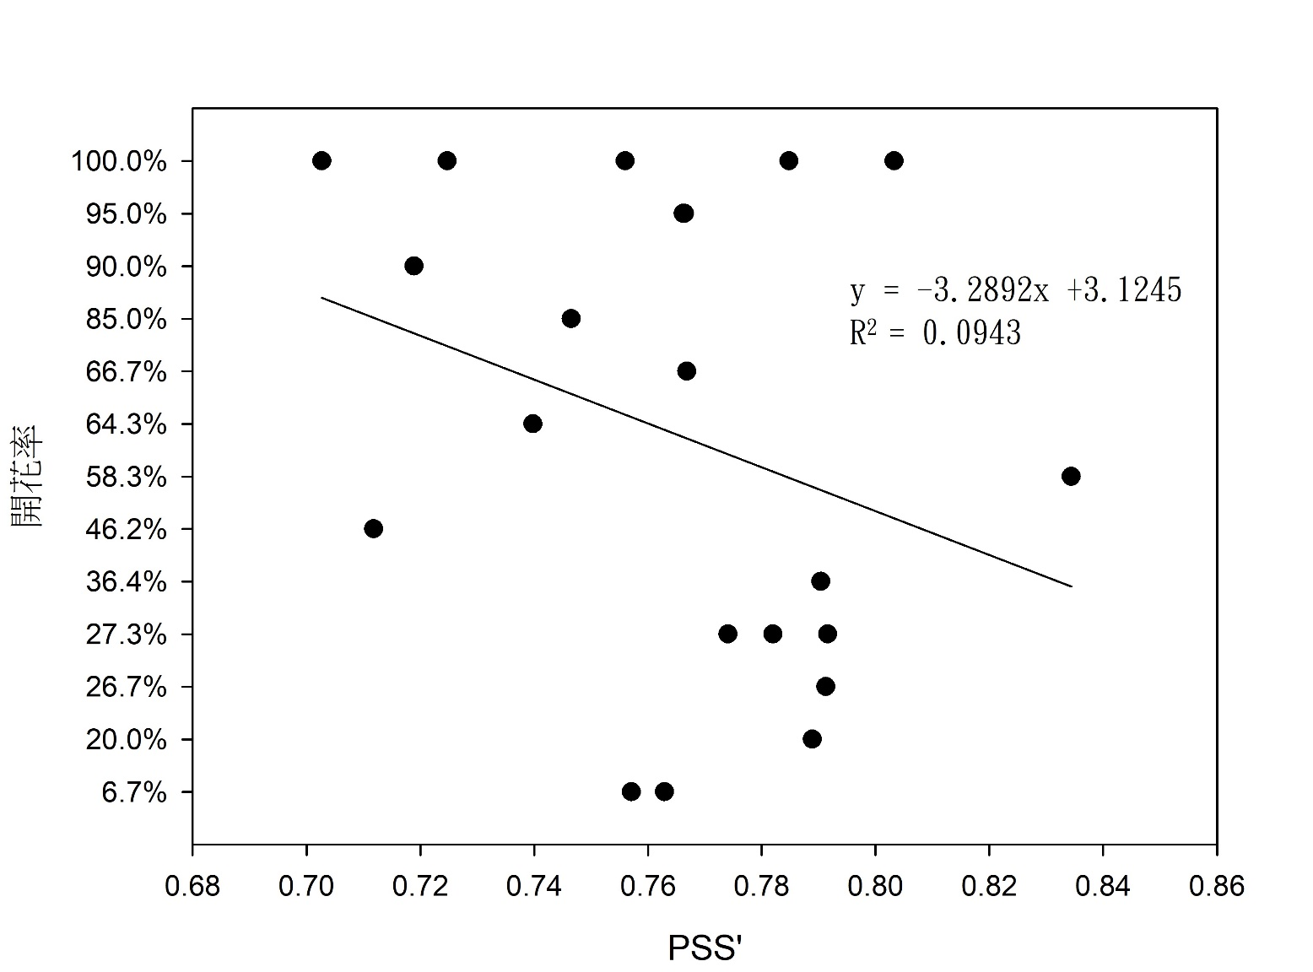
PSS′
Treatment | PSS′ | Flowering ratio
6CW (12)_4FR (2) 25/23℃ | 0.7629 | 6.67%
6CW (12)_4FR (2) 20/18℃ | 0.7571 | 6.67%
6CW (12)_4FR (1) 25/23℃ | 0.7889 | 20.00%
6CW (12)_4FR_half (2) 25/23℃ | 0.7913 | 26.67%
6CW (12)_2FR (2) 20/18℃ | 0.7741 | 27.27%
6CW (12)_2FR_diffuse (2) 20/18℃ | 0.782 | 27.27%
6CW (12)_4FR (1) 20/18℃ | 0.7916 | 27.27%
6CW (12)_4FR_half (2) 20/18℃ | 0.7904 | 36.36%
6CW (13)_4FR (4) 25/18℃ | 0.7118 | 46.15%
6CW (12) 20/18℃ (CK) | 0.8344 | 58.33%
6CW (13)_4FR (3) 25/18℃ | 0.7398 | 64.29%
6CW (13)_4FR (2) 25/18℃ | 0.7668 | 66.67%
6CW (14)_4FR (3) 20/18℃ | 0.7465 | 85.00%
6CW (14)_4FR (4) 20/18℃ | 0.7189 | 90.00%
6CW (14)_4FR (2) 20/18℃ | 0.7664 | 95.00%
6CW (14)+4FR (2) 20/18℃ | 0.7662 | 95.00%
6CW (14)+4FR (4) 20/18℃ | 0.7027 | 100.00%
6CW (14)+4FR (3) 20/18℃ | 0.7247 | 100.00%
6CW (14)+4FR_half (4) 20/18℃ | 0.756 | 100.00%
6CW (14)+4FR_half (3) 20/18℃ | 0.7848 | 100.00%
6CW (14)+4FR_half (2) 20/18℃ | 0.8033 | 100.00%
Flowering ratio

Slide 24
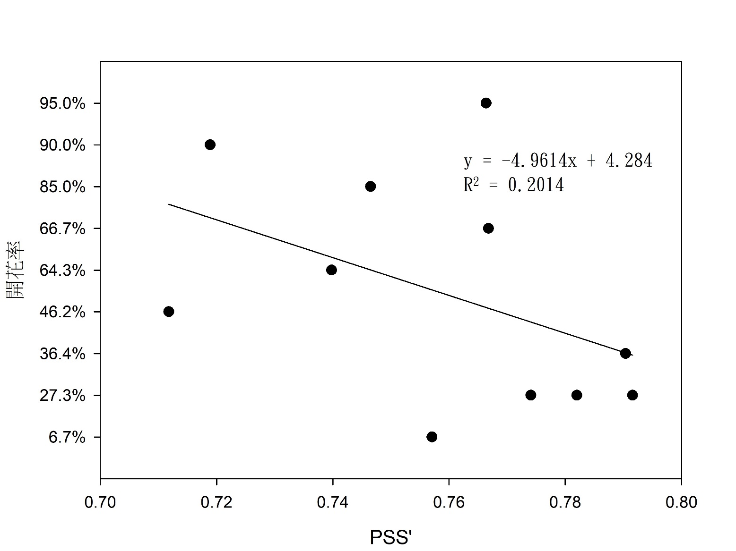
PSS′
Treatment | PSS$′$ | Flowering ratio
6CW (12)_4FR (2) 25/23℃ | 0.7629 | 6.67%
6CW (12)_4FR (2) 20/18℃ | 0.7571 | 6.67%
6CW (12)_4FR (1) 25/23℃ | 0.7889 | 20.00%
6CW (12)_4FR_half (2) 25/23℃ | 0.7913 | 26.67%
6CW (12)_2FR (2) 20/18℃ | 0.7741 | 27.27%
6CW (12)_2FR_diffuse (2) 20/18℃ | 0.782 | 27.27%
6CW (12)_4FR (1) 20/18℃ | 0.7916 | 27.27%
6CW (12)_4FR_half (2) 20/18℃ | 0.7904 | 36.36%
6CW (13)_4FR (4) 25/18℃ | 0.7118 | 46.15%
6CW (12) 20/18℃ (CK) | 0.8344 | 58.33%
6CW (13)_4FR (3) 25/18℃ | 0.7398 | 64.29%
6CW (13)_4FR (2) 25/18℃ | 0.7668 | 66.67%
6CW (14)_4FR (3) 20/18℃ | 0.7465 | 85.00%
6CW (14)_4FR (4) 20/18℃ | 0.7189 | 90.00%
6CW (14)_4FR (2) 20/18℃ | 0.7664 | 95.00%
6CW (14)+4FR (2) 20/18℃ | 0.7662 | 95.00%
6CW (14)+4FR (4) 20/18℃ | 0.7027 | 100.00%
6CW (14)+4FR (3) 20/18℃ | 0.7247 | 100.00%
6CW (14)+4FR_half (4) 20/18℃ | 0.756 | 100.00%
6CW (14)+4FR_half (3) 20/18℃ | 0.7848 | 100.00%
6CW (14)+4FR_half (2) 20/18℃ | 0.8033 | 100.00%
Flowering ratio

Slide 25
Coefficient of determination (R²)
Daily Integral PhotoStationary State model (PSS′)
Groups | R² (PSS$′$ vs. Flowering ratio)
Totally 21 treatments with various dark temp., duration of light period, intensity of CW and FR, FR concurrent with CW or FR in dark period only. | 0.0943
Totally 11 treatments with FR at dark period and DT @ 18℃ | 0.2014

Slide 26
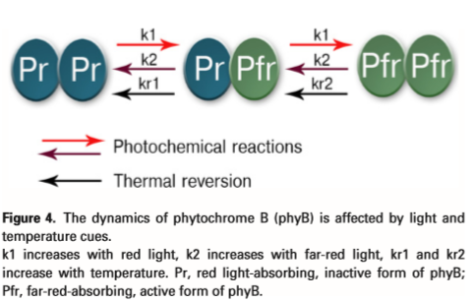
In previous models (PSS and PSS’), thermal reversion was missing.

Slide 27
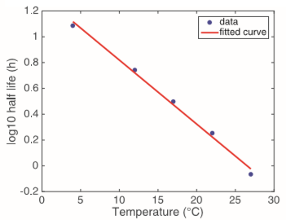
Phytochromes function as thermosensors
$${ t}_{1/2}(T)={10}^{\left(−0.0496×T+1.315\right)}$$
Thermal reversion
Legris et al., 2017
Half life of Pfr @ dark period
${ t}_{1/2}(22℃)$= 1.79 hours
${ t}_{1/2}(27℃)$= 0.86 hours
No. of Pfr retained after L_{N} hrs of dark period @ T ºC
Jung et al., 2016
$${0.5}^{{(L}_{N}÷t_{1/2}(T))}$$

Slide 28
Temperature calibrated PhotoStationary State model (T-PSS )
$$K1I=K_{1}\left(CW\right)×L_{CW}+K_{1}\left(FR\right)×L_{FR}$$
$$K2I=K_{2}\left(CW\right)×L_{CW}+K_{2}\left(FR\right)×L_{FR}$$
K₁(CW)：Conversion rate of Pr to Pfr under white light, in µs⁻¹
K₂(CW)： Conversion rate of Pfr to Pr under white light, in µs⁻¹
K₁(FR)： Conversion rate of Pr to Pfr under far-red light, in µs⁻¹
K₂(FR)： Conversion rate of Pfr to Pr under far-red light, in µs⁻¹
L_{CW}：Duration of CW LED, in hour/day
L_{FR}： Duration of Far-red LED, in hour/day
K₁I：Integral of active form phytochrome throughout light period
K₂I：Integral of inactive form phytochrome throughout light period
$$PSS′=\frac{K1I}{(K1I+K2I)}$$
$$t_{1/2}(T)={10}^{(−0.0496×T+1.315)}$$
T-PSS $=\frac{K1I×{0.5}^{{(L}_{N}÷t_{1/2}(T))}}{(K1I+K2I)}$
T：Temperature in dark period, in ℃
L_{N}：Duration of dark period (with Far-red LED hours), in hour
t_{1/2}：Temperature-responsive half-life period for Pfr, in hour

Slide 29
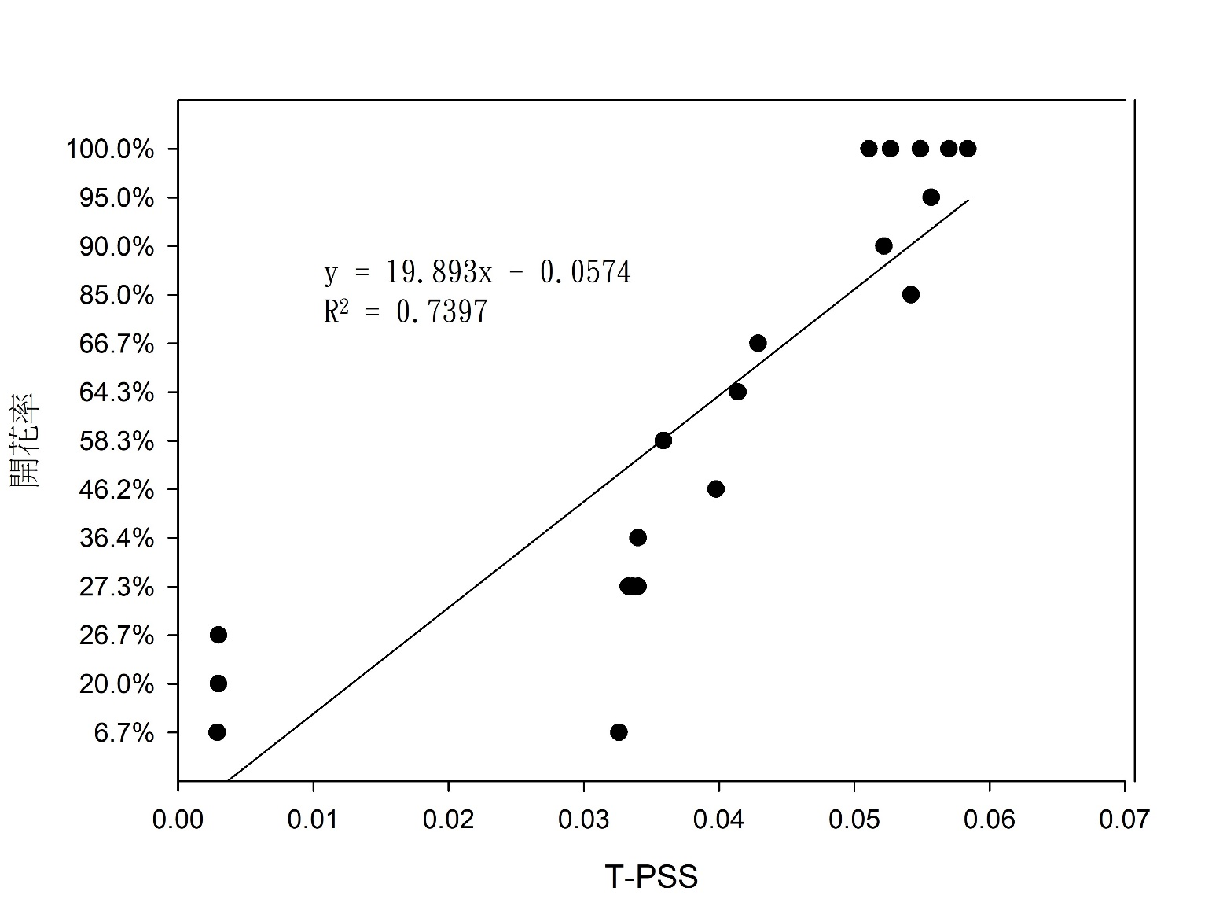
T-PSS
Treatment | T-PSS | Flowering ratio
6CW (12)_4FR (2) 25/23℃ | 0.0029 | 6.67%
6CW (12)_4FR (2) 20/18℃ | 0.0326 | 6.67%
6CW (12)_4FR (1) 25/23℃ | 0.0030 | 20.00%
6CW (12)_4FR_half (2) 25/23℃ | 0.0030 | 26.67%
6CW (12)_2FR (2) 20/18℃ | 0.0333 | 27.27%
6CW (12)_2FR_diffuse (2) 20/18℃ | 0.0336 | 27.27%
6CW (12)_4FR (1) 20/18℃ | 0.0340 | 27.27%
6CW (12)_4FR_half (2) 20/18℃ | 0.0340 | 36.36%
6CW (13)_4FR (4) 25/18℃ | 0.0398 | 46.15%
6CW (12) 20/18℃ (CK) | 0.0359 | 58.33%
6CW (13)_4FR (3) 25/18℃ | 0.0414 | 64.29%
6CW (13)_4FR (2) 25/18℃ | 0.0429 | 66.67%
6CW (14)_4FR (3) 20/18℃ | 0.0542 | 85.00%
6CW (14)_4FR (4) 20/18℃ | 0.0522 | 90.00%
6CW (14)_4FR (2) 20/18℃ | 0.0557 | 95.00%
6CW (14)+4FR (2) 20/18℃ | 0.0557 | 95.00%
6CW (14)+4FR (4) 20/18℃ | 0.0511 | 100.00%
6CW (14)+4FR (3) 20/18℃ | 0.0527 | 100.00%
6CW (14)+4FR_half (4) 20/18℃ | 0.0549 | 100.00%
6CW (14)+4FR_half (3) 20/18℃ | 0.0570 | 100.00%
6CW (14)+4FR_half (2) 20/18℃ | 0.0584 | 100.00%
Flowering ratio

Slide 30
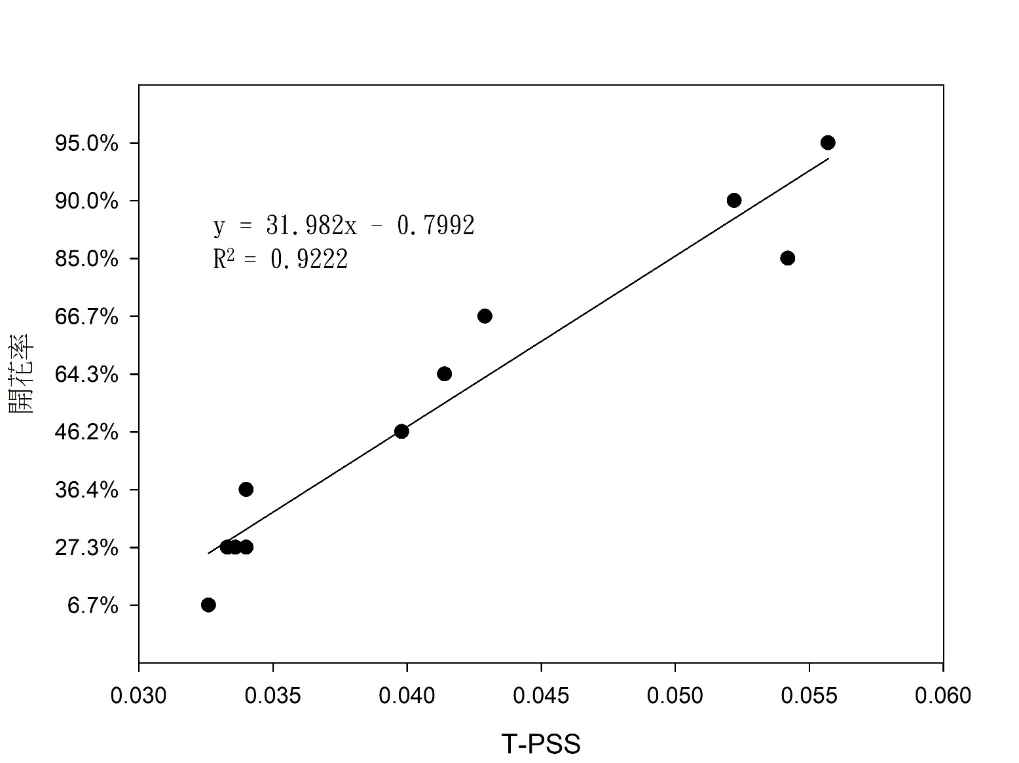
T-PSS
Treatment | T-PSS | Flowering ratio
6CW (12)_4FR (2) 25/23℃ | 0.0029 | 6.67%
6CW (12)_4FR (2) 20/18℃ | 0.0326 | 6.67%
6CW (12)_4FR (1) 25/23℃ | 0.0030 | 20.00%
6CW (12)_4FR_half (2) 25/23℃ | 0.0030 | 26.67%
6CW (12)_2FR (2) 20/18℃ | 0.0333 | 27.27%
6CW (12)_2FR_diffuse (2) 20/18℃ | 0.0336 | 27.27%
6CW (12)_4FR (1) 20/18℃ | 0.0340 | 27.27%
6CW (12)_4FR_half (2) 20/18℃ | 0.0340 | 36.36%
6CW (13)_4FR (4) 25/18℃ | 0.0398 | 46.15%
6CW (12) 20/18℃ (CK) | 0.0359 | 58.33%
6CW (13)_4FR (3) 25/18℃ | 0.0414 | 64.29%
6CW (13)_4FR (2) 25/18℃ | 0.0429 | 66.67%
6CW (14)_4FR (3) 20/18℃ | 0.0542 | 85.00%
6CW (14)_4FR (4) 20/18℃ | 0.0522 | 90.00%
6CW (14)_4FR (2) 20/18℃ | 0.0557 | 95.00%
6CW (14)+4FR (2) 20/18℃ | 0.0557 | 95.00%
6CW (14)+4FR (4) 20/18℃ | 0.0511 | 100.00%
6CW (14)+4FR (3) 20/18℃ | 0.0527 | 100.00%
6CW (14)+4FR_half (4) 20/18℃ | 0.0549 | 100.00%
6CW (14)+4FR_half (3) 20/18℃ | 0.0570 | 100.00%
6CW (14)+4FR_half (2) 20/18℃ | 0.0584 | 100.00%
Flowering ratio

Slide 31
Coefficient of determination (R²)
Temperature calibrated PSS (T-PSS)
Groups | R² (T-PSS vs. Flowering rate)
Totally 21 treatments with various dark temp., duration of light period, intensity of CW and FR, FR concurrent with CW or FR in dark period only. | 0.7397
Totally 11 treatments with FR at dark period and DT @ 18℃ | 0.9222

Slide 32
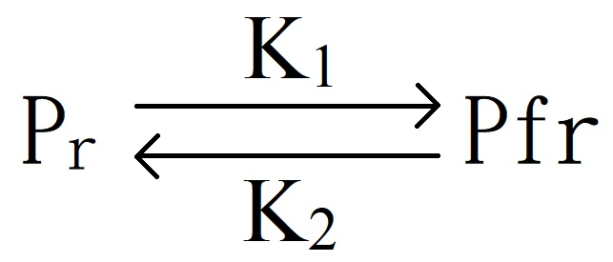
T-PSS
Textbook
UV+PPFD+FR
Red and Far-red
$$K_{1}\left(CW\right)=\sum_{300}^{800}{N_{CWλ}× σ_{rλ}}$$
$$K_{2}\left(CW\right)=\sum_{300}^{800}{N_{CWλ}×σ_{frλ}}$$
$$K_{1}\left(FR\right)=\sum_{300}^{800}{N_{FRλ}×σ_{rλ}}$$
$$K_{2}\left(FR\right)=\sum_{300}^{800}{N_{FRλ}× σ_{frλ}}$$
Red
Far-red
Is that necessary to use all the data from 300 to 800 nm ?

Slide 33
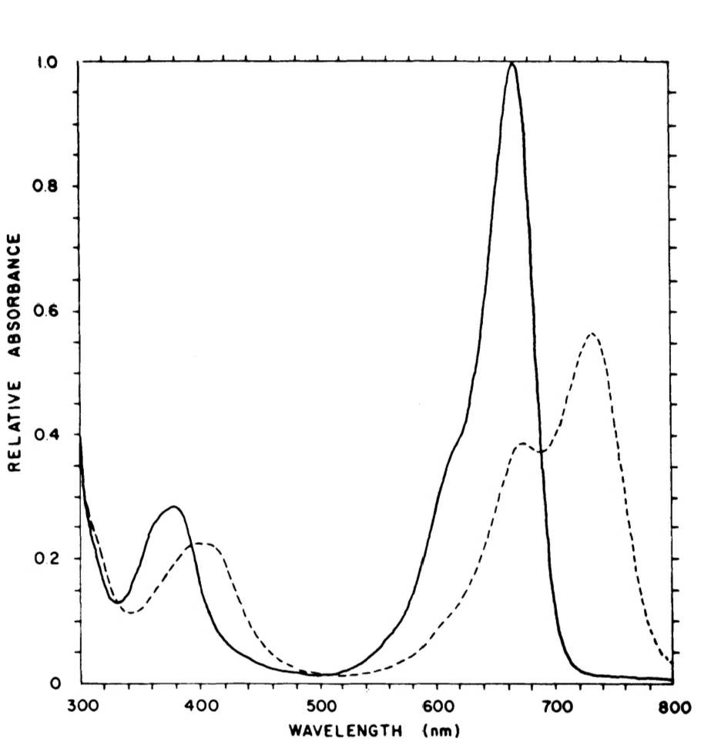
Advanced analysis of T-PSS
$$K_{1}\left(CW\right)=\sum_{300}^{800}{N_{CWλ}}× σ_{rλ}$$
$$K_{2}\left(CW\right)=\sum_{300}^{800}{N_{CWλ}}× σ_{frλ}$$
$$K_{1}\left(FR\right)=\sum_{300}^{800}{N_{FRλ}}× σ_{rλ}$$
$$K_{2}\left(FR\right)=\sum_{300}^{800}{N_{FRλ}}× σ_{frλ}$$
Three ranges
K1 & K2: 300~800 nm (from UV to FR)
K1 & K2: 600~800 nm (R and FR)
K1: 600~700 nm (R)
K2: 700~800 nm (FR)

Slide 34
Advanced analysis of T-PSS
Groups | K₁, K₂ 300~800 nm | K₁, K₂ 600~800 nm | K₁: 600~700 K₂: 700~800 nm
 | R² (T-PSS vs. Flowering rate)
Totally 21 treatments with various dark temp., duration of light period, intensity of CW and FR, FR concurrent with CW or FR in dark period only. | 0.7397 | 0.732 |  | 0.7267
Totally 11 treatments with FR at dark period and DT @ 18℃ | 0.9222 | 0.9201 |  | 0.917

Slide 35
含温度校正的简化版光稳态平衡模式 Temperature calibrated DLI based PSS (D-PSS)
$${DLI}_{R}={PPFD}_{R}×L_{CW}×3.6×{10}^{−3}$$
$${DLI}_{FR}={BPFD}_{FR }×L_{FR}×3.6×{10}^{−3}$$
PPFD_{R}：The average amount of red light during the growing period, in µmol·m^{2·}s⁻¹
L_{CW}：Duration of CW LED, in hour/day
DLI_{R}：Daily light integral of red light (600~700 nm) , in mol·m⁻²/day
BPFD_{FR}：The average amount of far-red light during the growing period, in µmol·m^{2·}s⁻¹
L_{FR}： Hours of Far-red LED, in hour/day
DLI_{FR}： Daily light integral of far-red light (700~800 nm) , in mol·m⁻²/day
D_{PSS}：Photostationary state based on DLI
C：Ratio of conversion rate of inactive vs. active phytochrome, C = 3.54
T： Temperature in dark period, in ℃
L_{N}：Duration of dark period (with Far-red LED hours), in hour
t_{1/2}：Temperature-responsive half-life period for Pfr, in hour
$$D_{PSS}=\frac{{DLI}_{R}×C}{{(DLI}_{R}×C+{DLI}_{FR})}$$
$$t_{1/2}(T)={10}^{(−0.0496×T+1.315)}$$
D-PSS$=\frac{{DLI}_{R}×C×{0.5}^{{(L}_{N}÷t_{1/2}(T))}}{{(DLI}_{R}×C+{DLI}_{FR})}$

Slide 36
Ratio of conversion rate of inactive vs. active phytochrome, C
Photochemical cross section
C equals ratio of the photochemical cross-section σr and σfr of Pr and Pfr in R and FR waveband, respectively.
σ_{r}
$$C=\frac{\sum_{600}^{700}{{\text{σr}}_{λ}}}{\sum_{700}^{800}{{\text{σfr}}_{λ}}}=3.54$$
σ_{fr}
Sager et al.,1988

Slide 37
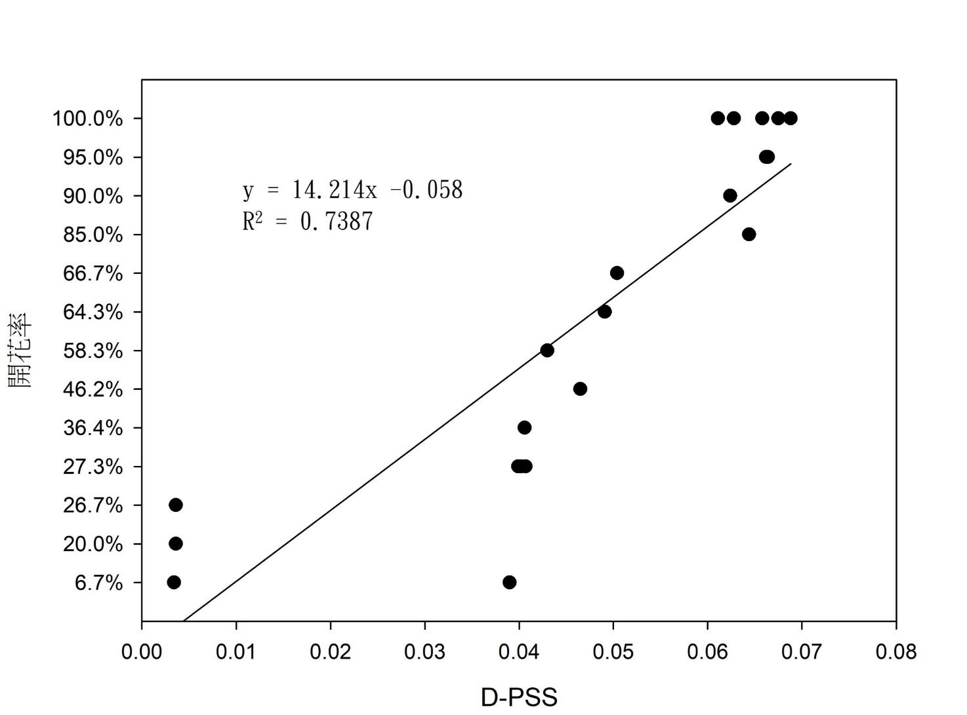
D-PSS
Treatment | D-PSS | Flowering ratio
6CW (12)_4FR (2) 25/23℃ | 0.0034 | 6.67%
6CW (12)_4FR (2) 20/18℃ | 0.0390 | 6.67%
6CW (12)_4FR (1) 25/23℃ | 0.0036 | 20.00%
6CW (12)_4FR_half (2) 25/23℃ | 0.0036 | 26.67%
6CW (12)_2FR (2) 20/18℃ | 0.0399 | 27.27%
6CW (12)_2FR_diffuse (2) 20/18℃ | 0.0402 | 27.27%
6CW (12)_4FR (1) 20/18℃ | 0.0407 | 27.27%
6CW (12)_4FR_half (2) 20/18℃ | 0.0406 | 36.36%
6CW (13)_4FR (4) 25/18℃ | 0.0465 | 46.15%
6CW (12) 20/18℃ (CK) | 0.0430 | 58.33%
6CW (13)_4FR (3) 25/18℃ | 0.0491 | 64.29%
6CW (13)_4FR (2) 25/18℃ | 0.0504 | 66.67%
6CW (14)_4FR (3) 20/18℃ | 0.0644 | 85.00%
6CW (14)_4FR (4) 20/18℃ | 0.0624 | 90.00%
6CW (14)_4FR (2) 20/18℃ | 0.0662 | 95.00%
6CW (14)+4FR (2) 20/18℃ | 0.0664 | 95.00%
6CW (14)+4FR (4) 20/18℃ | 0.0611 | 100.00%
6CW (14)+4FR (3) 20/18℃ | 0.0628 | 100.00%
6CW (14)+4FR_half (4) 20/18℃ | 0.0658 | 100.00%
6CW (14)+4FR_half (3) 20/18℃ | 0.0675 | 100.00%
6CW (14)+4FR_half (2) 20/18℃ | 0.0688 | 100.00%
Flowering ratio

Slide 38
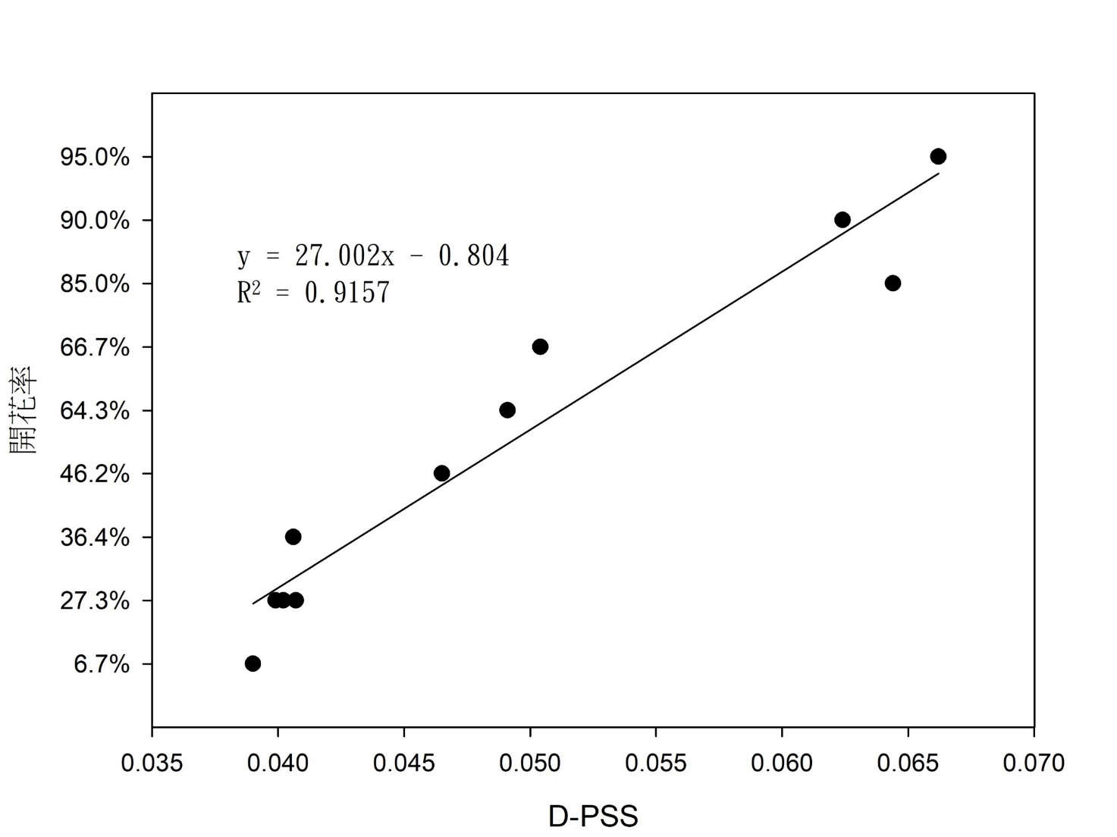
D-PSS
Treatment | D-PSS | Flowering ratio
6CW (12)_4FR (2) 25/23℃ | 0.0034 | 6.67%
6CW (12)_4FR (2) 20/18℃ | 0.0390 | 6.67%
6CW (12)_4FR (1) 25/23℃ | 0.0036 | 20.00%
6CW (12)_4FR_half (2) 25/23℃ | 0.0036 | 26.67%
6CW (12)_2FR (2) 20/18℃ | 0.0399 | 27.27%
6CW (12)_2FR_diffuse (2) 20/18℃ | 0.0402 | 27.27%
6CW (12)_4FR (1) 20/18℃ | 0.0407 | 27.27%
6CW (12)_4FR_half (2) 20/18℃ | 0.0406 | 36.36%
6CW (13)_4FR (4) 25/18℃ | 0.0465 | 46.15%
6CW (12) 20/18℃ (CK) | 0.0430 | 58.33%
6CW (13)_4FR (3) 25/18℃ | 0.0491 | 64.29%
6CW (13)_4FR (2) 25/18℃ | 0.0504 | 66.67%
6CW (14)_4FR (3) 20/18℃ | 0.0644 | 85.00%
6CW (14)_4FR (4) 20/18℃ | 0.0624 | 90.00%
6CW (14)_4FR (2) 20/18℃ | 0.0662 | 95.00%
6CW (14)+4FR (2) 20/18℃ | 0.0664 | 95.00%
6CW (14)+4FR (4) 20/18℃ | 0.0611 | 100.00%
6CW (14)+4FR (3) 20/18℃ | 0.0628 | 100.00%
6CW (14)+4FR_half (4) 20/18℃ | 0.0658 | 100.00%
6CW (14)+4FR减半 (3) 20/18℃ | 0.0675 | 100.00%
Flowering ratio

Slide 39
Determination coefficient (R²) of three PSS models on flowering ratio
Groups | PSS $′$ | T-PSS 300~800 nm | T-PSS 600~700 & 700~800 nm | D-PSS
Totally 21 treatments with various dark temp., duration of light period, intensity of CW and FR, FR concurrent with CW or FR in dark period only. | 0.0754 | 0.7397 | 0.7267 | 0.7387
Totally 11 treatments with FR at dark period and temperature @ 18 C | 0.0661 | 0.9222 | 0.917 | 0.9157

Slide 40
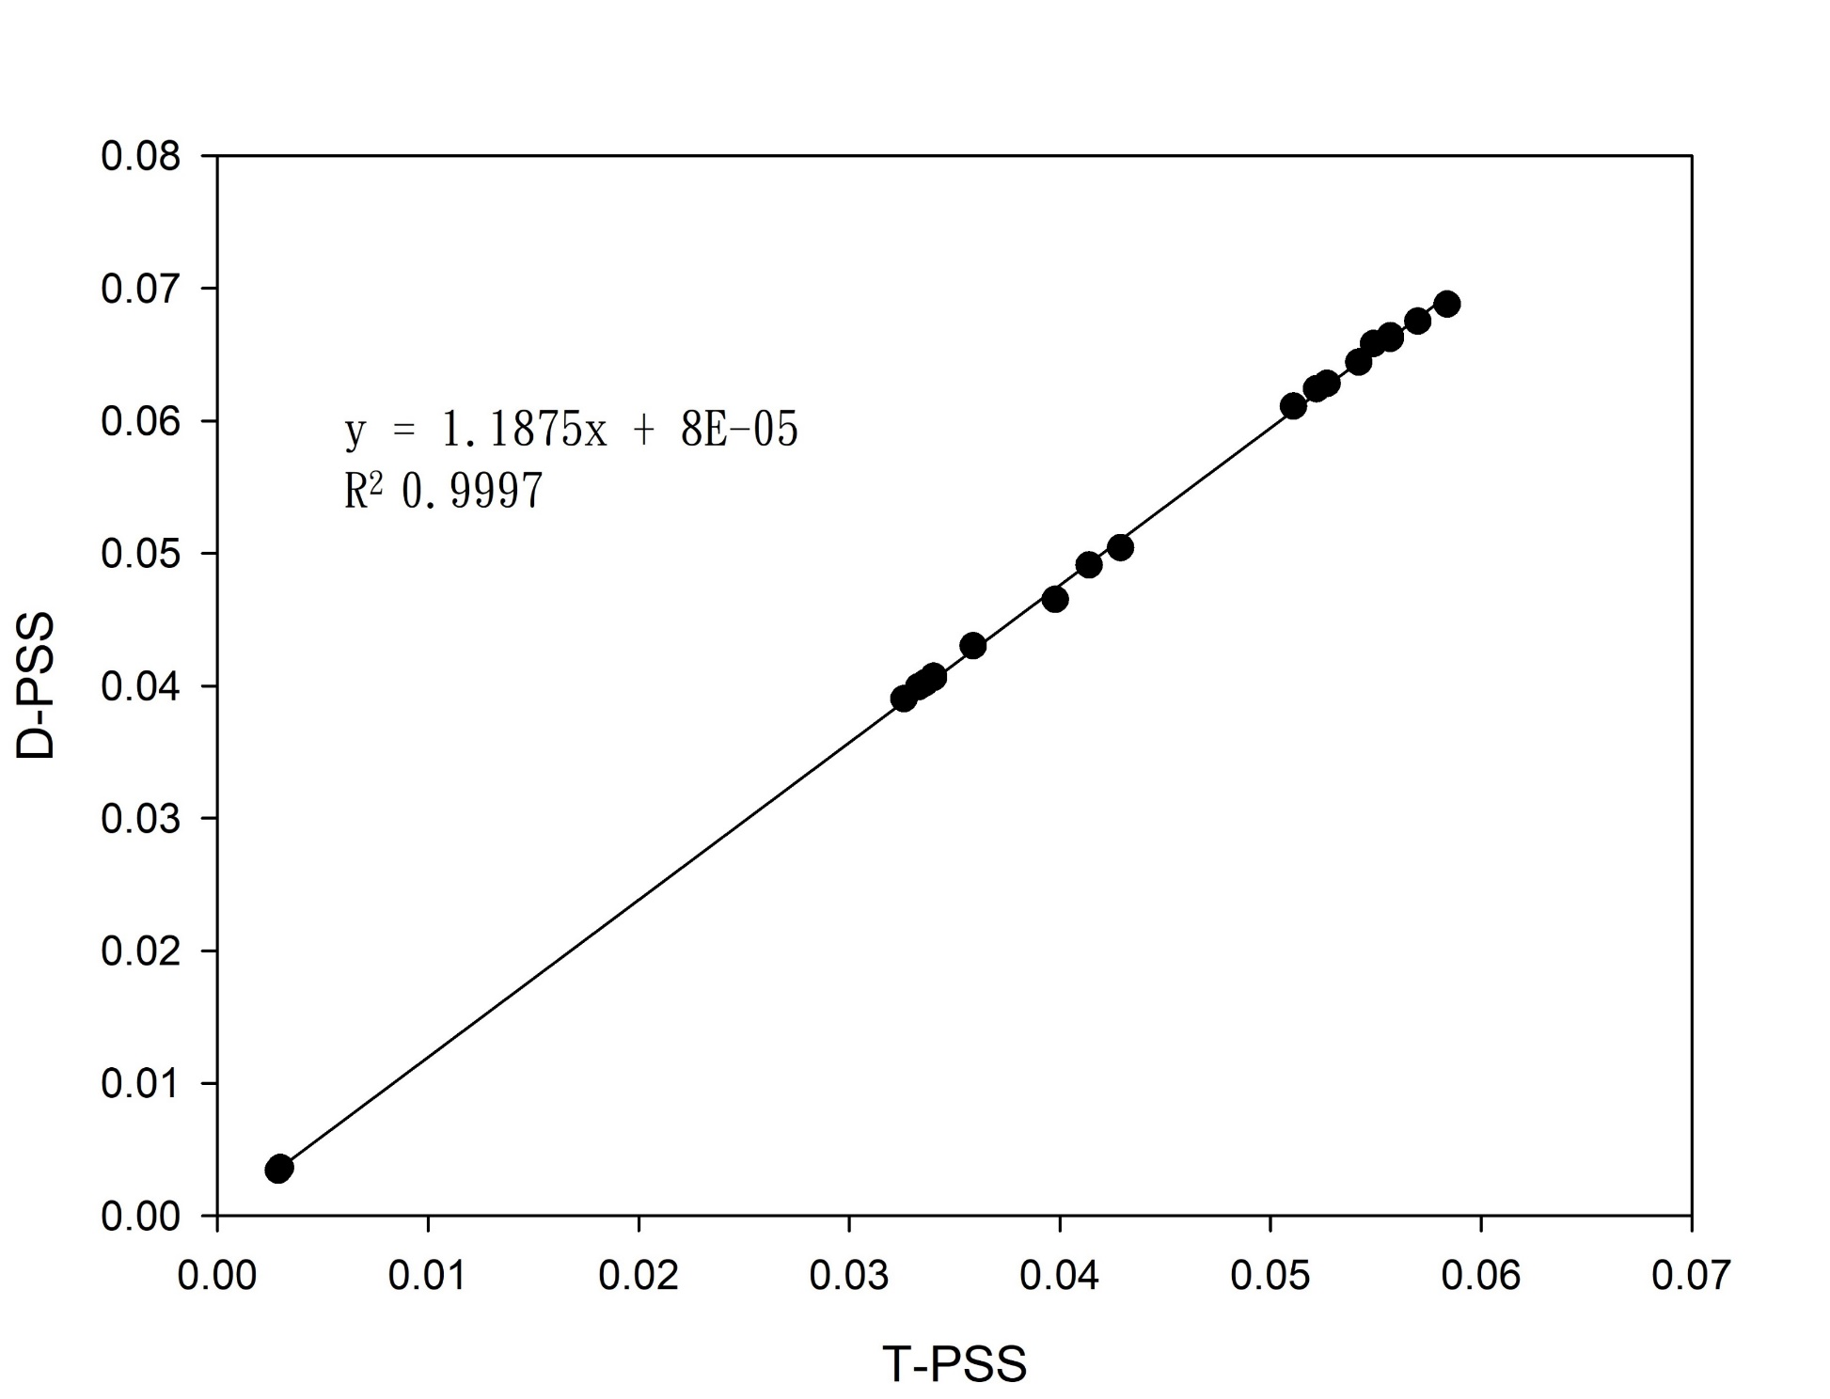
T-PSS 與 D-PSS 存在線性關係
There is a linear relationship between T-PSS and D-PSS
Y = 1.1875 X
R² = 0.9997

Slide 41
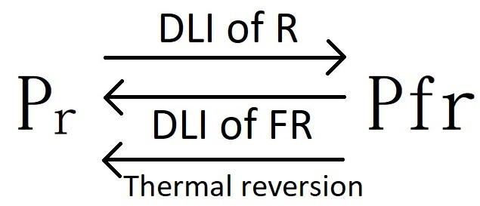
Conclusion
PSS or PSS x duration or % far red can’t be used to predict flowering ratio
Thermal reversion of phytochrome in dark period should not be neglected in PSS model.
T-PSS and D-PSS can be used to predict flowering ratio.
D-PSS is a simplify T-PSS using only DLI of R and FR instead of spectral data.

Slide 42
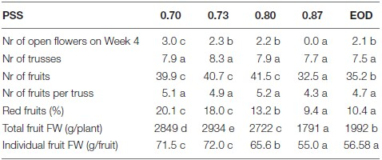
PSS vs. Photomorphogenesis
Tomato
Kalaitzoglou et al., 2019
Higher PSS, less no. of open flowers on wk 4
less no. of fruits
less % of red fruit
less total fruit weight/plt
small fruit FW

Slide 43
各处理组之兩种修正後光稳态平衡模式与开花率
Two modified photostationary state models and flowering rate of each treatment
Treatment | T-PSS | D-PSS | Flowering rate
6CW (12)_4FR (2) 25/23℃ | 0.0029 | 0.0034 | 6.67%
6CW (12)_4FR (2) 20/18℃ | 0.0326 | 0.0390 | 6.67%
6CW (12)_4FR (1) 25/23℃ | 0.0030 | 0.0036 | 20.00%
6CW (12)_4FR_half (2) 25/23℃ | 0.0030 | 0.0036 | 26.67%
6CW (12)_2FR (2) 20/18℃ | 0.0333 | 0.0399 | 27.27%
6CW (12)_2FR_diffuse (2) 20/18℃ | 0.0336 | 0.0402 | 27.27%
6CW (12)_4FR (1) 20/18℃ | 0.0340 | 0.0407 | 27.27%
6CW (12)_4FR_half (2) 20/18℃ | 0.0340 | 0.0406 | 36.36%
6CW (13)_4FR (4) 25/18℃ | 0.0398 | 0.0465 | 46.15%
6CW (12) 20/18℃ (CK) | 0.0359 | 0.0430 | 58.33%
6CW (13)_4FR (3) 25/18℃ | 0.0414 | 0.0491 | 64.29%
6CW (13)_4FR (2) 25/18℃ | 0.0429 | 0.0504 | 66.67%
6CW (14)_4FR (3) 20/18℃ | 0.0542 | 0.0644 | 85.00%
6CW (14)_4FR (4) 20/18℃ | 0.0522 | 0.0624 | 90.00%
6CW (14)_4FR (2) 20/18℃ | 0.0557 | 0.0662 | 95.00%
6CW (14)+4FR (2) 20/18℃ | 0.0557 | 0.0664 | 95.00%
6CW (14)+4FR (4) 20/18℃ | 0.0511 | 0.0611 | 100.00%
6CW (14)+4FR (3) 20/18℃ | 0.0527 | 0.0628 | 100.00%
6CW (14)+4FR_half (4) 20/18℃ | 0.0549 | 0.0658 | 100.00%
6CW (14)+4FR_half (3) 20/18℃ | 0.0570 | 0.0675 | 100.00%
6CW (14)+4FR_half (2) 20/18℃ | 0.0584 | 0.0688 | 100.00%

