Slide 1
Environmental Control in PFAL Nutrients & Water
[ATGS 7140] Plant Factory – Theory and Practice
Wei FANG
Dept. of Biomechatronics Engineering (BME) and Global ATGS
Center of Excellence for Controlled Environment Agriculture (CCEA)
National Taiwan University (NTU)

Slide 2
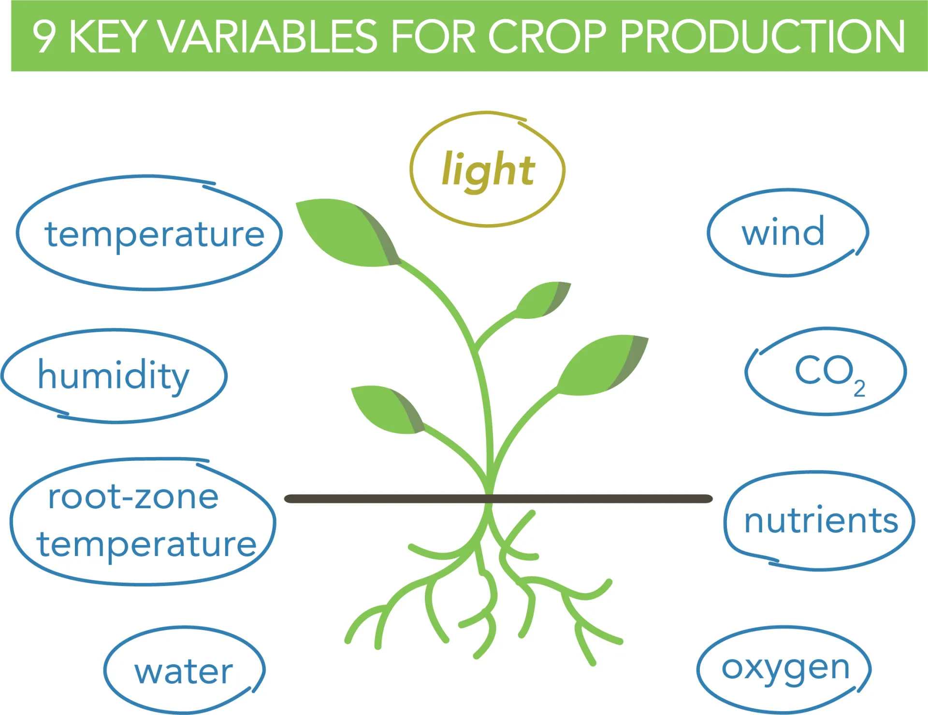
Topic 4
Topic 5
Topic 6

Slide 3
Five governing factors in PFAL
Air velocity, Temperature, Relative humidity
Air
Light
Water
Nutrient
Gas
quality
Intensity: PPFD
duration
CO₂
concentration
recipe
concentration: EC
Availability: pH
When
Frequency
Dissolved Oxygen
Root zone Temperature

Slide 4
Must have monitoring items in PFAL
T、 RH、Wind
Light Intensity, quality, duration
CO₂
Air Light Gas
Water Nutrient
Tw、DO
pH、EC

Slide 5
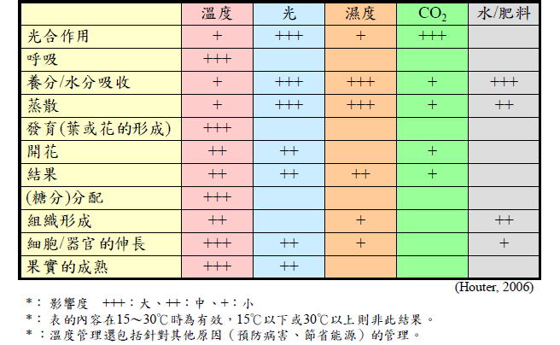
Factors affecting plant growth and development
Temperature
Light
Humidity
Nutrient+H₂O
photosynthesis
respiration
Absorb. of nutrient+H₂O
Transpiration
Development (leaf,flower formation)
booming
fruiting
Distribution of sugar
++
Formation of organ
Extension of cell/organ
Mature of fruit
Degree of influence: +++ large, ++ medium, + small
Suitable range in between 15 ~ 30 ºC
Modified by Fang, 2018

Slide 6
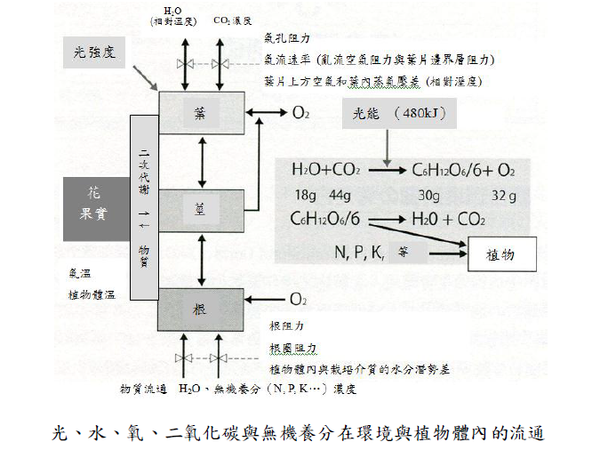
H₂O CO₂ concentration
light
Stomata resistant
Air velocity (resistant of boundary layer of air and leaf)
VPD/AHD between air and leaf affected by T and RH / AH
leaf
Energy_{light} (480kJ)
2^{ndary} metabolites
_{Flower}
_{Fruit}
stem
_{etc.}
plant
T_{air}
T_{leaf}
materials
root
Resistant of root, root zone
Water potential difference between root and growth media
Material exchange: H₂O, inorganic macro/micro nutrients (N, P, K, …) concentration

Slide 7
Outline
Preparation of nutrient solution
pH, EC
Management
pH
Adjustment
Hydroponic systems
Literature Review
Materials / Device
Recipes
Unit conversion
Preparation of nutrient solution
pH, EC
Management
pH
Adjustment
Hydroponic systems
Literature Review
Materials / Device
Recipes
Unit conversion
What is hydroponics and how does it works?
All about hydroponics

Slide 8
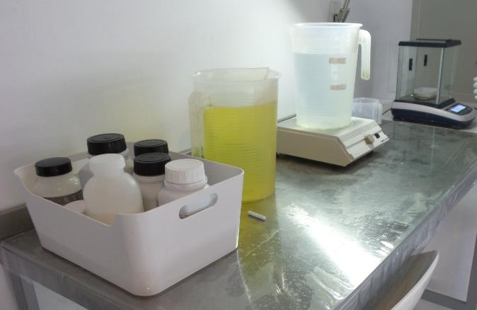
Materials and Device
5 L bucket
Fertilizers
Micro balance
Mag. mixer/blender
Stir bar

Slide 9
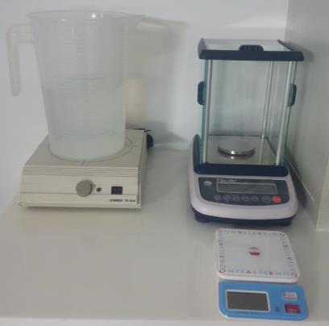
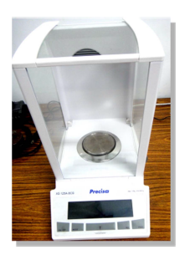
Related Equipment
Balance:
  Micro-elements:
  0.001 g grade (precise scale)
  Macro-elements:
  0.1 g grade
blender

Slide 10
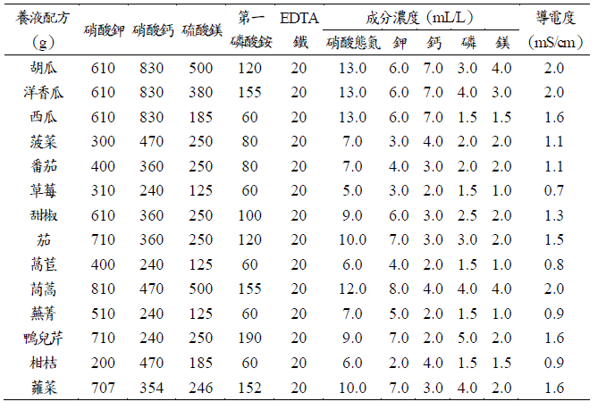
Macro elements of Yamazaki formula for various crops
1000 L nutrient solution
MgSO₄．7H₂O
PP
Fe．EDTA
EC
KNO₃
Ca(NO₃) ₂．4H₂O
NH₄
H₂PO₄
NO₃-N
K Ca P Mg
Lettuce
Notes:
手調換作物
量大
經驗
STRESS

Slide 11
Stock solution for micro elements dilute 10,000 times to use
 | concentration | Fertilizer | concentration | Amount required in 10 L of stock solution（g）
 | ppm |  | (mg/L )
B | 0.5 | 硼酸 (H₃BO₃) | 2.86 | 286
Mn | 0.5 | 氯化錳 (MnCl₂．4H₂O) or 硫酸錳（MnSO₄．4H₂O） | 1.81 or 2.13 | 181 or 213
Zn | 0.05 | 硫酸鋅 (ZnSO₄．7H₂O) | 0.22 | 22
Cu | 0.02 | 硫酸銅 (CuSo₄．5H₂O) | 0.08 | 8
Mo | 0.01 | 鉬酸鈉 (Na₂MoO₄．2H₂O) | 0.025 | 2.5
Fe | 3 | EDTA-Fe |  | 226
add 0.1 L (100 ml) of stock solution in 1 ton (1000 L) of nutrient solution

Slide 12
Concentration of recipe
1 S: 1 Strength
½ S: Half Strength
¾ S: 3 quarter Strength
½ or ¾ only represents concentration of macro elements. Concentration of micro elements should remain the same.
Assuming using Yamazaki lettuce formula at ³/₂ S, means all the macro elements are ³/₂ times of 1 S，
EC should be 0.8 x ³/₂ = 1.2 mS.cm⁻¹

Slide 13
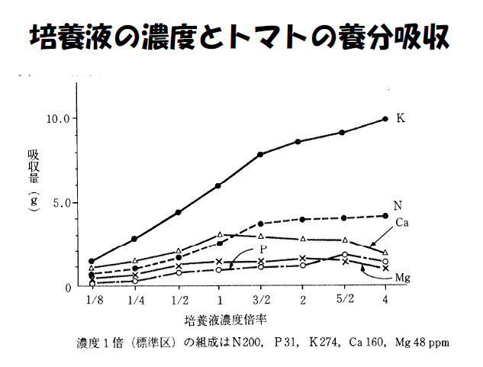
Absorption of macro elements of Tomato under various strength of recipe concentration
Tomato enjoy K and N
Too much K⁺ inhibit absorption of Ca⁺² and Mg⁺²
1 S：N 200, P 31, K 274, Ca 160, Mg 48 ppm

Slide 14
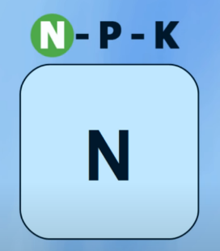
NO₃
Nitrate
NH₄
Ammonium
Vegetative Growth Stage
GROWTH ELEMENT

Slide 15
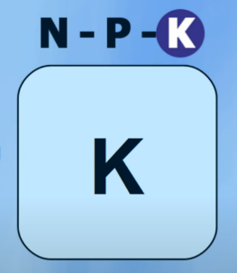
Heavy Fruiting and
Flowering
Add with
Bloom
Stimulants
HEALTH ELEMENT

Slide 16
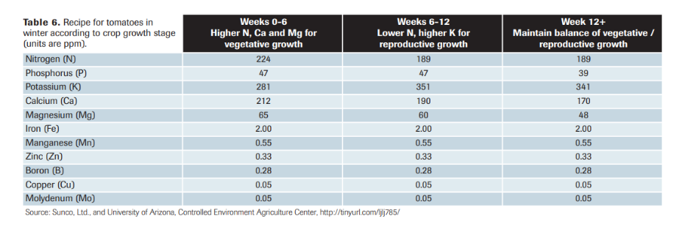
Tomato Recipe

Slide 17

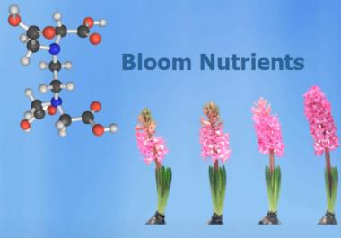
N
P
K
Ca
Mg
S
BASE NUTRIENTS
Macro nutrients
Macro elements

Slide 18
Cu
Fe
B
Mn
Zn
Si
Ni
Mo
Cl
Other important trace elements
Micro nutrients
Micro elements

Slide 19
19 elements for plants
類別 | element | Atomic weight | Available form
Macro 3 | 碳 C | 12.01 | CO₂ | 1mM 44 mg
 | 氫 H | 1.01 | H₂O | 1mM 18 mg
 | 氧 O | 16 | O₂ | 1mM 32 mg
Macro 6 | 氮 N | 14.01 | NO₃⁻,NH₄⁺ | 1 me = 14.0 mg
 | 磷 P | 30.98 | H₂PO₄⁻,HPO₄⁻² | 10.3
 | 鉀 K | 39.1 | K⁺ | 39.1
 | 鈣 Ca | 40.08 | Ca⁺² | 20
 | 鎂 Mg | 24.32 | Mg⁺² | 12.1
 | 硫 S | 32.07 | SO₄⁻² | 16
Micro 7 | 鐵 Fe | 55.85 | Fe⁺³,Fe⁺² | 27.9
 | 錳 Mn | 54.94 | Mn⁺² | 27.5
 | 硼 B | 10.82 | BO₃⁻³,B₄O₇⁻ | 3.6
 | 銅 Cu | 63.54 | Cu⁺²,Cu⁺ | 31.8
 | 鋅 Zn | 65.38 | Zn⁺² | 32.7
 | 鉬 Mo | 95.95 | MoO₄⁻² | 48
 | 氯 Cl | 35.46 | Cl⁻ | 35.4
Special 3 | 矽 Si | 28.09 | SiO₄⁻⁴ | 7
 | 鋁 Al | 26.98 | Al⁺³ | 9
 | 鈉 Na | 22.99 | Na+ | 23

Slide 20
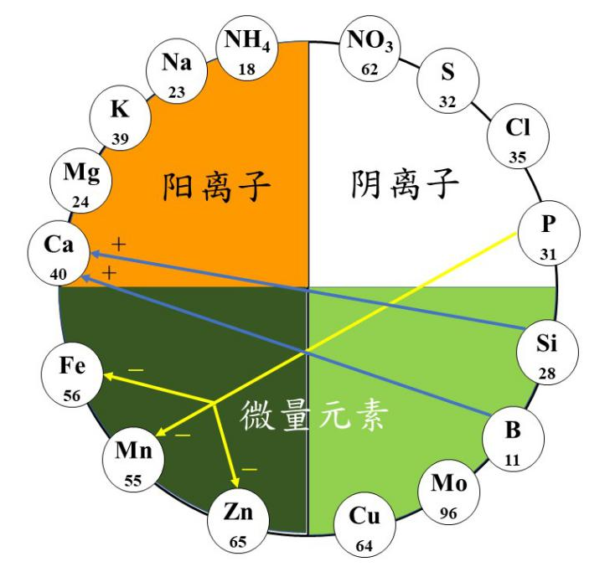
Competition/Cooperation among ions
Ions in same quadrant are competing
Plant preferred ions with low atomic weight x valence
  NH₄⁺>Na⁺>K⁺>Mg⁺²>Ca⁺²
  18, 23, 39, 24*2, 40*2
ions in different quadrants also affect one another
  Macro affects micro, such as P up, inhibits Fe, Mn, Zn
  Micro affects macro, such as Si, B up, promotes Ca
Cation
Anion
Trace Element
Micro Element

Slide 21
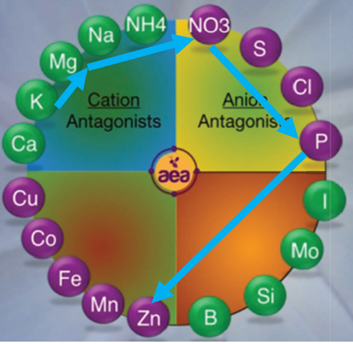
AEA Antagonistic interactions
Low K →
High Mg →
low NO3 →
high P → low Zn
www.NovaCropControl.nl

Slide 22
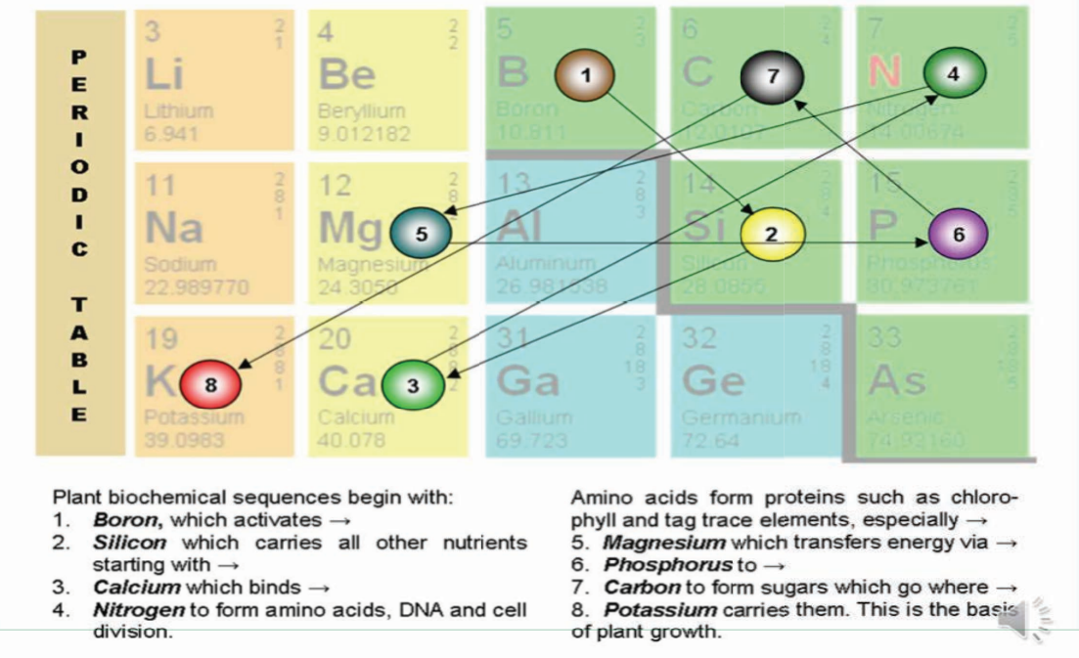
Biochemical sequence of nutrition in plants

Slide 23
Frequent used fertilizer
Type of fertilizer | Molecular formula | Molecular weight | ion | solubility | purity | Price
 |  |  |  | 20℃ g/l | % | NT$/kg
硝酸鉀 | KNO₃ | 101 | K⁺,NO₃⁻ | 315 | 95 | 50~60
硝酸鈣 | Ca(NO₃)₂‧4H₂O | 236 | Ca⁺²,2(NO₃⁻) | 1270 | 70 | 20~27
磷酸銨 | NH₄H₂PO₄ | 115 | NH₄⁺,H₂PO₄⁻ | 365 | 98 | 50~64
硫酸鎂 | MgSO₄‧7H₂O | 246 | Mg⁺²,SO₄⁻² | 252 | 45 | 44
硝酸銨 | NH₄NO₃ | 80 | NH₄⁺,NO₃⁻ | 655 | 98
硫銨 | (NH₄)₂SO₄ | 132 | 2(NH₄⁺),SO₄⁻² | 754 | 94 | 5.6
氯化銨 | NH₄Cl | 53 | NH₄⁺,Cl⁻ | 1630
尿素 | (NH₂)₂CO | 60 | NH₄⁺ | 1000 | 98 | 9.8
硫酸鉀 | K₂SO₄ | 174 | 2K⁺,SO₄⁻ | 111 | 90 | 31
氯化鉀 | KCl | 74 | K⁺,Cl⁻ | 265 | 95 | 8.4
氯化鈣 | CaCl₂‧2H₂O | 147 | Ca⁺²,Cl⁻ | 536 | 75 | 24
磷酸一鉀 | KH₂PO₄ | 136 | K⁺,H_{2PO4}⁻ | 227 | 98 | 70
EDTA鐵 | Fe⁻EDTA | 421 | Fe⁺² | 421 | 12.5 | 250
硼酸 | H₃BO₃ | 62 | B₃⁺ | 46 | 18 | 55~60
硫酸錳 | MnSO₄‧4H₂O | 223 | Mn⁺²,SO₄⁻² | 500 | 99

Slide 24
Nutrient Concentration
Frequent used units
Macro elements
    mM 或 mmol/L
    me/L
Micro elements
    ppm
    mg/L
    μM 或 μmol/L
gram equivalent = atomic weight/valence
(克當量=原子量/原子價)
Milligram equivalent, me = e/1000 毫克當量

Slide 25
me/L to ppm
ppm: parts per million
1 mg in in 1 L of water, 1 g in 1000 L of water
1 g in 1 ton of water is 1 ppm
Element | Atomic weight | Valence | 1 me/L
K | 39.1 | 1 | 39.1 mg/L
Ca | 40 | 2 | 20 mg/L
Mg | 24.3 | 2 | 12.15 mg/L
me/L x atomic weight/valence = ppm

Slide 26
Example
fertilizer | N |  | P | K | Ca | Mg | EC | Amount
 | NO₃-N | NH₄-N
unit | me/L | me/L | me/L | me/L | me/L | me/L | mS/cm | g
Target concentration | 7 | 0.67 | 2 | 4 | 3 | 2 | 0.24
Source water | 0 | 0 | 0 | 0.02 | 1.6 | 0.45
Required | 7 | 0.67 | 2 | 3.98 | 1.4 | 1.55
KNO₃ | 3.98 |  |  | 3.98 |  |  |  | 402
Ca(NO₃)₂．4H₂O | 1.4 |  |  |  | 1.4 |  |  | 165
MgSO₄．7H₂O |  |  |  |  |  | 1.55 |  | 191
NH₄H₂PO₄ |  | 0.67 | 2 |  |  |  |  | 76
(NH₄NO₃) | (1.62) | (1.62) |  |  |  |  |  | (64.8)
(KNO₃) | (1.62) |  |  | (1.62) |  |  |  | (163.6)
合計 | 5.38 | 0.67 | 2 | 4 | 3 | 2
3.98 me/L N → 3.98 x (39+62) / 1 = 401.98 g KNO₃ (KNO₃ molecular weight 39+62 )
1.4 me/L Ca ➔ 1.4 x (40+62x2+4x18) / 2 = 330/2 = 165

Slide 27
Yamazaki formula for Lettuce
Chemical composition of nutrient solution. | purity (％) | lettuce (mg/L) | Stock solution (100X) (g/500 mL) | Stock solution (100X) (g/500 mL)
硝酸鈣 Ca(NO₃) ₂．4H₂O | 70 | 240 | 12 | 12/0.7 = 17.14
硝酸鉀 KNO₃ | 99.8 | 400 | 20 | 20.04
硫酸鎂 MgSO₄．7H₂O | 49 | 125 | 6.25 | 12.76
磷酸ㄧ銨 NH₄H₂PO₄ | 98.5 | 60 | 3 | 3.05
鉗形鐵 Fe．EDTA | 99.9 | 20 | 1 | 1.00
硼酸 H₃BO₃ | 99.9 | 1.2 | 0.6 (1000X；500 mL) | 0.6006
硫酸銅 CuSO₄．5H₂O | 99.9 | 0.09 | 0.045 (1000X；500 mL) | 0.0450
硫酸鋅 ZnSO₄．7H₂O | 98 | 0.04 | 0.02 (1000X；500 mL) | 0.0204
硫酸錳 MnSO₄．H₂O | 97.5 | 1.82 | 0.813 (1000X；500 mL) | 0.8339
鉬酸鈉 NaMoO₄．2H₂O | 99.9 | 0.01 | 0.005 (1000X；500 mL) | 0.0050
Notes:
12*100/70=17.14

Slide 28
2 versions of Yamazaki Recipe
Molecular weight
g/5L for stock solution, diluted 200 times, EC = 800 μS/cm = 0.8 mS/cm
Compound
or
or
or
or
or
or

Slide 29
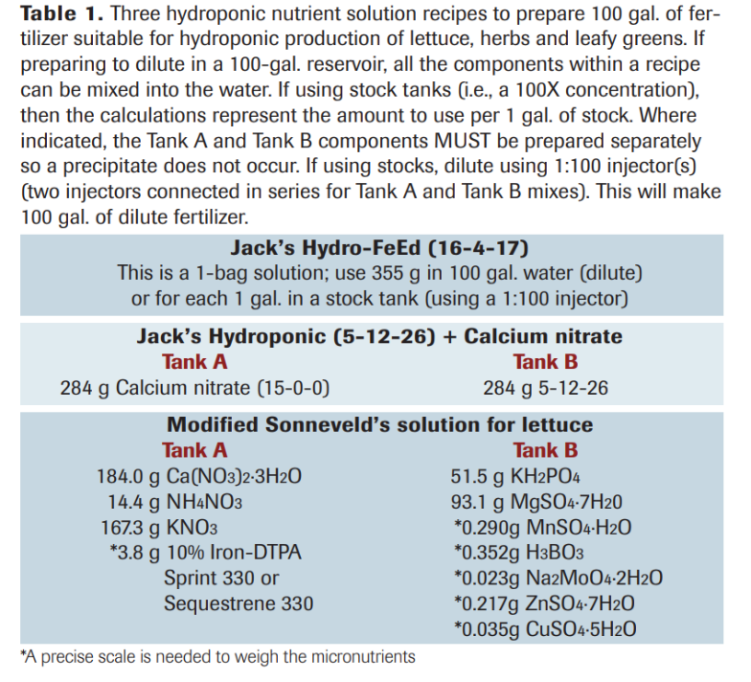
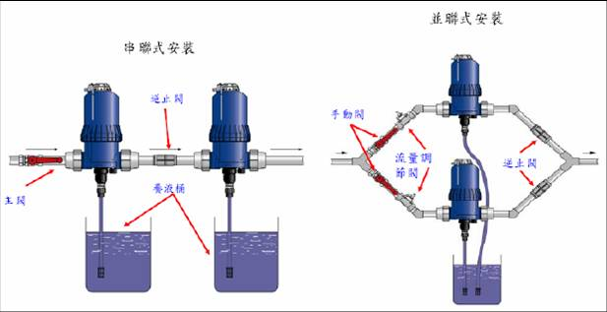
diluter

Slide 30
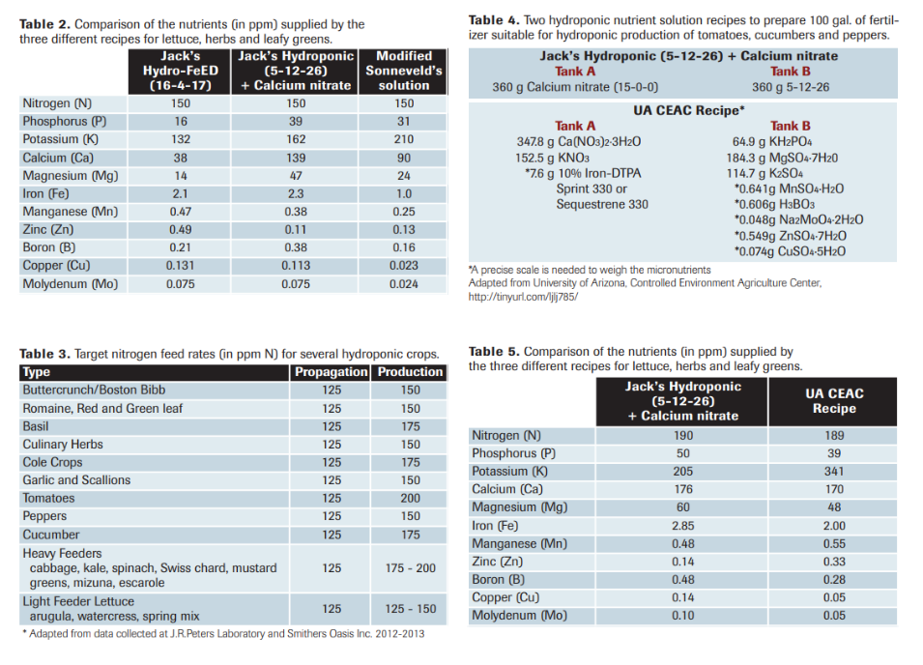

Slide 31
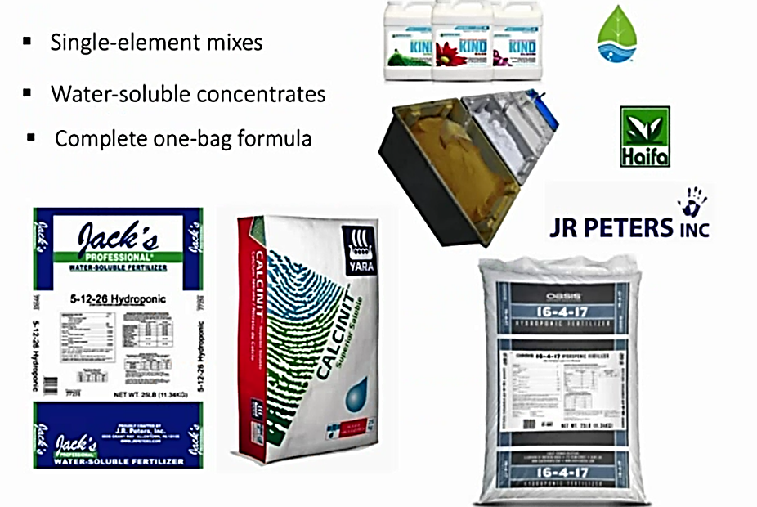
Commercially available fertilizers for hydroponic systems

Slide 32
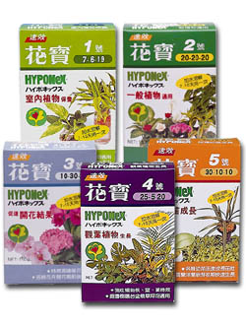
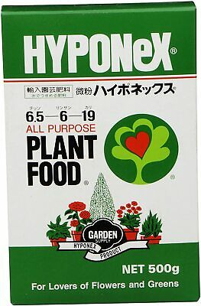
Hyponex
various size
  Medium: 500 g
  Large: 2 kg, 800 NT$
 | N:P:K
No.1 | 07-06-19 | Leafy vegetable
No.2 | 20-20-20 | General usage
No.3 | 10-30-20 | Promote flowering
No.4 | 25-05-20 | Leafy Ornamental plants
No.5 | 30-10-10 | Fast growth of Seedling

Slide 33
Hyponex No.1 (N-P-K: 7-6-19)
Hyponex NO.1
氮 |  |  | 7%
銨態氮 | Ammoniacal Nitrogen | NH₄-N | 1.2%
硝酸態氮 | Nitrate Nitrogen | NO₃-N | 5.8%
可利用磷 | Available Phosphate | P₂O₅ | 6%
水溶性鉀 | Soluble Potassium | K₂O | 19%
來源 | Sources
硝酸鉀 | Potassium Nitrate
重過磷酸鈣 | Triple SuperPhosphate
硫酸銨 | Ammonium Sulfate

Slide 34
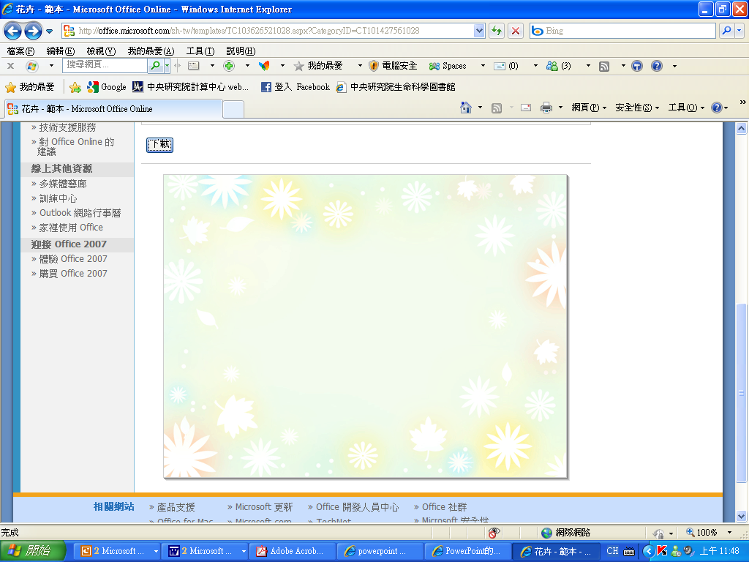
More recipes
in ppm
Elements | US Hoagland and Arnon / Modified Hogland | UK Cooper | Netherlands Modified Steiner | US Wilcox 1 | US Wilcox 2 | Canada Resh | Japan
N | 210 / 224 | 200 | 171 | 132 | 162 | 175 | 132
P | 31 / 62 | 60 | 48 | 58 | 58 | 65 | 42
K | 234 / 235 | 300 | 304 | 200 | 284 | 400 | 314
Ca | 160 / 160 | 170 | 180 | 136 | 136 | 197 | 162
Mg | 48 / 24 | 50 | 48 | 47 | 47 | 44 | 50
Fe | 50 / 1~3 | 12 | 3 | 4 | 4 | 2 | 3
Mn | 0.5 / 0.11 | 2 | 1 | 0.5 | 0.5 | 0.5 | 0.5
B | 0.5 / 0.27 | 1.5 | 0.3 | 1.5 | 1.5 | 0.5 | 0.5
Zn | 0.05 / 0.13 | 0.1 | 0.4 | 0.3 | 0.3 | 0.05 | 0.05
Cu | 0.02 / 0.03 | 0.1 | 0.2 | 0.1 | 0.1 | 0.05 | 0.02
Mo | 0.01 / 0.05 | 0.2 | 0.1 | 0.1 | 0.1 | 0.02 | 0.01
S | / 32
Cl, Ni, Si | / 1.77, 0.03, 28

Slide 35
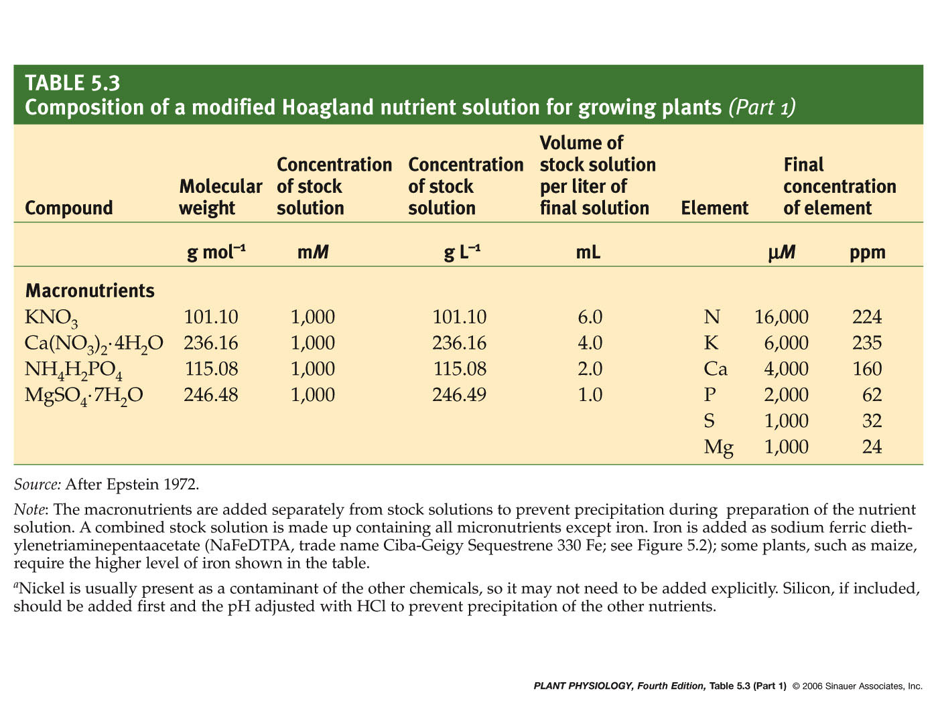
Modified Hoagland
35
Notes:
Ca (uM)=1000000uM *4/1000=4000uM
N (uM)=1000000uM*6/1000+1000000uM*4/1000*2+1000000uM*2/1000=6000+8000+2000=16000
Ca (ppm)=236000mg/L *4/1000*40/236.16=160 N(ppm)=101100mg/L*6/1000*14/101.1+236160*4/1000*14/236.16*2+115080*2/1000*14/115.08=84+112+28=224

Slide 36
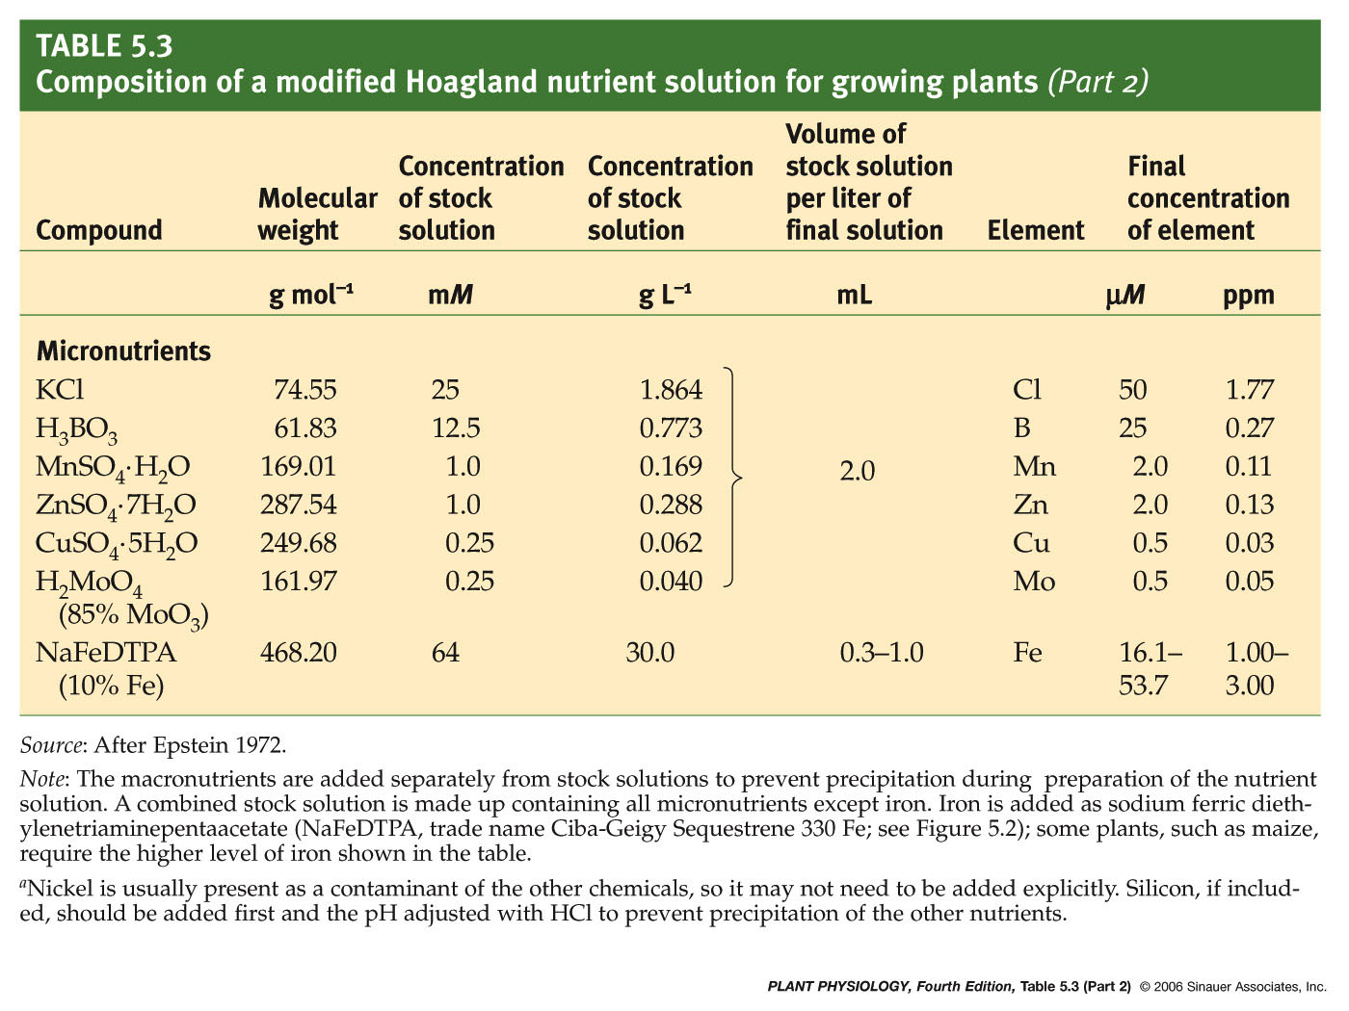
36
Notes:
pp4e-table-05-03-2.jpg

Slide 37
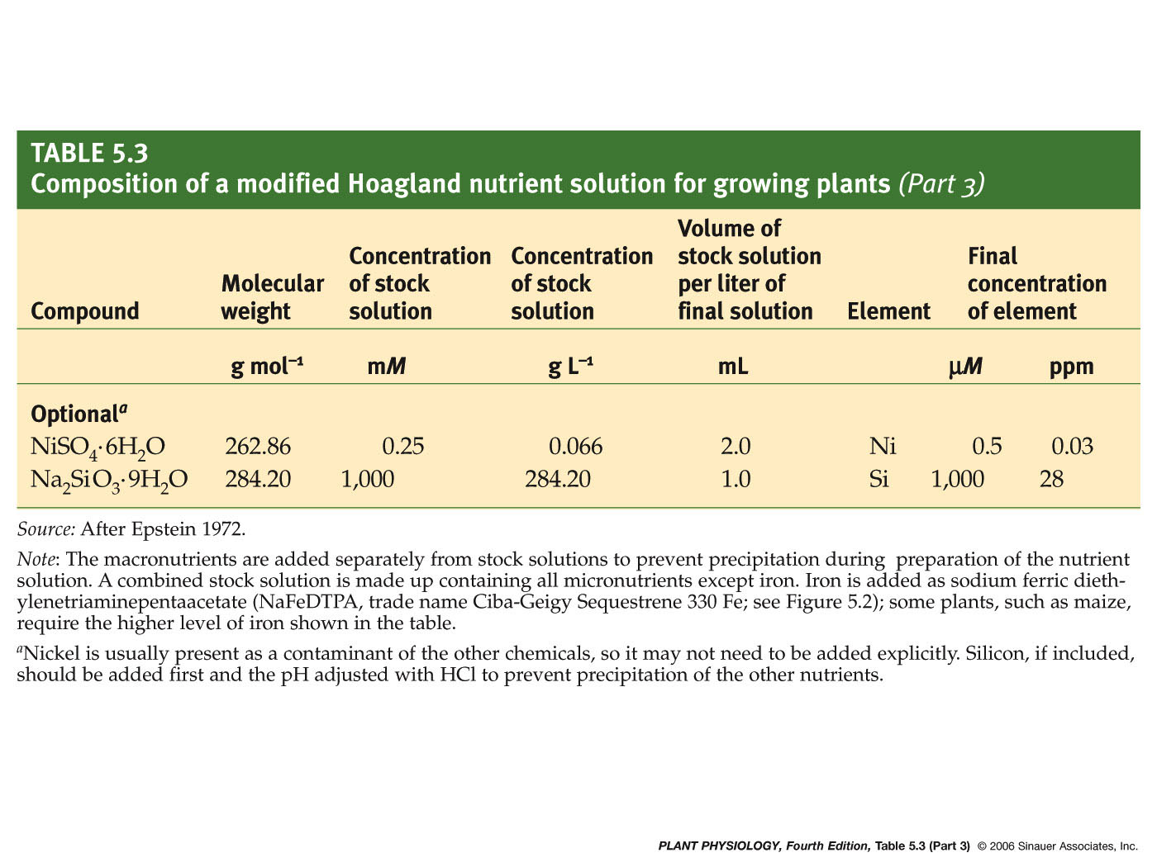
37
Notes:
pp4e-table-05-03-3.jpg

Slide 38
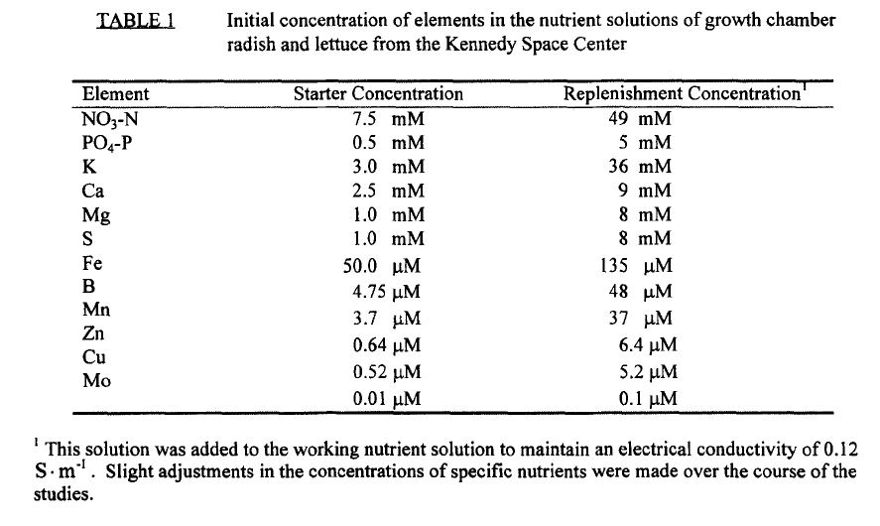
Radish and Lettuce
JFK Space Center
mM = mmol/L
μM = μmol/L
0.12 S/m = 1.2 mS/cm = 1200 μS/cm

Slide 39
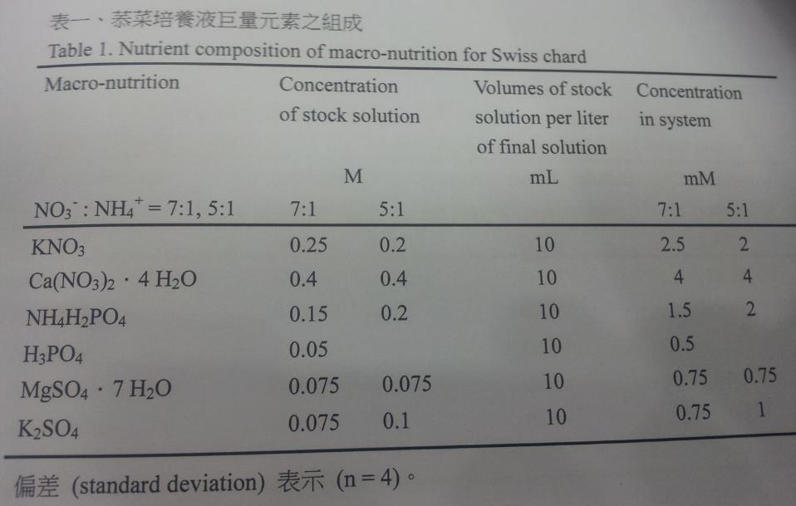

Slide 40
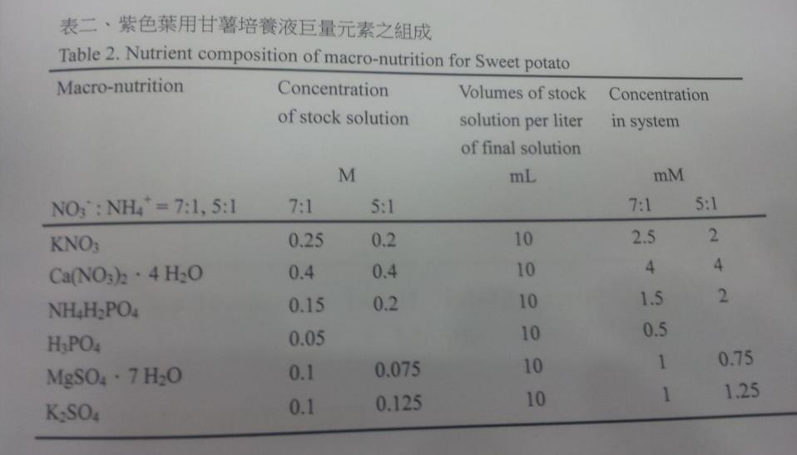

Slide 41
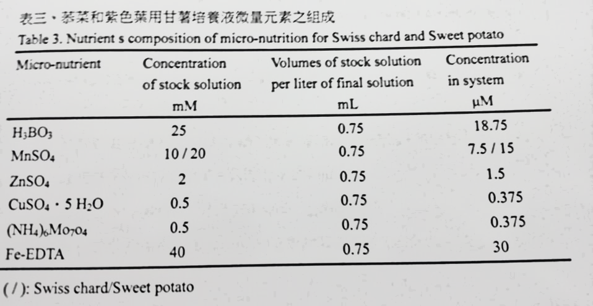

Slide 42
Home Hydroponic Garden’s Recipe
 | Compound |  | g/10L
Stock A | 磷酸一銨 | NH₄H₂PO₄ | 340
(Macro) | 硝酸鈣 | Ca(NO₃)₂．4H₂O | 2080
 | 硝酸鉀 | KNO₃ | 1100
 |  |  | g/4L
Stock B | 硫酸鎂 | MgSO_{4‧}7H₂O | 492
(Micro) | 硫酸錳 | MnSO_{4．}4H₂O | 2.48
 | 硼酸 | H₃BO₃ | 6.2
 | 硫酸銅 | CuSO₄．5H₂O | 0.48
 | 硫酸鋅 | ZnSO₄．7H₂O | 1.2
 | 鉬酸銨 | (NH₄)₆Mo₇O₂₄．4H₂O | 0.02
 | 螯合鐵 | EDTA₂Fe | 8.46
add 5 ml A(Macro) and 2 ml B(micro) in 1 L of water
Bradley, P. And Tabares, C.H.M., 2000, Spreading Simplified Hydroponics：Home Hydroponic Gardens, Global Hydroponics Network, Corvallis, OR.

Slide 43
Generic Hydroponic Recipe
 | Compound |  | g/100L
A | 硝酸鈣 | Ca(NO₃)₂．4H₂O | 13110
 | 硝酸鉀 | KNO₃ | 2557
 | 螯合鐵 | EDTA₂Fe | 500
B | 硝酸鉀 | KNO₃ | 2557
 | 磷酸鉀 | KH₂PO₄ | 3567
 | 硫酸鎂 | MgSO_{4‧}7H₂O | 6625
 | 硫酸錳 | MnSO_{4．}4H₂O | 121
 | 硫酸鋅 | ZnSO₄．7H₂O | 11
 | 硼酸 | H₃BO₃ | 39
 | 硫酸銅 | CuSO₄．5H₂O | 3
 | 鉬酸銨 | (NH₄)₆Mo₇O₂₄．4H₂O | 1.02
Both dilute 1: 100, EC=2.5, TDS=1806
Morgan, L., 2002e, The Growing Edge 14(1)：11.

Slide 44
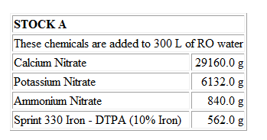
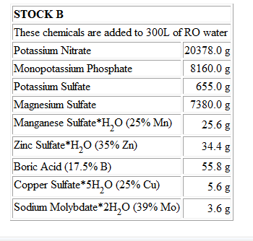
Lettuce (for 300 L RO water)
diluted 100 times for plants
Both ends of red line will leads to precipitation if put in same tank
Stock A and B should not mixed directly, dilute separately
Cornell Univ.

Slide 45
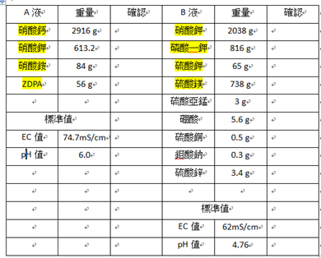
for 30 L RO water

Slide 46
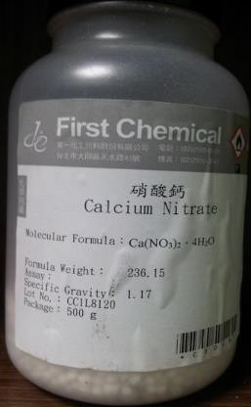
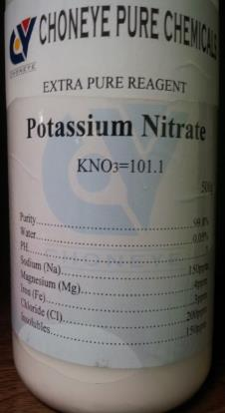
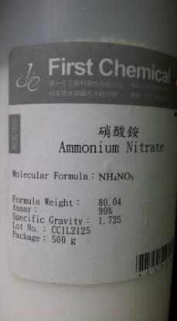
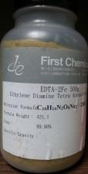
4 single element fertilizers for stock solution A
四水硝酸鈣
硝酸鉀
硝酸銨
螯合鐵

Slide 47
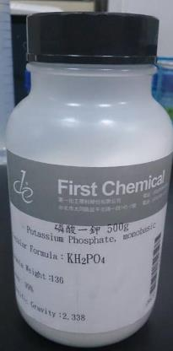
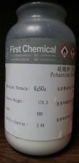
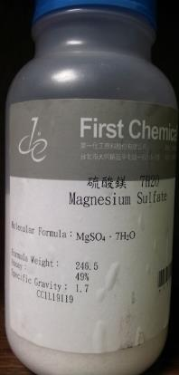
4 out of 9 single element fertilizers for stock solution B
KNO3
KH2PO4
K2SO4
MgSO4.7H2O
硝酸鉀
磷酸一鉀
硫酸鉀
七水硫酸鎂

Slide 48
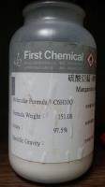
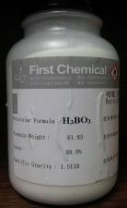
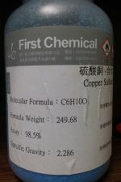
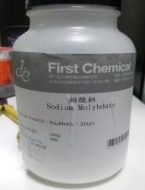
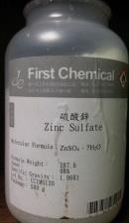
5 out of 9 single element fertilizers for stock solution B
一水硫酸亞錳 硼酸 五水硫酸銅 二水鉬酸鈉 七水硫酸鋅
Zinc Sulfate*7H2O (??%Zn)

Slide 49
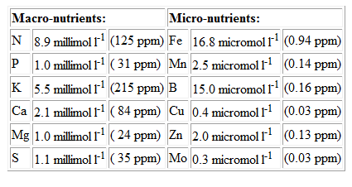
Final concentration of each element
14
31
39
40
24
32
millimol/L * molecular weight = mg/L = ppm
micromol/L * molecular weight / 1000 = ppm

Slide 50
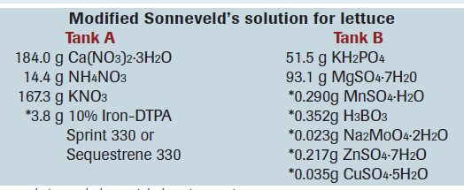
2015 Cornell Recipe：DFT
For 100 gallon (378.5 L) RO water = Dilute 100 times in 1 gallon RO water to make stock solution
4
7
New recipe
4
9
Old recipe

Slide 51
Comparison on new/old Cornell Recipes
4
4
7
9

Slide 52
2015 Cornell
Recipe adjustment due to compounds with various hydrate
or
or
Magnesium sulfate
Magnesium sulfate monohydrate
or
Magnesium sulfate heptahydrate

Slide 53
Outline
Preparation of nutrient solution
pH, EC
Management
pH
Adjustment
Hydroponic systems
Literature Review
meters
Introducing EC & pH
Maintenance of electrodes
EC control

Slide 54
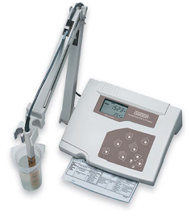
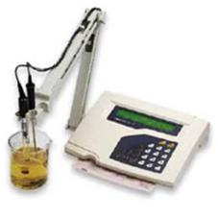
Desktop device
EC meter pH meter

Slide 55
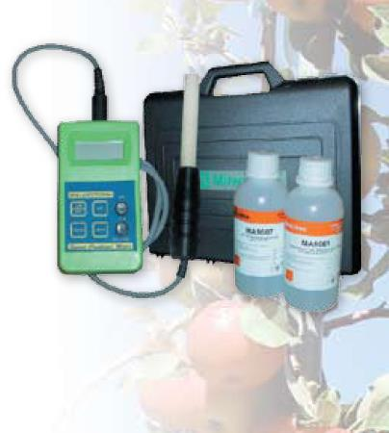
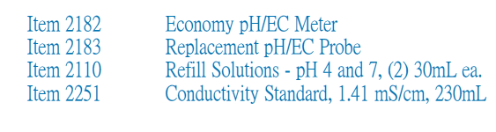
Portable pH/EC meter

Slide 56

pH and Alkalinity

Slide 57


Slide 58

Alkalinity
Alkalinity: Determine the sensitivity / durability of water to pH variation.
Low alkalinity: very sensitive
High alkalinity: low sensitive, required more acid to reduce pH and more alkali liquid to increase pH
Alkalinity high, pH also high
Knowing alkalinity of source water is vital.
Alkalinity test strip

Slide 59

Proper range for alkalinity

Slide 60
Electrical Conductivity (EC)
EC meter
Positively proportion to concentration of ionized nutrients
EC in mS/cm= mmhos/cm
    1.0 mS/cm = 0.1 S/m = 1000 μS/cm
    1 dS/m = 0.1 S/m = 100 mS/100 cm = 1 mS/cm
An overall index, not able to know details of each elements
electrod
electrod
solution
Notes:
++++++++

Slide 61

Electrical Conductivity (EC)
Lots of Units
1 mS/cm
1 dS/m
1 mmhos/cm
1000 μS/cm
1000 μmhos/cm
?

Slide 62
RO water is a must better source water
Assuming Target EC for nutrient solution is 1.2 mS/cm
Water | EC mS/cm | Unknown risk
Tap water | 0.2 | 16.67% | 20
Tap water | 0.1 | 8.3% | 10
RO water | 0.01 | 0.83% | 1

Slide 63

Upper limit of source water

Slide 64

EC vs. Nutrient concentration of a Japanese hydroponic recipe

Slide 65
EC, CF, TDS
More ions in the water leads to higher Electrical Conductivity.
Three commonly used terms for measuring concentration of the solution：
  EC (in mS/cm or μS/cm)、 Conductivity Factor (CF, in CF) and Total Dissolved Solid (TDS, in ppm)
    Convert EC to CF: 1 mS/cm = 10 CF
    Convert EC to TDS: There exists different standard, leads to different conversion constant. 1 mS/cm = 500, 640 and 700 ppm for US、ERUO and Australia, respectively.

Slide 66

Conversion Tables for devices from different countries
for EC measurement

Slide 67

pH
Range of pH varied for different crops
pH range for hydroponics:
5.5~6.5

Slide 68

pH < 4.5
pH > 8

Slide 69
pH Adjustment for RO/Tap water
RO water
pH | 5.0~5.3~5.5
EC | < 0.01 mS/cm
Tap water in Taipei
pH | 6.4~6.5~6.6
EC | 0.1 mS/cm
Target pH for hydroponics 5.5~6.5
RO water need to add NaOH or KOH Tap water need to add H₃PO₄ or HCl or H₂SO₄

Slide 70



portable pH meter

Slide 71
Maintenance of electrodes
pH & EC electrodes are consumable materials
  Both required calibration at least once per month.
  EC electrode has min maintenance requirement
  pH electrode
    has short usable lifespan (6 ~ 12 months)
    need to be submerged in saturated KCl solution when not in use.

Slide 72


EC calibration solution
If provided is powder type, need to be soak in pure water or at least de-ionized water to make the calibration solution
EC calibration solution has sever standards (upper photo)
Commonly used is under 25 ºC, EC values of 1413 and 12880 μS/cm
Solution at different temperature will have different EC value ever for same standard solution. (as shown in the bottom photo)

Slide 73





pH buffer solution
pH buffer solution is in liquid form
  normally pH = 4, 7, 10
  Temperature also affects pH values, as shown below
  pH = 10.01
For hydroponic applications, only pH=4, 7 are needed for calibration.

Slide 74
EC control
EC low, provide with rich solution
  Manually
  Direct injection
  Using Solenoid Valves
  Using peristaltic pump
EC high, add in RO water
  Manually
  Automatically (water level valve)

Slide 75


Direct injection
pH, EC and water temperature sensors

Slide 76

Solenoid Valves

Slide 77

peristaltic pump

Slide 78


Design 1: sensors in the buffering tank
peristaltic pump
To growth area
Controller
peristaltic pump
fixed amount
EC sensor
pH sensor
A solution
B solution
acid
circulation
pump

Slide 79

Design 2：Sensors not in the buffering tank

Slide 80

Two water levels to control EC

Slide 81



Touch screen
Control box

Slide 82

Example of a pH, EC control Box

Slide 83


Concentrated Tanks
30 L PE buckets/tanks for concentrated A, B solutions
Float valve

Slide 84


Mixing tank
Nutrient supply line

Slide 85



Nutrient control
Two water levels control
return water inlet
water outlet
Kong and Fang, 2012

Slide 86

EC control (60 L water)
EC Set point：1200 μS/cm
EC from 1000 → 1200 μS/cm
  required < 2 min
Time elapsed, min

Slide 87

pH control (60 L water)
pH setpoint：5.5
pH from pH = 5 → 5.5
  required 2.5 min
Time elapsed, min

Slide 88
Apply this system to 6 ton of water
EC from 1000 → 1200 μS/cm
  required 2 x (6000/60) = 200 min (1 μS/cm / min)
pH from pH = 5 → 5.5
  required 2.5 x 100= 250 min (0.01 / 5 min)
Capability of the control > dynamic change of the culturing system

Slide 89

Variation of EC
0 ~ 10 g/L of Hyponex No.1

Slide 90

Variation of EC
0 ~ 1 g/L of Hyponex No.1

Slide 91

Variation of EC
0 ~ 10 g/L of Hyponex No.2

Slide 92

Variation of EC
0 ~ 3 g/L of Hyponex No.2

Slide 93

Variation of EC
0 ~ 2 g/L of Hyponex No.2

Slide 94


Hyponex No.1 vs. No.2
No.1
= (1.2 – 0.01)/1.152
No.2
= (1.2 – 0.01)/0.892
Required quantity, no. of 2 kg boxes and total price
for 1 ton of nutrient solution@ EC=1.2 mS/cm
boxes
total NT$
No.1
No.2
Assuming 800 NT$ per 2 kg pack

Slide 95
Outline
Preparation of nutrient solution
pH, EC
Management
pH Adjustment
Hydroponic systems
Literature Review

Slide 96

Variation of pH
0 ~ 1 g/L of Hyponex No.1

Slide 97

Variation of pH
0 ~ 1 g/L of Hyponex No.2

Slide 98


pH variation in Hyponex No.1, 2
N:P:K
07-06-19
N:P:K
20-20-20
K⁺ → H⁺
NO₃⁻ → OH⁻
Hyponex No.1
Hyponex No. 2

Slide 99

pH variation of
0 ~ 30 g/L Hyponex No.2
Not totally dissolved

Slide 100

pH variation of
0 ~ 8 g/L Hyponex No.2
Not totally dissolved

Slide 101
Range of pH for hydroponic system
pH range
  Best: 6.0~6.2
  Proper: 6.0-6.5
  OK: 5.5-6.5
  pH > 8, Fe, Mn, P deficit
  pH < 4.5, Ca, Mg, K precipitation and more

Slide 102

pH affects availability

Slide 103

A different diagram proper range: 6.5~7 for soil

Slide 104
pH adjustment
1000 L target pH6.0 H₃PO₄ (mL) |  |  | 1000 L target pH6.0 KOH (mL)
pH | 8.5% H₃PO₄ |  | pH | 4.0% KOH
7.0 | 940.7 |  | 5 | 707.9
6.9 | 891.7 |  | 5.1 | 666.8
6.8 | 832.7 |  | 5.2 | 619.2
6.7 | 763.7 |  | 5.3 | 564.9
6.6 | 684.6 |  | 5.4 | 504
6.5 | 595.6 |  | 5.5 | 436.5
6.4 | 496.5 |  | 5.6 | 362.5
6.3 | 387.4 |  | 5.7 | 281.8
6.2 | 268.3 |  | 5.8 | 194.4
6.1 | 139.1 |  | 5.9 | 100.5
6.0 | – |  | 6 | –

Slide 105

pH adjustment pH DOWN
T affects pH
Same amount of acid does not bring down same amount of decrease in pH

Slide 106

pH adjustment pH UP
T affects pH
Same amount of alkali liquid does not leads to same amount of pH increment
pH adjustment is more difficult to predict compare with EC adjustment

Slide 107

Reduce pH

Slide 108

Amount of pH decrement

Slide 109

Increase pH

Slide 110

Amount of pH increment

Slide 111
pH adjustment
To reduce pH by 1, such as pH 7 → pH 6
  Required 0.9~1 ml/L of 8.5%H₃PO₄
  Diluted 200 times first then drip in and stirred
To increase pH by 1, such as pH 5 → pH 6
  Add 0.7 mL/L of 4 %KOH
  Diluted 200 times first then drip in and stirred
The variation of pH is not linear to the amount of H₃PO₄ or KOH added.

Slide 112
Reasons of pH variation during cultural period
Plant absorption differences among elements, such as tomato prefer NO₃⁻，PO₃⁻³ and K⁺, melon prefer Ca⁺² and Mg⁺²
Improper match of recipe and plants
Under strong light and high T, plants absorbed more N, P, K, absorbed less Ca, Mg, leads to pH increase
Under less light and low T environment, pH tends decrease

Slide 113
Reasons of pH variation during cultural period (cont..)
CO₂ in the air dissolved in water to form H₂CO₃ (carbonic acid), leads to pH decrease
from respiration of root, CO₂ combined with Ca⁺²、Mg⁺² to form CaCO₃, MgCO₃ precipitation, lead to increase of pH
Some plants such as lettuce, strawberry preferred NH₄⁺(Ammonium), after absorption, roots excrete H⁺ leads to reduction of pH
Some plants such as pak choy, Chinese cabbage preferred NO₃⁻ (Nitrate), after absorption, roots excrete OH⁻ leads to increase of pH

Slide 114

pH variation after root absorbed NH₄⁺/NO₃⁻
NH₄⁺
NO₃⁻

Slide 115
Outline
Preparation of nutrient solution
pH, EC
Management
pH adjustment
Hydroponic systems

Slide 116

Comparison on 4 hydroponic systems
1
2
NFT
DFT/DWC with air pump
3
4
Wick culture
DFT/DWC without air pump
DFT/DWC with capillary stripe

Slide 117

Comparison on 4 hydroponic systems
Pak choy
Bok choy
1 2 3 4
1 2 3 4
Scallion
Lettuce
1 2 3 4
1 2 3 4

Slide 118
Popular Hydroponic Systems
Nutrient Film Technique, NFT
Leafy vegetable (UK)
Deep Flow Technique, DFT
Deep Water Culture, DWC
Leafy vegetable (Japan)
Drip Irrigation (rockwool)
Vine plants: tomato, melon, pepper, cucumber (The Netherlands)
Ebb and Flow (E&F)
all of above, tuber plant
Aeroponics (spraying, misting, fogging)
Wick culture

Slide 119

NFT
Advantages of NFT
Easy installation
Low installation cost
Continuous flow

Slide 120

NFT trough system

Slide 121
Disadvantages of NFT
Limited amount of nutrient solution
  Large influence by the surrounding temperature due to high water T has low saturated dissolved oxygen (DO).
  only true for GH, not for PFAL
  Large influence by the plant absorption
Limited space for root growth: only suitable for plants that did not has lots of roots
Vigorous growth of root might block the solution flow leads to uneven distribution of nutrient concentration
Easy to fail in in locations with unstable power supply

Slide 122

DFT / DWC

Slide 123



DFT: Pipe Culture

Slide 124





Slide 125

DFT bench system

Slide 126


Hyponica style DFT
M style DFT

Slide 127

Fixed platform DFT without air pump
Roots are partially soaked in nutrient solution

Slide 128

Floating platform DFT with air pump
Roots are totally soaked in nutrient solution

Slide 129
Disadvantages/Advantage of DFT
Compare with NFT
  More solution required
  More nutrients required
  DO is of great concerned
  More costly to setup and to operate
  Easy to manage, for beginners
  Limited variation on DO due to air T
  Limited variation on nutrients due to plant absorption

Slide 130

Drip irrigation using rockwool

Slide 131

Rockwool cube and plate
Rockwool cube
Rockwool plate

Slide 132

Drip irrigation using rockwool
High wire system

Slide 133


Various Systems using Rockwool
Drip irrigation
Ebb and Flow

Slide 134



Ebb and Flow using double pumps
Pump1
Pump2
Pump 1 & Pump 2 switch on/off

Slide 135
Amount of water used
NFT < E&F < DFT
Little water used, no room for error, less forgiving
More water used, more fertilizer required, higher operating cost
More water used, heavier the static load to the growth shelf, higher hardware fixed cost

Slide 136

Aeroponics

Slide 137




Slide 138




Aeroponics

Slide 139




Slide 140


Tuber plants
Potato
Sweetpotato
Jingsung

Slide 141

TS type PFAL: Aeroponics
T: triangle, S: spray

Slide 142
TS 700 and TS 1000
1993, Kyoto, Japan
400 m²
Production 700 plant/day (TS700)
4 employee
2001, Kyoto, Japan
500 m²
Production 1000 plant/day (TS1000)
6 employee

Slide 143

TS type PFAL: Aeroponics
HPS lamp

Slide 144

Aeroponics

Slide 145
AeroFarms: The largest PFAL in US
https://www.youtube.com/watch?v=ME_rprRlmMM&t=32s
https://www.youtube.com/watch?v=1m9U-AZ98_k
https://youtu.be/YDQQj-WzT_U

Slide 146
Ratio of nutrient solutions
R = U : B
U: total amount of solution on cultural shelf
B: amount of solution in buffering tank
R small, easy to operate, but required large buffering tank
Manually operated system, R should be minimized
Automatic control system, R should be maximized

Slide 147
Circulation control
Continuous type
  NFT (Nutrient Film Technique)
  DFT (Deep Flow Technique, also named DWC, deep water culture)
Intermittent type
  Ebb and Flow type
  Aeroponic type
  DFT (DWC)

Slide 148





Timer for continuous or intermittent control of pump

Slide 149

Plumbing Design of circulating pumps
Sensor required flowing solution
Buffer tank required stir/Agitating all the time to ensure better mixing and proper DO
For Intermittent flow
For Continuous flow
149

Slide 150
Outline
Preparation of nutrient solution
pH, EC
Management
pH adjustment
Hydroponic systems
Literature Review

Slide 151
Literature Review
Influence of sources of N
Influence of NO₃/NH₄
Influence of water temperature
Influence of concentration of K⁺
Growing Komatsuna with supplemental micro elements

Slide 152
L1. Hoagland for lettuce - With different source of N
Compound | Concentration of stock | Final concentration of element (ppm)
Potassium nitrate (NO₃⁻) or ammonium sulfate (NH₄⁺) or potassium nitrite (NO₂⁻) |  | N | 50
Potassium sulfate (K₂SO₄) | 0.25 M | K | 226
Magnesium sulfate (MgSO₄) | 0.5 M | Mg | 120
Calcium phosphate [Ca (H₂PO₄)₂] | 0.025 M | Ca | 58
Calcium sulfate (CaSO₄) | 0.005 M | Ca | 136
Boric acid (H₃BO₃) | 0.005 M | B | 0.25
Manganese sulfate (MnSO₄) | 0.005 M | Mn | 0.25
Zinc sulfate (ZnSO₄) | 0.005 M | Zn | 0.025
Copper sulfate (CuSO₄) | 0.005 M
Sodium molybdate (NaMoO₃) | 0.005 M
pH=6.0~6.5
Communications in Soil Science and Plant Analysis, 2008, 39: 207–216

Slide 153
L1. Hoagland for lettuce - With different source of N
Table 1. Influence of sources of N and type of lettuce on different attributes of lettuce
Measurements | Sources of N
 | NO₃ | NO₂ | NH₄
Plant height (cm) | 14.2 a | 12.6 b | 12.8 b
Number of leaves/plant | 9.4 a | 7.4 c | 8.4 b
Root vascular Discolorationª | 0.4 b | 1.6 a | 1.4 a
Root fresh wt (g) | 8.1 a | 4.5 b | 5.0 b
Leaf fresh wt (g) | 46.1 a | 35.6 b | 39.2ab
Fresh biomass yield (g) | 54.2 a | 40.1 b | 44.2 ab
Dry biomass yield (g) | 6.6 | 4.5 | 5.0
Plant NO₃-N (mg kg⁻¹) | 3453 a | 3030 a | 2100 b
ªRoot vascular discoloration, rated as 1=low, 2=medium, and 3=high.
Note. Means in the same row followed by different letters are significantly different at the P<0.05 level.
Ns=nonsignificant; , indicate significance at P <0.05 and 0.01 levels, respectively.
Communications in Soil Science and Plant Analysis, 2008, 39: 207–216

Slide 154


L2. Influence of NO₃/NH₄ ratio on plant height. leaves number, leaf area, yield and RCC of Spinach
Acta Hort. 2009. 843: 269–274

Slide 155

L3. Water Temperature affects leaf number and length of Spinach
African Journal of Agricultural Research (2009) 4 (12): 1442 - 1446

Slide 156

L3. Water Temperature affects yield of Spinach
African Journal of Agricultural Research (2009) 4 (12): 1442 - 1446

Slide 157
Element (mM) | 1/1K | 1/2K | 1/4K | 1/8K | 1/16K
K | 3.000 | 1.500 | 0.750 | 0.375 | 0.188
Ca | 2.000 | 2.750 | 3.125 | 3.313 | 3.406
N | 7.500 | 7.500 | 7.500 | 7.500 | 7.500
NO₃-N | 7.000 | 7.000 | 7.000 | 7.000 | 7.000
NH₄-N | 0.500 | 0.500 | 0.500 | 0.500 | 0.500
P | 0.500 | 0.500 | 0.500 | 0.500 | 0.500
Mg | 1.000 | 1.000 | 1.000 | 1.000 | 1.000
S | 1.000 | 1.000 | 1.000 | 1.000 | 1.000
Fe | 0.02600 | 0.02600 | 0.02600 | 0.02600 | 0.02600
Mn | 0.00460 | 0.00460 | 0.00460 | 0.00460 | 0.00460
Zn | 0.00038 | 0.00038 | 0.00038 | 0.00038 | 0.00038
Cu | 0.00016 | 0.00016 | 0.00016 | 0.00016 | 0.00016
B | 0.024000 | 0.024000 | 0.024000 | 0.024000 | 0.024000
Mo | 0.00011 | 0.00011 | 0.00011 | 0.00011 | 0.00011
Na | 0.05200 | 0.05200 | 0.05200 | 0.05200 | 0.05200
L4. Concentrations
(in mM) of elements in nutrient solution for 5 treatments

Slide 158

L4. Lower K⁺ in solution leads to higher Ca⁺² and lower Mg⁺² in leaves

Slide 159
Results of above 4 papers
Influence of sources of N for lettuce
  NO₃ > NH₄ > NO₂
Influence of NO₃/NH₄ for spinach
  75/25 > 50/50 > 25/75 > 100/0
Influence of water temperature for spinach
  28 ºC > 26 > 24 ~ 10 ºC
Influence of concentration of K⁺
  Lower concentration of K⁺ leads to higher Ca⁺² and lower Mg⁺²

Slide 160
L5. Growing Komatsuna with supplemental Micro elements
Aiming at reducing nitrate concentration with no sacrifice on shoot fresh mass
Huang, 2021 (Thesis)
Micro-elements of NTU solution (mg L⁻¹) in EXP 1
Treatments | Fe | Mn | B | Cu | Zn | Mo | Na
NTU (CK) | 3.2 | 0.5 | 0.52 | 0.02 | 0.05 | 0.01 | 1.31
NTU + Mn |  | 1 |  |  |  | 0.01
NTU + Mo |  | 0.5 |  |  |  | 0.45
NTU + MnMo |  | 1 |  |  |  | 0.45
Macro-elements of NTU solution NO₃-N:83.9 NH₄-N:7.3 PO₄-P:16.6 K:154.8 Ca:40.7 Mg:16.6 SO₄-S:16.6

Slide 161

Treatment code of EXP1 | LED light | Recipe code
CW_NTU (CK) | CW | NTU
CW_NTU + Mn |  | NTU + Mn
CW_NTU + Mo |  | NTU + Mo
CW_NTU + MnMo |  | NTU + MnMo
RW_NTU | RW | NTU
RW_NTU + Mn |  | NTU + Mn
RW_NTU + Mo |  | NTU + Mo
RW_NTU + MnMo |  | NTU + MnMo
LED type | Blue (%) | Green (%) | Red (%) | PPFD (μmol m⁻² s⁻¹ )
CW | 27 | 48 | 25 | 236
RW | 1 | 4 | 95 | 232

Slide 162
Treatment code of EXP1 | Seedling stage (DAS = 8~14) |  | Mature stage (DAS = 15~28)
CW_NTU (CK) | L1_236_H24_d182_A25_ | N1_E1.2 | L1_236_H16_d47_A25/20_ | N1_E0.6
CW_NTU + Mn |  | N2_E1.2 |  | N2_E0.6
CW_NTU + Mo |  | N3_E1.2 |  | N3_E0.6
CW_NTU + MnMo |  | N4_E1.2 |  | N4_E0.6
RW_NTU | L2_232_H24_d182_A25_ | N1_E1.2 | L2_232_H16_d47_A25/20_ | N1_E0.6
RW_NTU + Mn |  | N2_E1.2 |  | N2_E0.6
RW_NTU + Mo |  | N3_E1.2 |  | N3_E0.6
RW_NTU + MnMo |  | N4_E1.2 |  | N4_E0.6
DAS=0： H0_N0_E0_ A25
Stage 1 (DAS=1~3)： L1_230_H24_d772_N0_E0 _ A25
Stage 2 (DAS=4~7)： L1_230_H24_d772_N1_E1.2_ A25
Seedling stage (DAS = 8~14) ： Lx_y_H24_d182_Nx_E1.2_A25
Mature stage (DAS = 15~28) ：Lx_y_H16_d47_Nx_E0.6_A25/20
Lx_y：L：LED type，x=1：CW，x=2：RW，
y：PPFD in μmol·m⁻²·s⁻¹
Hx：H: Light period, x：hrs, in h d⁻¹
dx：d: cropping density, x：density in plt·m⁻²
Ex：E: EC of nutrient solution, x: EC value in mS·cm⁻¹
Ax/y：A: Indoor temperature, x/y: day/night temperature in ℃
Nx：N: Nutrient recipe,
x: type, x=0, tap water, x=1, NTU formula, x=2, NTU + Mn, x=3, NTU + Mo, x=4, NTU + MnMo

Slide 163

DAS = 28

Slide 164
DAS = 28
Treatment code of EXP1 | Shoot fresh mass (g·plt⁻¹) |  | Nitrate concentration (mg·kg⁻¹)
CW_NTU (CK) | 78.5 ± 20.3 | ab | 7268 ± 717 ab
CW_NTU + Mn | 81.6 ± 18.1 | ab | 8003 ± 541 ab
CW_NTU + Mo | 90.0 ± 16.4 | ab | 8336 ± 1003 ab
CW_NTU + MnMo | 72.0 ± 21.4 | b | 7913 ± 295 ab
RW_NTU | 88.0 ± 28.4 | ab | 6777 ± 703 c
RW_NTU + Mn | 75.5 ± 31.7 | ab | 7113 ± 975 abc
RW_NTU + Mo | 107.9 ± 38.0 | a | 7503 ± 1141 bc
RW_NTU + MnMo | 71.9 ± 25.7 | b | 7794 ± 478 ab
NTU + Mo is the best recipe for shoot fresh mass
NTU + MnMo leads to biological disorder
High proportion of red light can be used
EC drop from 1.2 to 0.6 at 2 weeks before harvest does not help in reducing nitrate concentration, which is still very high (>> 3000 ppm)
Drop of EC leads to the low shoot fresh mass.

Slide 165
L5. Growing Komatsuna with supplemental Micro elements
Aiming at reducing nitrate concentration with no sacrifice on shoot fresh mass
Treatments of EC reduction at various stages (EC in mS·cm⁻¹) in EXP2
EC reduction code | Seeding stage DAS = 4~7 | Seedling stage DAS = 8~14 | Mature stage 1 DAS = 15~21 | Mature stage 2 DAS = 22~28
EC-48 (no drop) | 1.2 | 1.2 | 1.2 | 1.2
EC-39 (1 rapid drop) | 1.2 | 1.2 | 1.2 | 0.3
EC-36 (1 mild drop) | 1.2 | 1.2 | 0.6 | 0.6
EC-33 (2 mild drops) | 1.2 | 1.2 | 0.6 | 0.3
EC-24 (2 mild drops) | 1.2 | 0.6 | 0.3 | 0.3

Slide 166

L5. Growing Komatsuna with supplemental Micro elements
Aiming at reducing nitrate concentration with no sacrifice on shoot fresh mass
Treatment code of EXP2 | Recipe | LED | EC reduction code
CW_EC-48 | NTU + Fe | CW | EC-48
CW_EC-39 |  |  | EC-39
CW_EC-36 |  |  | EC-36
CW_EC-33 |  |  | EC-33
CW_EC-24 |  |  | EC-24
R_EC-48 |  | R | EC-48
R_EC-39 |  |  | EC-39
R_EC-36 |  |  | EC-36
R_EC-33 |  |  | EC-33
R_EC-24 |  |  | EC-24

Slide 167
L5. Growing Komatsuna with supplemental Micro elements
Aiming at reducing nitrate concentration with no sacrifice on shoot fresh mass
Code of EXP2 | Seedling stage (DAS = 8~14) |  | Mature stage 1 (DAS = 15~21) |  | Mature stage 2 (DAS = 22~28)
CW_EC-48 | L1_248_H24_d182_A25/20_ | E1.2 | L1_248_H16_d47_A25/20_ | E1.2 | L1_248_H16_d47_A25/20_ | E1.2
CW_EC-39 |  | E1.2 |  | E1.2 |  | E0.3
CW_EC-36 |  | E1.2 |  | E0.6 |  | E0.6
CW_EC-33 |  | E1.2 |  | E0.6 |  | E0.3
CW_EC-24 |  | E0.6 |  | E0.3 |  | E0.3
R_EC-48 | L2_245_H24_d182_A25/20_ | E1.2 | L2_245_H16_d47_A25/20_ | E1.2 | L2_245_H16_d47_A25/20_ | E1.2
R_EC-39 |  | E1.2 |  | E1.2 |  | E0.3
R_EC-36 |  | E1.2 |  | E0.6 |  | E0.6
R_EC-33 |  | E1.2 |  | E0.6 |  | E0.3
R_EC-24 |  | E0.6 |  | E0.3 |  | E0.3
Nutrient recipe is NTU + Fe for all treatments

Slide 168
L5. Growing Komatsuna with supplemental Micro elements
Aiming at reducing nitrate concentration with no sacrifice on shoot fresh mass
Treatment code of EXP2 | Shoot fresh mass (g·plt⁻¹) |  | Root fresh mass (g·plt⁻¹) | Nitrate concentration (mg·kg⁻¹)
CW_EC-48 | 157.3 ± 37.2 | a ^{x} | 16.3 ± 3.8 a | 6193 ± 691 b
CW_EC-39 | 149.6 ± 33.5 | ab | 10.1 ± 3.9 cd | 4846 ± 535 d
CW_EC-36 | 154.7 ± 16.1 | a | 13.0 ± 3.9 b | 5357 ± 622 cd
CW_EC-33 | 140.4 ± 6.5 | abc | 12.9 ± 0.9 bc | 2271 ± 260 e
CW_EC-24 | 82.7 ± 7.7 | d | 10.9 ± 1.7 bcd | 2798 ± 151 e
R_EC-48 | 144.2 ± 6.8 | abc | 10.1 ± 0.6 cd | 7935 ± 688 a
R_EC-39 | 126.1 ± 9.2 | b | 9.4 ± 1.9 d | 5782 ± 846 bc
R_EC-36 | 133.1 ± 17.6 | bc | 10.3 ± 2.3 bcd | 5054 ± 512 d
R_EC-33 | 124.4 ± 5.4 | b | 11.5 ± 0.7 bcd | 2669 ± 362 e
R_EC-24 | 80.9 ± 10.8 | d | 10.4 ± 1.0 bcd | 2261 ± 394 e
Shoot fresh mass (FM) is in direct proportion with total EC CW is better than pure R in shoot fresh mass production using NTU+Fe recipe 4 out of 10 treatments (CW or R_EC-33 and EC-24) have nitrate concentration less than 3000 ppm EC-24 (1.2-0.6-0.3-0.3) treatments have least amount of fresh mass, 2 weeks of EC 0.3 reduced fresh mass a lot. CW_EC-33 (1.2-1.2-0.6-0.3) is the best treatment with shoot FM > 140 g, Nitrate < 3000 ppm).
DAS = 28

Slide 169
L5. Growing Komatsuna with supplemental Micro elements
Aiming at reducing nitrate concentration with no sacrifice on shoot fresh mass
Micro-elements of NTU solution (mg L⁻¹) in EXP3
Treatments | Fe | Mn | B | Cu | Zn | Mo | Na
NTU | 3.2 | 0.5 | 0.52 | 0.02 | 0.05 | 0.01 | 1.31
NTU + Mo | 3.2 |  |  |  |  | 0.45 | 1.31
NTU + Fe | 4.8 |  |  |  |  | 0.01 | 2.06
NTU + MoFe | 4.8 |  |  |  |  | 0.45 | 2.06
LED type | Blue (%) | Green (%) | Red (%) | PPFD (μmol m⁻² s⁻¹ )
CW | 27 | 48 | 25 | 248
R | 0 | 0 | 100 | 245

Slide 170
Treatment codes of EXP3 | LED type | Nutrient Recipe
CW_NTU (CK) | CW | NTU
CW_NTU + Mo |  | NTU + Mo
CW_NTU + Fe |  | NTU + Fe
CW_NTU + MoFe |  | NTU + MoFe
R_NTU | R | NTU
R_NTU + Mo |  | NTU + Mo
R_NTU + Fe |  | NTU + Fe
R_NTU + MoFe |  | NTU + MoFe
Treatments | Seedling stage (DAS = 8~14) |  | Mature stage 1 (DAS = 15~21) |  | Mature satge 2 (DAS = 22~28)
CW_NTU (CK) | L1_248_H24_d182_A25_ | N1_E1.2 | L1_248_H16_d47_A25/20_ | N1_E0.6 | L1_248_H16_d47_A25/20_ | N1_E0.3
CW_NTU + Mo |  | N2_E1.2 |  | N2_E0.6 |  | N2_E0.3
CW_NTU + Fe |  | N3_E1.2 |  | N3_E0.6 |  | N3_E0.3
CW_NTU + MoFe |  | N4_E1.2 |  | N4_E0.6 |  | N4_E0.3
R_NTU | L2_245_H24_d182_A25_ | N1_E1.2 | L2_245_H16_d47_A25/20_ | N1_E0.6 | L2_245_H16_d47_A25/20_ | N1_E0.3
R_NTU + Mo |  | N2_E1.2 |  | N2_E0.6 |  | N2_E0.3
R_NTU + Fe |  | N3_E1.2 |  | N3_E0.6 |  | N3_E0.3
R_NTU + MoFe |  | N4_E1.2 |  | N4_E0.6 |  | N4_E0.3
Nx：Nutrient recipe type
x=0, tap water, x=1: NTU formula, x=2, NTU+Mo, x=3, NTU+Fe, x=4, NTU+MoFe

Slide 171

DAS = 28

Slide 172
L5. Growing Komatsuna with supplemental Micro elements
Aiming at reducing nitrate concentration with no sacrifice on shoot fresh mass
Treatment code of EXP3 | Shoot fresh mass (g·plt⁻¹) | Root Fresh mass (g·plt⁻¹) | Nitrate concentration (mg·kg⁻¹)
CW_NTU (CK) | 159.1 ± 8.3 a ^{x} | 21.6 ± 1.2 abc | 3013 ± 542 a
CW_NTU + Mo | 155.5 ± 6.9 ab | 21.9 ± 2.6 abc | 2265 ± 291 c
CW_NTU + Fe | 165.2 ± 7.7 a | 23.1 ± 1.6 abc | 2271 ± 260 c
CW_NTU + MoFe | 129.3 ± 13.1 e | 22.0 ± 2.4 abc | 2977 ± 607 a
R_NTU | 139.8 ± 9.0 bc | 22.7 ± 1.9 ab | 2747 ± 496 abc
R_NTU + Mo | 135.5 ± 8.9 de | 19.8 ± 1.6 cd | 2395 ± 400 bc
R_NTU + Fe | 146.4 ± 6.4 bcd | 20.5 ± 1.3 bcd | 2669 ± 362 abc
R_NTU + MoFe | 133.5 ± 9.7 de | 19.1 ± 2.8 d | 2972 ± 508 ab
7 out of 8 treatments, Nitrate concentration < 3000 ppm CW is better than just R NTU+Fe is better than NTU+Mo
DAS = 28

Slide 173

Hydroponics is a perfect tool for nutrient deficiency research
-N
-P
-K
-Ca

Slide 174
Why Are My Leaves Turning Yellow?
N
Mg
Fe
NO₃
Nitrate
NH₄
Ammonium
Bottom of
the Plant
Top of
the Plant
more on nutrient deficiencies

Slide 175

N
Nitrogen deficiency initially resulted in lighter green color which proceeded to uniform chlorosis (yellowing) of older leaves. Reduced growth was noticeable within the first two weeks of exposure to the deficient conditions (A). Severe chlorosis of older leaves was observed after three weeks of deficient conditions (B)

Slide 176



Mg
About 10 days after deficient conditions mature leaves exhibited light interveinal chlorosis (A) and shortly thereafter marginal necrosis was visible (B). After three weeks of Mg deficient conditions, all lower leaves exhibited severe interveinal chlorosis as well as marginal necrosis and some scattered necrotic spots along the leaf blade (C)

Slide 177


Fe
Iron deficiency resulted in interveinal chlorosis of new growth within 10 days of exposure to deficient conditions (A). By the third week similar symptoms became more advanced on the plant and were presented on recently mature and younger leaves (B).

Slide 178
THE END

